Slide 1
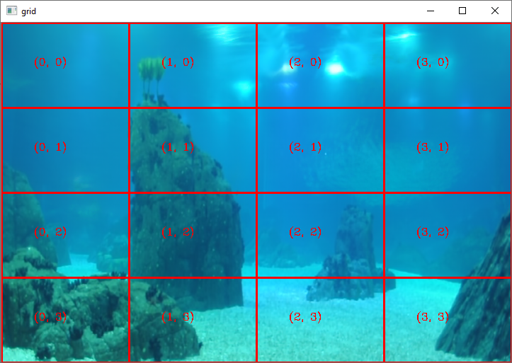
Switching Model Initialization
Parameters of each node:
Motion vectors
Vectors variance
Transition matrices

Slide 2
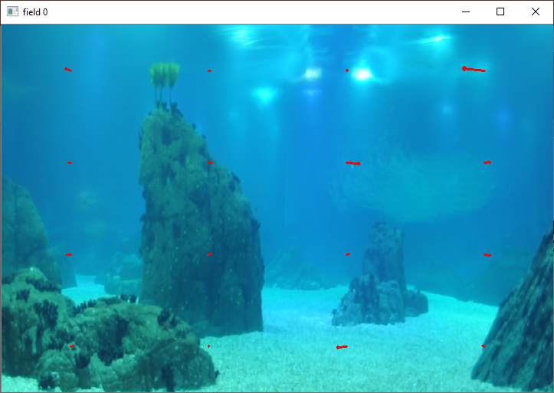
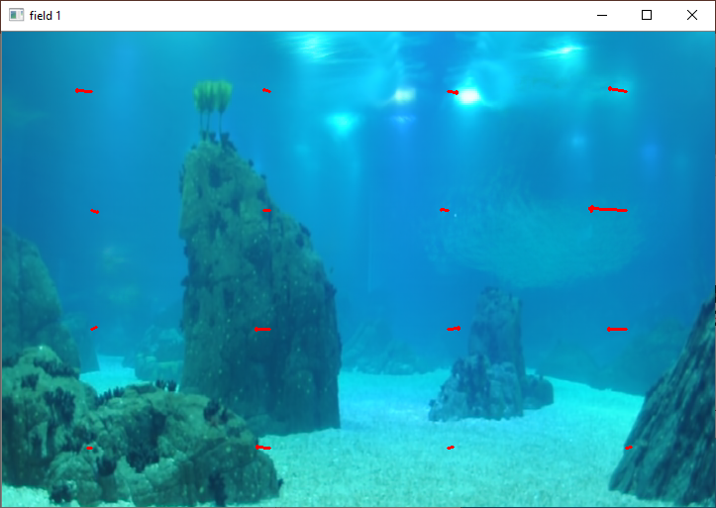
Switching Model Initialization

Slide 3


Switching Model Initialization

Slide 4
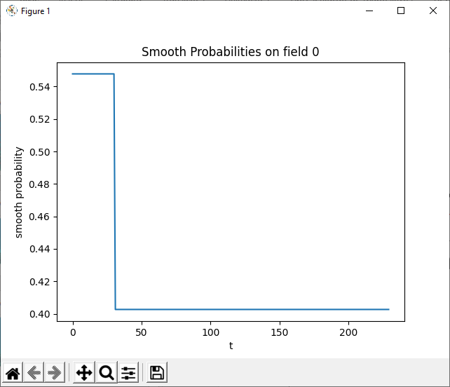
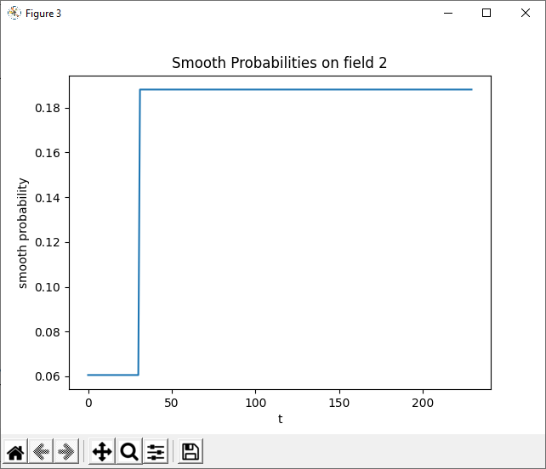
Smooth probabilities for an example trajectory

Slide 5
Training
Update variances
Update motion vectors
Update transition matrices

Slide 6
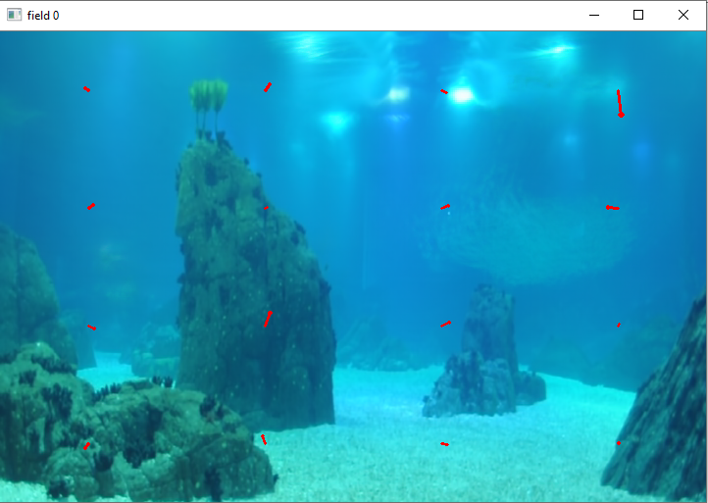

Motion Vectors After Training

Slide 7

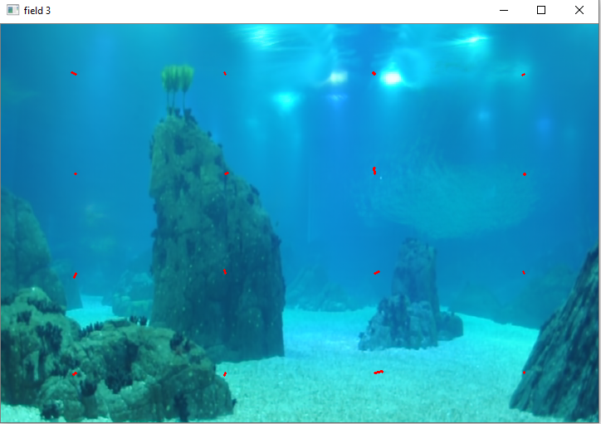
Motion Vectors After Training

Slide 8
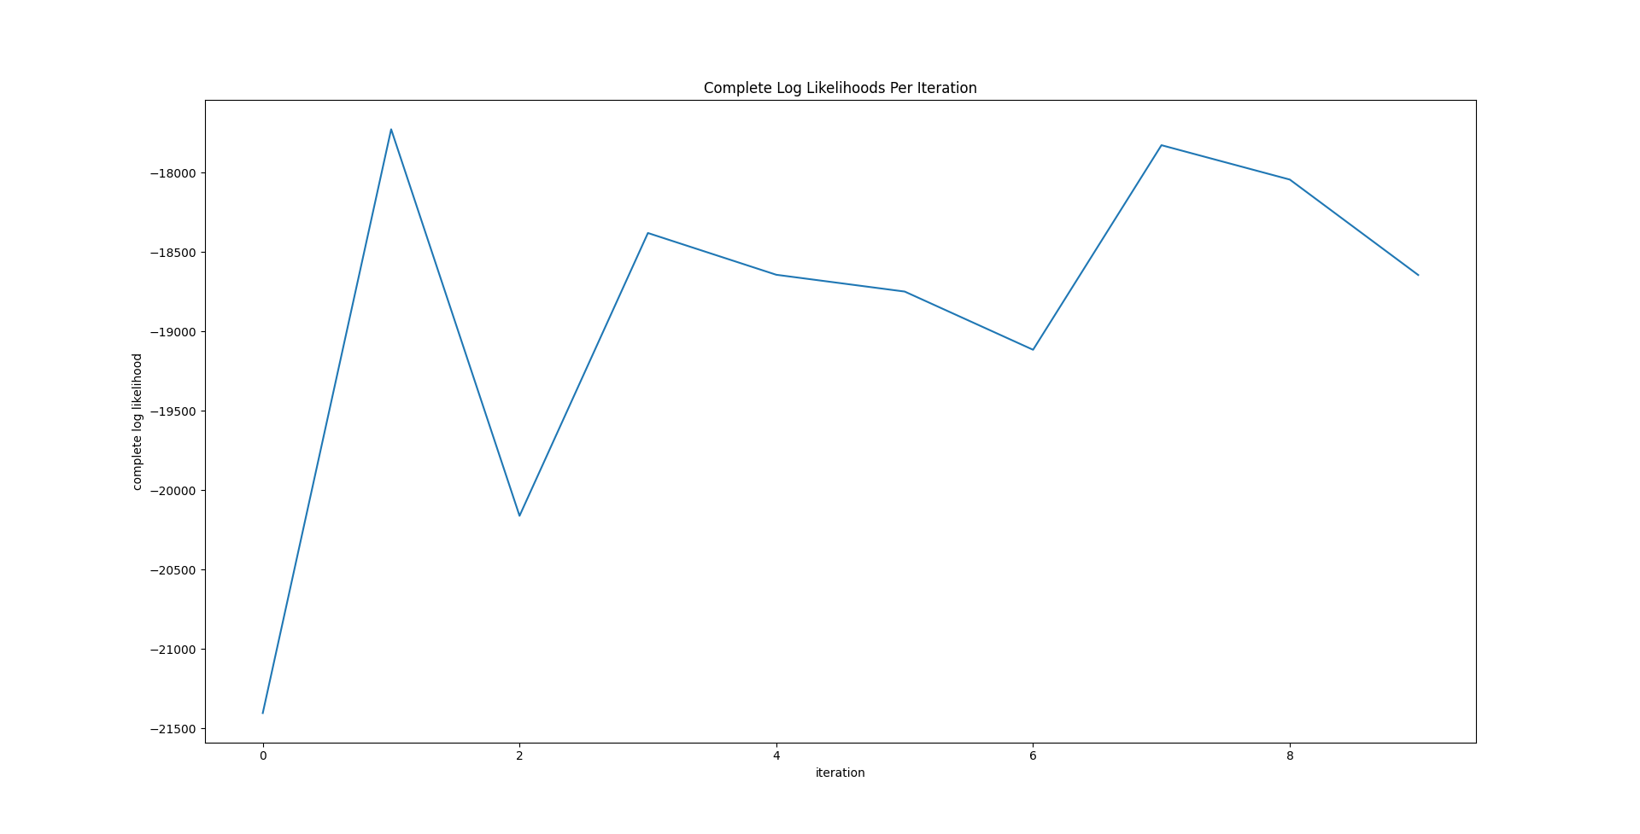
Log Likelihood

Slide 9
Next steps – interesting trajectories classification using Switching Model
normal trajectories
training
normal switching model
Interesting trajectories
training
Interesting switching model
classification(trajectory) = argmax(joint prob(trajectory, normal SM), joint prob(trajectory, interesting SM))
Tunning ? Grid size, nr of fields, alpha, delta

