Slide 1
Project 1 – Artificial Intelligence - L.EIC
Heuristic Search Methods for One-Player Solitaire Games
Gonçalo Costa
Luís Du

Slide 2
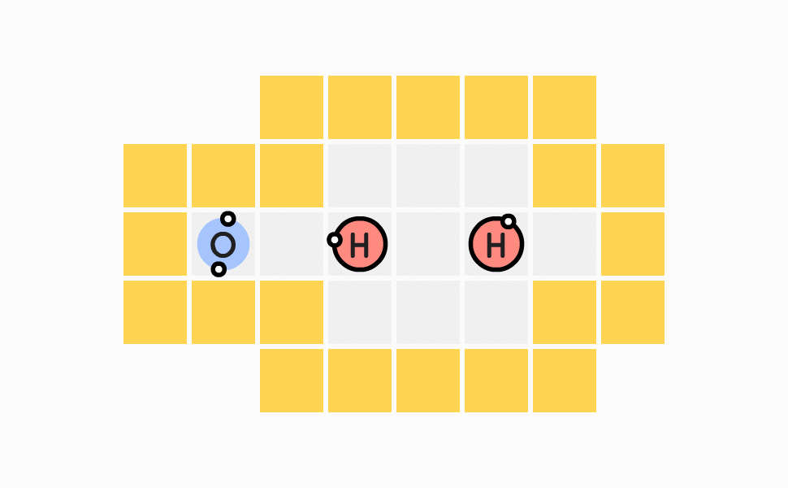
Definition of the game
Sokobond is a logic-based puzzle game where you move atoms around a grid to form chemical compounds. The player controls an atom that can move and push atoms in various directions. The objective is to organize atoms so that they form molecules according to specific rules.
References : https://www.sokobond.com ; https://steamcommunity.com/sharedfiles/filedetails/?id=292624025 ;

Slide 3
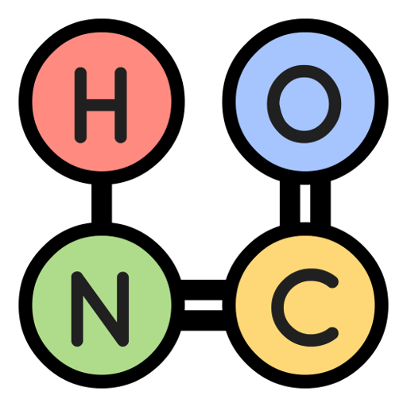



SOKOBOND
There are five elements introduced: Helium (0 bonds), Hydrogen (1 bond), Oxygen (2 bonds), Nitrogen (3 bonds) and Carbon (4 bonds).
There are also 3 powerups in the game:
  Turn the molecule into a snake (if possible)
  Duplicate the connection (if possible)
  Cut the connection.

Slide 4
Formulation of the problem as a search problem
State representation: Board with the molecules distributed in their respective positions.
Initial State: Board with the molecules distributed in their respective initial positions.
Objective Test: All atoms present on the board with no valence electrons (available bonds) remaining.
Operators: Move the atom (Hero) to
- Up. Precondition: the atom can move upwards. Cost: 1.
- Down. Precondition: the atom can move downwards. Cost: 1.
- Left. Precondition: the atom can move to the left. Cost: 1.
- Right. Precondition: the atom can move to the right. Cost: 1.
Solution Cost: Total number of moves required to reach the objective test.

Slide 5
Game implementation
Programming language: python
Libraries used: pygame
Data structure: classes, sets, hashmaps, lists
Graphical interface: Game
Game logic: Board
Search algorithms: Algorithms
Game
Board
Compound
Algorithms
Atom

Slide 6
Search methods
Uninformed Search methods:
  BFS
  DFS
Informed Search methods:
  Best-first search
  Greedy Search
  A * Algorithm

Slide 7
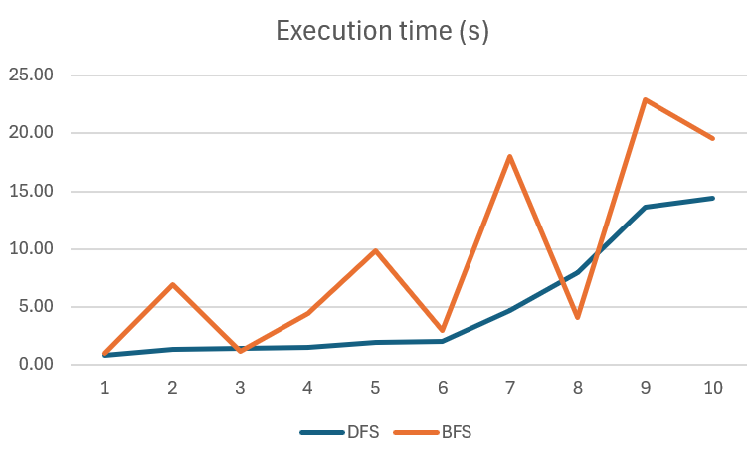
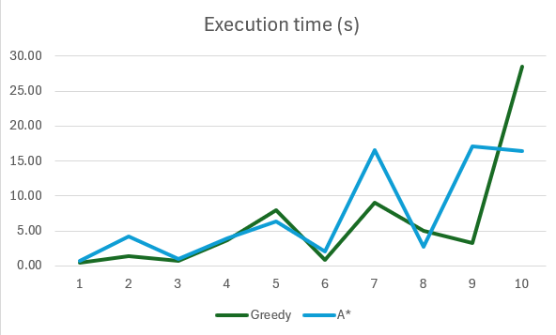
Execution time

Slide 8
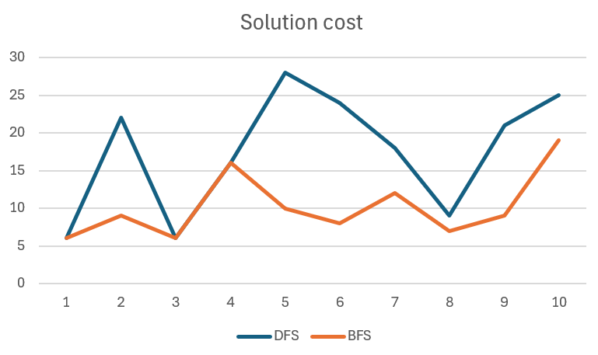
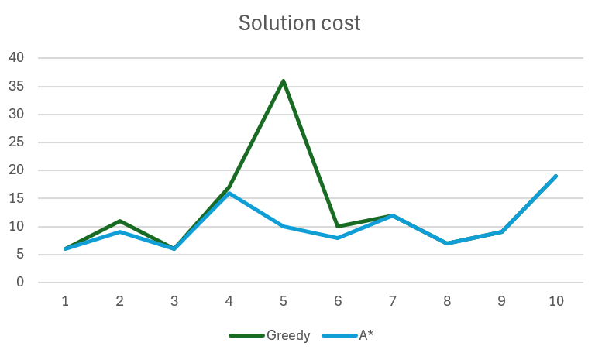
Solution Quality

Slide 9
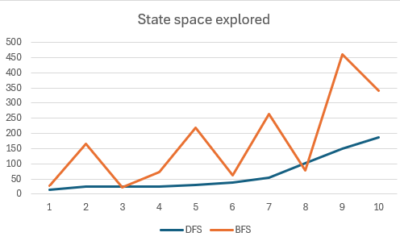
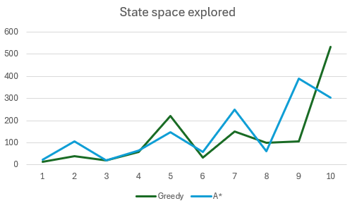
State space explored

Slide 10
Conclusion
Analysis of search algorithms in solving Sokobond puzzles.
BFS and A* provide optimal solutions but are memory-intensive and slower.
DFS and Best-First Search offer faster execution and efficient memory usage but may yield suboptimal solutions.
Choice of algorithm depends on problem requirements and computational resources.
For optimal solutions, prioritize BFS and A* despite higher computational costs.
For speed and memory efficiency, consider DFS and Best-First Search.
Understanding trade-offs aids in selecting appropriate algorithms for Sokobond puzzles or similar problems.

