Slide 1

IronRegression
A machine learning quest
Gonçalo Carvalho

Slide 2
Project Overview 💻
Context
In this project, it’s provided a dataset (CSV file) of house sale prices for King County, including Seattle, over an one year period from May 2014 to May 2015.
Main Task
Develop a machine learning model to predict the house sale prices
Approach
Doing several notebooks with slightly differences between them and checking the results

Slide 3
Exploring the data

Slide 4
Exploring the data 🔍
Function | Output
.head() | Overview of the dataset
.shape | 21613 rows and 21 columns
.info() | Zero non-null values, 1 categorical column (date), 20 numerical columns (5 as float)
.nunique() | Overview of how many unique values each column has
str.lower().str.replace(" ", "_") | Snake case of columns

Slide 5
2. Cleaning the data

Slide 6
Cleaning the data 🚿
Remove “id” column:
.set_index()
Transforming “date” to an integer:
.to_datetime()
Apply lambda x: x.toordinal
Check for null values, duplicates and empty spaces
Bin “floors” and “bathrooms” values and transform them from float into integer

Slide 7
3. EDA

Slide 8
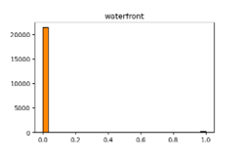
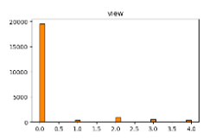
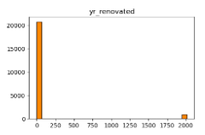
EDA 📊
Check the count, mean, std, min, max and different quartiles
.describe().T
Plot the distribution for each column and 3 of them got my attention:
In my opinion, by its meaning and results, the columns “waterfront”, “view” and “yr_renovated” can be treated as a boolean (but then I did data*1)

Slide 9
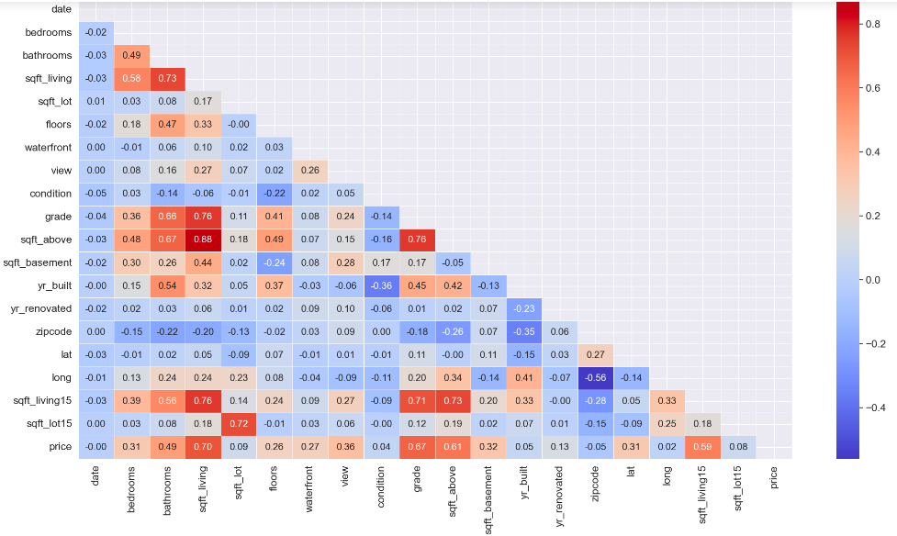
EDA 📊
Check the correlations
There is no correlation above 0.9 so I didn't dropped any column

Slide 10
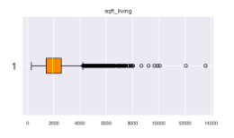
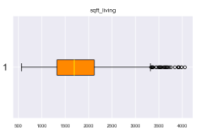
EDA 📊
Boxplot distribution
Remove outliers
Example of one of the boxplots with and without the outliers

Slide 11
4. Model

Slide 12
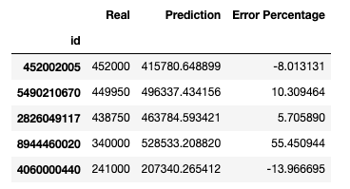

Model 💃
Linear Regression
test_size=0.3
random_state=42
Table with real results vs results predict
Model accuracy results

Slide 13
5. Improving model

Slide 14
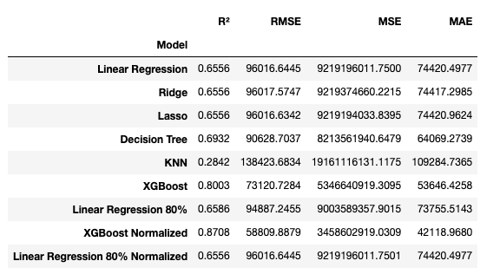
Improving model 💥
Testing different models:
Ridge Regression
Lasso Regression
Decision Trees
KNN
XGBoost
Linear Regression
test_size=0.2
random_state=42
Normalize data and remodel:
MinMaxScaler

Slide 15
Conclusions 💭
For this specific model, I came with the following conclusions:
Less data doesn't mean a more accurate model
Accuracy results doesn't change too much with the data cleaning and featuring engineering
XGBoost got the best results suggesting a non linear relationship between features and target.
Difficulties 🎨
Being creative to try different approaches
Understanding why linear regression get better results with outliers

Slide 16
Thank You!
Gonçalo Carvalho

