Slide 1

Stack Ensemble Fuzzy Models
Gonçalo Rosa – ist1114759
Elvira Marín Gayte – ist1117071
Intelligent systems 2025

Slide 2
INDEX
INTRODUCTION
DEVELOPMENT
RESULTS
OBSERVATIONS

Slide 3
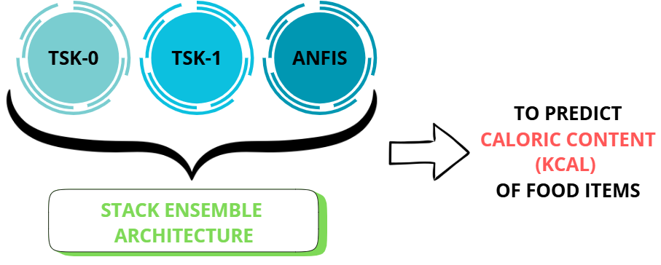
INTRODUCTION
Fuzzy systems
Model ensembling
Prediction

Slide 4
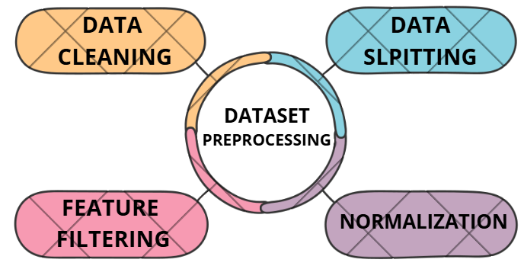
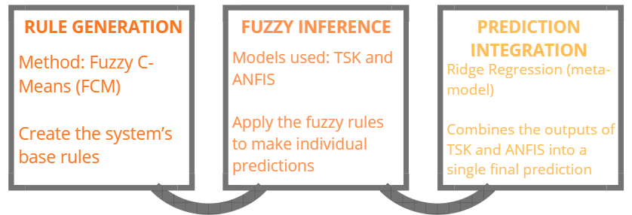
DEVELOPMENT
METHODOLOGY

Slide 5
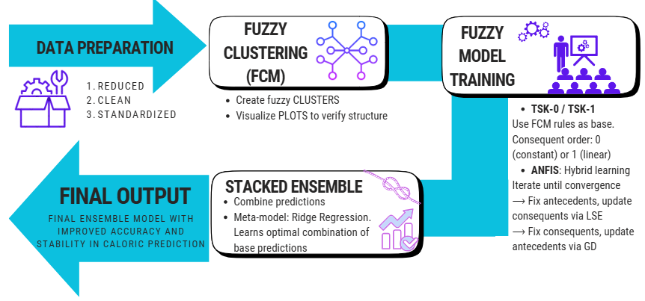
DEVELOPMENT- IMPLEMENTATION

Slide 6
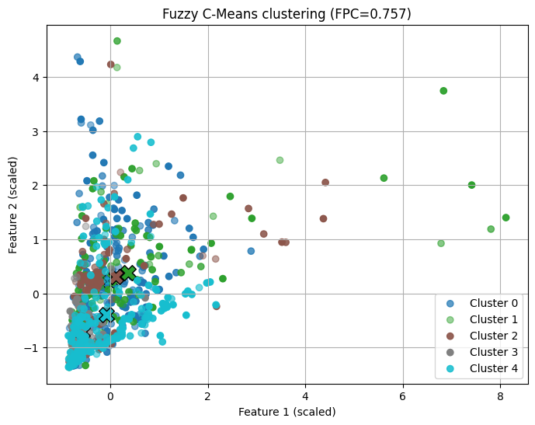
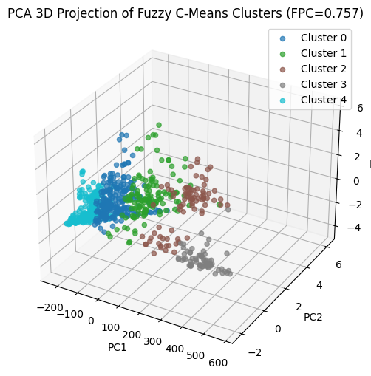

Slide 7
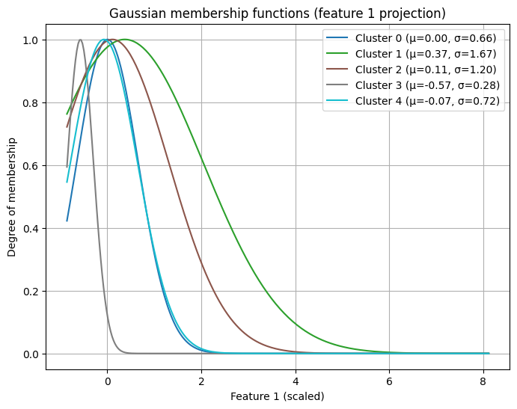

Slide 8
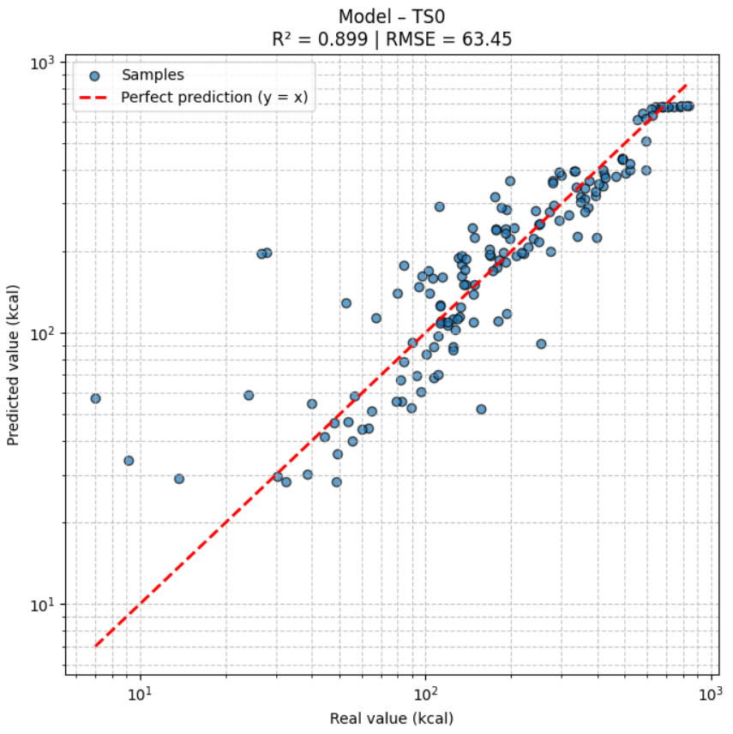
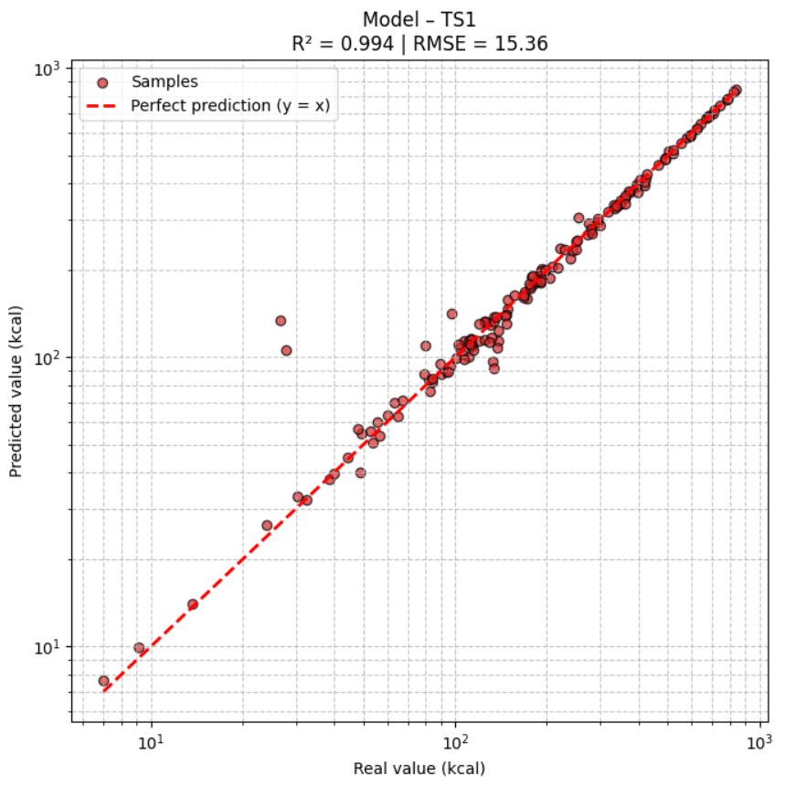
RESULTS

Slide 9
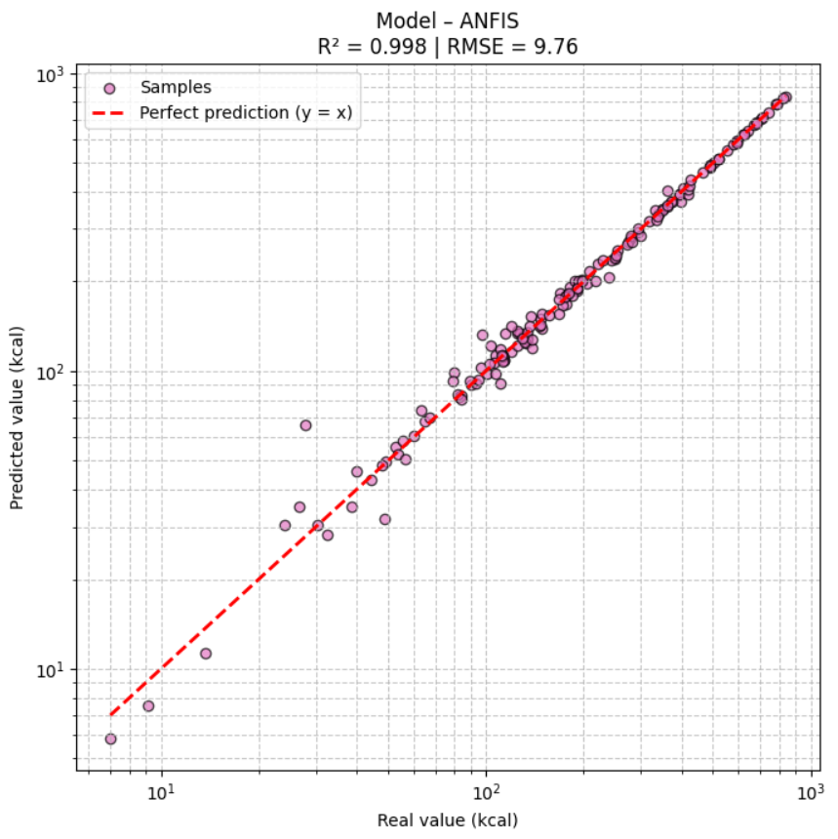
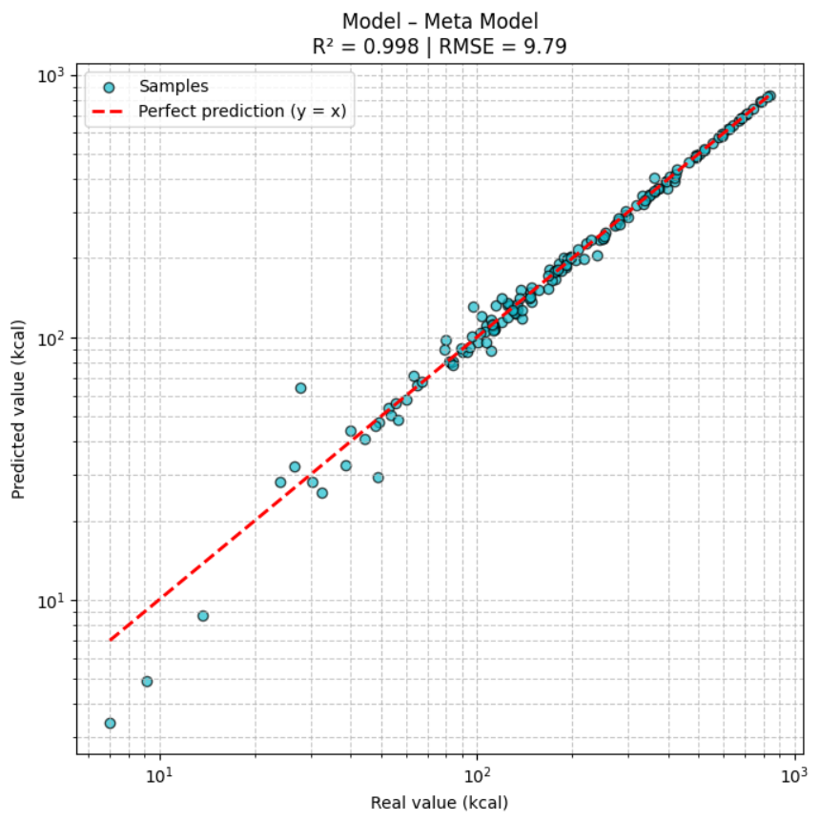
RESULTS

Slide 10
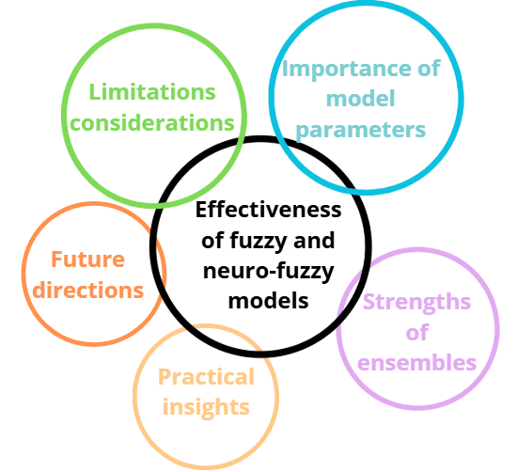
OBSERVATION
Effectiveness of fuzzy models: Accurate calorie prediction.
Importance of model parameters: Clusters, learning rate crucial.
Strengths of ensembles: Robust, less sensitive predictions.
Practical insights: Smooth transitions, interpretable results.
Limitations / considerations: Outliers distort some predictions.
Future directions: Extend datasets, improve ensembles.

Slide 11
Stack Ensemble Fuzzy Models
THANK YOU
Gonçalo Rosa – ist1114759
Elvira Marín Gayte – ist1117071
Intelligent systems 2025

