Slide 1
Scaling Rails
a system-wide approach to performance optimization
MSc thesis presentation
July 2010
MIEIC / FEUP

Slide 2
Structure

Slide 3
Context
Problem
Approach
Results
Conclusions

Slide 4
Context
Problem
Approach
Results
Conclusions

Slide 5
Context
Problem
Approach
Results
Conclusions

Slide 6
Context
Problem
Approach
Results
Conclusions

Slide 7
Context
Problem
Approach
Results
Conclusions

Slide 8
Context
Problem
Approach
Results
Conclusions

Slide 9
Web

Slide 10
More importance

Slide 11
More users

Slide 12
Evolution

Slide 13
Web 2.0

Slide 14
Better UX

Slide 15
Better response times

Slide 16
Better web, better tools

Slide 17
Ruby on Rails

Slide 18
Fast development

Slide 19
Full-featured applications

Slide 20
Popularity

Slide 21
Scalability

Slide 22
Performance

Slide 23
Popular websites

Slide 24
Rails doesn’t scale

Slide 25
Twitter

Slide 26


Slide 27
YellowPages

Slide 28
“Just throw hardware at it”

Slide 29
Rails doesn’t scale

Slide 30
Hulu

Slide 31
Huge hardware infrastructure

Slide 32
Basecamp

Slide 33
David Heinemeier Hansson*
*Rails creator

Slide 34
What’s missing here?

Slide 35
Problem
Context
Approach
Results
Conclusions

Slide 36
Focus on

Slide 37
Performance?

Slide 38
Scalability?

Slide 39
Complexity

Slide 40
Rails

Slide 41
Ruby

Slide 42
Web server

Slide 43
Database

Slide 44
Operating System

Slide 45
Not much, actually

Slide 46
Targeting 3 core issues

Slide 47
Information

Slide 48
There are benchmarks

Slide 49
There are configurations

Slide 50
There is information

Slide 51
Scattered

Slide 52
Outdated

Slide 53
Specific

Slide 54
Awareness

Slide 55
Ruby 1.9

Slide 56
Rails 3

Slide 57
2008

Slide 58
They are not commonly used

Slide 59
Applications

Slide 60
Plugins

Slide 61
Gems

Slide 62
Profiling

Slide 63
Native tools

Slide 64
Rails

Slide 65
Ruby

Slide 66
Which are broken

Slide 67
Don’t integrate with each other

Slide 68
Text-based

Slide 69
Approach
Context
Problem
Results
Conclusions

Slide 70
Information

Slide 71
General guide

Slide 72
Centralized information

Slide 73
Publicly accessible

Slide 74
Awareness

Slide 75
General guide

Slide 76
Advantages of updating

Slide 77
Show off

Slide 78
Profiling

Slide 79
Native tools

Slide 80
Integrated

Slide 81
More powerful

Slide 82
More intuitive

Slide 83
How?

Slide 84
Target all system components

Slide 85
Unified perspective

Slide 86
Rails!

Slide 87
Results
Context
Problem
Approach
Conclusions

Slide 88
Operating System

Slide 89
Development

Slide 90
General benchmarking tool

Slide 91
CPU-intensive

Slide 92
I/O

Slide 93
Workload

Slide 94
Benchmarking

Slide 95
General benchmark

Slide 96
Ubuntu, Debian, CentOS, Gentoo

Slide 97
Ubuntu – CPU usage
Debian – Workload
Gentoo – CPU + I/O
CentOS – inconsistent

Slide 98
Ubuntu – CPU usage
Debian – Workload
Gentoo – CPU + I/O
CentOS – inconsistent

Slide 99
Not really conclusive
99
Scaling Rails: a system-wide approach to performance optimization

Slide 100
Web server benchmark

Slide 101
> 30 seconds = failed request

Slide 102
Requests / Concurrency

Slide 103
10000 / 1000
100000 / 1000
100000 / 10000

Slide 104
Ubuntu, Debian, Gentoo

Slide 105
Apache / Nginx

Slide 106
Default configurations

Slide 107
Low or medium concurrency: OK

Slide 108
High concurrency: FAIL

Slide 109
Except…

Slide 110
Gentoo
110
Scaling Rails: a system-wide approach to performance optimization

Slide 111
Very stable

Slide 112
High scalability

Slide 113
What about BSD?

Slide 114
Gentoo, FreeBSD

Slide 115
Ruby benchmarking suite

Slide 116
8 macro benchmarks
62 micro benchmarks
3 rdoc-related benchmarks

Slide 117
Time – less is better

Slide 119
More ~29% time on FreeBSD overall

Slide 121
More ~22% time on FreeBSD overall

Slide 122
Gentoo
122
Scaling Rails: a system-wide approach to performance optimization

Slide 123
Great performance

Slide 124
High configurability

Slide 125
Will be used in the remaining work

Slide 126
Tweaking
126
Scaling Rails: a system-wide approach to performance optimization

Slide 127
Deadline I/O Scheduler
Non-preemptive configuration
100Hz timer interrupt
TCP tweaks
Kernel buffer and limit tweaks

Slide 128
Operating System
Development ->
Benchmarking tool
Benchmark ->
General benchmark
Web server benchmark
Ruby benchmark
Tweaking ->
Kernel fine-tunning
128
Scaling Rails: a system-wide approach to performance optimization

Slide 129
Ruby

Slide 130
Benchmarking
130
Scaling Rails: a system-wide approach to performance optimization

Slide 131
MRI (1.8)
YARV (1.9)

Slide 132
Worth updating?

Slide 133
Ruby benchmarking suite

Slide 135
Less ~108% time on YARV overall

Slide 136
YARV’s performance is outstanding
136
Scaling Rails: a system-wide approach to performance optimization

Slide 137
What does this mean, for Rails?

Slide 138
Web server analysis will tell

Slide 139
Development
139
Scaling Rails: a system-wide approach to performance optimization

Slide 140
Porting escolinhas.pt to Ruby 1.9

Slide 141
escolinhas.pt

Slide 142
> 70 models
> 130000 lines of code
> 40 plugins/gems
> 10 development branches

Slide 143
Rails 2.3

Slide 144
Porting

Slide 145
Straightforward
145
Scaling Rails: a system-wide approach to performance optimization

Slide 146
Fast
146
Scaling Rails: a system-wide approach to performance optimization

Slide 147
Issues

Slide 148
Encoding

Slide 149
Fix?

Slide 150
A small patch for Rails
150
Scaling Rails: a system-wide approach to performance optimization

Slide 151
Natively fixed in Rails 3

Slide 152
More?

Slide 153
Rare functionality changes

Slide 154
Rare syntax changes

Slide 155
Less than 0.1% of the time
155
Scaling Rails: a system-wide approach to performance optimization

Slide 156
Increasing YARV’s flexibility

Slide 157
For adaptive performance
157
Scaling Rails: a system-wide approach to performance optimization

Slide 158
Tweaked MRI gave Twitter +30%

Slide 159
Same principle -> YARV

Slide 160
Configurable GC

Slide 161
5 configuration options

Slide 162
Ruby benchmarking suite

Slide 163
~15% less time needed overall
163
Scaling Rails: a system-wide approach to performance optimization

Slide 164
Slightly better memory usage

Slide 165
With a sample configuration which was not fine-tunned!
165
Scaling Rails: a system-wide approach to performance optimization

Slide 166
Improving YARV’s profiler

Slide 167
Storing more data

Slide 168
Storing correct data

Slide 169
Retrieval

Slide 170
In a formatted string

Slide 171
Not enough

Slide 172
Hash

Slide 173
For automated processing
173
Scaling Rails: a system-wide approach to performance optimization

Slide 174
Hierarchical HTML viewer

Slide 175
For human processing
175
Scaling Rails: a system-wide approach to performance optimization

Slide 176
And sanity
176
Scaling Rails: a system-wide approach to performance optimization

Slide 177
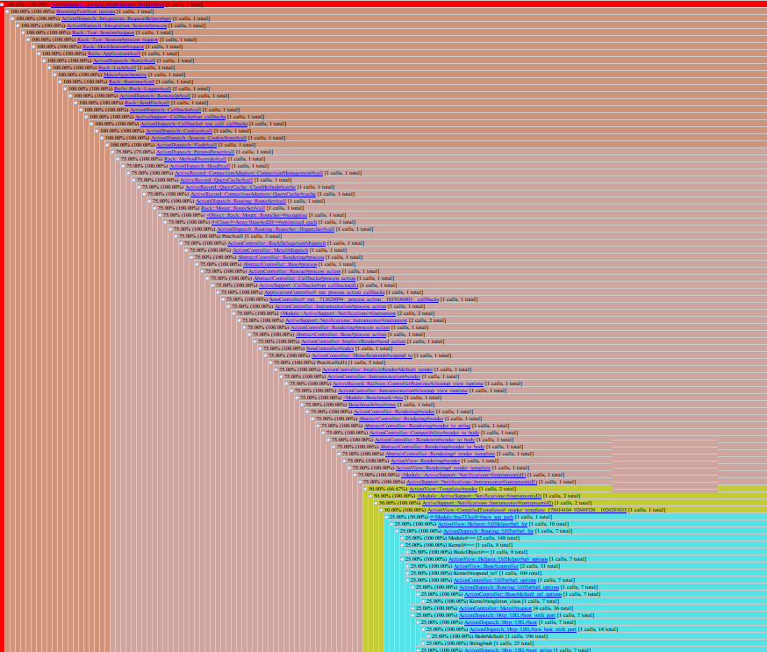

Slide 178
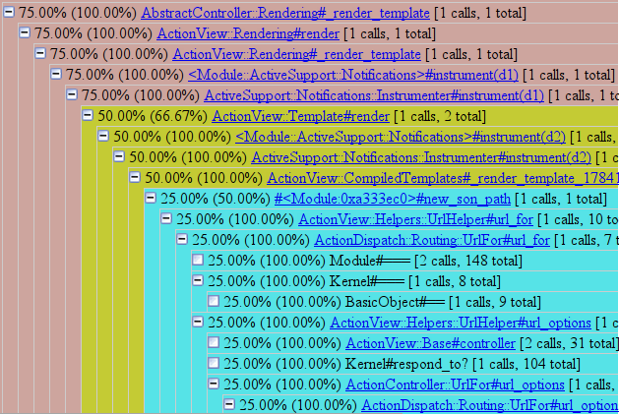

Slide 179
Ruby
Benchmark ->
YARV and MRI
Development ->
Porting escolinhas.pt to Ruby 1.9
Increasing YARV’s flexibility
Fixed and enhanced internal profiler
179
Scaling Rails: a system-wide approach to performance optimization

Slide 180
Rails Web Servers

Slide 181
Development

Slide 182
Monitoring memory usage script

Slide 183
Measuring consumption over time

Slide 184
Very light, configurable

Slide 185
Proper output format (CSV)

Slide 186
Benchmarking

Slide 187
Many small benchmarks

Slide 188
One complete analysis

Slide 189
3 pages: heavy, medium, light

Slide 190
Proxy performance

Slide 191
Apache, Nginx, Cherokee

Slide 192
Nginx slightly faster
192
Scaling Rails: a system-wide approach to performance optimization

Slide 193
Nginx lighter
193
Scaling Rails: a system-wide approach to performance optimization

Slide 194
Passenger performance

Slide 195
Apache, Nginx

Slide 196
With Nginx it yields better results
196
Scaling Rails: a system-wide approach to performance optimization

Slide 197
Thin and Unicorn comparison

Slide 198
Similar performance

Slide 199
Thin is slightly lighter
199
Scaling Rails: a system-wide approach to performance optimization

Slide 200
Threaded Thin performance

Slide 201
Worse than non-threaded Thin

Slide 202
In-depth analysis

Slide 203
Passenger, Thin, Unicorn, Nginx

Slide 204
30 and 60 workers

Slide 205
MRI and YARV

Slide 206
Using autobench

Slide 207
Similar performance among web servers

Slide 208
But…

Slide 209
MRI (1.8)

Slide 210
YARV (1.9)

Slide 211
1 iteration -> 15/16 interations

Slide 212
2,5 requests/s -> 5 requests/s

Slide 213
Huge improvement!
213
Scaling Rails: a system-wide approach to performance optimization

Slide 214
Rails Web Servers
Benchmark ->
Reverse proxies
Passenger on Apache and Nginx
Thin and Unicorn
Threaded Thin
Thin, Unicorn, Passenger and Nginx
214
Scaling Rails: a system-wide approach to performance optimization

Slide 215
Databases

Slide 216
Development

Slide 217
mysql2 adapter

Slide 218
Type conversions in C

Slide 219
Average 400% improvement

Slide 220
Likely to replace mysql adapter

Slide 221
Caveat

Slide 222
More fields fetched than those used

Slide 223
Solution?

Slide 224
Lazy type casting

Slide 225
Databases
Development ->
Adding lazy type-casting to mysql2
225
Scaling Rails: a system-wide approach to performance optimization

Slide 226
Rails

Slide 227
Benchmarking

Slide 228
Various Rails features

Slide 229
Eager loading
Transactions
Magic finders
Fetching in batches

Slide 230
Hypothetical situations

Slide 231
Eager loading – 93%
Transactions – 93%
Magic finders – 68%
Fetching in batches – 10%

Slide 232
Development

Slide 233
Rails profiling tools

Slide 234
Working

Slide 235
Seamless integration with YARV
235
Scaling Rails: a system-wide approach to performance optimization

Slide 236
Porting renowned Rails plugins

Slide 237
Used by escolinhas.pt

Slide 238
acts_as_list
permalink_fu
acts_as_paranoid

Slide 239
Compatible with Rails 3

Slide 240
Compatible with Ruby 1.9

Slide 241
Easing the porting effort
241
Scaling Rails: a system-wide approach to performance optimization

Slide 242
Porting Redmine

Slide 243
Compatible with Rails 3

Slide 244
Compatible with Ruby 1.9

Slide 245
Highly increasing the visibility of the benefits
245
Scaling Rails: a system-wide approach to performance optimization

Slide 246
Ruby Summer of Code

Slide 247
Benchmarking Continuous Integration

Slide 248
Rails core team

Slide 249
Full-stack benchmarking suite

Slide 250
Automated

Slide 251
Smashing performance regressions
251
Scaling Rails: a system-wide approach to performance optimization

Slide 252
Community blog

Slide 253
Performance-oriented article series

Slide 254
Rails Magazine

Slide 255
Ruby on Rails
Benchmark->
Eager loading, transactions, magic finders, fetching in batches
Development ->
Integrating profiling tools with YARV’s
Porting Redmine and plugins to Rails 3 and Ruby 1.9
Benchmarking CI for Rails
Community blog
Performance-oriented article series for Rails Magazine
255
Scaling Rails: a system-wide approach to performance optimization

Slide 256
Conclusions
Context
Problem
Approach
Results

Slide 257
General guide was created

Slide 258
Information from benchmarking and analyzing

Slide 259
Covering all system components

Slide 260
Publicly accessible

Slide 261
Profiling tools are functional

Slide 262
Enhanced

Slide 263
Seamlessly integrate

Slide 264
Increased global awareness

Slide 265
General guide

Slide 266
Flexible GC in YARV

Slide 267
Porting Redmine & Plugins

Slide 268
Public blog

Slide 269
Article series

Slide 270
Official benchmarking CI

Slide 271
Direct improvement

Slide 272
YARV

Slide 273
mysql2

Slide 274
Future research

Slide 275
Non-relational databases

Slide 276
Native caching for Rails

Slide 277
Rewriting web servers in C

Slide 278
Ongoing work

Slide 279
Blog

Slide 280
Performance-oriented article series

Slide 281
Benchmarking CI

Slide 282
Thank you
Gonçalo S. Silva
Supervisor: Ademar Aguiar (PhD.)
http://goncalossilva.com
http://twitter.com/goncalossilva

