Slide 1

Building Event-driven apps on Azure using Azure Serverless
Hugo Barona
João Gonçalves
Festive Tech Calendar (@_CloudFamily)

Slide 2







Introducing
10+ years of experience in Software Design, Development and Architecture
Microsoft stack while leveraging the open-source technologies
Pluralsight author, Public Speaker and Tech Community Contributor
Hugo Barona
Cloud Solutions Architect

Slide 3



Introducing
10+ years of experience in Software Development and Architecture
Microsoft stack while leveraging the open source technologies
Azure Architecture and Azure DevOps certified.
Joao Goncalves
Solutions Architect

Slide 4

Workshop Deployment https://github.com/goncalvesj/festive-calendar-serverless

Slide 5







Services Used
Azure Static Web Apps (Preview)
Cosmos DB
Custom Vision
Functions
SignalR
Storage Account
Power BI

Slide 6
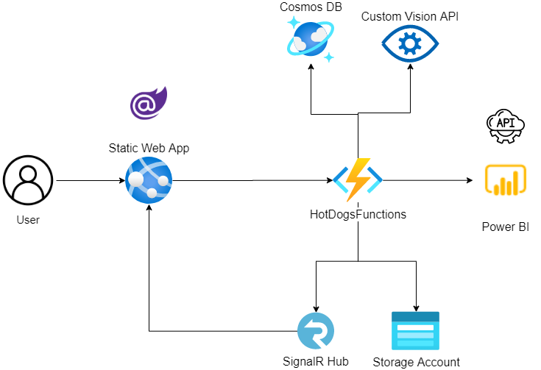
Worshop App Architecture
Notes:
UploadImage
ProcessImage
PushMessage

Slide 7
Workshop Continuation

Slide 8
A few take aways
Do not use generic events
Only create events when you really need
Design to failure (Resilient design)
Idempotent operations
Load-Leveling pattern
Azure Reference Architecture - Event-driven and Event sourcing architectures
https://www.youtube.com/watch?v=_NW_fI75bLs
Notes:
UploadImage
ProcessImage
PushMessage

Slide 9
Resources
Resource | Location
Azure Serverless | http://azure.com/serverless
Azure Functions | http://azure.com/functions
Azure Solution Architectures | https://azure.microsoft.com/en-us/solutions/architecture/
Azure SignalR | https://azure.microsoft.com/en-us/services/signalr-service/
Create serverless applications | https://docs.microsoft.com/en-ie/learn/paths/create-serverless-applications/

Slide 10

Let’s connect!
www.hugobarona.com
goncalvesj.github.io

