Slide 1
Ethereum Private Network
Tutorial & Demo
Wenyan Qin
2017-05

Slide 2
Agenda
Setup Private Network
Allocate & Transfer ether “Money” (Tokens)
Demo

Slide 3
Private Network Setup
Steps:
Download Ethereum and Client Wallet
Creating Genesis State of the Private Network
Creating Private Network Accounts and allocate funds
Starting up member nodes
Running private miner and transfer moneys
Official Website: http://Ethereum.org
Downloads https://geth.ethereum.org/downloads/
geth-alltools-windows-amd64-1.6.0-facc47cb.zip
Wallet https://github.com/ethereum/mist/releases/download/v0.8.9/Ethereum-Wallet-win64-0-8-9.zip
Support platforms: Linux, macOS, Windows

Slide 4
Ethereum Node Utilities and Wallets
Full node utilities include:
geth - main Ethereum CLI client
abigen - abi generator to convert smart contract
bootnode - for peers to find the bootstrap node
disasm - disassmbler to convert EVM bytecode to readable assembly code
evm - evm environment for running EVM byecode
gethrpctest - developer tools for rpc-test
rlpdum - developer tool to conver rlp dump
swarm - swarm daemon and tool
Popular Wallets
Ethereum Wallet, Mist, Parity
Download and Install, make sure all the utils are include in the $PATH

Slide 5
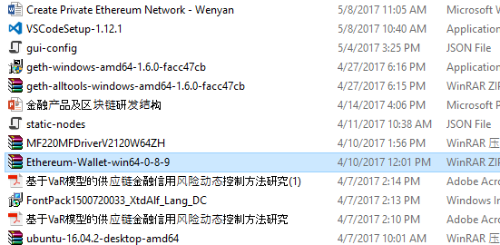
Install Ethereum Wallet
- Unzip Ethereum-Wallet-win64-0-8-9.zip

Slide 6
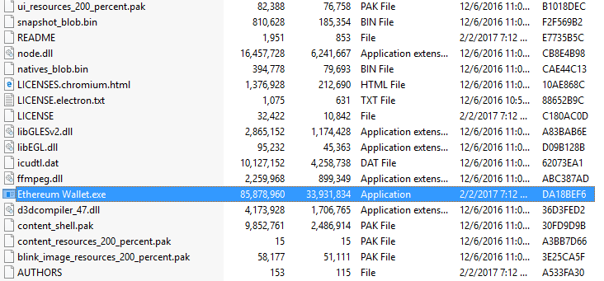
Install Ethereum Wallet
- Double click “Ethereum Wallet.exe”

Slide 7
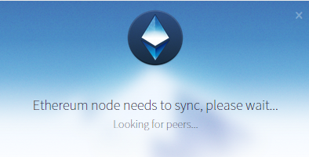
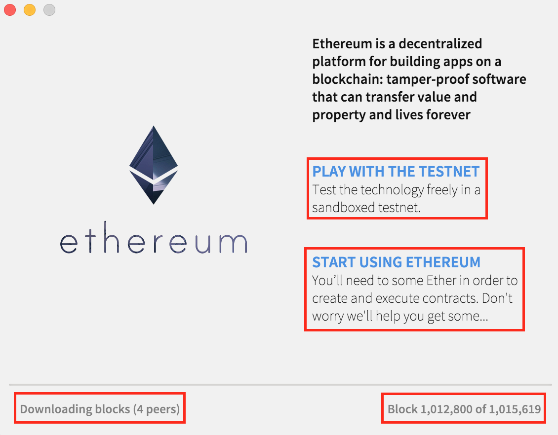
Install Ethereum Wallet
- Installation GUI Screen
- Download blocks

Slide 8
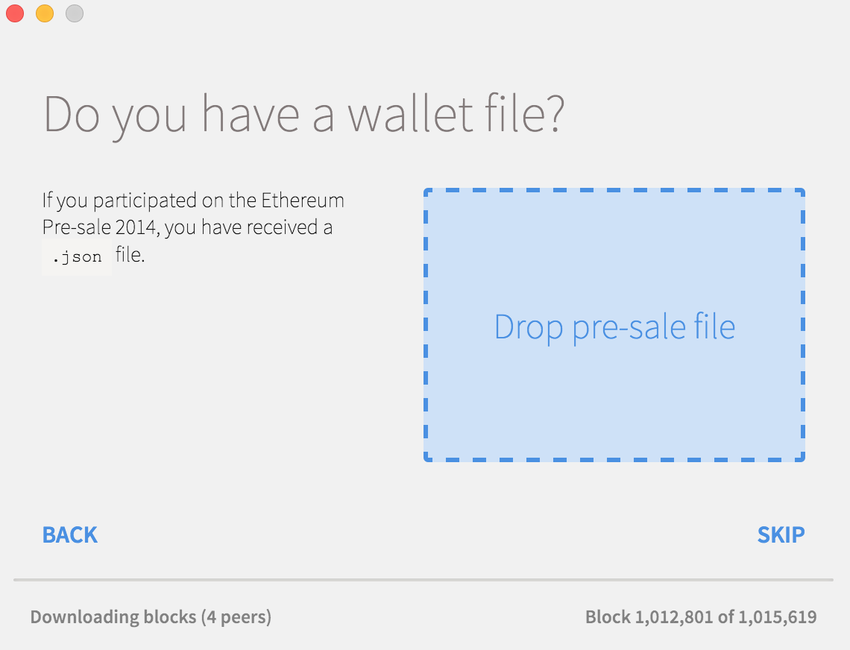
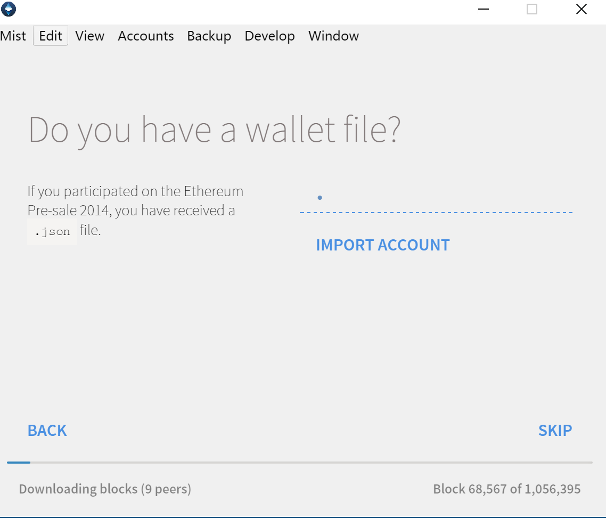
Install Ethereum Wallet
- For now skip import wallet files
- SKIP unless you do have files to be imported

Slide 9
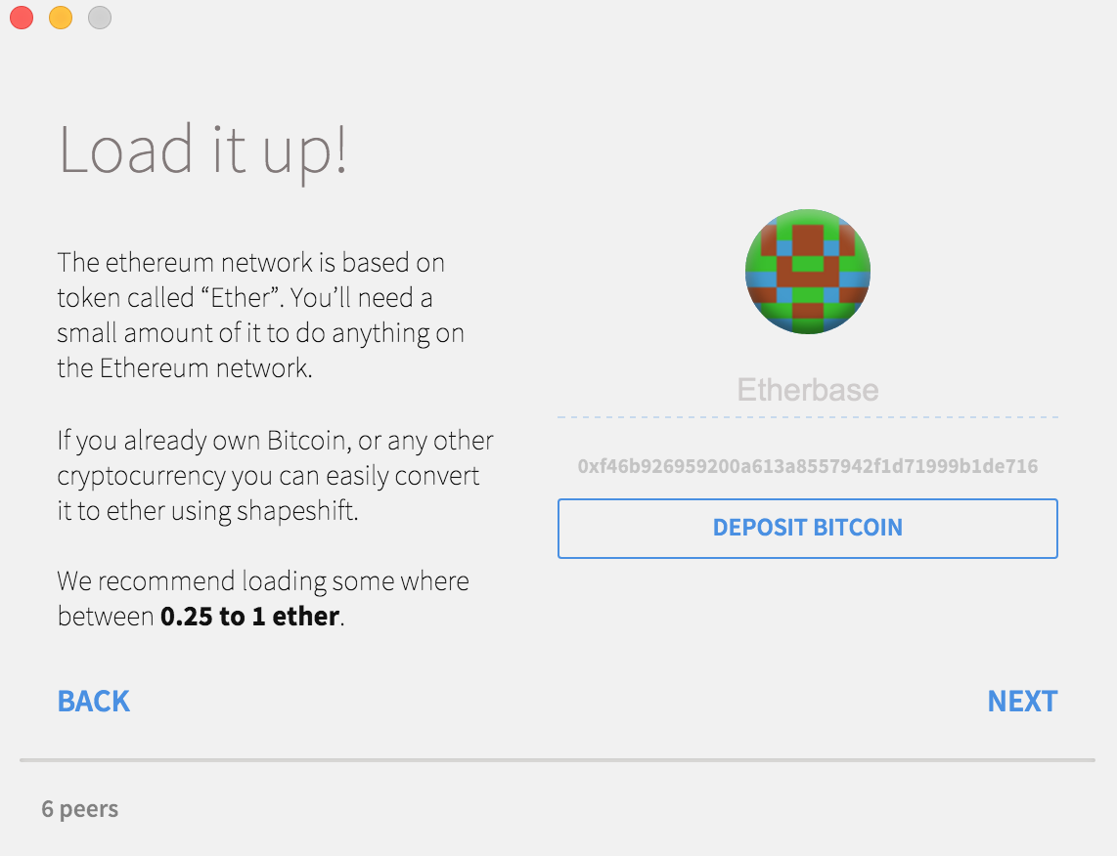
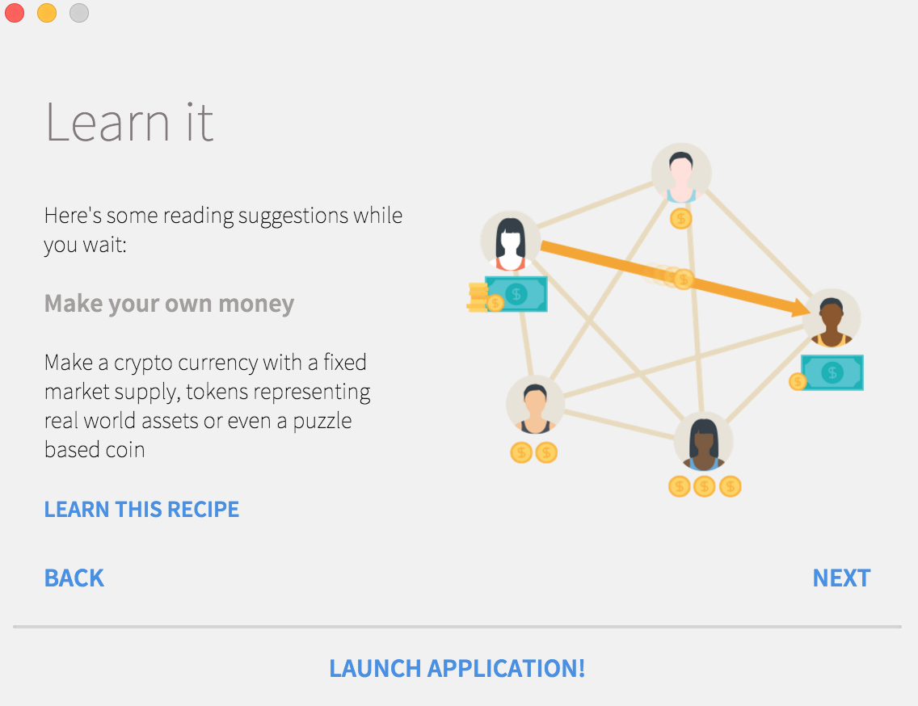
Install Ethereum Wallet
- Click Next unless you like to deposit BITCOIN
- NEXT …

Slide 10
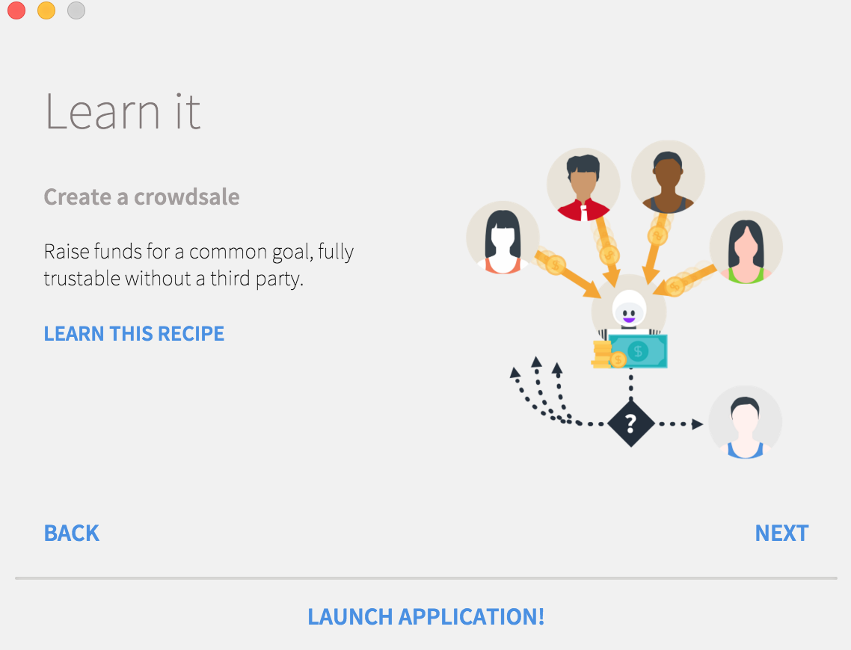
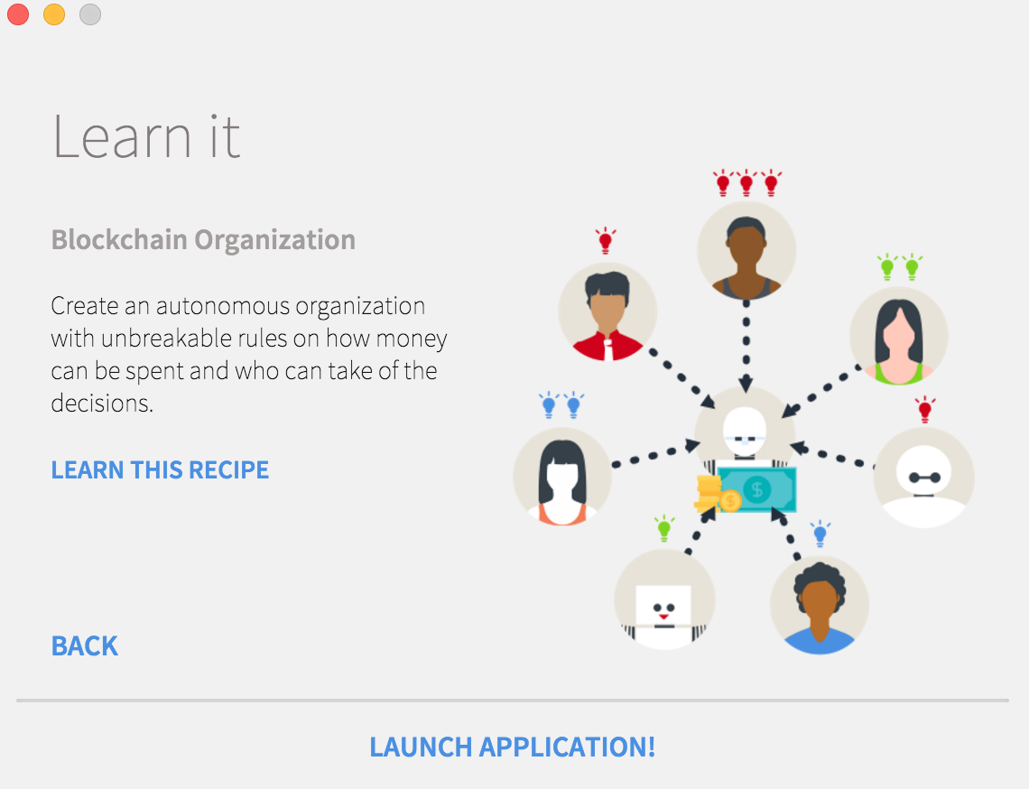
Install Ethereum Wallet
- NEXT …
- NEXT …

Slide 11
Creating Genesis State of the Private Network - utilities
C:\Program Files\Geth>dir
Volume in drive C is Windows7_OS
Directory of C:\Program Files\Geth
04/27/2017 06:17 PM <DIR> .
04/27/2017 06:17 PM <DIR> ..
04/14/2017 07:02 PM 6,789,705 abigen.exe
04/14/2017 07:02 PM 13,337,839 bootnode.exe
04/14/2017 07:02 PM 13,019,114 evm.exe
04/14/2017 07:02 PM 20,838,891 geth.exe
04/14/2017 07:02 PM 10,012,805 puppeth.exe
04/14/2017 07:02 PM 2,830,336 rlpdump.exe
04/14/2017 07:02 PM 16,940,024 swarm.exe
04/27/2017 06:17 PM 123,909 uninstall.exe
8 File(s) 83,892,623 bytes
2 Dir(s) 34,893,565,952 bytes free

Slide 12
Creating Genesis State of the Private Network
C:\eth_dev\tnet01>dir
05/08/2017 11:31 AM 541 Genesis01.json
05/08/2017 01:28 PM 852 Genesis02.json
C:\eth_dev\tnet01>cat Genesis01.json
{
"config": {
"chainId": 0,
"homesteadBlock": 0,
"eip155Block": 0,
"eip158Block": 0
},
"alloc" : {},
"coinbase" : "0x0000000000000000000000000000000000000000",
"difficulty" : "0x20000",
"extraData" : "",
"gasLimit" : "0x2fefd8",
"nonce" : "0x0000000000000042",
"mixhash" : "0x0000000000000000000000000000000000000000000000000000000000000000",
"parentHash" : "0x0000000000000000000000000000000000000000000000000000000000000000",
"timestamp" : "0x00"
}

Slide 13
Creating Genesis State of the Private Network
– initialize genesis state
C:\eth_dev\tnet01>geth --datadir data init Genesis01.json
WARN [05-08|14:24:37] No etherbase set and no accounts found as default
INFO [05-08|14:24:37] Allocated cache and file handles database=C:\\eth_dev\\tnet01\\data\\geth\\chaindata cache=128 handles=1024
INFO [05-08|14:24:37] Writing custom genesis block
INFO [05-08|14:24:37] Successfully wrote genesis state hash=5e1fc7…d790e0
C:\eth_dev\tnet01>

Slide 14
Creating Genesis State of the Private Network – startup node
C:\eth_dev\tnet01>geth --datadir data
WARN [05-08|14:27:49] No etherbase set and no accounts found as default
INFO [05-08|14:27:49] Starting peer-to-peer node instance=Geth/v1.6.0-stable-facc47cb/windows-amd64/go1.8.1
INFO [05-08|14:27:49] Allocated cache and file handles database=C:\\eth_dev\\tnet01\\data\\geth\\chaindata cache=128 handles=1024
WARN [05-08|14:27:49] Upgrading chain database to use sequential keys
INFO [05-08|14:27:49] Database conversion successful
INFO [05-08|14:27:49] Initialised chain configuration config="{ChainID: 0 Homestead: 0 DAO: <nil> DAOSupport: false EIP150: <nil> EIP155: 0 EIP158: 0 Engine: unknown}"
INFO [05-08|14:27:49] Disk storage enabled for ethash caches dir=C:\\eth_dev\\tnet01\\data\\geth\\ethash count=3
INFO [05-08|14:27:49] Disk storage enabled for ethash DAGs dir=C:\\Users\\Dou\\AppData\\Ethash count=2
WARN [05-08|14:27:49] Upgrading db log bloom bins
INFO [05-08|14:27:49] Bloom-bin upgrade completed elapsed=27.010ms
INFO [05-08|14:27:49] Initialising Ethereum protocol versions="[63 62]" network=1
INFO [05-08|14:27:49] Loaded most recent local header number=0 hash=5e1fc7…d790e0 td=131072
INFO [05-08|14:27:49] Loaded most recent local full block number=0 hash=5e1fc7…d790e0 td=131072
INFO [05-08|14:27:49] Loaded most recent local fast block number=0 hash=5e1fc7…d790e0 td=131072
INFO [05-08|14:27:49] Starting P2P networking
INFO [05-08|14:27:51] RLPx listener up self=enode://e620d67b48ac3d170524f7117d9863bfc0e26e8ba2b6
7bebfb2846f8884e5e00ba74ef974fca5c89edc36579c5d43524dab96740954f30578115ef891038dd7a@[::]:30303
INFO [05-08|14:27:51] IPC endpoint opened: \\.\pipe\geth.ipc

Slide 15
Creating Genesis State of the Private Network – create accounts
– attach to node from another terminal window, for non windows you need to specify ipc: option
C:\eth_dev\tnet01\data>geth attach
Welcome to the Geth JavaScript console!
instance: Geth/v1.6.0-stable-facc47cb/windows-amd64/go1.8.1
modules: admin:1.0 debug:1.0 eth:1.0 miner:1.0 net:1.0 personal:1.0 rpc:1.0 txpool:1.0 web3:1.0
> eth.accounts
null
> personal.newAccount("testing")
"0xace34025bff8124573c825f618b7de100038ad1a"
> personal.newAccount("testing")
"0xc495d2dc6d491520c03c54c7e7f07d2f5cc61c10"
> personal.newAccount("testing")
"0x3613197b2871d12ac2d8d1f113d38ec99265b173"
> eth.accounts
["0xace34025bff8124573c825f618b7de100038ad1a", "0xc495d2dc6d491520c03c54c7e7f07d2f5cc61c10",
"0x3613197b2871d12ac2d8d1f113d38ec99265b173"]
> web3.fromWei(eth.getBalance(eth.accounts[0]).toNumber(), "ether")
"0"
> web3.fromWei(eth.getBalance(eth.accounts[1]).toNumber(), "ether")
"0"
> web3.fromWei(eth.getBalance(eth.accounts[2]).toNumber(), "ether")
"0"
>

Slide 16
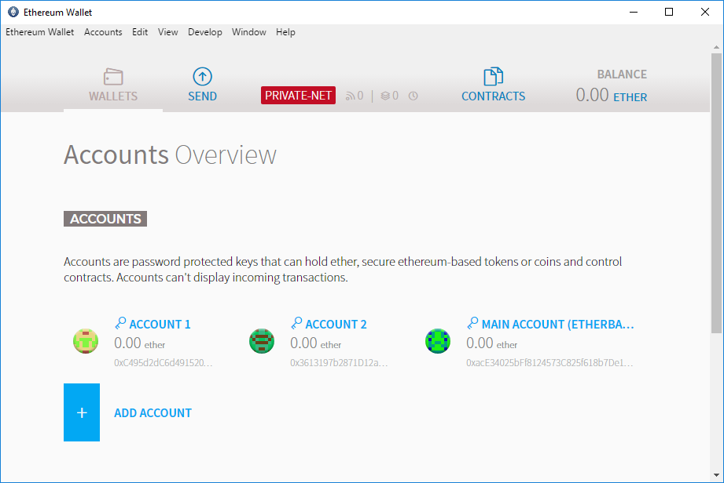
Creating Genesis State of the Private Network – create accounts
– double click “Ethereum Wallet.exe” check we have accounts created with 0 ether

Slide 17
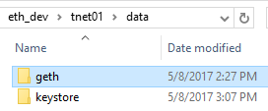
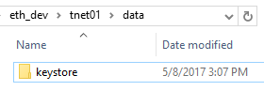
Creating Genesis State of the Private Network – Pre-allocate ethers
Ctl+C from running geth node windows to stop Ethereum node
under data folder, delete geth foder, keep keystore folder
FO [05-08|15:06:46] New wallet appeared url=keystore://C:\\eth_dev\\tnet01\\da… status=Locked
FO [05-08|15:07:03] New wallet appeared url=keystore://C:\\eth_dev\\tnet01\\da… status=Locked
FO [05-08|15:07:14] New wallet appeared url=keystore://C:\\eth_dev\\tnet01\\da… status=Locked
FO [05-08|15:27:18] Got interrupt, shutting down...
FO [05-08|15:27:18] IPC endpoint closed: \\.\pipe\geth.ipc
FO [05-08|15:27:18] Blockchain manager stopped
FO [05-08|15:27:18] Stopping Ethereum protocol
FO [05-08|15:27:20] Ethereum protocol stopped
FO [05-08|15:27:20] Transaction pool stopped
FO [05-08|15:27:20] Database closed database=C:\\eth_dev\\tnet01\\data\\geth\\chaindata

Slide 18
Creating Genesis State of the Private Network – Pre-allocate ethers
Genesis02.json with pre-allocate ethers to known accounts
C:\eth_dev\tnet01>cat Genesis02.json
{
"config": {
"chainId": 0,
"homesteadBlock": 0,
"eip155Block": 0,
"eip158Block": 0
},
"alloc" : {
"0xace34025bff8124573c825f618b7de100038ad1a": {
"balance": "1000000000000000000000“ },
"0xc495d2dc6d491520c03c54c7e7f07d2f5cc61c10": {
"balance": "5000000000000000000000" },
"0x3613197b2871d12ac2d8d1f113d38ec99265b173": {
"balance": "6000000000000000000000" }
},
"coinbase" : "0x0000000000000000000000000000000000000000",
"difficulty" : "0x20000",
"extraData" : "",
"gasLimit" : "0x2fefd8",
"nonce" : "0x0000000000000042",
"mixhash" : "0x0000000000000000000000000000000000000000000000000000000000000000",
"parentHash" : "0x0000000000000000000000000000000000000000000000000000000000000000",
"timestamp" : "0x00"
}
C:\eth_dev\tnet01>geth --datadir data init Genesis02.json
INFO [05-08|15:36:42] Allocated cache and file handles database=C:\\eth_dev\\tnet01\\data\\geth\\chaindata cache=128 handles=1024
INFO [05-08|15:36:42] Writing custom genesis block
INFO [05-08|15:36:42] Successfully wrote genesis state hash=f87e81…48d1d2

Slide 19
Creating Genesis State of the Private Network – Pre-allocate ethers
Rerun “geth –datadir data” to start the Ethereum node
Rerun in another windows to attach to the running node
C:\eth_dev\tnet01>geth attach
Welcome to the Geth JavaScript console!
instance: Geth/v1.6.0-stable-facc47cb/windows-amd64/go1.8.1
coinbase: 0xace34025bff8124573c825f618b7de100038ad1a
at block: 0 (Thu, 01 Jan 1970 08:00:00 CST)
datadir: C:\eth_dev\tnet01\data
modules: admin:1.0 debug:1.0 eth:1.0 miner:1.0 net:1.0 personal:1.0 rpc:1.0 txpool:1.0 web3:1.0
> web3.fromWei(eth.getBalance(eth.accounts[0]).toNumber(), "ether")
"1000"
> web3.fromWei(eth.getBalance(eth.accounts[1]).toNumber(), "ether")
"5000"
> web3.fromWei(eth.getBalance(eth.accounts[2]).toNumber(), "ether")
"6000"
>

Slide 20
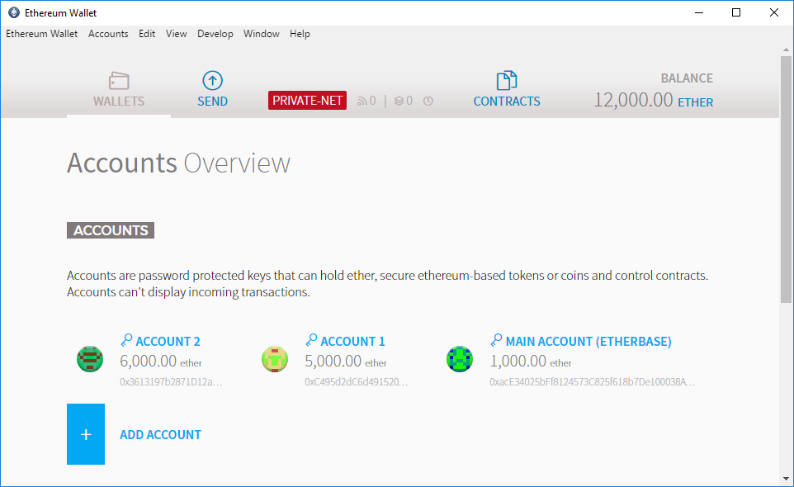
Creating Genesis State of the Private Network – Pre-allocate ethers

Slide 21
Start mining on Private Network
C:\eth_dev\tnet01>geth attach
Welcome to the Geth JavaScript console!
instance: Geth/v1.6.0-stable-facc47cb/windows-amd64/go1.8.1
coinbase: 0xace34025bff8124573c825f618b7de100038ad1a
at block: 0 (Thu, 01 Jan 1970 08:00:00 CST)
datadir: C:\eth_dev\tnet01\data
modules: admin:1.0 debug:1.0 eth:1.0 miner:1.0 net:1.0 personal:1.0 rpc:1.0 txpool:1.0 web3:1.0
> web3.fromWei(eth.getBalance(eth.accounts[0]).toNumber(), "ether")
"1000"
> web3.fromWei(eth.getBalance(eth.accounts[1]).toNumber(), "ether")
"5000"
> web3.fromWei(eth.getBalance(eth.accounts[2]).toNumber(), "ether")
"6000"
> miner.start()

Slide 22
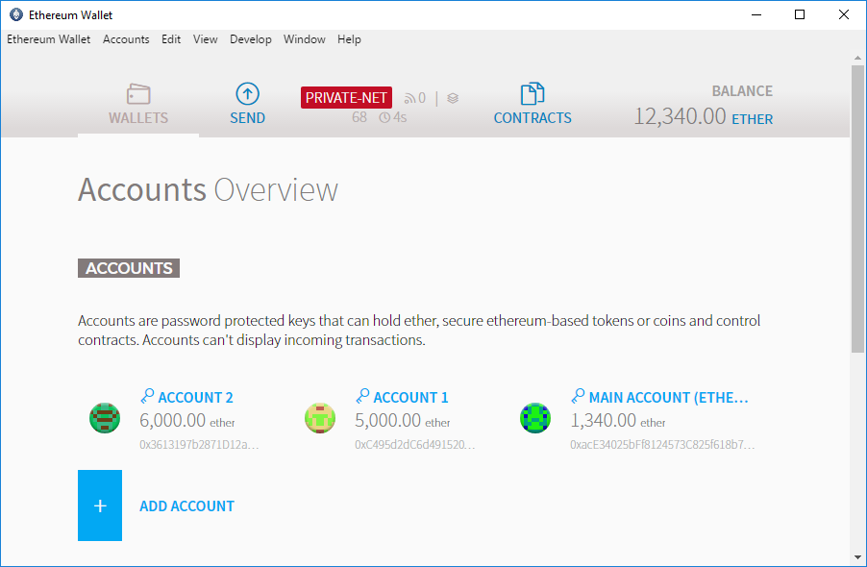
Start mining on Private Network – will see ether growing for MAIN ACCOUNT

Slide 23
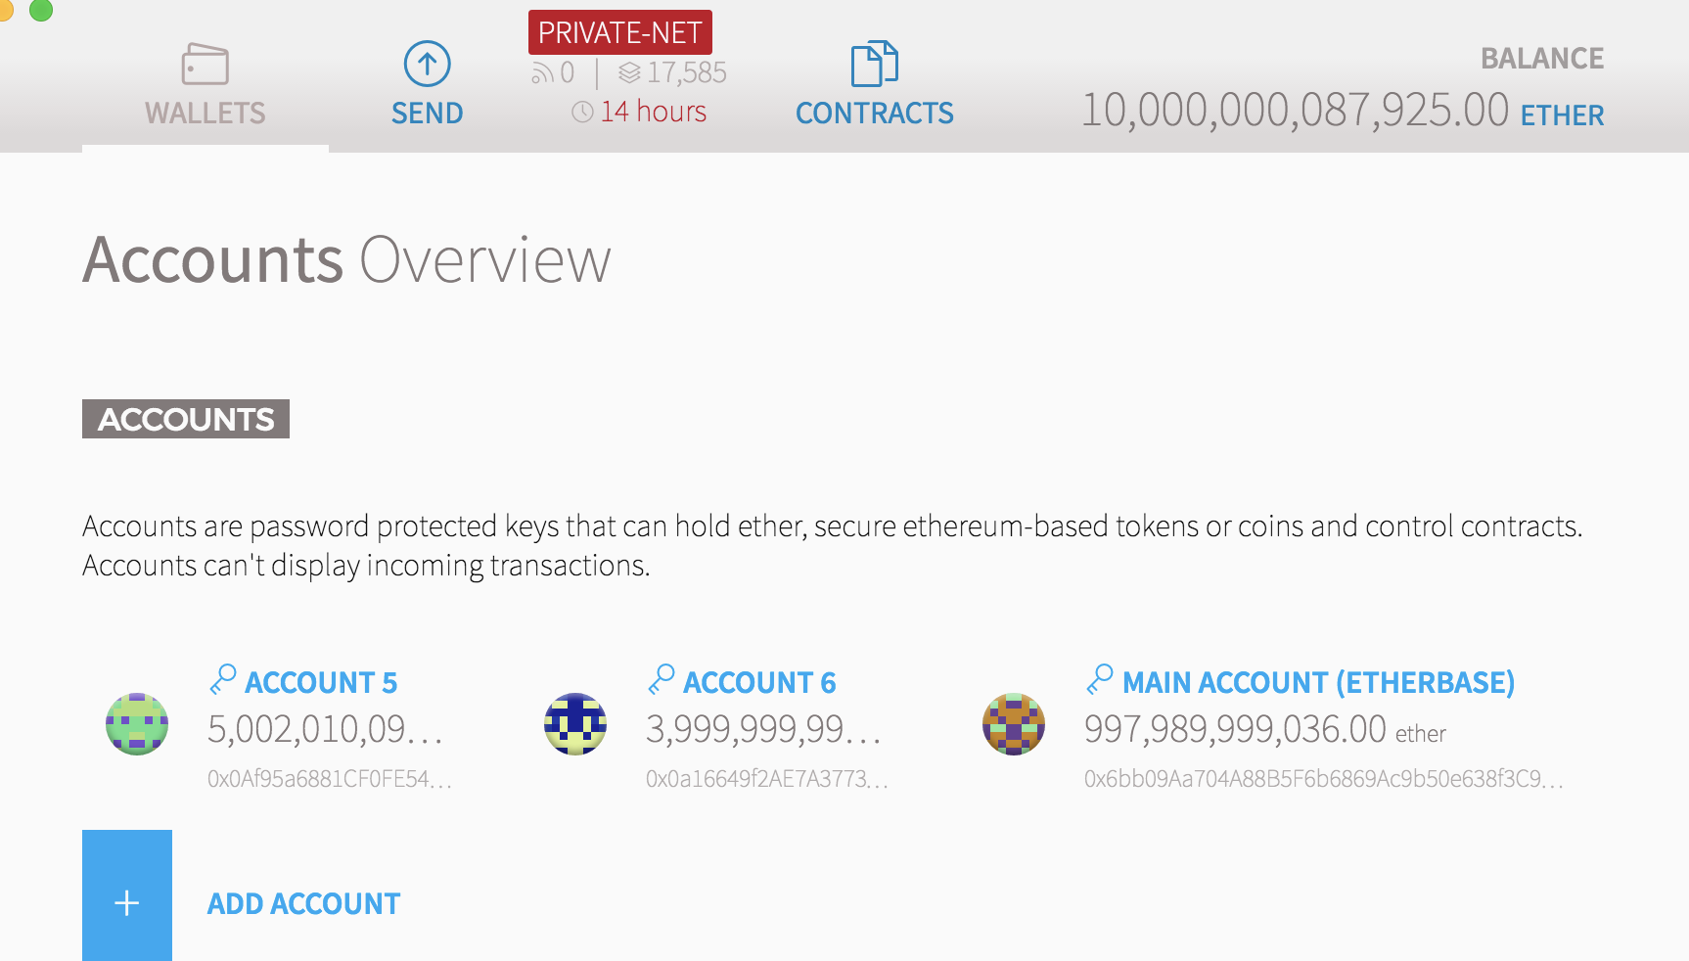
Transfer ethers/fund on Private Network
Private Network
Pre-Allocate ethers

Slide 24
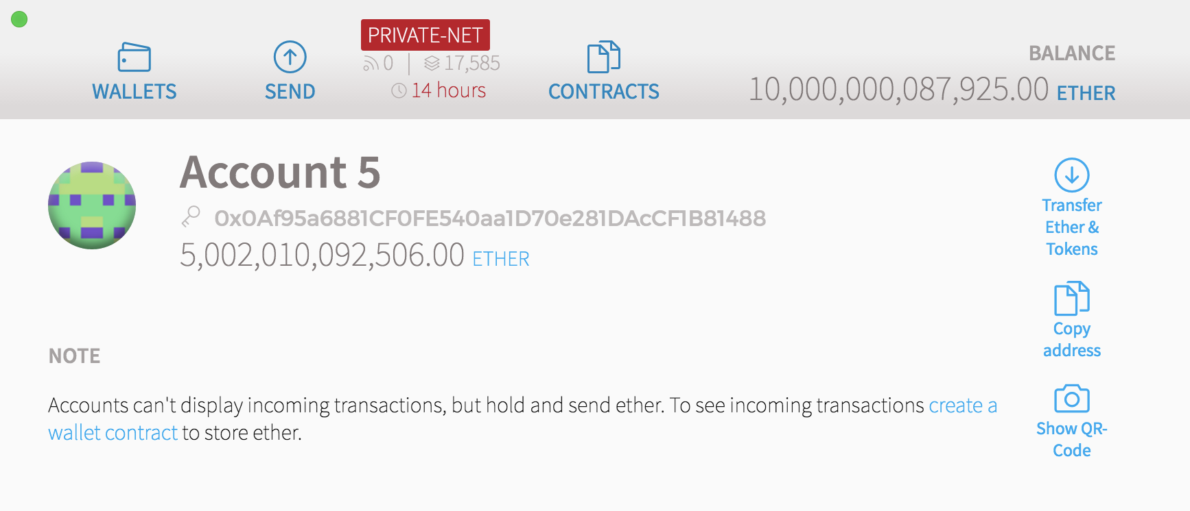
Transfer ethers/fund on Private Network
Current Balance
Click to transfer Ether to this account

Slide 25
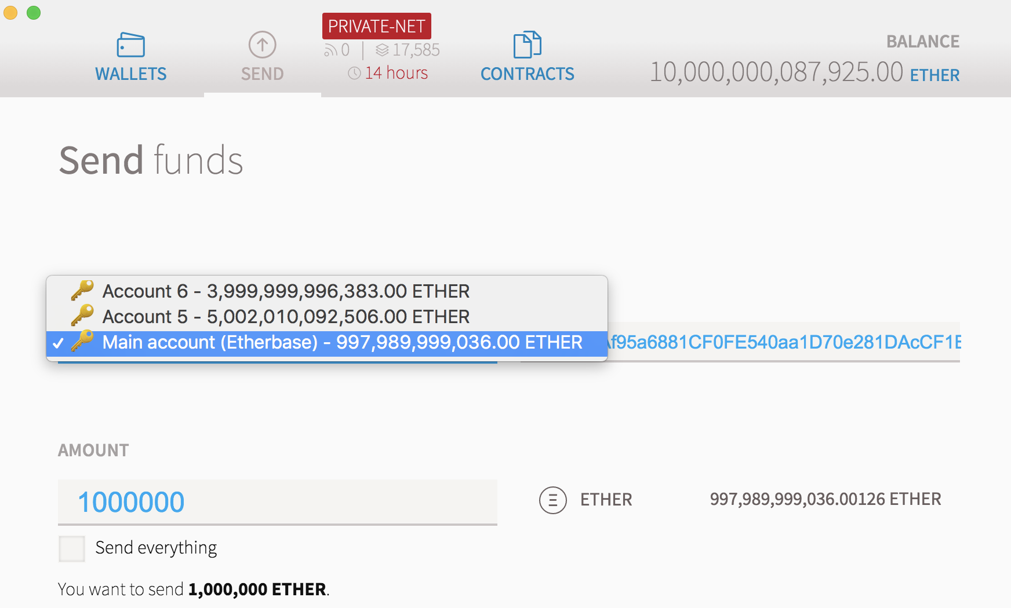
Transfer ethers/fund on Private Network
1 - Select From Account
2 - Enter Amount to transfer Ether

Slide 26
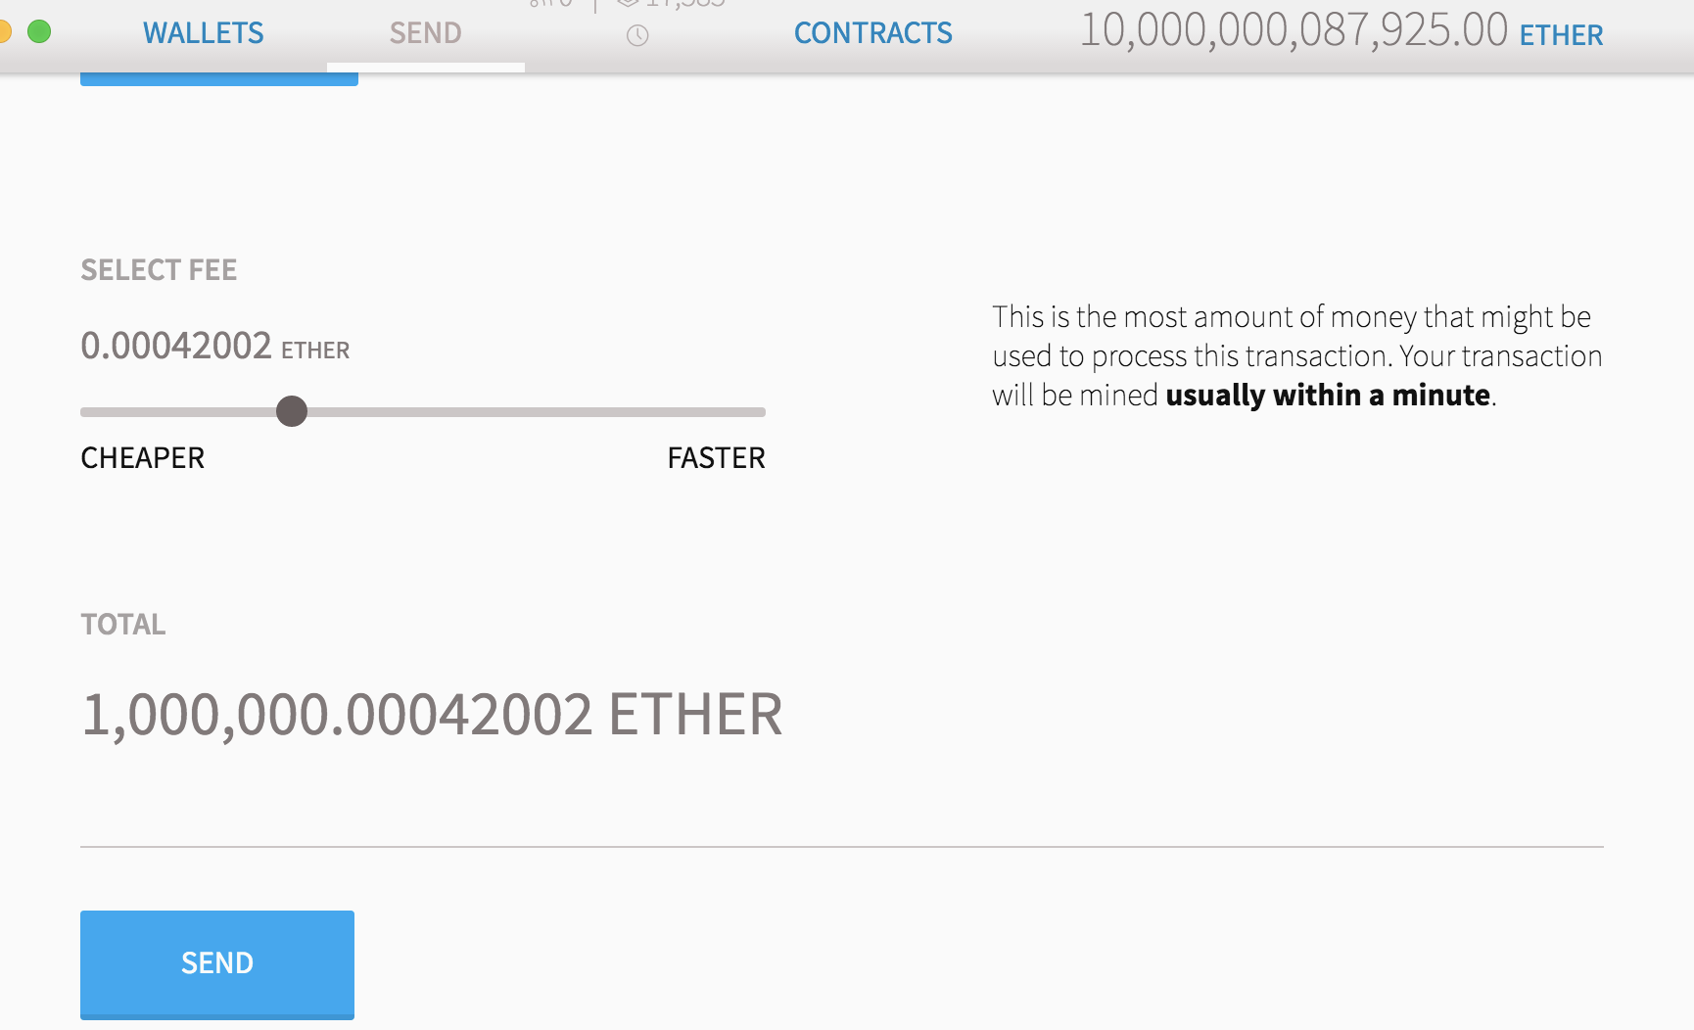
Transfer ethers/fund on Private Network
Click “Sent” to start sending ethers

Slide 27
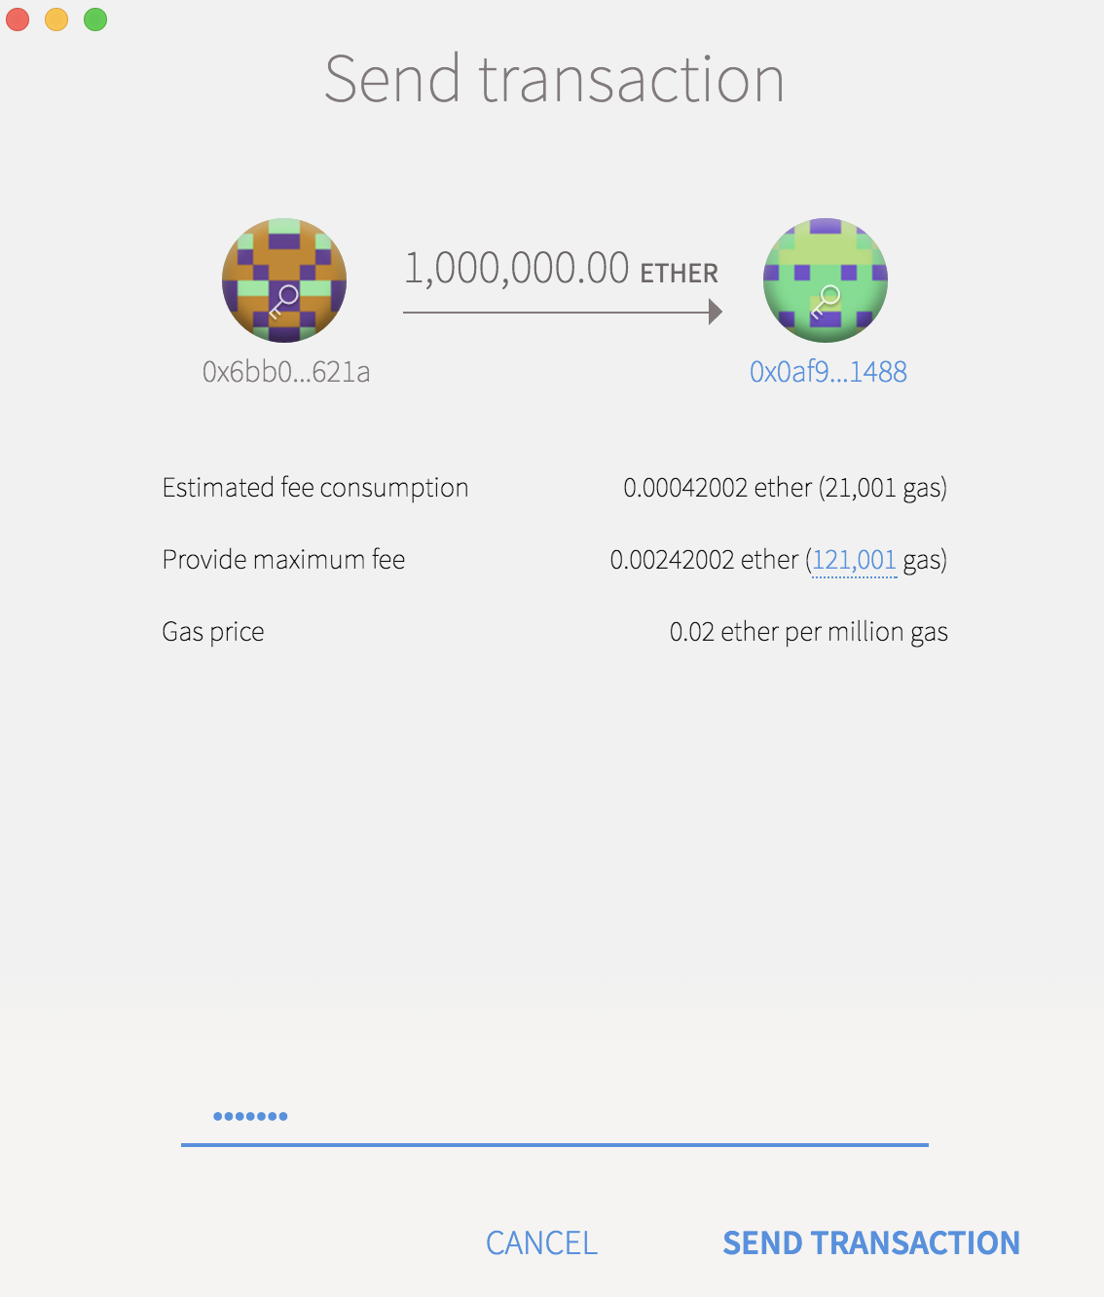
Transfer ethers/fund on Private Network
Transaction Summary Before Send
Enter Password and Send

Slide 28
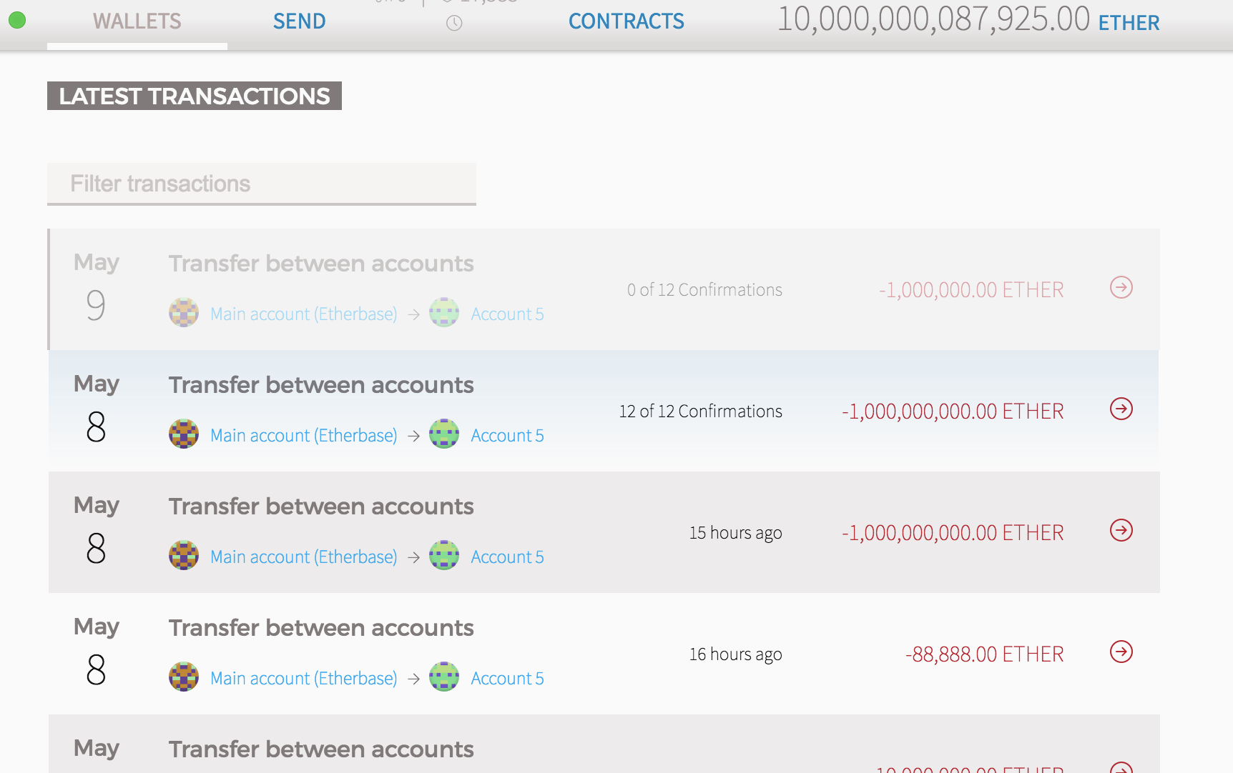
Transfer ethers/fund on Private Network

Slide 29
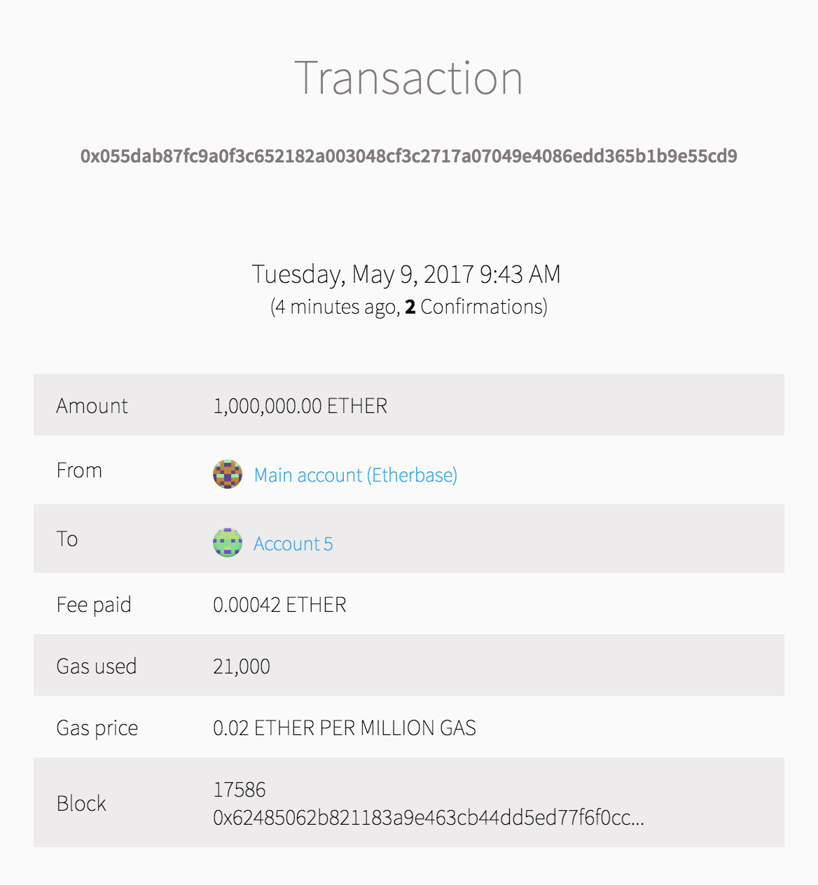
Transfer ethers/fund on Private Network
Transaction Summary After Sent

Slide 30
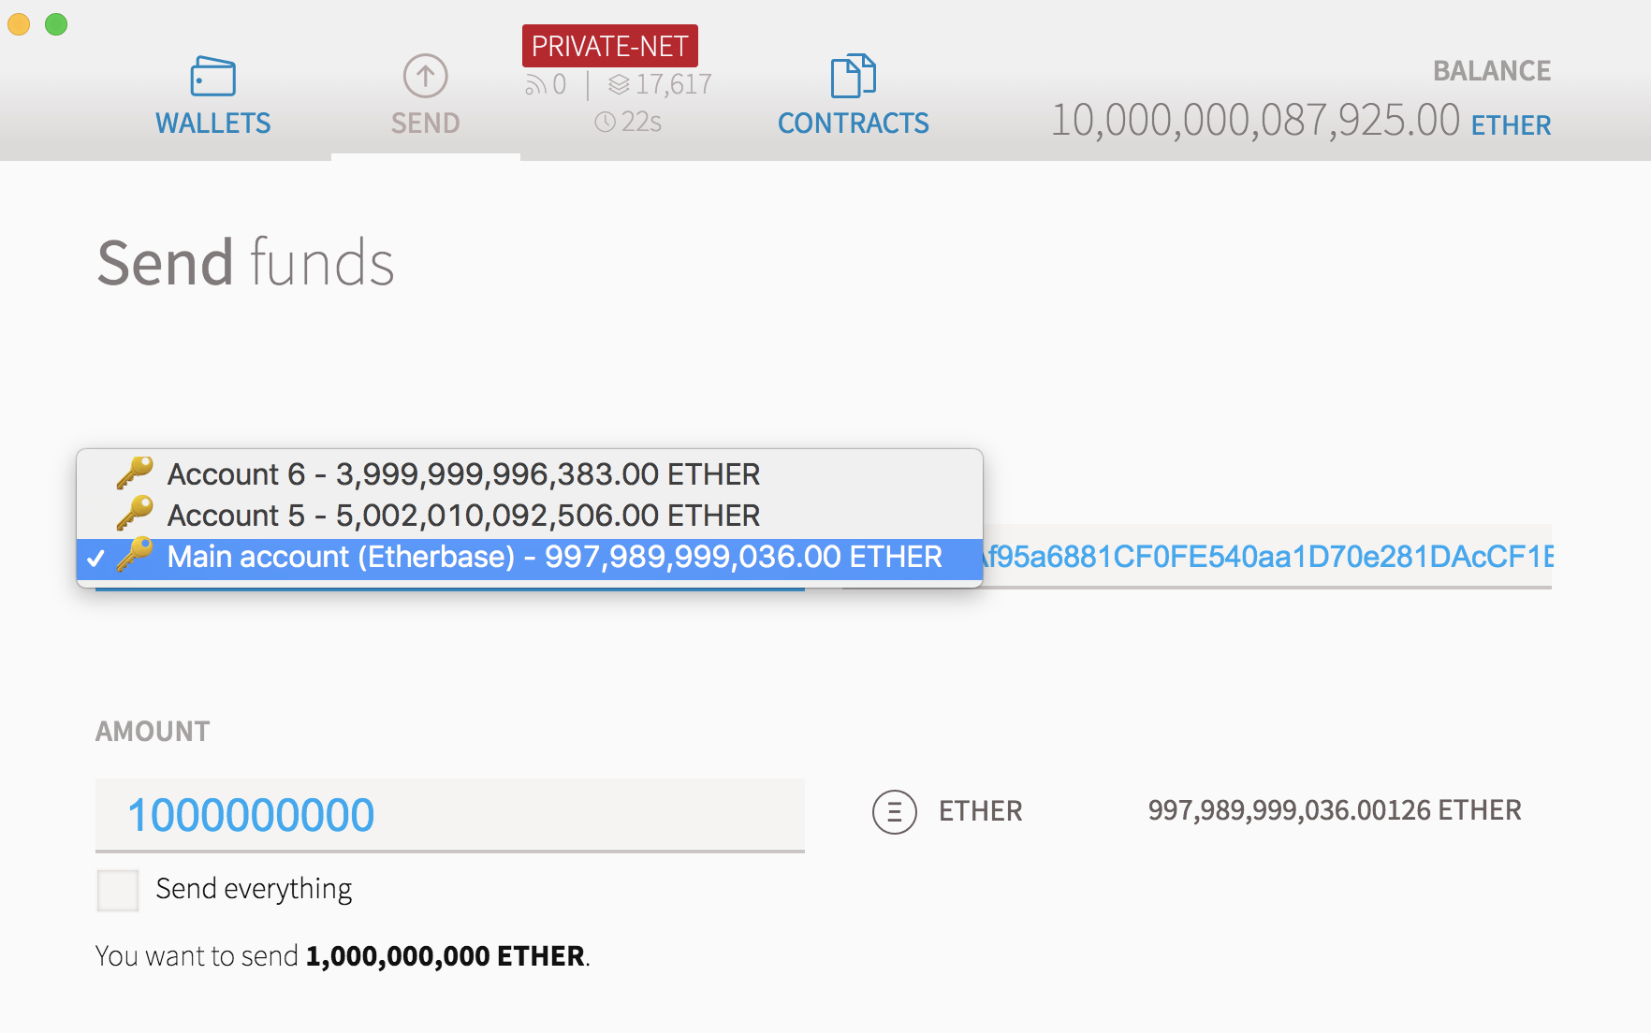
Transfer ethers/fund on Private Network
1 - Select From Account
2 - Enter Amount to transfer Ether Again

Slide 31
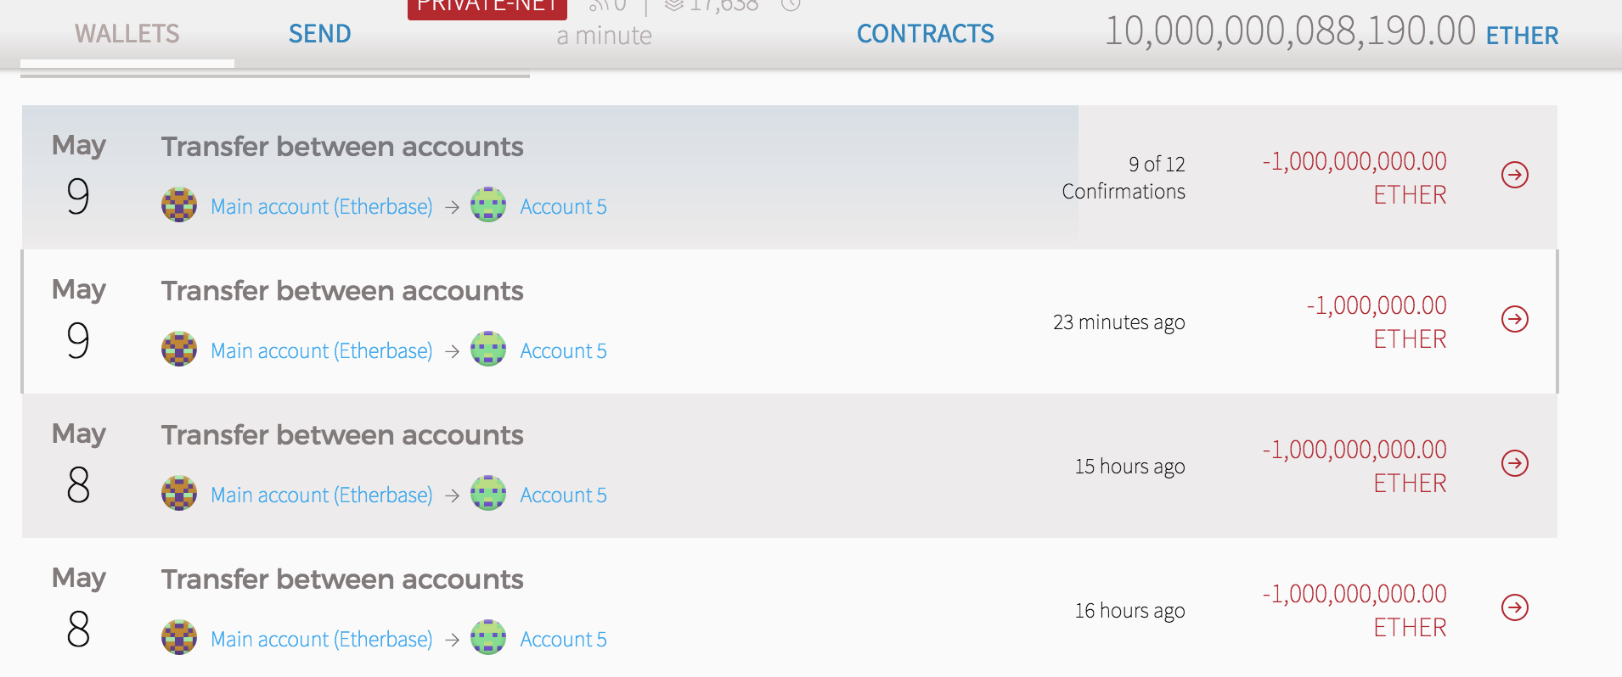
Transfer ethers/fund on Private Network
Transaction Details

Slide 32
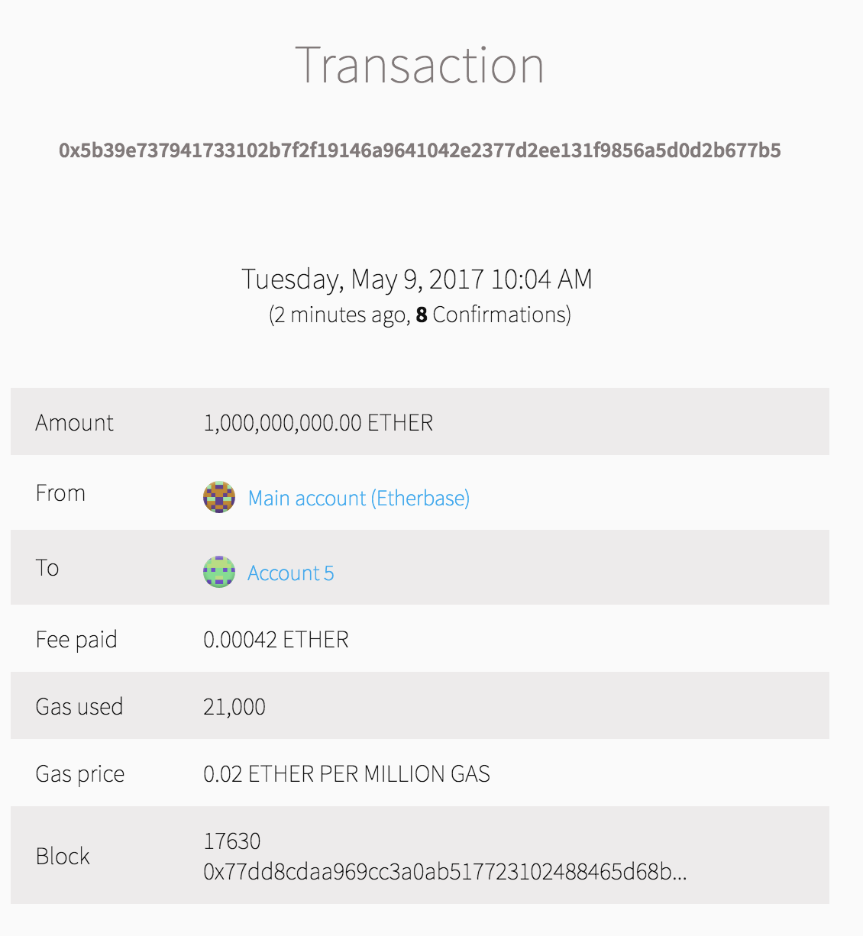
Transfer ethers/fund on Private Network
Transaction Summary After Sent

Slide 33
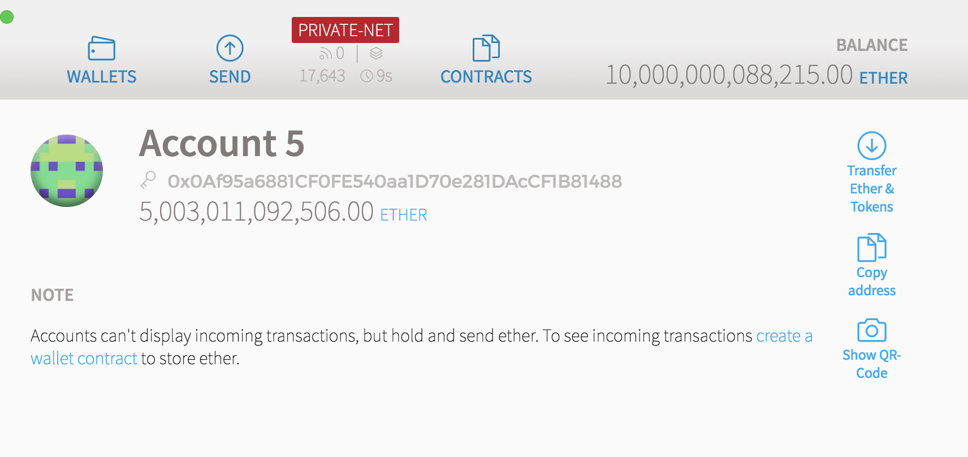
Transfer ethers/fund on Private Network
Total Amount Grown After Two Transactions
1 – 1,000,000
2 – 1,000,000,000

Slide 34
THANK YOU
Wenyan Qin
2017-05

