Slide 1
Ethereum Smart Contract
Tutorial & Demo
Wenyan Qin
2017-05

Slide 2
Agenda
Setup Ethereum and Start Dev Network
Allocate & Transfer ether “Money” (Tokens)
Smart Contract & Demo

Slide 3
Private/Dev Network Setup
Steps:
Download Ethereum and Client Wallet
Start Dev Network
Creating Dev Network Accounts and allocate funds
Running private miner and getting Ethers
Development Smart Contract
Official Website: http://Ethereum.org
Downloads https://geth.ethereum.org/downloads/
geth-alltools-windows-amd64-1.6.0-facc47cb.zip
Wallet https://github.com/ethereum/mist/releases/download/v0.8.9/Ethereum-Wallet-win64-0-8-9.zip
Support platforms: Linux, macOS, Windows

Slide 4
Ethereum Node Utilities and Wallets Installed
Full node utilities include:
geth - main Ethereum CLI client
abigen - abi generator to convert smart contract
bootnode - for peers to find the bootstrap node
disasm - disassmbler to convert EVM bytecode to readable assembly code
evm - evm environment for running EVM byecode
gethrpctest - developer tools for rpc-test
rlpdum - developer tool to conver rlp dump
swarm - swarm daemon and tool
Popular Wallets
Ethereum Wallet, Mist, Parity (Here we will use Ethereum Wallet for demo)
Download and Install, make sure all the utils are include in the $PATH

Slide 5
Create dev folder & start Ethereum node in dev mode On #1 Windows
C:\eth_dev\dev01>geth --datadir data_d1 --dev
#1 Windows
C:\eth_dev\dev01>geth --datadir data_d1 --dev
WARN [05-11|15:43:20] No etherbase set and no accounts found as default
INFO [05-11|15:43:20] Starting peer-to-peer node instance=Geth/v1.6.1-stable-021c3c28/windows-amd64/go1.8.1
INFO [05-11|15:43:20] Allocated cache and file handles database=C:\\eth_dev\\dev01\\data_d1\\geth\\chaindata cache=128 handle
s=1024
INFO [05-11|15:43:20] Writing custom genesis block
INFO [05-11|15:43:20] Initialised chain configuration config="{ChainID: 1337 Homestead: 0 DAO: <nil> DAOSupport: false EIP15
0: 0 EIP155: 0 EIP158: 0 Engine: ethash}"
WARN [05-11|15:43:20] Ethash used in test mode
WARN [05-11|15:43:20] Upgrading db log bloom bins
INFO [05-11|15:43:20] Bloom-bin upgrade completed elapsed=3.007ms
INFO [05-11|15:43:20] Initialising Ethereum protocol versions="[63 62]" network=1
INFO [05-11|15:43:20] Loaded most recent local header number=0 hash=e5be92…38f3bc td=131072
INFO [05-11|15:43:20] Loaded most recent local full block number=0 hash=e5be92…38f3bc td=131072
INFO [05-11|15:43:20] Loaded most recent local fast block number=0 hash=e5be92…38f3bc td=131072
INFO [05-11|15:43:20] Starting P2P networking
INFO [05-11|15:43:20] started whisper v.5.0
INFO [05-11|15:43:20] RLPx listener up self="enode://059ea7908cb964378aab90f7fd32f224742b1d4897ee0324253ebe70
c66cc3b4b9d669b2c72b532ed436e95713e96baa0d591facc956b3ea656e4b0dd3be2e97@[::]:58048?discport=0"
INFO [05-11|15:43:20] IPC endpoint opened: \\.\pipe\geth.ipc

Slide 6
Open #2 window attach to the up & running Ethereum node.
C:\Program Files\Geth>geth attach ipc:\\.\pipe\geth.ipc
#2 Windows
C:\Program Files\Geth>geth attach ipc:\\.\pipe\geth.ipc
Welcome to the Geth JavaScript console!
instance: Geth/v1.6.1-stable-021c3c28/windows-amd64/go1.8.1
modules: admin:1.0 debug:1.0 eth:1.0 miner:1.0 net:1.0 personal:1.0 rpc:1.0 shh:1.0 txpool:1.0 web3:1.0
> eth.accounts
[]
> personal.newAccount("Good4Testing")
"0x4d6736d479e3facfde81fef388c2d3ce3faeb586"
> eth.getBalance(eth.accounts[0])
0
> miner.start()
When account created, the #1 windows which started the
#1 Windows
INFO [05-11|15:47:19] New wallet appeared url=keystore://C:\\eth_dev\\dev01\\dat… status=Locked

Slide 7
Open #3 window to launch the Ethereum wallet .
C:\Program Files\Ethereum-Wallet>"Ethereum Wallet.exe" ipc:\\.\pipe\geth.ipc
- Or simply click “Ethereum Wallet” icon from your desktop
- For windows platform, Wallet will automatically find the proper geth.ipc unless specified
#3 Windows
C:\Program Files\Ethereum-Wallet>"Ethereum Wallet.exe" ipc:\\.\pipe\geth.ipc
C:\Program Files\Ethereum-Wallet>
[2017-05-11 15:59:11.199] [INFO] main - Running in production mode: true
Secp256k1 bindings are not compiled. Pure JS implementation will be used.
[2017-05-11 15:59:11.744] [INFO] main - Starting in Wallet mode
[2017-05-11 15:59:14.163] [INFO] Db - Loading db: C:\Users\Dou\AppData\Roaming\Ethereum Wallet\mist.lokidb
[2017-05-11 15:59:14.192] [INFO] Windows - Creating commonly-used windows
[2017-05-11 15:59:14.194] [INFO] Windows - Create secondary window: loading, owner: notset
[2017-05-11 15:59:14.372] [INFO] updateChecker - Check for update...
…
[2017-05-11 15:59:54.929] [INFO] Sockets/node-ipc - Connect to {"path":"\\\\.\\pipe\\geth.ipc"}
[2017-05-11 15:59:54.962] [INFO] Sockets/3 - Connected!
[2017-05-11 15:59:54.996] [INFO] (ui: splashscreen) - Network is privatenet
[2017-05-11 15:59:57.133] [INFO] NodeSync - No more sync necessary
[2017-05-11 15:59:57.134] [INFO] main - Loading Interface at file://C:\Program Files\Ethereum-Wallet\resources\app.asar/interface/wallet/index.html
[2017-05-11 15:59:57.143] [INFO] NodeSync - Sync loop ended
[2017-05-11 16:00:01.275] [INFO] Sockets/2 - Connect to {"path":"\\\\.\\pipe\\geth.ipc"}
[2017-05-11 16:00:01.278] [INFO] Sockets/2 - Connected!
[2017-05-11 16:00:01.294] [INFO] Sockets/2 - Disconnecting...
[2017-05-11 16:00:03.812] [INFO] Sockets/2 - Connect to {"path":"\\\\.\\pipe\\geth.ipc"}
[2017-05-11 16:00:05.204] [INFO] Sockets/2 - Connected!
[2017-05-11 16:00:07.450] [INFO] (ui: browser) - Connect to node...

Slide 8
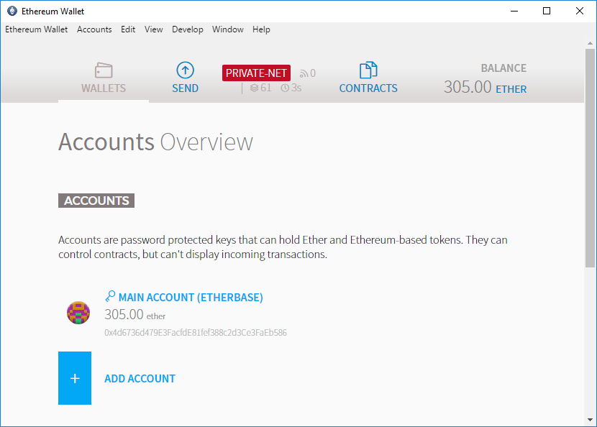
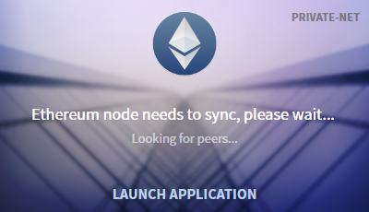
Ethereum Wallet is UP
It’s a private DEV net, and the miner makes the ether keep growing as shown

Slide 9
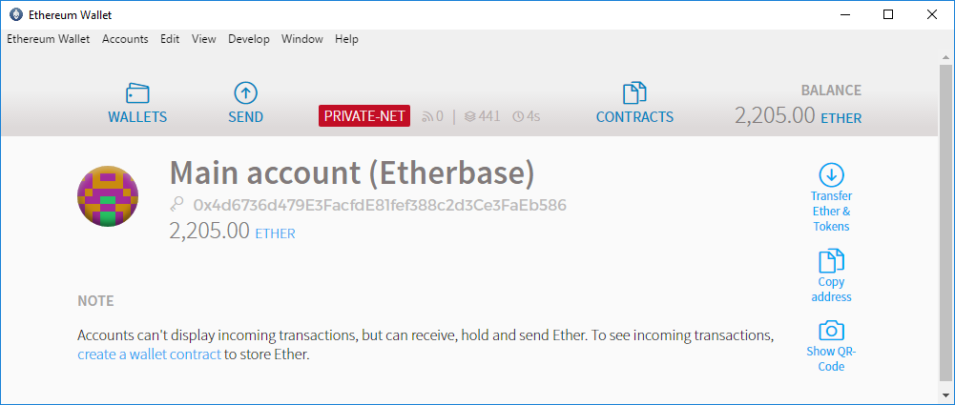
Ethereum Wallet is UP
It’s a private DEV net, and the miner makes the ether keep growing as shown
Main Account is the account with a long string as address

Slide 10
#1 window shows the detail mining status
#1 Windows
INFO [05-11|15:58:58] Generating DAG in progress epoch=1 percentage=39 elapsed=11.724s
INFO [05-11|15:59:00] Generating DAG in progress epoch=1 percentage=45 elapsed=12.983s
INFO [05-11|15:59:00] Generating DAG in progress epoch=1 percentage=51 elapsed=13.080s
INFO [05-11|15:59:00] Successfully sealed new block number=5 hash=752a0f…9b1977
INFO [05-11|15:59:00] Generating DAG in progress epoch=1 percentage=52 elapsed=13.771s
INFO [05-11|15:59:00] Generating DAG in progress epoch=1 percentage=53 elapsed=13.779s
INFO [05-11|15:59:00] Generating DAG in progress epoch=1 percentage=54 elapsed=13.785s
INFO [05-11|15:59:00] Generating DAG in progress epoch=1 percentage=55 elapsed=13.794s
INFO [05-11|15:59:00] 🔨 mined potential block number=5 hash=752a0f…9b1977
INFO [05-11|15:59:00] Commit new mining work number=6 txs=0 uncles=0 elapsed=1.001ms
INFO [05-11|15:59:01] 🔗 block reached canonical chain number=1 hash=49f561…177682
INFO [05-11|15:59:01] Commit new mining work number=7 txs=0 uncles=0 elapsed=0s
INFO [05-11|15:59:01] Generating DAG in progress epoch=1 percentage=64 elapsed=14.284s
INFO [05-11|15:59:01] Generating DAG in progress epoch=1 percentage=65 elapsed=14.291s
INFO [05-11|15:59:01] Generating DAG in progress epoch=1 percentage=69 elapsed=14.334s
INFO [05-11|15:59:01] Generating DAG in progress epoch=1 percentage=70 elapsed=14.345s
INFO [05-11|15:59:01] Generating DAG in progress epoch=1 perce

Slide 11
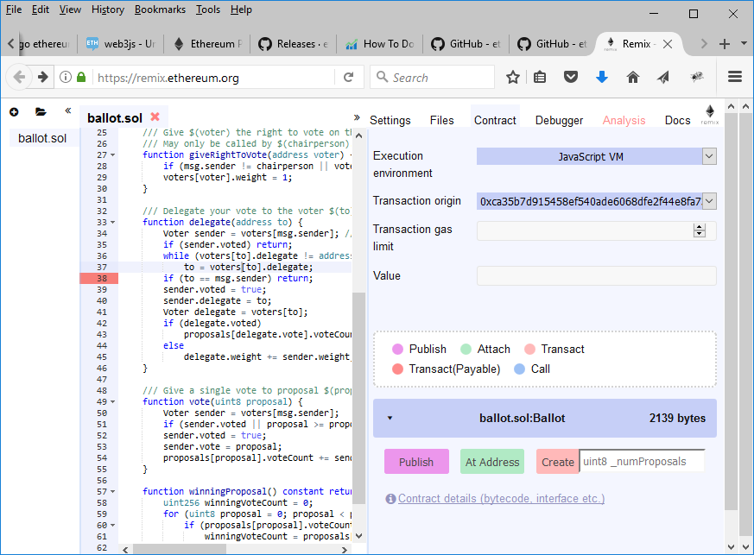
remix.Ethereum.org – Smart Contract Online Compiler/Browser Editor
Goto remix.Ethereum.org and a sample smart contract is listed
Click “Contract“ Tab → “Contract details (bytecode, interface etc.) ” link on the web page as shown

Slide 12
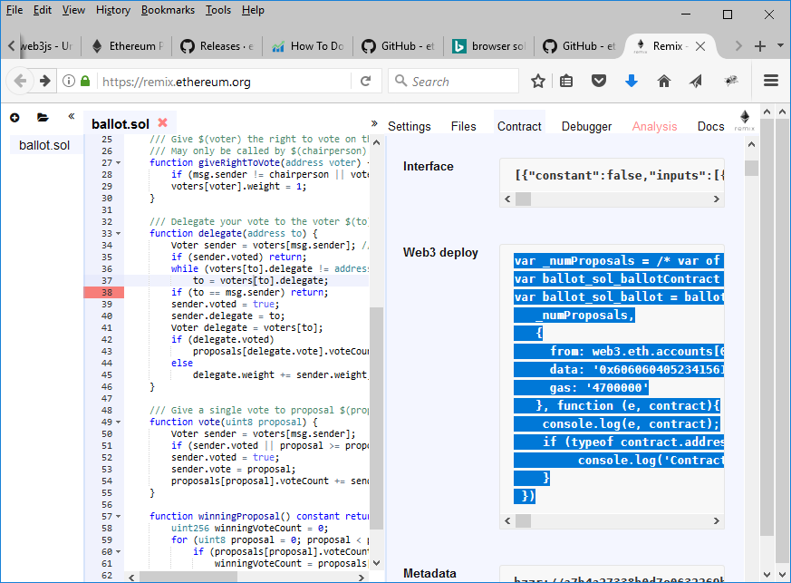
remix.Ethereum.org – Smart Contract Online Compiler/Browser Editor
Goto Web3 deploy, select the contract code and copy onto the clipboard (Ctl+C on Windows)
Then go back to #2 windows which has geth command line web3 interface.

Slide 13
remix.Ethereum.org – Smart Contract Online Compiler/Browser Editor
The contract code for web3 deploy looks like below
Provide the number of 8 as shown and Ctrl + C to copy to clipboard again
var _numProposals = 8 /* var of type uint8 here */ ;
var ballot_sol_ballotContract = web3.eth.contract([{"constant":false,"inputs":[{"name":"to","type":"address"}],"name":"delegate","outputs":[],"payable":false,"type":"function"},{"constant":true,"inputs":[],"name":"winningProposal","outputs":[{"name":"winningProposal","type":"uint8"}],"payable":false,"type":"function"},{"constant":false,"inputs":[{"name":"voter","type":"address"}],"name":"giveRightToVote","outputs":[],"payable":false,"type":"function"},{"constant":false,"inputs":[{"name":"proposal","type":"uint8"}],"name":"vote","outputs":[],"payable":false,"type":"function"},{"inputs":[{"name":"_numProposals","type":"uint8"}],"payable":false,"type":"constructor"}]);
var ballot_sol_ballot = ballot_sol_ballotContract.new(
_numProposals,
{
from: web3.eth.accounts[0],
data: '0x6060604052341561000c57fe5b60405160208061085b833981016040528080519060200190919050505b336
..
5156106bb57fe5b906000526020600020900160005b50600001600082825401925050819055505b50505600a165627a7a72305820a7b4a27338b0d7e0632269bd6c19e0f764f685718ffac81e3d2cf54775a4a3590029',
gas: '4700000'
}, function (e, contract){
console.log(e, contract);
if (typeof contract.address !== 'undefined') {
console.log('Contract mined! address: ' + contract.address + ' transactionHash: ' + contract.transactionHash);
}
})

Slide 14
Smart Contract geth command line approach
Window #1 - C:\eth_dev\dev01> geth --datadir data_d1 –dev –unlocked 0
Window #2 - C:\Program Files\Geth> geth attach ipc:\\.\pipe\geth.ipc
C:\Program Files\Geth>geth attach ipc:\\.\pipe\geth.ipc
Welcome to the Geth JavaScript console!
instance: Geth/v1.6.1-stable-021c3c28/windows-amd64/go1.8.1
coinbase: 0x4d6736d479e3facfde81fef388c2d3ce3faeb586
at block: 2417 (Thu, 11 May 2017 18:04:02 CST)
datadir: C:\eth_dev\dev01\data_d1
modules: admin:1.0 debug:1.0 eth:1.0 miner:1.0 net:1.0 personal:1.0 rpc
> miner.start()
null
> personal.unlockAccount(eth.accounts[0])
Unlock account 0x4d6736d479e3facfde81fef388c2d3ce3faeb586
Passphrase:
true
> var _numProposals = 8 /* var of type uint8 here */ ;
Undefined
> var ballot_sol_ballotContract = web3.eth.contract([{"constant":false,"inputs":[{"name":"to","type":"address"}],"name":
"delegate","outputs":[],"payable":false,"type":"function"},{"constant":true,"inputs":[],"name":"winningProposal",..
Paste the copied web3 deploy contract code from clipboard directly into the geth web3 interface

Slide 15
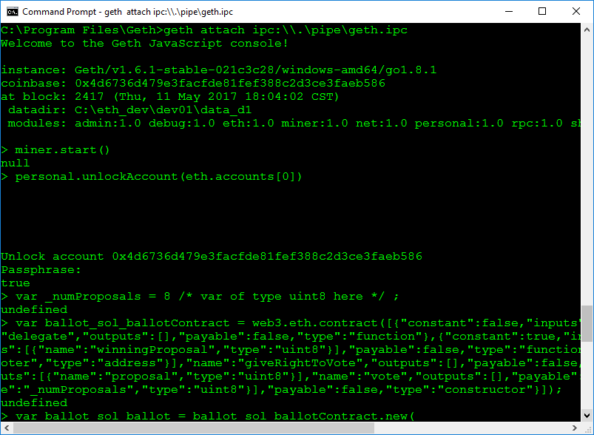
Smart Contract geth command line approach
Paste the web3 contract conde into the geth command line screen as shown.

Slide 16
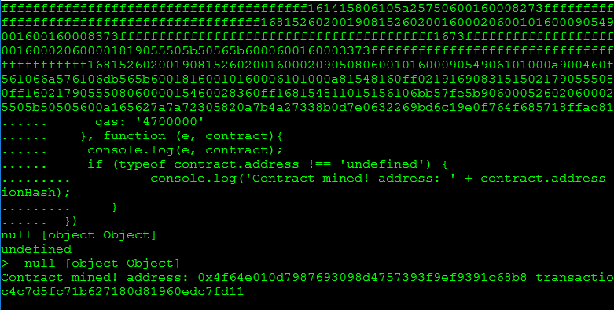
Smart Contract geth command line approach
Contract address: 0x4f64e010d7987693098d4757393f9ef9391c68b8

Slide 17
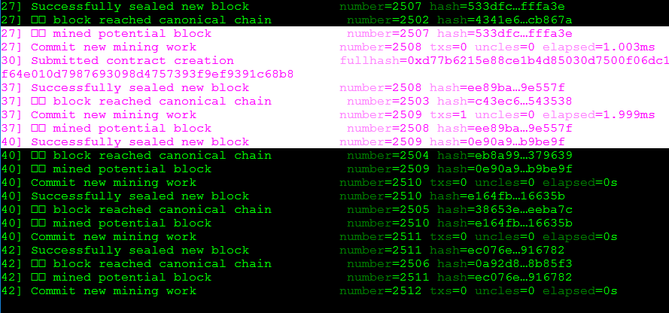
Smart Contract geth command line approach
Smart contract transaction Hash: 0xd77b6215e88ce1b4d85030d7500f06dc1c4c7d5fc71b627180d81960edc7fd11

Slide 18
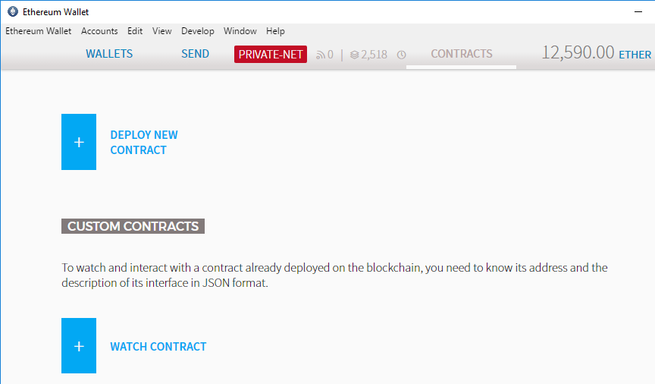
Smart Contract from Ethereum Wallet:
From Wallet on Dev network, click “WATCH CONTRACT”

Slide 19
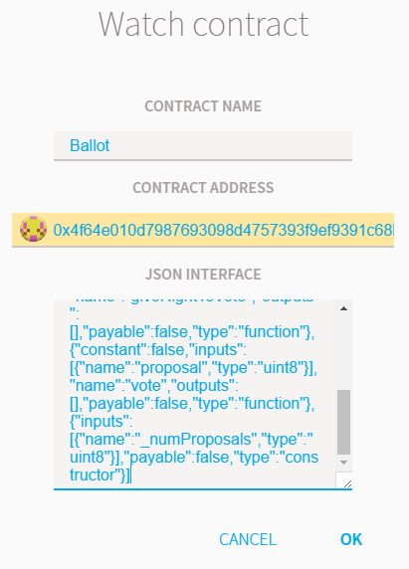
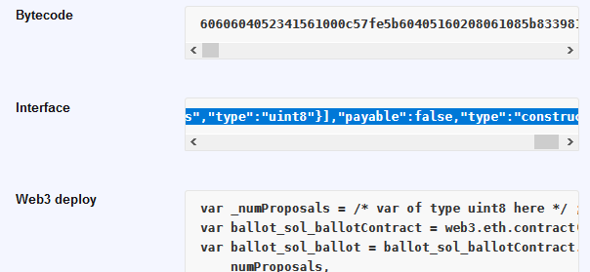
Smart Contract from Ethereum Wallet:
Enter contract info, NAME, ADDRESS, INTERFACE as shown

Slide 20
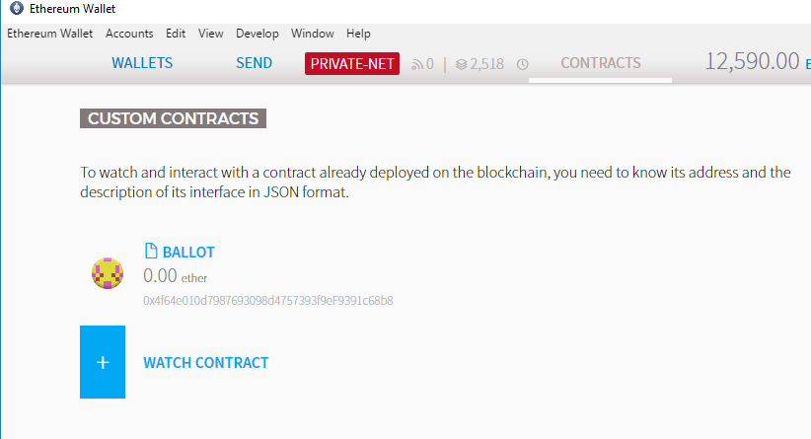
Smart Contract from Ethereum Wallet:
Smart Contract BALLOT which has deployed with address as 0x4f64e010d7987693098d4757393f9ef9391c68b8

Slide 21
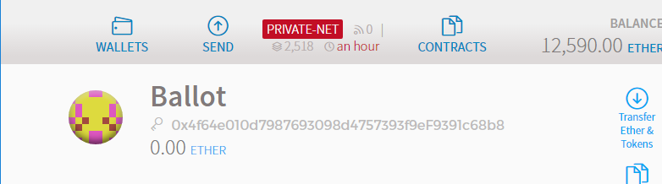
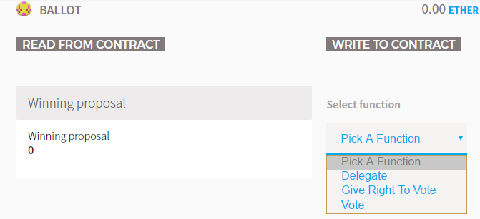
Smart Contract from Ethereum Wallet:
Smart Contract BALLOT deployed with address as 0x4f64e010d7987693098d4757393f9ef9391c68b8

Slide 22
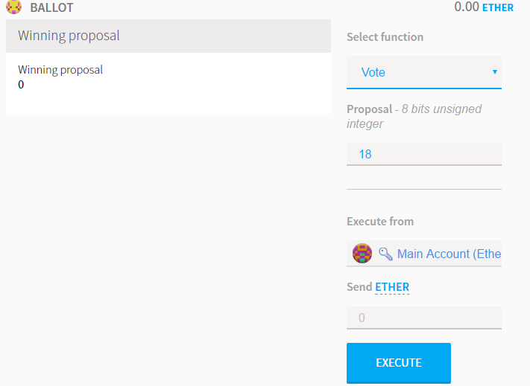
Smart Contract from Ethereum Wallet:
Smart Contract BALLOT function, write to contract

Slide 23
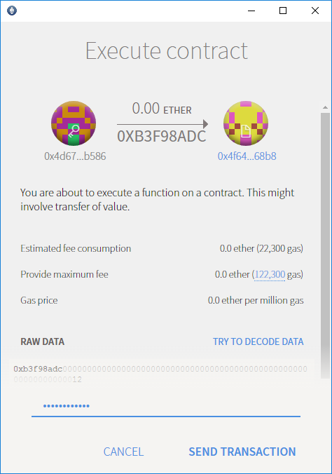
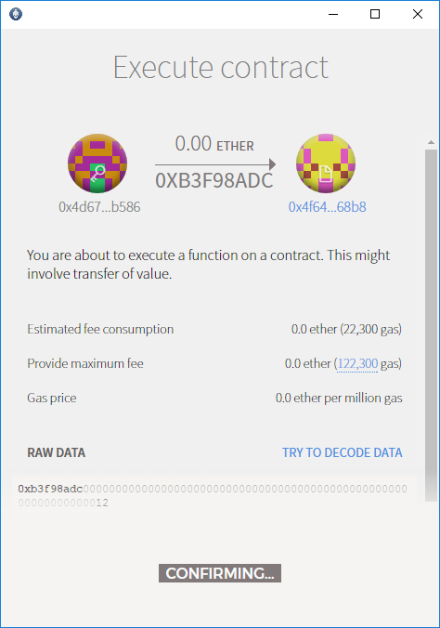
Smart Contract from Ethereum Wallet:
So you can interact with the smart contract.

Slide 24
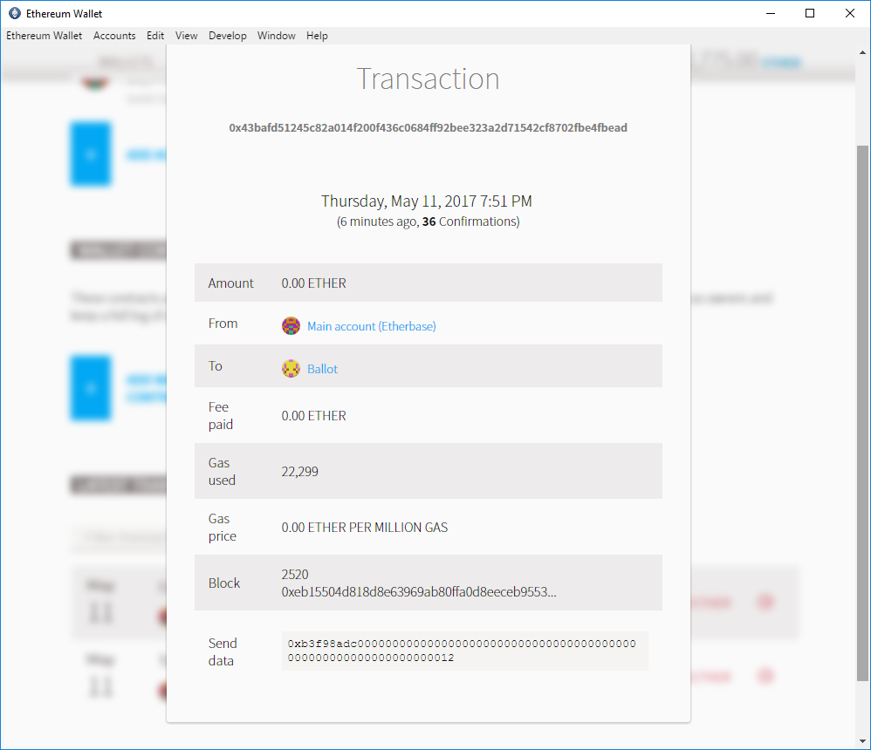
Smart Contract from Ethereum Wallet:
So you can interact with the smart contract.

Slide 25
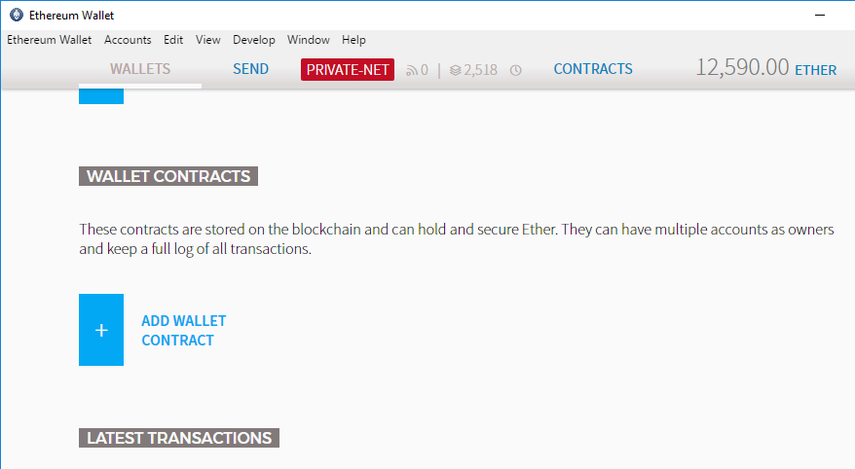
Smart Contract from Ethereum Wallet:
From Wallet on Dev network, click “ADD WALLET CONTRACT”

Slide 26
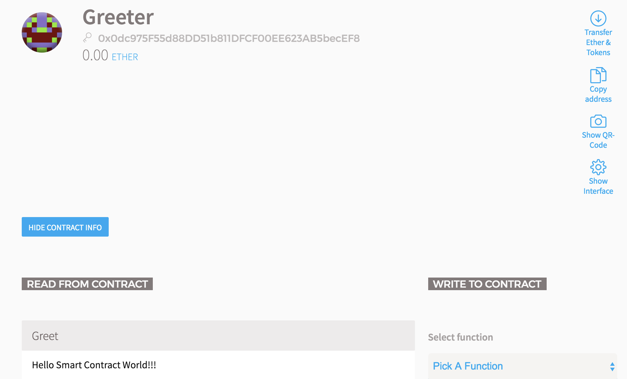
Smart Contract from Ethereum Wallet:
Another Sample Smart Contract
Greeter run result Greeter.Greet() saying “Hello Smart Contract World!!!”

Slide 27
Thank You!
Wenyan Qin
2017-05

