Slide 1
Design and development of Traffic and Accident Management
Team Members
Project Guide
1.Sourabh Gond
2.Ranjan Modi
3.Monu Vishwakarma
4.Sachin Kushwaha
5.Sonali
Dr. Rajeev Kumar Gupta
CSE Department

Slide 2
Problem Statement
In India more than 37 million people are using motorcycles. Since usage is high, accident percentage of two wheelers are also high compared to four wheelers. The impacts of these accidents are more dangerous when the driver involves in a high speed accident without wearing helmet.
Government has made it a punishable offense to ride a bike without helmet and have adopted manual strategies to catch the violators. But, sometimes bikers without helmet could not caught by traffic police.

Slide 3
About Project
In the perception to make a traffic and accident system acute, we provide desktop application which can reduces the efforts of traffic police and provide moreover functionality to them for catch the bikers easily who don’t wear helmets.
Desktop application will automatically extract the images of bikers who don’t wear helmets and it will save these images for further procedure. Images will be extract from the surveillance video on public road .
Desktop application will provide features like visualization of data related to occurrence of vehicles on different attributes.

Slide 4
Tools & Technologies
Development Tools & Technologies
Anaconda Distribution
Python 3
Mysql

Slide 5
Requirements
Functional Requirement
Login: The Login function except the input of username and password ,if both are valid then user will automatically navigate to the home page.
Update user information: The update user function update the username and password whenever user wants.
Display data: The Display data function display data in the table. Output is based on attributes like frequency of total vehicles, bikes without helmet, bikes with helmet.
Graph plot: The graph plot function plot the graph between the given time slot by user. It plots the count plot graph of table data.

Slide 6
Requirements
Non Functional Requirement
Database: A data base management system that is available in the public domain should be used.
Platform: Both Windows and UNIX versions of the software need to be developed.
Safety and Security: No loss or minimum loss, Privacy and Security of data is major concerned which can be achieved by regular backup of database and by applying concept of OOPs (such as Encapsulation, Abstraction and Inheritance).

Slide 7
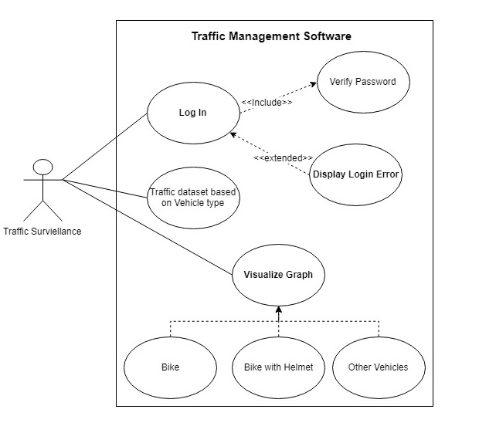
Use Case Diagram

Slide 8
THANK YOU

