Slide 1

LOGISTIC REGRESSION & SOFTMAX REGRESSION
Perceptron
Logistic Regression
Softmax Regression
Code demo

Slide 2
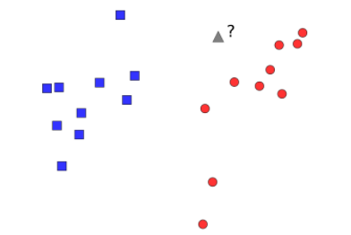
1. Perceptron
Given 2 labeled classes
Find a plane line such that:
All points in class 1 lie on one side
All points on class 2 lie on the other side

Slide 3
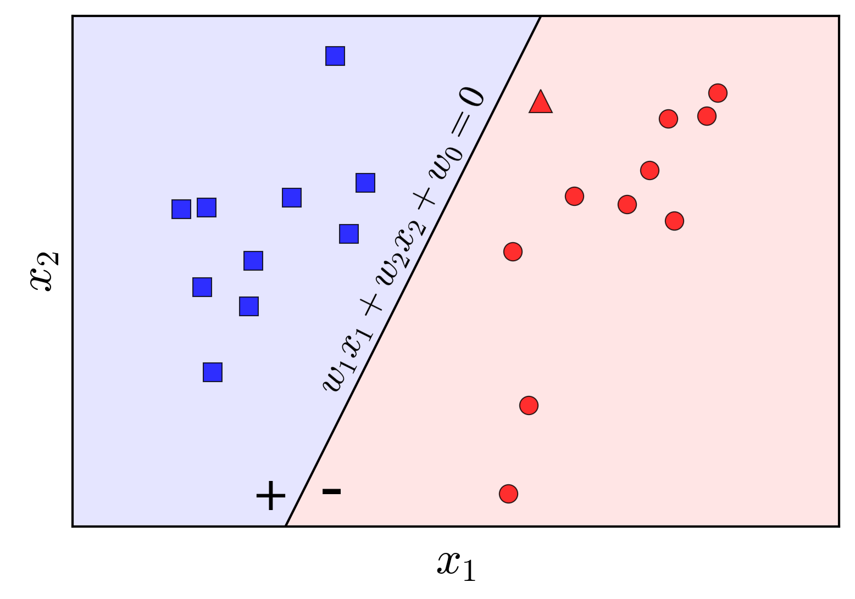

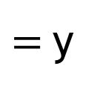

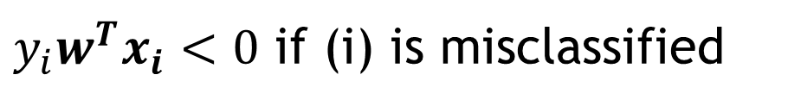
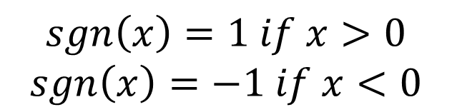
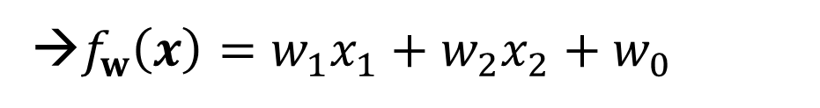
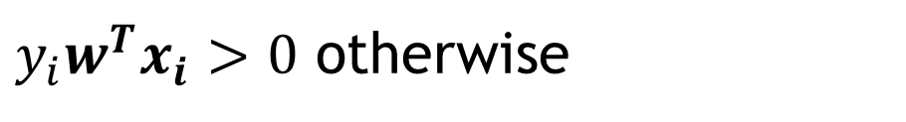
1. Perceptron
$f_{w}\left(x\right)=w_{1}x_{1}+…+w_{d}x_{d}+w_{0}$
Assume d = 2
→$f_{w}\left(x\right)=w_{1}x_{1}+w_{2}x_{2}+w_{0}$
$$=w^{T}x$$
$=$y
$$sgn\left(x\right)=1 if x>0$$
$$sgn\left(x\right)=−1 if x<0$$
$y_{i}w^{T}x_{i}<0$ if (i) is misclassified
$y_{i}w^{T}x_{i}>0$ otherwise

Slide 4
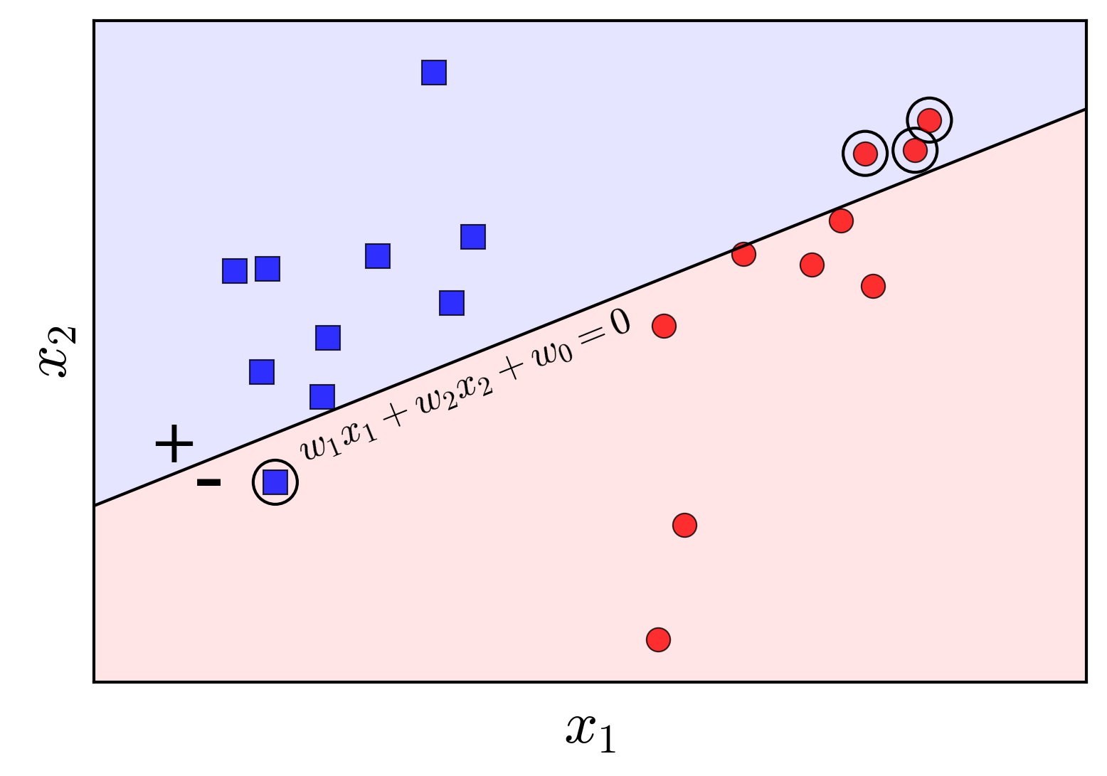


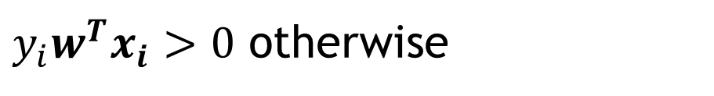
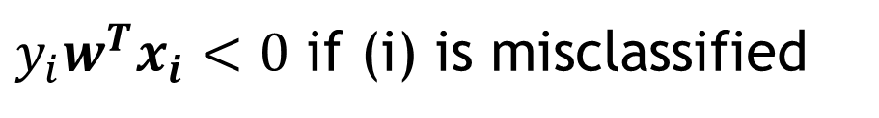
1. Perceptron
$y_{i}w^{T}x_{i}<0$ if (i) is misclassified
$y_{i}w^{T}x_{i}>0$ otherwise

Slide 5


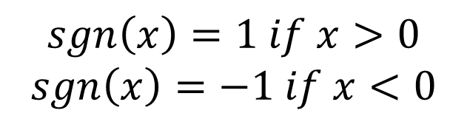
1. Perceptron
Store all misclassified points in M
Stochastic Gradient Descent (SGD)
→ Optimize each point in misclassified data
$$f\left(x\right)=sgn(w^{T}x)$$
$$sgn\left(x\right)=1 if x>0$$
$$sgn\left(x\right)=−1 if x<0$$
Update weight:

Slide 6
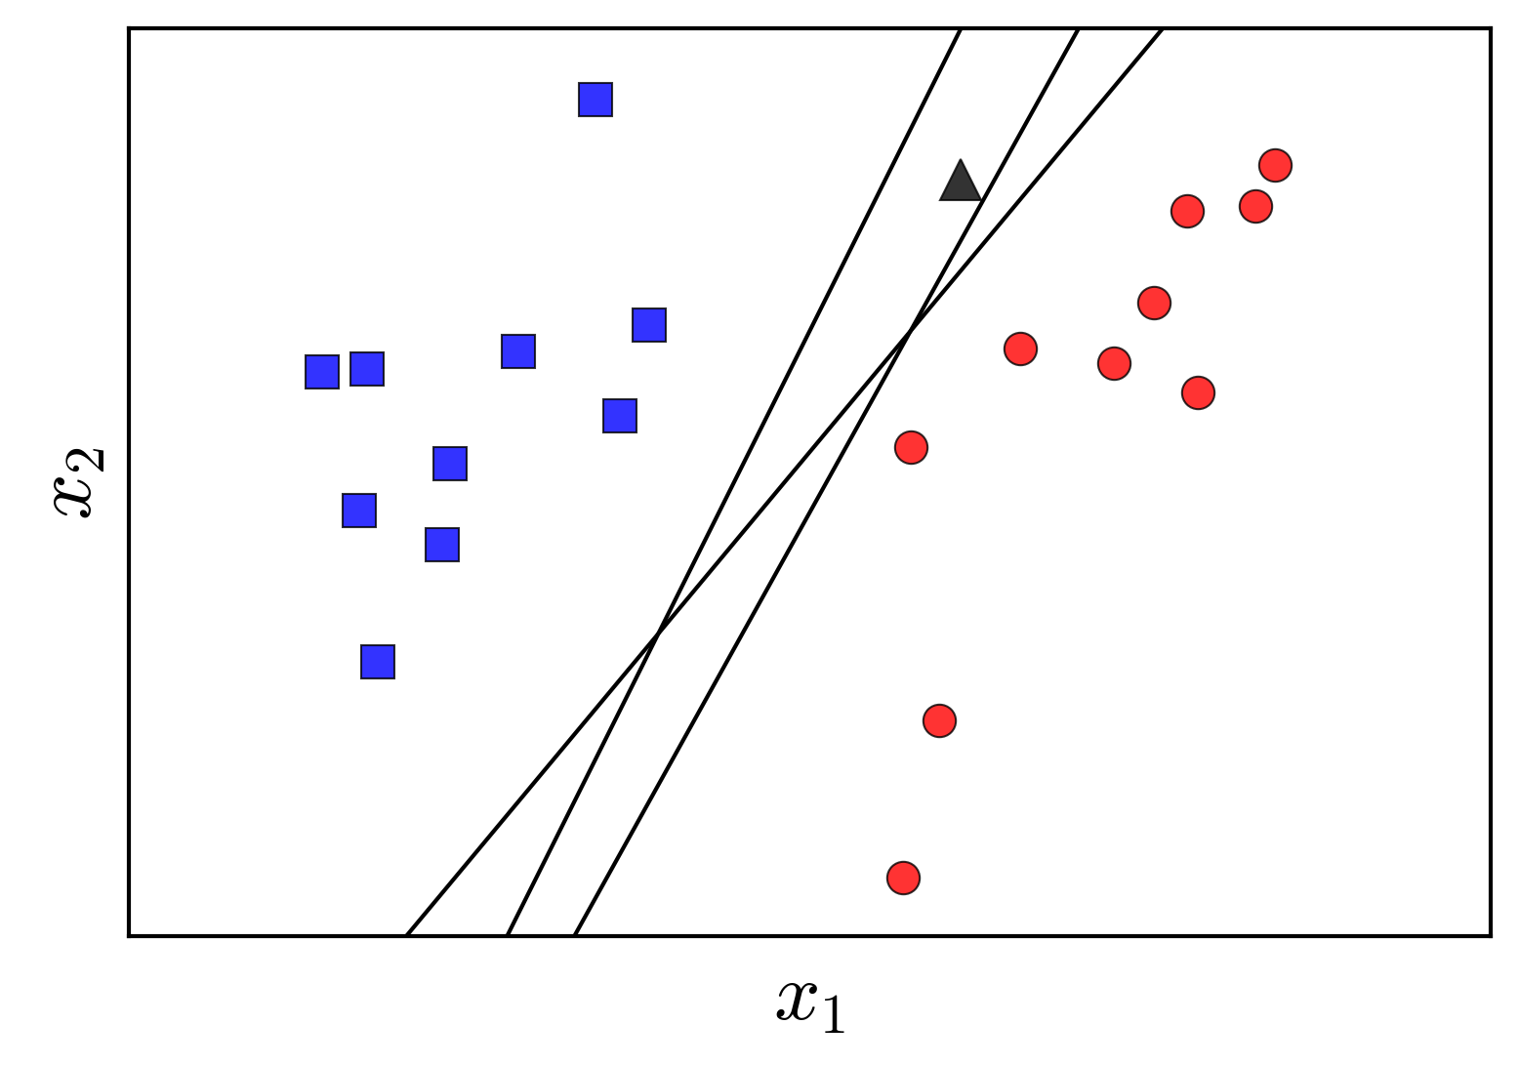
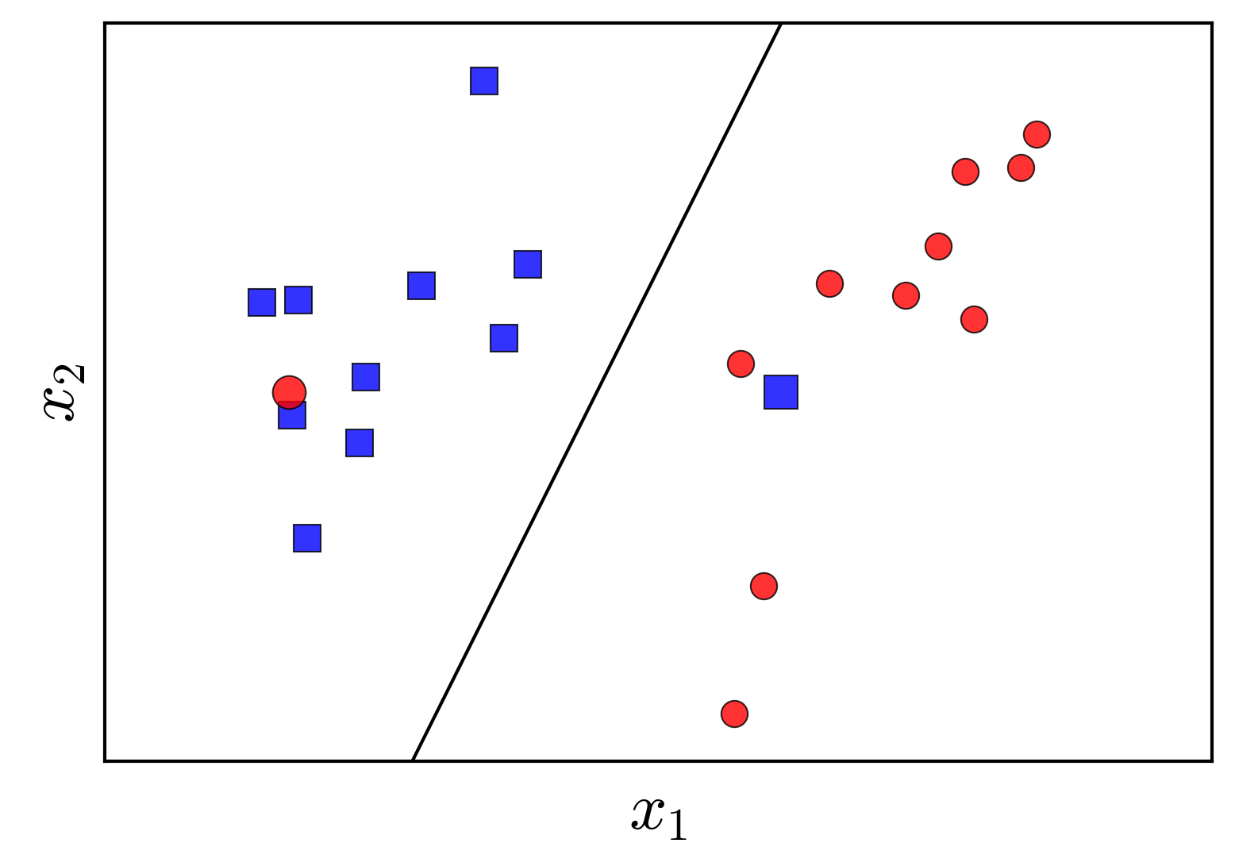
1. Perceptron
PLA can has a lot of different solutions
Different lines will determine the triangle points of different classes
PLA requires linearly separable data

Slide 7

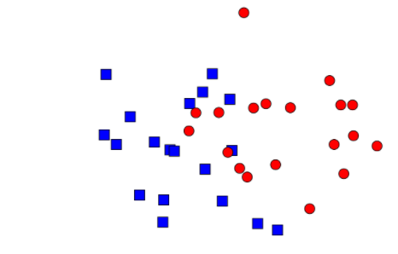
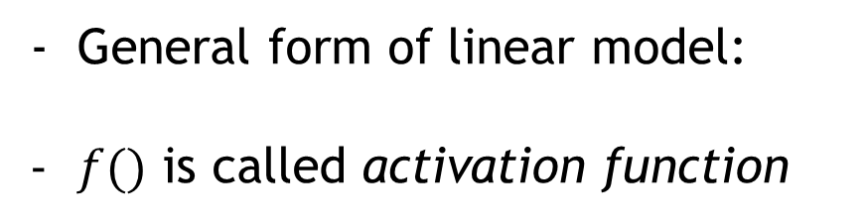



2. Logistic Regression
General form of linear model:
$f()$ is called activation function
$$f\left(x\right)=w^{T}x∈R$$
+ Linear Regression:
+ Perceptron Learning Algorithm (PLA):
$$f\left(x\right)=sgn\left(w^{T}x\right)∈\{−1,1\}$$
Logistic Regression:
$$f\left(x\right)={θ(w}^{T}x)$$

Slide 8
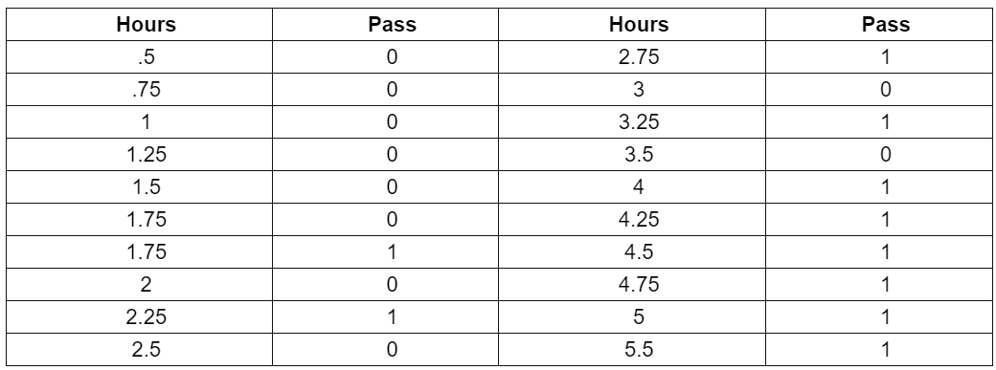
2. Logistic Regression
Example:

Slide 9
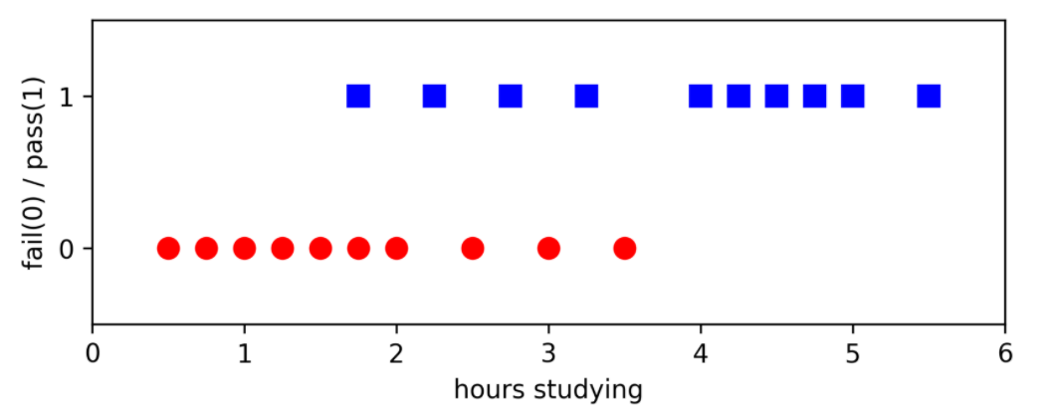
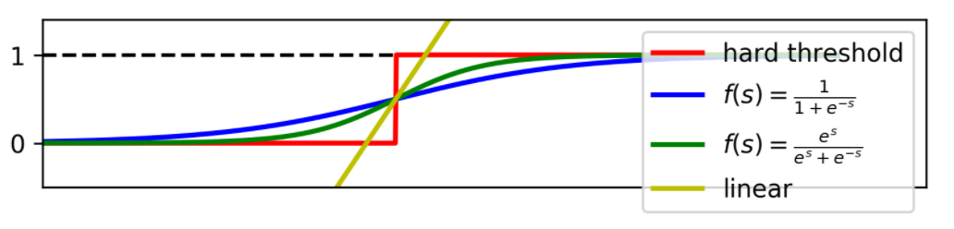
2. Logistic Regression
Example:
Some activation function:

Slide 10
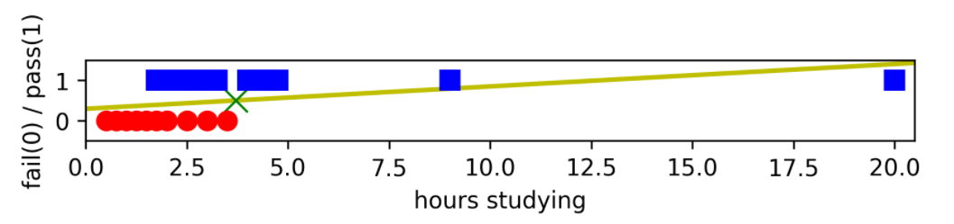
2. Logistic Regression
Linear Regression line:
Set threshold = 0.5:
+ Data having output >= 0.5 is in class 1 (pass) and otherwise
Assume some student learn > 15h per day and pass (absolutely), threshold will be increased → a lot of student learn 4-5h per day and truly pass, but be predicted fail
Bad model

Slide 11

2. Logistic Regression
Sigmoid function and tanh function:
continuous function with real values, bounded in the interval (0, 1)
Set y coordinate of ½ as a diving point, points farther from this point to the left have the value closer to 0 and otherwise
→ The more you study, the higher the probability of passing and vice versa
Smooth (have derivatives everywhere) → beneficial in optimization

Slide 12
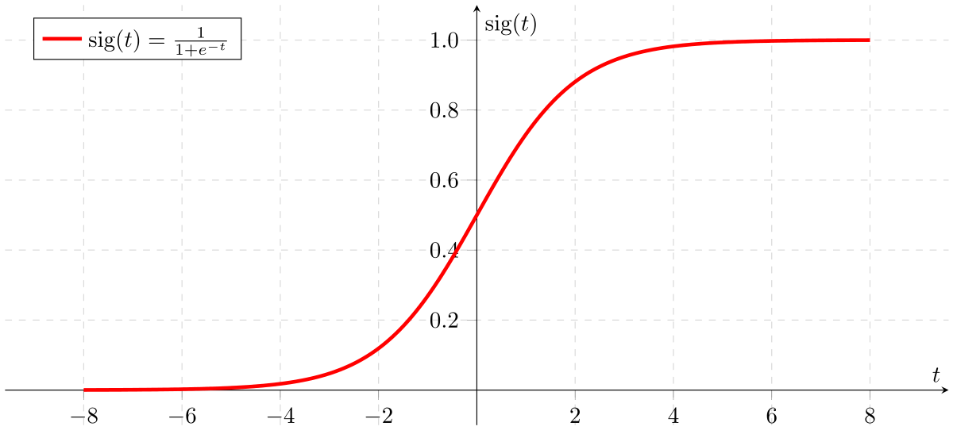



2. Logistic Regression
* Sigmoid Function
Bounded in (0, 1):
Beautiful derivatives:

Slide 13
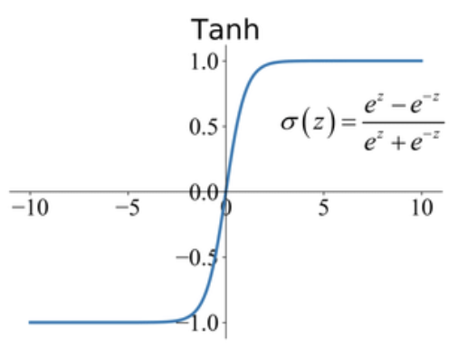


2. Logistic Regression
* Tanh Function
Bounded in (-1, 1)
Can easily convert to (0, 1):

Slide 14
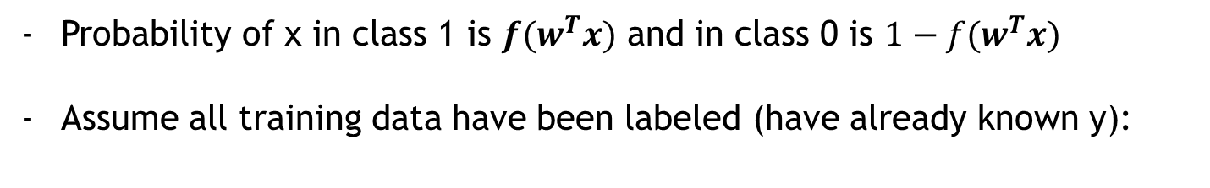
2. Logistic Regression
* Loss function and optimize method
Probability of x in class 1 is $f(w^{T}x)$ and in class 0 is $1−f(w^{T}x)$
Assume all training data have been labeled (have already known y):

Slide 15





2. Logistic Regression
* Loss function and optimize method
Set $z_{i}={f(w}^{T}x)$ :
All training set and
Assume all training data independent to each other

Slide 16

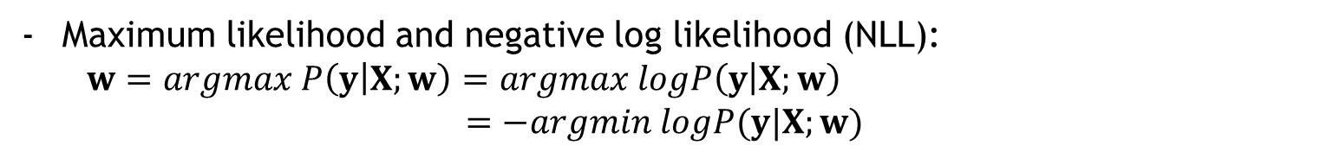

2. Logistic Regression
* Loss function and optimize method
Maximum likelihood and negative log likelihood (NLL):
$w=argmax P\left(y | X;w\right)=argmax logP\left(y | X;w\right)$
$=−argmin logP(y|X;w)$
$z_{i}={f(w}^{T}x)$

Slide 17


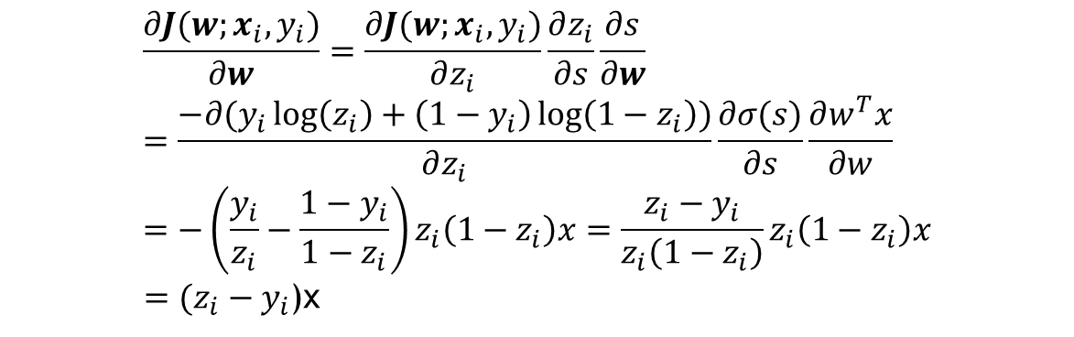
2. Logistic Regression
* Loss function and optimize method
Use Stochastic Gradient Descent (SGD) method:
Derivatives of sigmoid function:
Derivatives of loss function:
$$\frac{∂J(w;x_{i},y_{i})}{∂w}=\frac{∂J(w;x_{i},y_{i})}{∂z_{i}}\frac{∂z_{i}}{∂s}\frac{∂s}{∂w}=\frac{−∂(y_{i}\log\left(z_{i}\right)+\left(1−y_{i}\right)\log\left(1−z_{i}\right))}{∂z_{i}}\frac{∂σ(s)}{∂s}\frac{∂w^{T}x}{∂w}=−\left(\frac{y_{i}}{z_{i}}−\frac{1−y_{i}}{1−z_{i}}\right)z_{i}\left(1−z_{i}\right)x=\frac{z_{i}−y_{i}}{z_{i}\left(1−z_{i}\right)}z_{i}\left(1−z_{i}\right)x$$
$=(z_{i}−y_{i}$)x

Slide 18
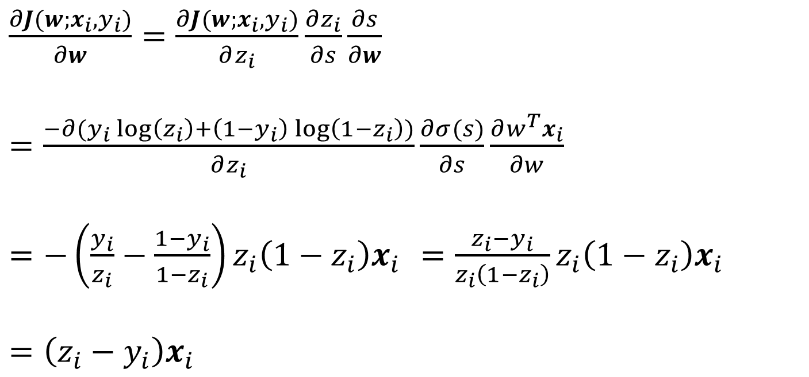
2. Logistic Regression
* Loss function and optimize method
Derivatives of loss function:
$\frac{∂J(w;x_{i},y_{i})}{∂w}=\frac{∂J(w;x_{i},y_{i})}{∂z_{i}}\frac{∂z_{i}}{∂s}\frac{∂s}{∂w}$
$=\frac{−∂(y_{i}\log\left(z_{i}\right)+\left(1−y_{i}\right)\log\left(1−z_{i}\right))}{∂z_{i}}\frac{∂σ(s)}{∂s}\frac{∂w^{T}x_{i}}{∂w}$
$=−\left(\frac{y_{i}}{z_{i}}−\frac{1−y_{i}}{1−z_{i}}\right)z_{i}\left(1−z_{i}\right)x_{i} =\frac{z_{i}−y_{i}}{z_{i}\left(1−z_{i}\right)}z_{i}\left(1−z_{i}\right)x_{i}$
$=\left(z_{i}−y_{i}\right)x_{i}$

Slide 19


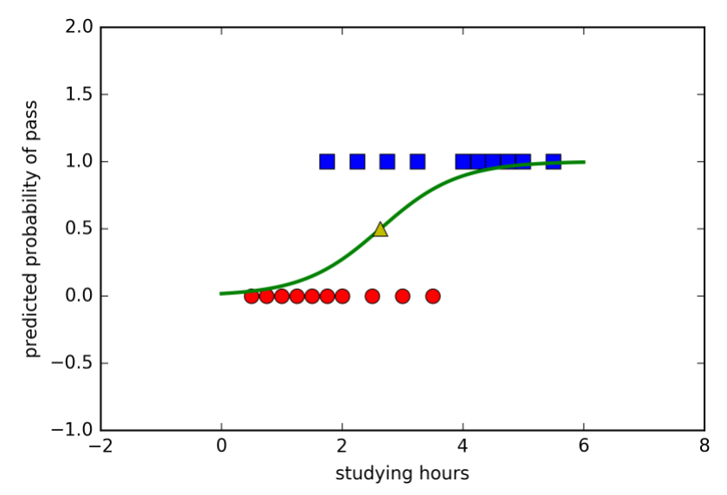
2. Logistic Regression
* Loss function and optimize method
Derivatives of loss function:
Update weight:

Slide 20
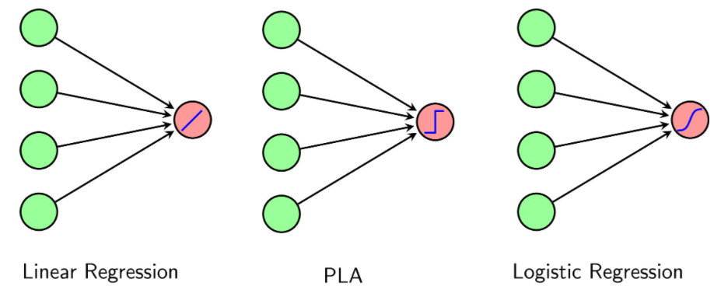
3. Softmax Regression
X
X
X
w
w
w
s
s
s
z
z
z

Slide 21
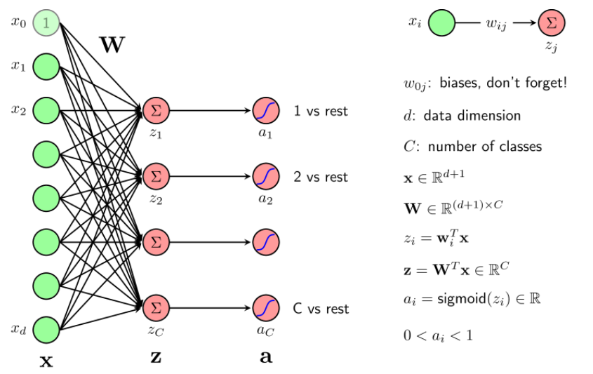
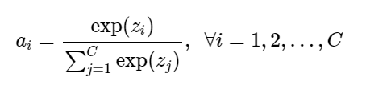
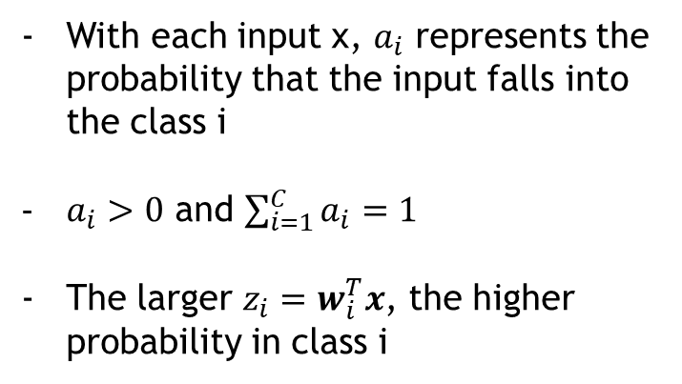
3. Softmax Regression
With each input x, $a_{i}$ represents the probability that the input falls into the class i
$a_{i}>0$ and $\sum_{i=1}^{C}{a_{i}=1}$
The larger $z_{i}=w_{i}^{T}x$, the higher probability in class i
* Softmax function:

Slide 22
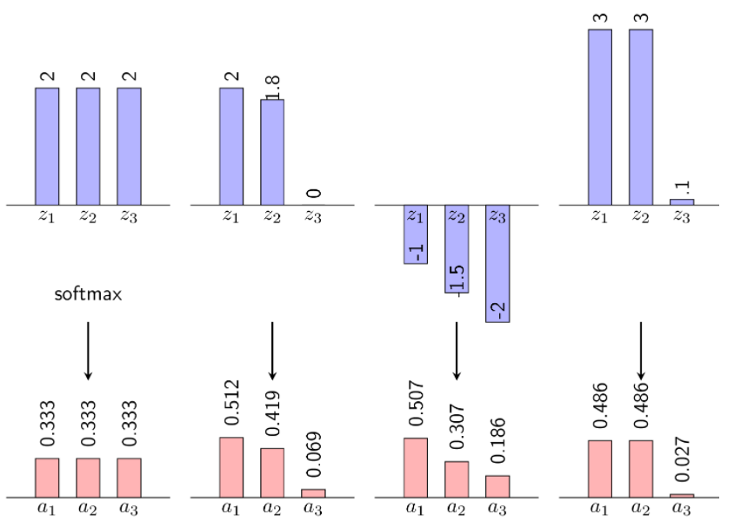


3. Softmax Regression
- Probability of a data is in class i:

Slide 23

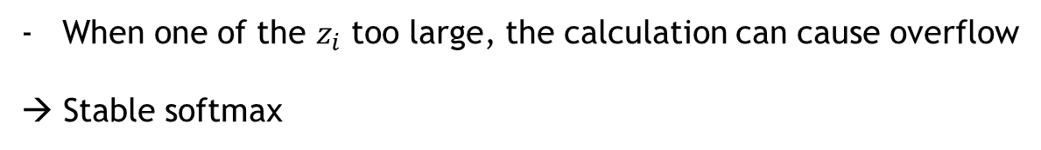
3. Softmax Regression
When one of the $z_{i}$ too large, the calculation can cause overflow
→ Stable softmax

Slide 24
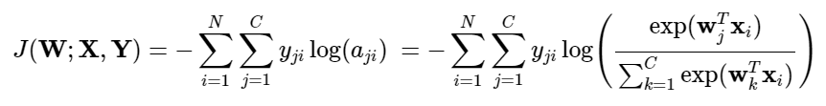



3. Softmax Regression
* Loss function:
* Loss function of each data $x_{i}$:

Slide 25
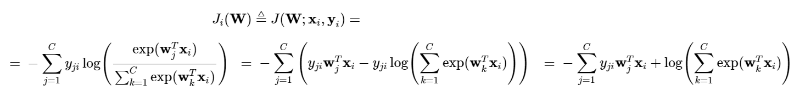



3. Softmax Regression
We use Stochastic Gradient Descent:
Next we use formula:
Update weight:

Slide 26
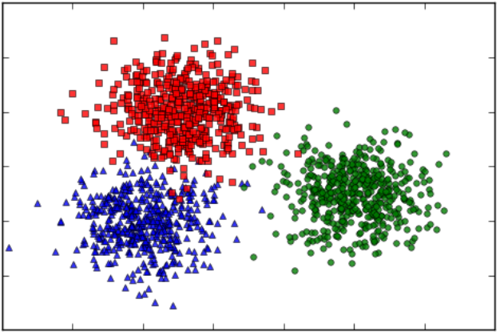
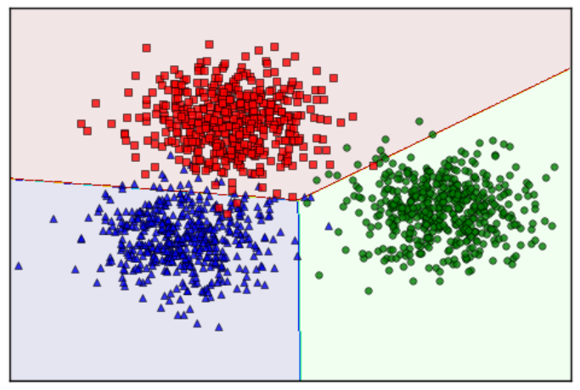
3. Softmax Regression

Slide 27
The end

