Slide 1
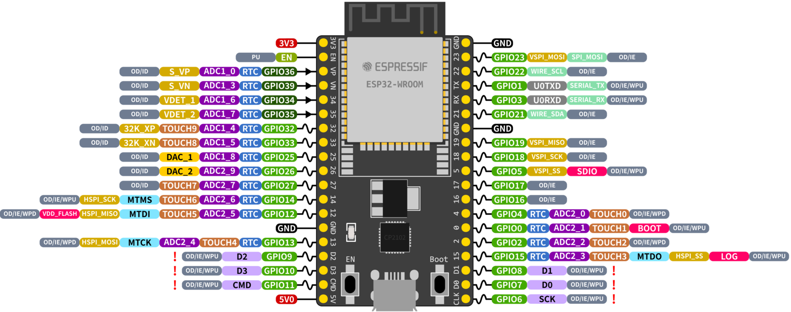
470KOhm
+
12V
-
100KOhm
To tank conductor 1
To tank conductor 2

