Slide 1
Campus Meal Ordering System
Team Foodie
Instructors: Bo An, Leong Yin Yoke Junie, Qiu Wei, Wang Rundong

Slide 2
Team Composition
Role | Name | Matriculation No.
Project Manager Frontend Developer | Ma Xiao | U1722964K
Lead Developer Backend Developer | He Yu Hao | U1722945E
Frontend Developer Release Engineer | Han Simeng | U1722715F
Frontend Developer QA Engineer | Loh Yi Xuan Renice | U1822247D
Backend Developer QA Manager | Yeoh Jun Yi | U1822869H

Slide 3
Outline
Product Introduction
Project Management
Technical Analysis
Design for Maintainability
Software Quality Assurance
Risk Management
Release Management

Slide 4
Campus Meal Ordering System
Key Features of CMOS
A platform for campus dining ecosystem, consist of 3 inter-linked applications:
Client
Vendor
Delivery man
Seamless interactions between 3 roles (clients, vendors and delivery men)
Clear order status track for clients
Safety: Integration with Google OAuth
Convenience: No need registration, just starts with Google!

Slide 5

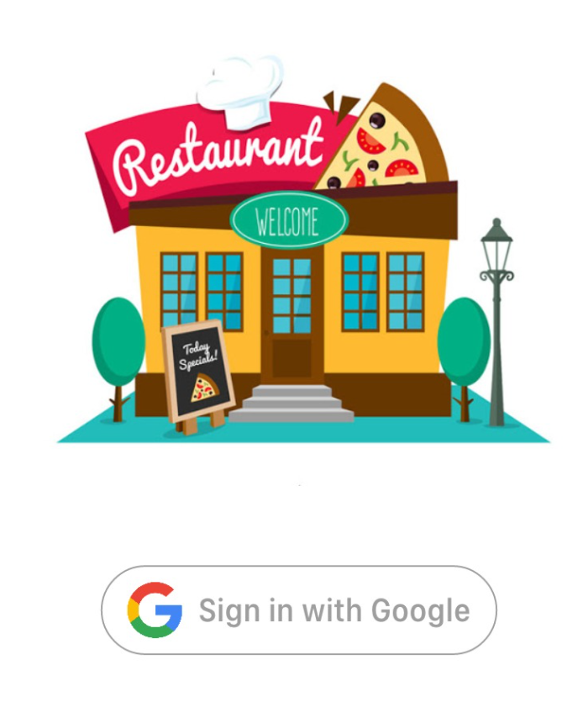

Campus Meal Ordering System: Login Page
Client | Vendor | Delivery Man

Slide 6
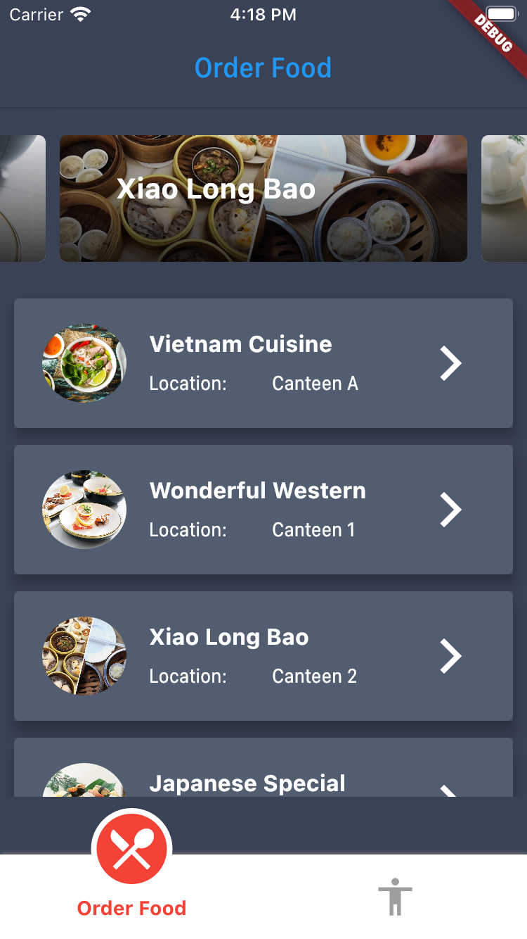
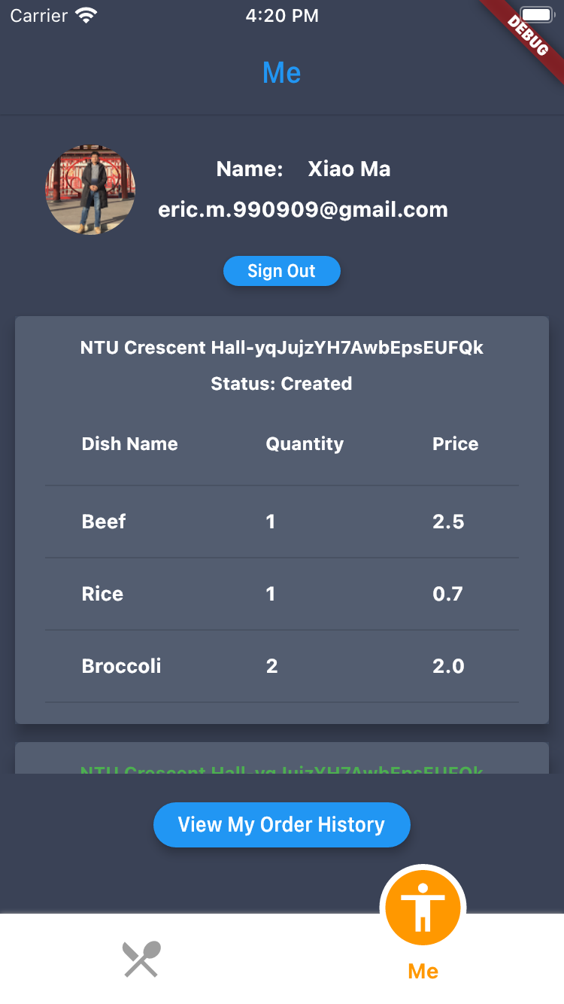
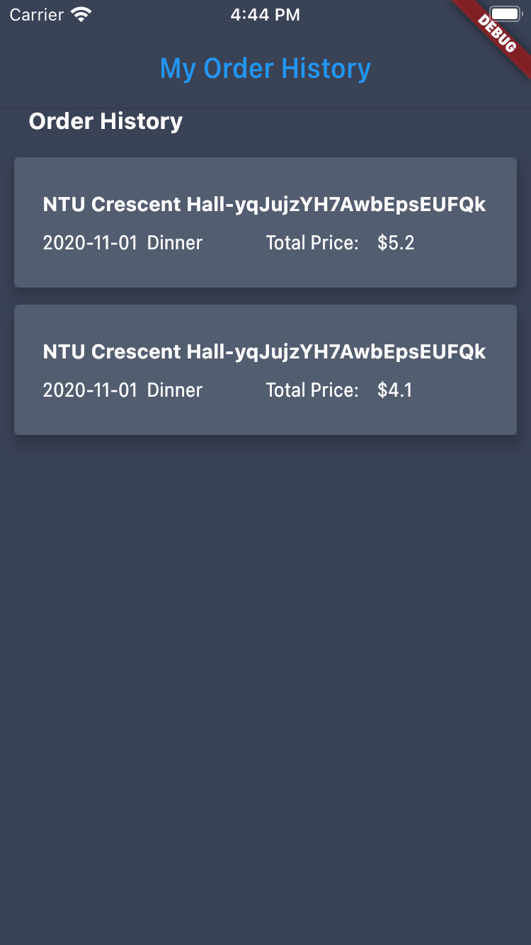
Campus Meal Ordering System: Client
Browse Restaurants | View Current Order | View Order History

Slide 7
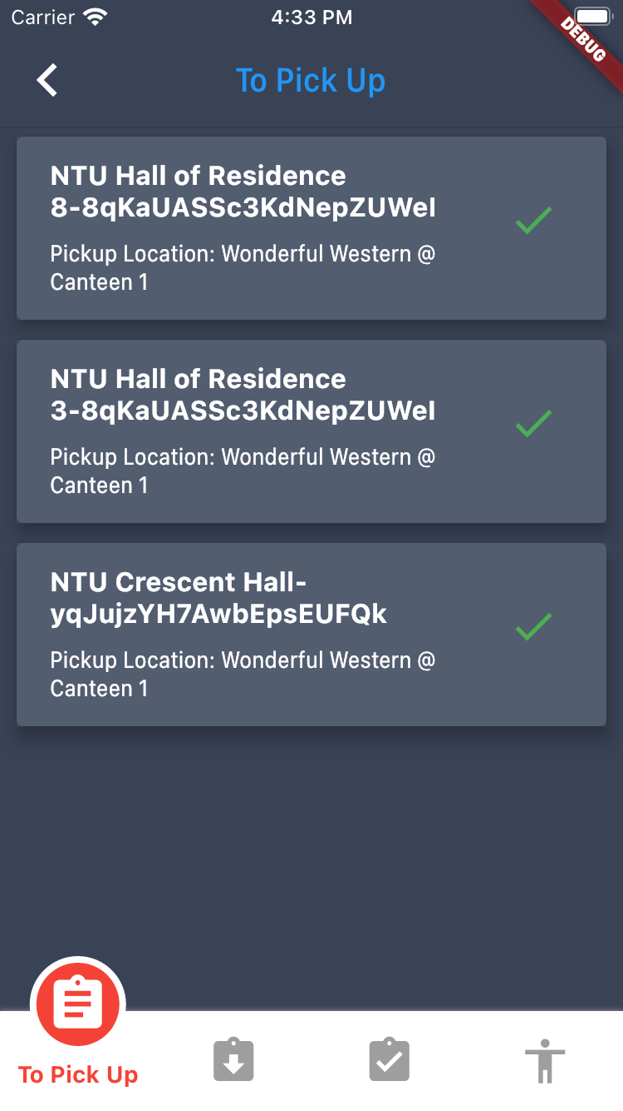
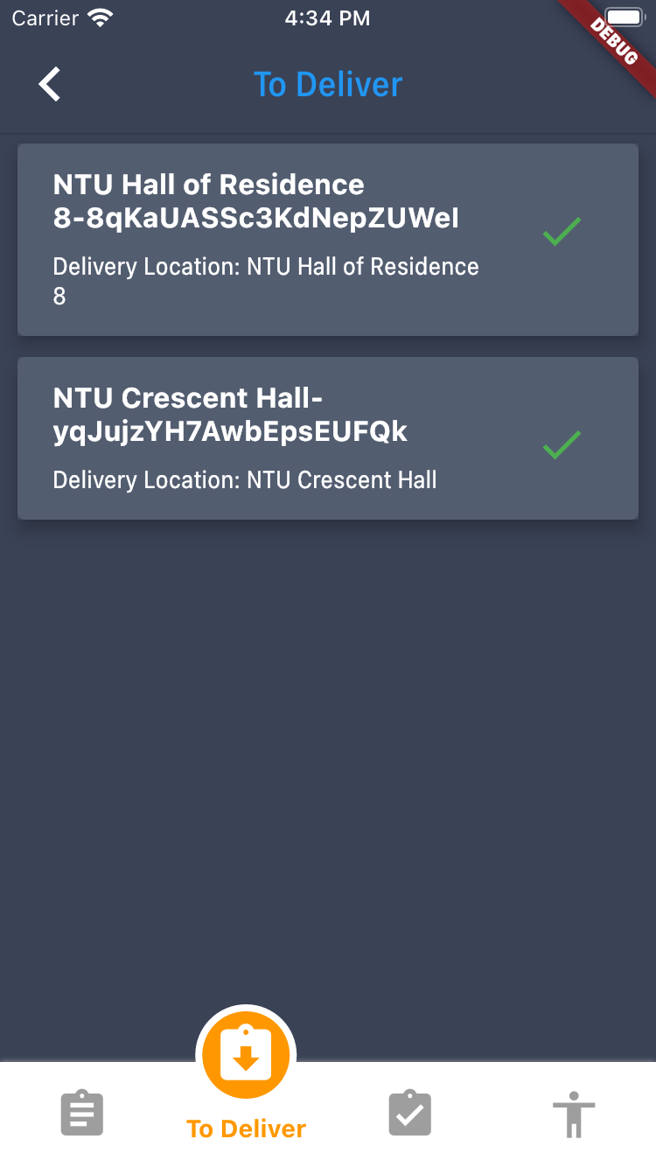
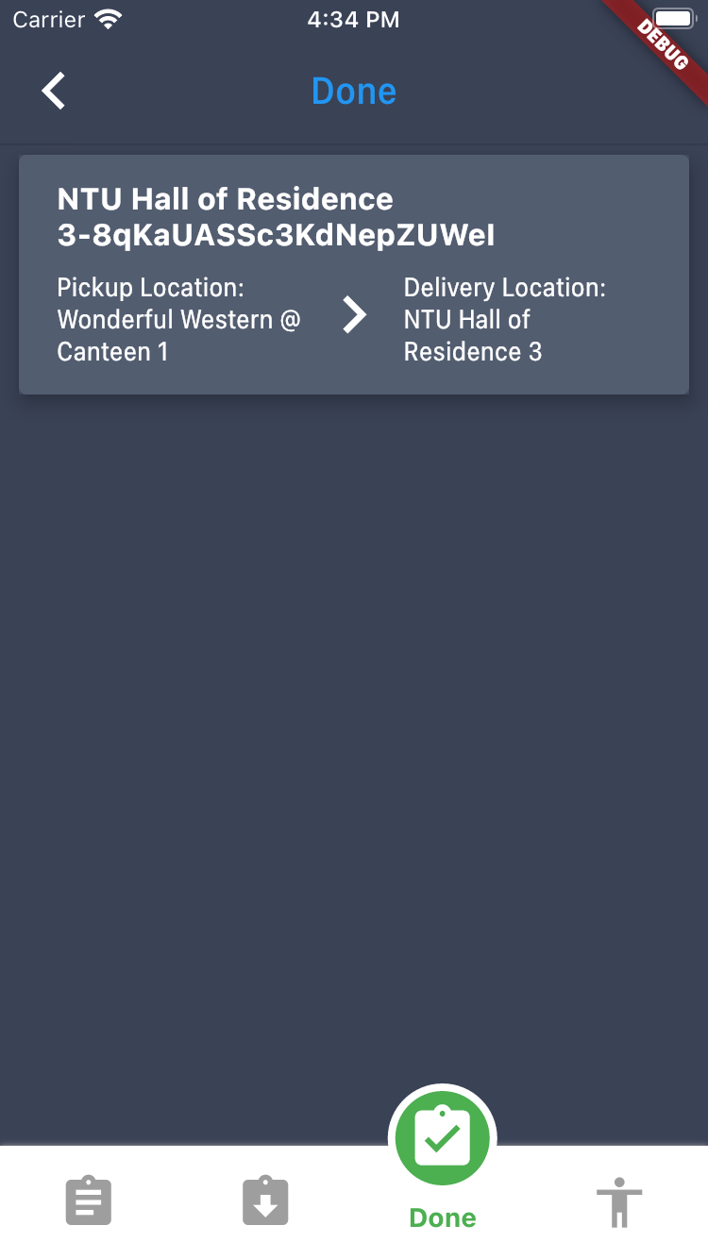
Campus Meal Ordering System: Delivery Man
Orders to be picked up | Orders to be delivered | View delivery History

Slide 8
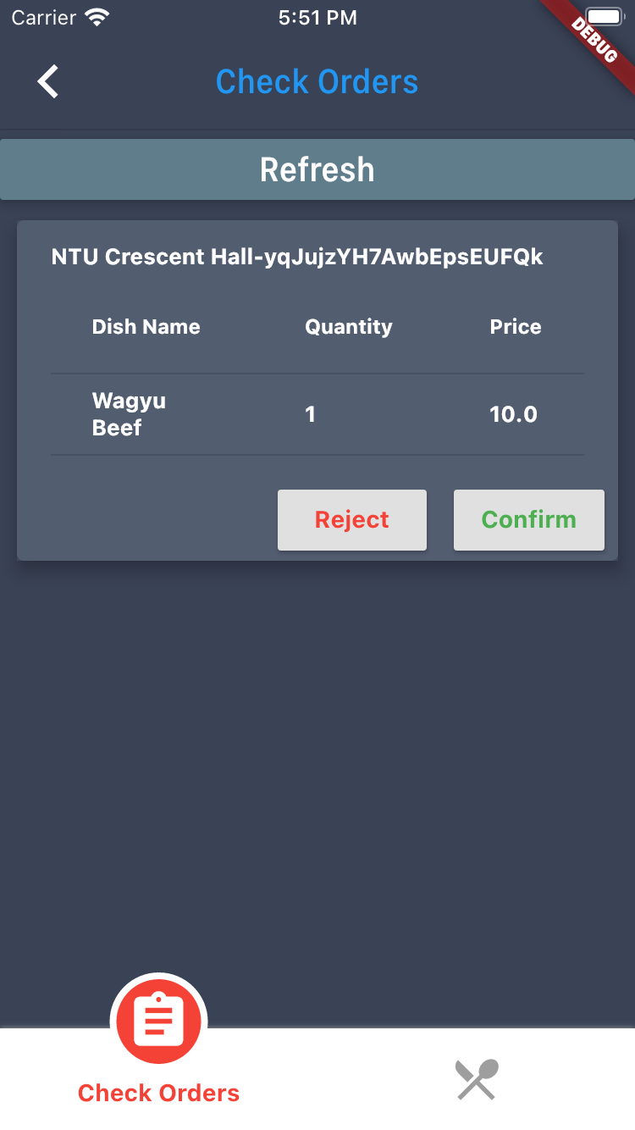
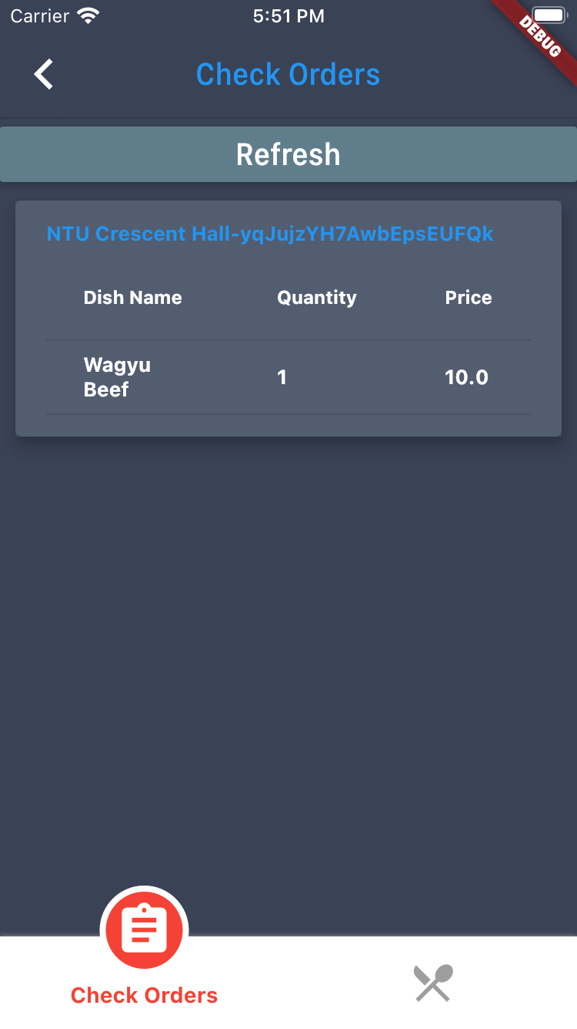
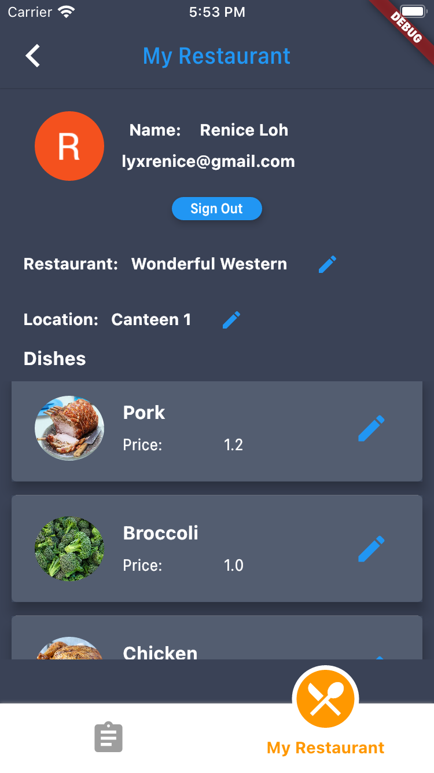
Campus Meal Ordering System: Vendor
Pending orders | Confirmed orders | View my restaurant

Slide 9
LIVE DEMO

Slide 10
Project Management

Slide 11
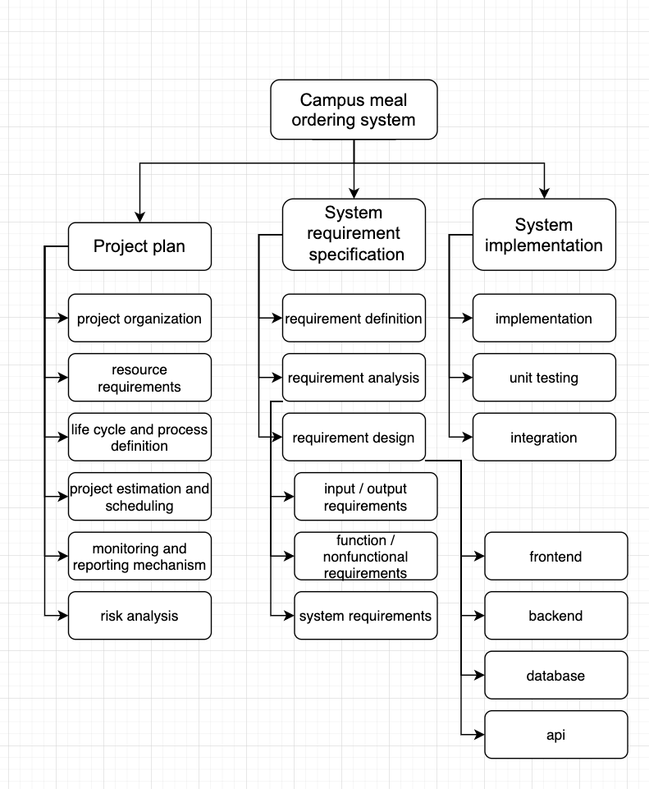
Project Management
Work Breakdown Structure
System Requirement Specification
Project Plan
System Implementation

Slide 12
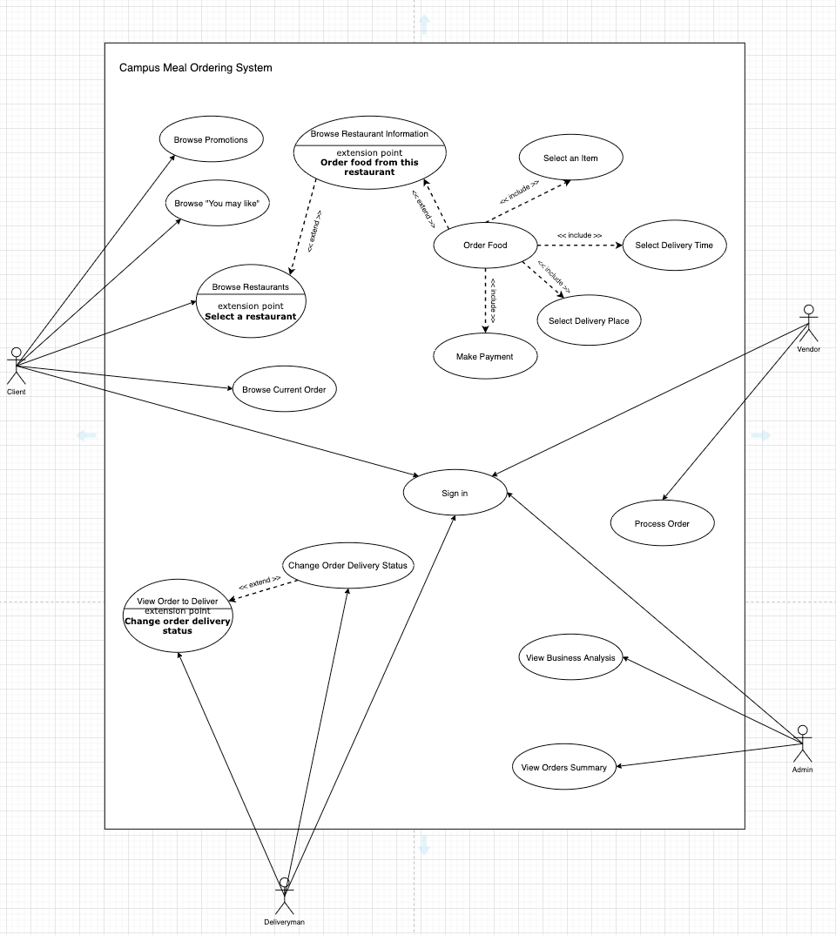
Project Management
System Requirement Specifications
Use case model
Functional requirements
Software requirements
Hardware requirements
Deployment requirements

Slide 13
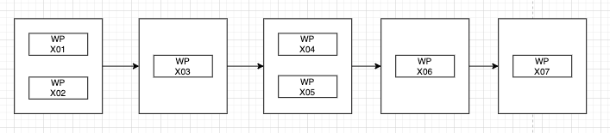
Project Management
Work Package # | Work Package Description | Duration | Dependencies
X01 | Project Proposal | 14 days | -
X02 | Requirement Specification | 7 days | -
X03 | Software System Design | 5 days | X01, X02
X04 | Frontend Services | 36 days | X03
X05 | Backend Services | 36 days | X03
X06 | Management Plan | 4 days | X04, X05
X07 | Test & Integration | 11 days | X06
Project Plan
Project breakdown structure
Activities dependencies
Project estimation
Function Point model estimation
Project timeline

Slide 14
Technical Analysis

Slide 15




Technology Tools

Slide 16



Collaboration Tools

Slide 17
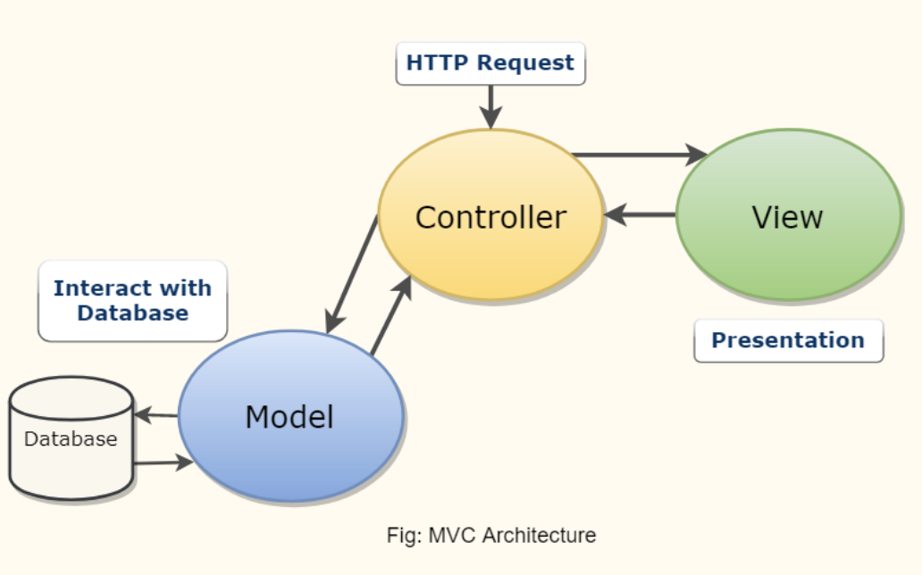
Design Pattern

Slide 18
Software Maintainability

Slide 19
Design for Maintainability
Early Planning
Anticipate of potential rising issues
Consideration of future features
Easy modification of features

Slide 20
Design for Maintainability
Maintainability Practices
Standardized Documentation
Version Control
Readable Code
Modularity
Notes:
●Usage of proper coding standards, convention and style
○System can be maintained easily if standards are adhered to
○Tools can be used to flag warnings of deviation in naming
●Usage of well known communication standards and formats
○Eg. REST API

Slide 21
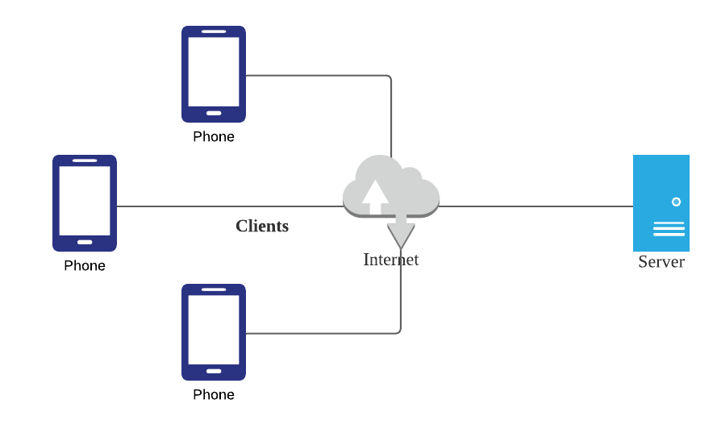
Design for Maintainability
Design Architecture
Server-Client Model

Slide 22
Software Quality Assurance Plan

Slide 23
Software Quality Assurance Plan
Requirement Specification
Identify project attributions
Review on client requirements
Review on software requirements
Software Design
Review on software design
Review on system architecture necessary to match client’s requirements
Software Development Life Cycle
Maintenance
Post-mortem meeting
Implementation
Review on test readiness
Review on system to determine if CMOS is aligned with client’s requirements
Testing
Review on test results

Slide 24
QA Metrics
Fan-in/Fan-out
Length of code
Cyclomatic Complexity
Length of identifiers
Depth of conditional-nesting
Fog of index

Slide 25
Risk Management

Slide 26
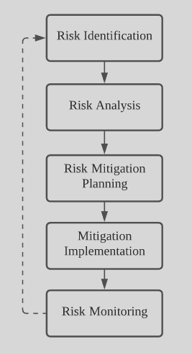
Risk Management
5-Step Process
Risk Identification
Risk Analysis
Risk Mitigation Planning
Mitigation Implementation
Risk Monitoring
Notes:
And now I will share about risk management of our project. We have a 5 step process namely, risk identification, analysis, mitigation, implementation and lastly monitoring.

Slide 27
Risk Management: Identification
Risk Types
Technical
Project Management
Resource Management
Political
Project Team
Notes:
Firstly, we have risk identification. We have identified the following risk types for our project: technical, project management resource management, political and project team.

Slide 28
Risk Management: Identification
Technical
Database overload
External attacks on server
Loss of data
Inadequacy of technical personnel

Slide 29
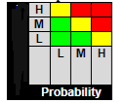
Risk Management: Analysis
Risk
Probability of occurrence
High - More than 70%
Medium - Between 30% to 70%
Low - Less than 30%
Severity
Low, medium, high
Based on the impact it has on the project schedule, cost and performance
Impact
Severity
Notes:
Once we have identified the risks, we will then analyse it. Depending on the probability of occurrence, they will be rated - low, medium or high. Next, we will analyse the severity and give a rating based on the impact it has on the project schedule, cost and performance. With the ratings of both the probability and the severity, the risk will be categorised red, yellow or green as shown on the graph. Risks that fall within the RED or YELLOW zones will have risk response planning which may include both a risk mitigation and a risk contingency plan.

Slide 30
Risk Management: Analysis
Risk | Probability | Severity | Impact
Loss of Data | Low | High | Project schedule disrupted Disclosure of confidential information
Key person risk | Medium | High | Project schedule disrupted
Notes:
Here are some examples of risk analysis. For Loss of Data, the probability is low, but the severity is high, therefore its risk is assessed to be in the yellow zone. And the impact on the project are schedule disruption and disclosure of confidential information.

Slide 31
Risk Management: Planning and Implementation
Methods
Avoid
Mitigate
Transfer
Accept
Notes:
Following the analysis, we will plan on ways to tackle the risk in the yellow or red zone. There are four approaches to take.
We avoid the risk by removing the threat and eliminating the cause
We mitigate the risk by Identifying ways to reduce the probability or the impact of it
We transfer the risk by making another party responsible such as buying insurance, outsourcing, etc
We accept the risk and nothing will be done.

Slide 32
Risk Management: Planning and Implementation
Risk | Approach | Mitigation Strategy
Key person risk | Mitigate | Organise team to ensure increased overlap of work roles between team members to encourage cross understanding of domain areas and to ensure that work is able to continue regardless. Ensure there is a proper chain of command in place to provide smooth succession in the event of personnel loss.
Notes:
For example, for a key person risk, the approach we will take is mitigation. Our mitigation strategies consist of reorganising the team to ensure increased overlap of work roles between team members such that the members understand each other’s domain areas so that work is able to continue regardless. Also, there should be a proper chain of command in place to provide smooth succession in the event of personnel loss.

Slide 33
Risk Management: Monitoring
Monitored throughout project lifecycle
Risk assessment done bi-weekly
Standard Operating Procedure (SOP) Document
Notes:
Lastly, after mitigating risk, the risk will be montiroed throughout hte project lifecycle. .
Every fortnight there would be a risk assessment done for new potential risks and risks that have already been identified should be reassessed for changes in likelihood.
Also, a standard operating procedure (SOP) document should be released for steps the team should take to mitigate select risks.

Slide 34
Release Plan

Slide 35
Release Plan: Assumptions, Constraints
Assumptions:
Team composition
Indefinite support for the technologies: Flutter, Android, IOS
Constraints:
Short develop time

Slide 36
Release Plan: Risks
People risk
Development environment risk
Time estimation risk
Requirement risk
Stakeholder risk

Slide 37
Release Approach: Rationale and Strategy
Rationale
Application fulfilling the requirements
Testing must be done before release
Strategy
First version: important and critical features
Subsequent versions: less important features; tested before release
Content: client, vendor and deliveryman apps
Schedule
Impacts
Notification: team members and end-user

Slide 38

THANK YOU!
Does anyone have any questions?
Notes:
Thank you!

