Slide 1
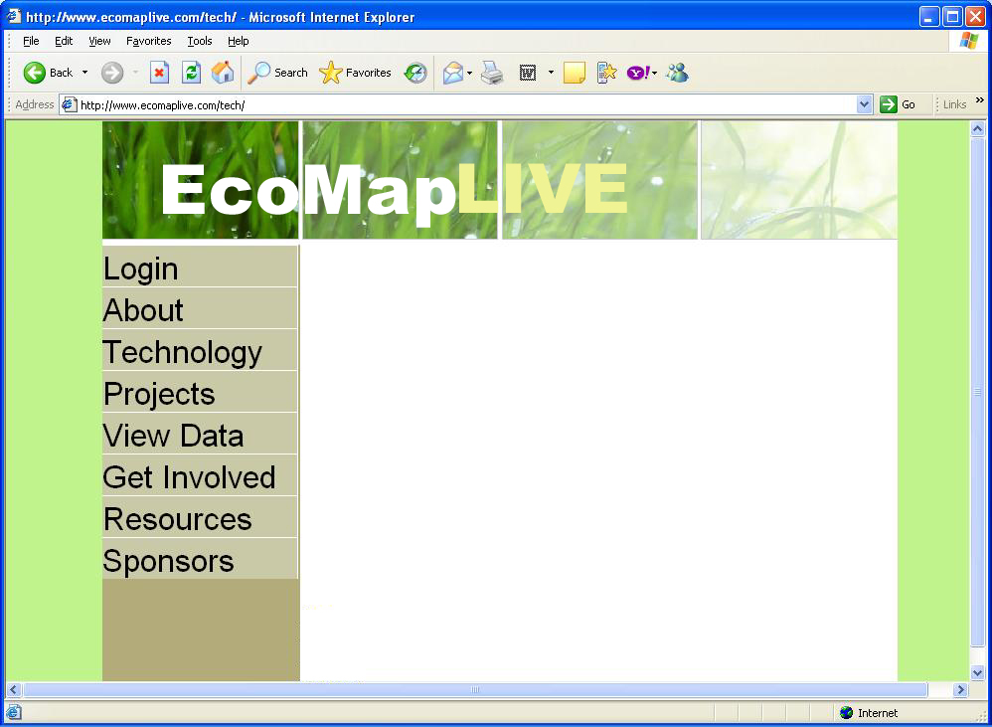
This is .JPG
If the font were slightly smaller, maybe this column could be thinner and leave more space for the main page?

Slide 2
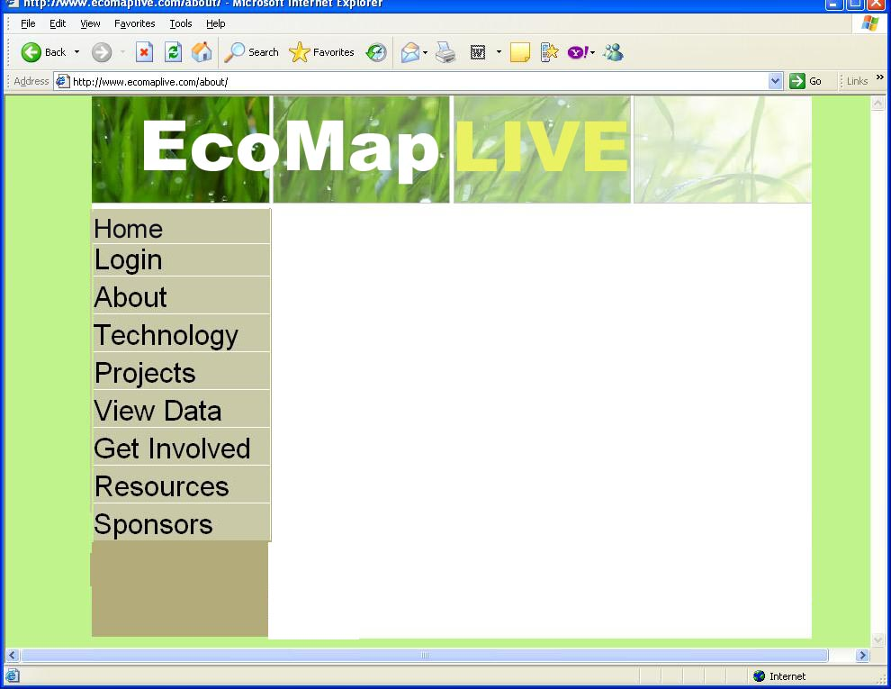
Notice I added a HOME link
This is .JPG with slightly larger title

Slide 3

This is .PNG – note colors

Slide 4
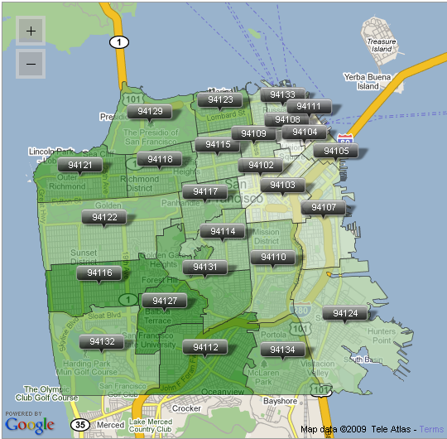
Home page
MapItNow!
Click here to use our online mapping tool.
EcoMapLive is a simple platform that enables people to create and share maps of sensor data. To learn more about the system, click here.

Slide 5
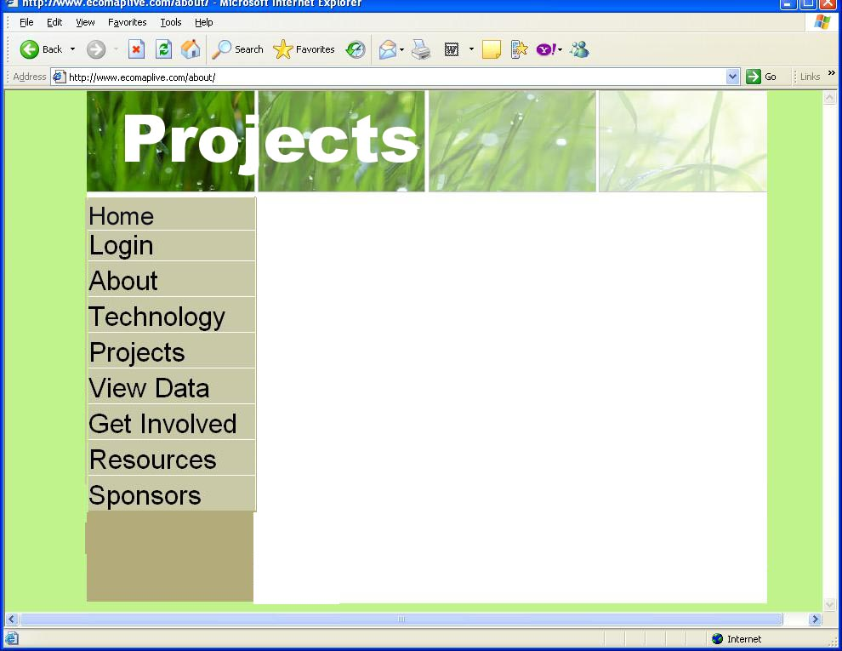
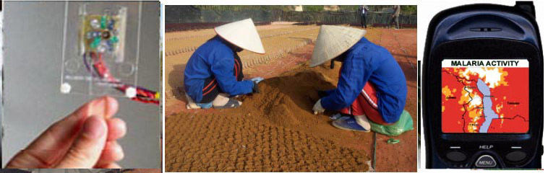
CitiSense Project
The CitiSense project applies a citizen science approach to the urban environment.
BlueView Project
BlueView uses Bluetooth as a proxy for visualizing the flow of people and vehicles

Slide 6


Slide 7


Slide 8


Slide 9
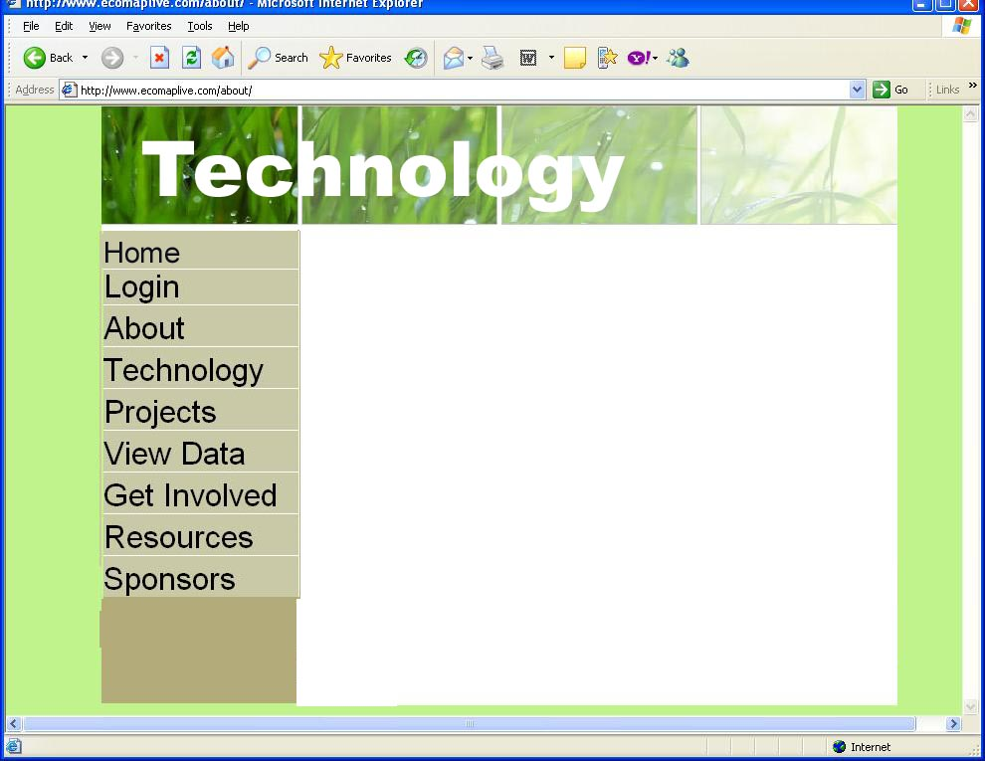

Slide 10
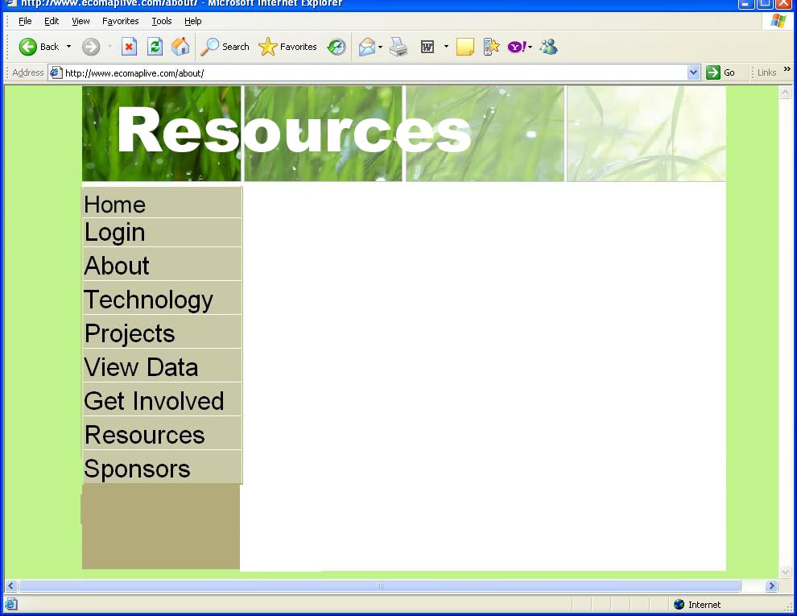
EPA
Columbia Water project
Urbanecomap.org
CENS (at UCLA)
Etc.

