Slide 1
Controlled Contactless Entry System (C²-EZ)
Purdue School of Engineering and Technology
Electrical Computer Engineering (ECE): Christopher Raymond, Vineetha Chatla

Slide 2
Problem statement
The challenge at hand is to create a safe and healthy workplace environment amidst the ongoing threat of infectious diseases. By adopting proactive measures and early detection devices, we aim to minimize the spread of disease between coworkers and promote employee wellbeing.
This problem is critical to address as it impacts the health and safety of our team members and addressing it will help us maintain business operations and foster a productive work culture.

Slide 3
Introduction
The COVID-19 pandemic has had far-reaching impacts on the United States, costing an estimated 16 trillion dollars when accounting for the loss of life, economic damages, and healthcare expenses, according to data published by John Hopkins. Understanding the full extent of the pandemic's impact is critical in mitigating future outbreaks and preventing similar losses.
As the world continues to adapt to the COVID-19 pandemic, companies are beginning to make plans for the future of work. According to Resume Builder 9/10 companies plan to require their employees to work in the office by 2023. This shift towards in-person work has important implications for employee safety, health, and productivity.
The pandemic-related absenteeism that many companies have experienced has resulted in significant financial losses. According to EBN , at the height of the pandemic, pandemic-related absenteeism was creating $1 billion in employer losses each week. By understanding the financial impact of the pandemic on businesses, employers can take steps to mitigate future losses and promote employee wellbeing.
Despite the ongoing efforts to control the COVID-19 pandemic, the potential for future outbreaks remains. According to Duke Global Health Institue , the statistical likelihood of another global pandemic occurring within the next few years is 38%. Understanding the likelihood and potential impact of future pandemics is crucial in taking proactive steps to prevent their spread and minimize their impact on public health and the economy.

Slide 4
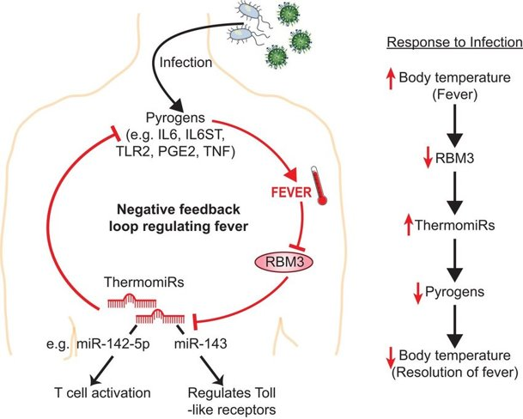
Fever and contagious infections
In general, many contagious respiratory infections, such as the common cold, flu, or COVID-19, can cause a fever in a significant percentage of cases.
According to the Centers for Disease Control and Prevention (CDC), fever is a common symptom of COVID-19, occurring in approximately 83-99% of cases.

Slide 5

COMPEDITORS DESIGN
COST 181.37

Slide 6
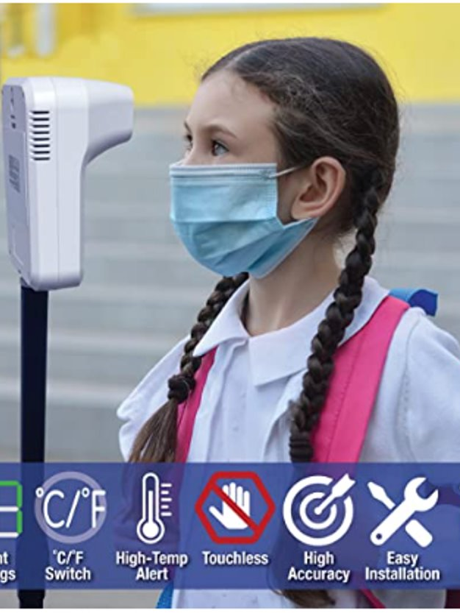
PROTOTYPE DESIGN
COMPONENT | COST (USD)
FRDM K64 | 9.70
MLX90614 (IR SENSOR) | 23.11
PN5180 (NFC SENSOR) | 10.67
GROVE SENSOR | 4.99
WIFI SENSOR | 2.99
3-D CASING PRINT | 7.85
ESTIMATED TOTAL | 59.31

Slide 7
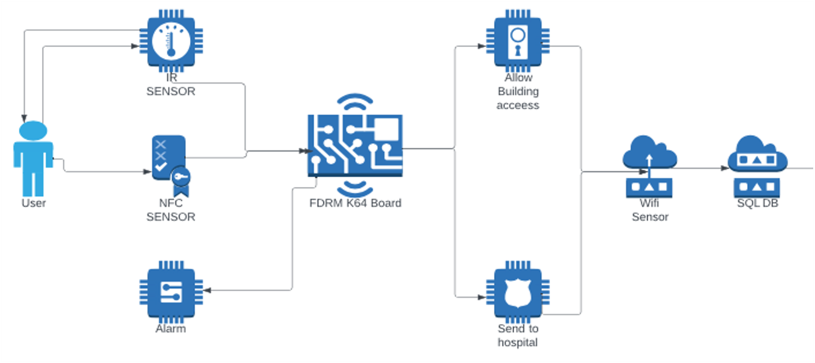
Block diagram

Slide 8

Sensors

Slide 9
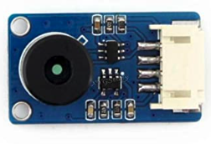
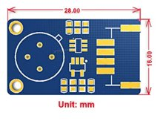
MLX90614
Infrared Temperature Sensor
Measures the surface temperature of an object without touching it, depending on the emitted IR waves of the target.
Also measures the average temperature over an area.
Contact-less, high precision, high resolution, fast response.
Calibrated before delivery, with gradient temperature compensation.
Works with 3.3V/5V MCU system directly, thanks to the built-in level translation.
Cost $27.99

Slide 10
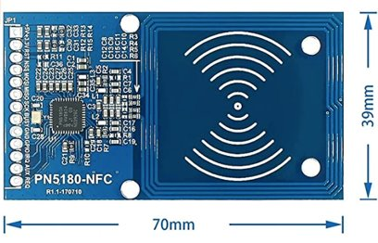
PN5180 Module NFC Module
PN5180 can support more cards with different protocols (ISO / IEC 18092.14443 A / B, FeliCa, 15693)
Adding the DPS function can increase the stability of the reception (easier to pass EMV improve antenna feedback).
PN5180 supports card emulation and PEER TO peer mode.
Module uses serial peripheral interface SPI
Application: Pay, Physical access control, E-government, Industrial control
Cost $15.90

Slide 11
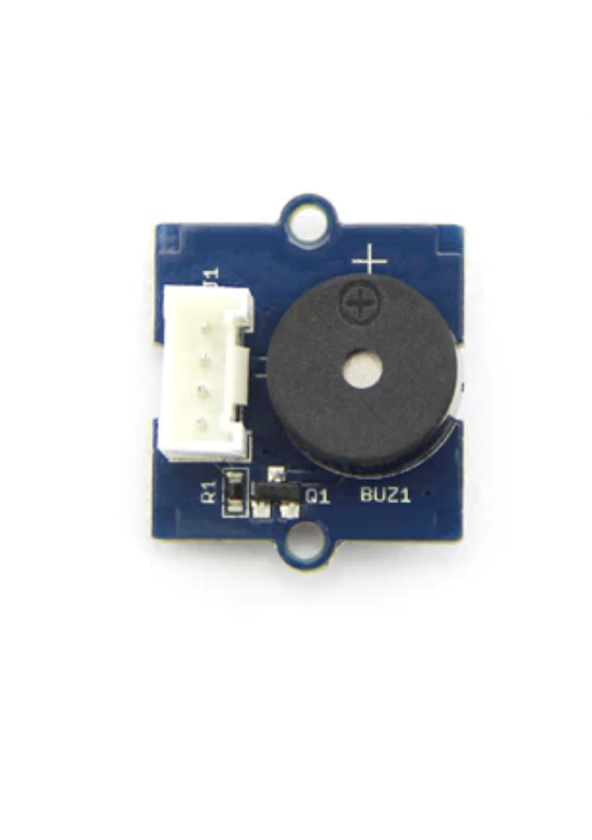
Grove Buzzer sensor
Operating voltage: 4-8V
Sound output: >=85 dB
No complex driver is required
Toggle the buzzer on or off by setting the GPIO output to 1 or 0.
Connect the grove cable to the buzzer and the grove digital output.

Slide 12
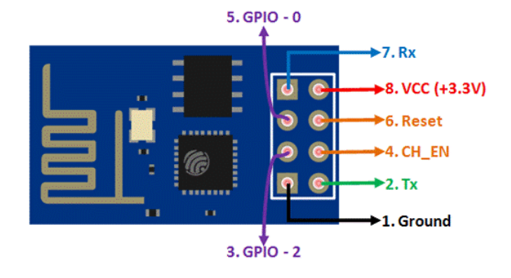
ESP 8266 WIFI Sensor

Slide 13
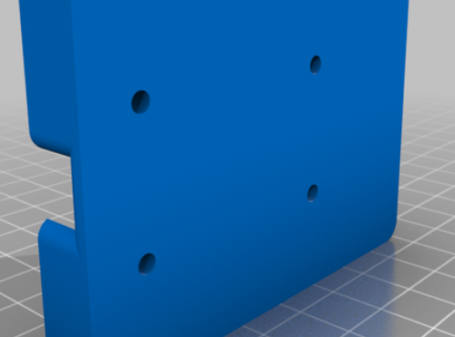
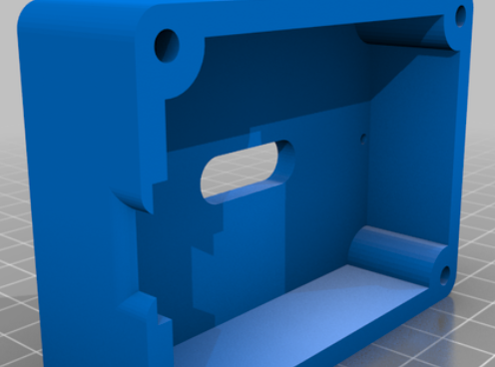
FRDM-K64 / NFC / WIFI CARD HOUSING

Slide 14
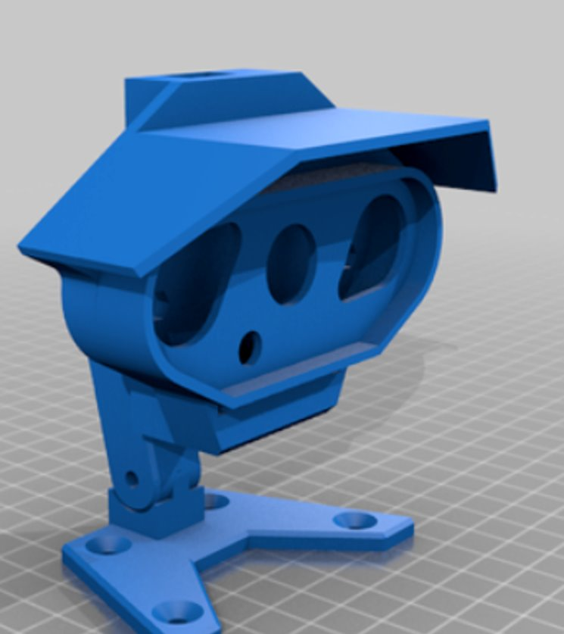
IR TEMPERATURE HOUSING

Slide 15

DEMOSTRATION 1
INSERT VIDEO

Slide 16
DEMOSTRATION 2
INSERT VIDEO

Slide 17
DEMOSTRATION 3
INSERT VIDEO

Slide 18

GITREPO AND RESOURCES
CLICK --> GITHUB REPO

