Slide 1


Localized Voice Assistant for Senior Citizens
Hey
Lumi !!
Presented by:
24B91A0408 – A. Sravanthi
24B91A0457 – G.P.S. Lakshmi
24B91A0462 – G. Pavani
24B91A0467 – G. Yasaswini
24B91A0468– G. Rekha
24B91A0472 – I. Harshini

Slide 2
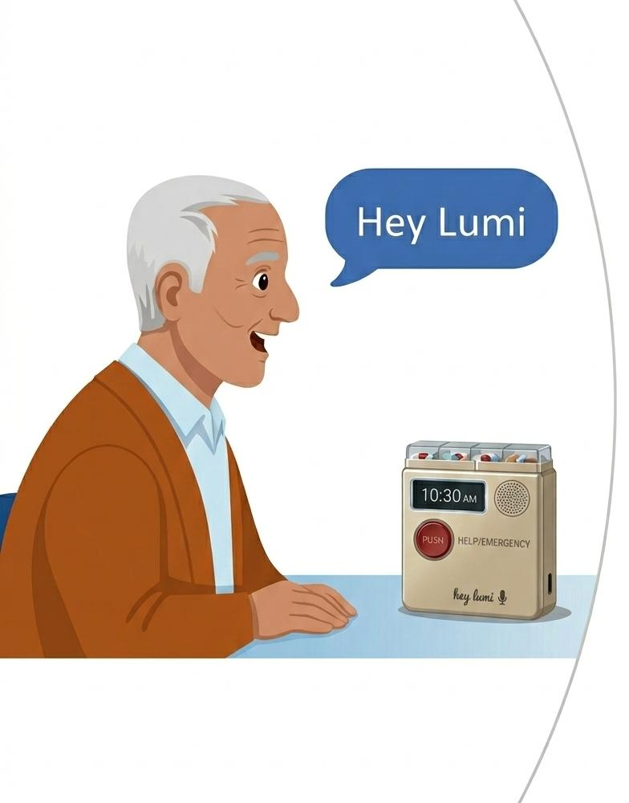
Introduction
The Problem Today
Senior citizens struggle with complex digital devices.
Medicines and emergency situations are not managed effectively.
Many smart assistants depend on continuous internet connectivity.
Why We Built Lumi
Activated by saying “Hey Lumi” or pressing one large button.
Provides Telugu voice reminders for medicines and appointments.
Includes voice and manual emergency activation.
Designed as a privacy-focused standalone assistant.

Slide 3
Stakeholders – QBL Analysis
Key Stakeholders | Problem | Quick | Bold | Long Lasting
Senior Citizens (Primary Users) | Offline localised voice assistant Emergency help button with voice Local voice news & weather announcer Local language fall detection voice alert | ✅ ✅ ✅ ✅ | ✅ ✅ ✅ | ✅ ✅
Family Members | Medicine Remainder Health monitoring Home safety alerts with warnings Voice assistant for visually impaired | ✅ | ✅ ✅ ✅ | ✅ ✅
Caretaker: Companies – Care Takers Old Age Homes | voice based appointment remainder Daily routine voice remainder Emergency voice call to contacts Voice guided medication identification | ✅ ✅ ✅ ✅ | ✅ ✅ | ✅ ✅ ✅ ✅

Slide 4
Problem Statement
Identifying the key difficulties affecting elderly independence and safety:
Missed medicines & appointments
Digital Complexity
Smartphones are difficult to operate
Health & Safety Risks
No immediate emergency response
Frequent updates confuse elderly users
Smart assistants stop without Wi-Fi
Connectivity Dependency
Power cuts reduce reliability
Language & Emotional Gap
Limited regional language support
Lack of daily interaction & companionship

Slide 5
Need for the Proposed System
🚨 Safety Need
Faster emergency response
Reliable alerts during power interruptions
💊 Health Support
Timely medicine and appointment reminders
Automated daily help
🌐 Accessibility Need
Simple voice-based interaction
Regional language support
❤️ Emotional Support
Improves confidence and independence
A reliable voice-based assistive system is essential.

Slide 6
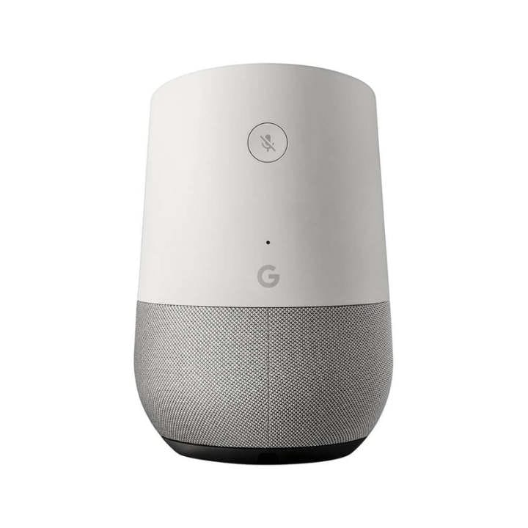
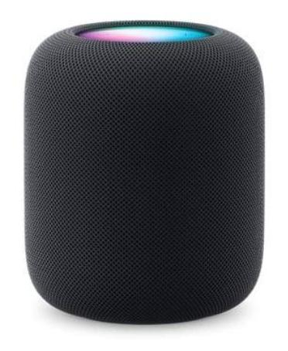
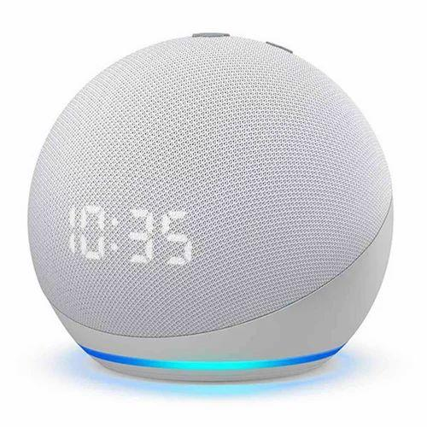
Existing Systems & Limitations
🖥️Existing Systems
Smart voice assistants (Alexa, Google Assistant, Siri)
Smartphone reminder applications
Smart home automation devices
Wearable emergency alert systems
🟥Limitations
Require continuous internet connectivity
Complex setup for elderly users
Limited regional language support
High implementation cost
Dependence on cloud connectivity
Dependence on smartphones or external devices
Lack of personalized elderly-focused features
Alexa
Google Assistant
Siri

Slide 7
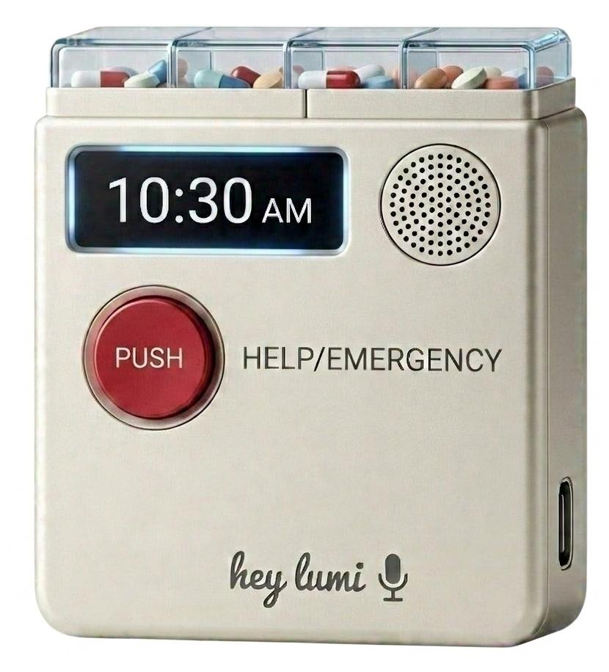
Objectives
Design a localized, senior-friendly voice assistant
Provide automatic medicine and appointment reminders
Enable emergency activation via voice and button
Support Telugu voice interaction
Implement priority-based task management
Display real-time clock and battery status on OLED display

Slide 8
Our Proposed System
System Concept
Localized Offline Voice Assistant designed specifically for senior citizens.
Key Features
Works completely offline
Supports regional languages
Simple voice-based interaction
Emergency SOS alert system
Medicine & appointment reminders
How It Solves the Problem
No internet dependency
Quick emergency communication with caregivers
Fast emergency communication
Low-cost & privacy-friendly
Enables safe and independent living
Optimized for rural and low-network areas
Focused on safety, health, and daily assistance
Single-button activation system
Low power consumption design
Reduces complexity for elderly users
Supports regional communication barriers
Customizable voice commands
Faster response compared to cloud assistants

Slide 9
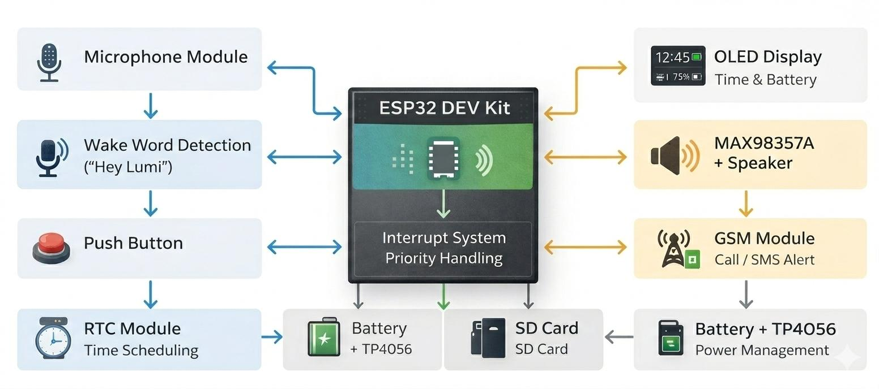
System Architecture Diagram
ESP32 acts as the central processing and control unit
Voice, button, and scheduled inputs are handled using a priority-based system
Emergency can be triggered by voice command or long-press button
System operates using a standalone embedded architecture with rechargeable battery backup.

Slide 10
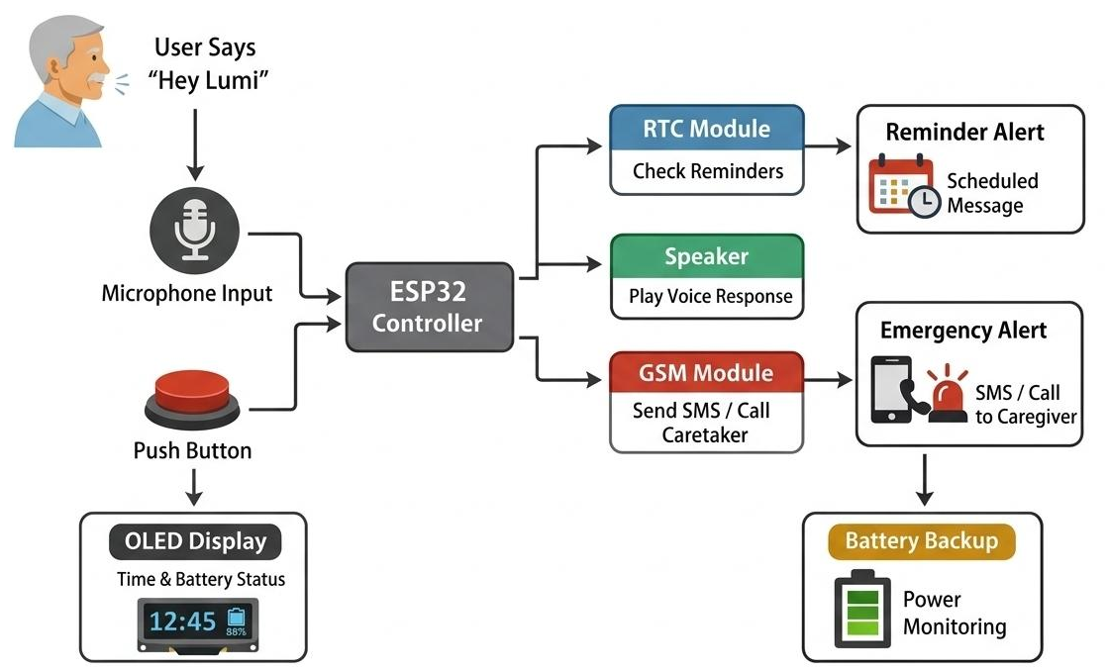
Block Diagram

Slide 11
Hardware Components Overview
1. Core Processing Unit
2. Audio Interface System
Microphone – Captures voice commands
Amplifier + Speaker – Voice output & reminders
5V Active Buzzer – Alert notifications
3. User Interaction
Large Push Button – Wake input & emergency trigger
OLED Display – Time, battery & system status display
4. Safety & Communication
GSM Module (SIM900L) – Emergency calls & SMS alerts
5. Reminder & Storage System
RTC Module – Accurate timekeeping
SD Card Module – Stores audio files & logs
Servo Motor – Controls medicine box compartments
7. Power Management
Li-ion Batteries – Portable power supply
Charging Module – Charging & protection
Switch – Power control
8. Supporting Components
Jumper wires, resistors, breadboard, USB cable – Circuit assembly
ESP32 DEVKIT V1 – Main control and processing unit

Slide 12
Task Priority & Interrupt System
Emergency
Companion interaction
Medicine & Appointment Reminders
Safety Alerts
Interrupt System
Higher-priority tasks override lower-priority tasks
Emergency stops all ongoing functions instantly
Button Control
Long Press → Emergency Mode
Short Press → Active Listening Mode

Slide 13
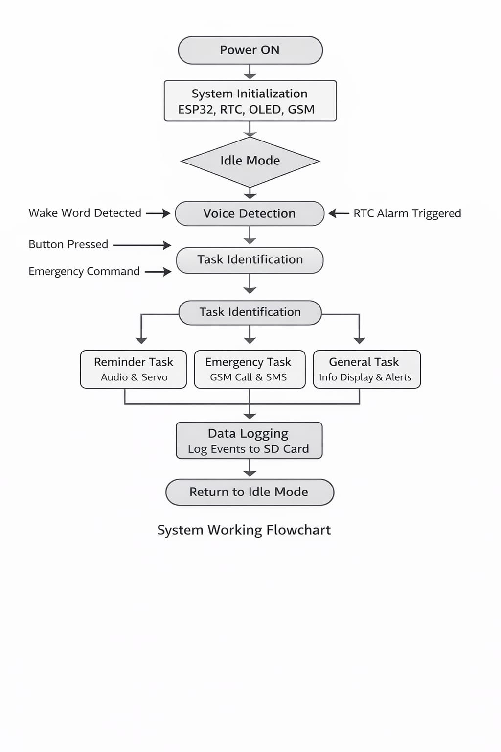
System Working Flowchart

Slide 14
Safety & Security Features
Voice trigger command: “Help”
Long-press button activation
Immediate task interruption
GSM-based alert notification system
Priority override mechanism

Slide 15
Future Enhancements & Innovations
🧠Improved Voice Recognition Enhance accuracy and support multiple local languages.
📱Caregiver Mobile Alerts Send emergency notifications to a mobile app for faster response.
🏠Smart Home Control Control lights, fans, and other appliances through voice commands.
💊Automated Medicine Dispenser Integrate a smart medicine box for automatic pill dispensing.
📍Location Tracking for Safety Add GPS module to track the user location during emergencies.
🤖AI-Based Health Monitoring Future integration with sensors to monitor health conditions.

Slide 16
Applications & Social Impact
🏠
Applications
Suitable for homes, old age homes, rural healthcare centres, assisted living facilities, and community-based senior support programs.
🌍
Social impact
Improves safety and independence of senior citizens, reduces caregiver stress, and enables reliable emergency support.
👥
Target Users
Senior citizens living independently, elderly individuals in assisted care environments, and caregivers checking remotely.

Slide 17
Conclusion
Safe & Offline - Telugu voice assistant for seniors
Medicine & Appointment Reminders – Automated alerts
Emergency Alerts – GSM calls & SMS to caregivers
Smart Home Control & Companionship – Voice based interaction
Portable & Privacy-Friendly – Expandable design for future sensors
Lumi is a reliable, language-friendly, and safety-focused voice assistant designed to enhance independence and confidence among senior citizens.
Thank YOU!!

