Slide 1
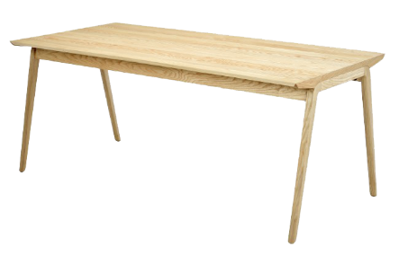

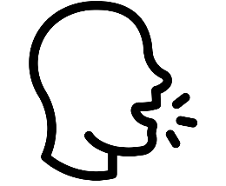
Semantic representations
Phonological representations
Catalan
Visual recognition
Phonological retrieval
/’taw.lə/
Articulation

Slide 2
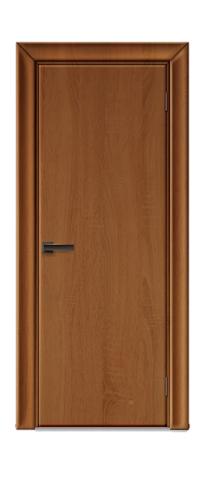
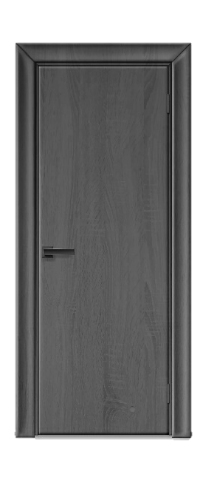
Semantic representations
Phonological representations
Catalan
/’taw.lə/
Articulation
Visual recognition
Phonological retrieval
/’me.sa/
Spanish

Slide 3
Semantic representations
Phonological representations
Catalan
/’taw.lə/
Articulation
Visual recognition
Cross-language activation
Phonological retrieval
/’me.sa/
Spanish

Slide 4


Phonological representations
Semantic representations
Catalan
Repeated exposure
Word learning
/’taw.lə/
/’taw.lə/

Slide 5
Phonological representations
Semantic representations
Catalan
/’taw.lə/
/’taw.lə/
/’me.sa/
/’me.sa/
Spanish

Slide 6
Phonological representations
Semantic representations
Catalan
/’taw.lə/
/’taw.lə/
Cross-language link
/’me.sa/
/’me.sa/
Spanish

Slide 7
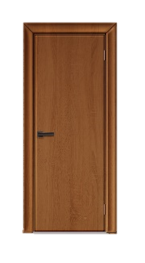
Phonological representations
Semantic representations
Catalan
/’pɔɾ.tə/
/’pɔɾ.tə/
/’pweɾ.ta/
/’pweɾ.ta/
Spanish

