Slide 1




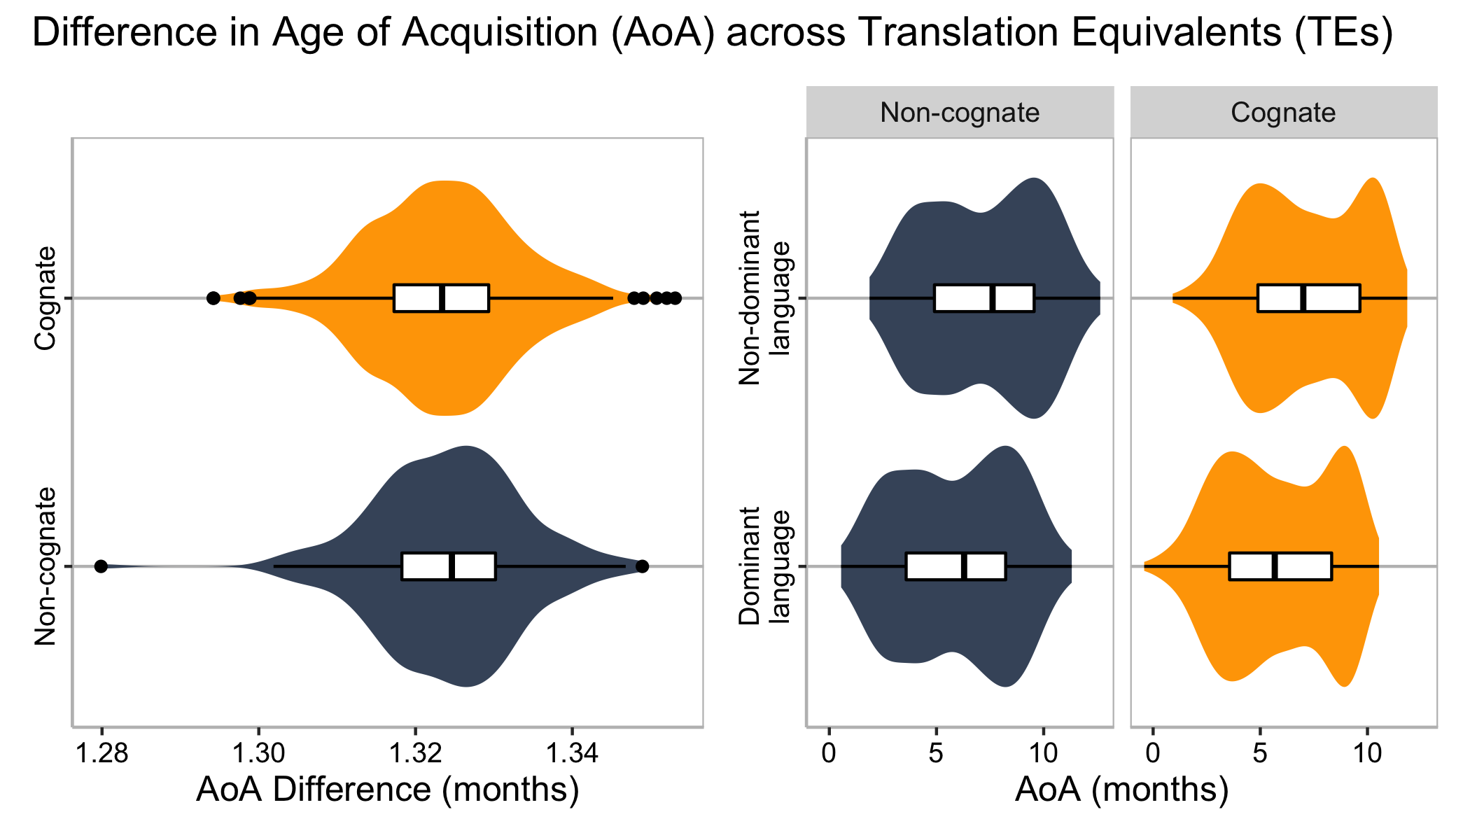
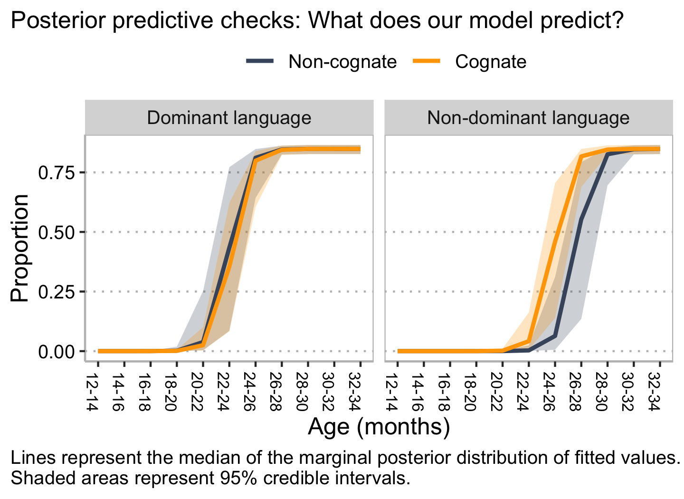
Does cognateness impact bilingual lexical acquisition?
P1-D-60
Gonzalo García-Castro, Daniela Avila-Varela & Nuria Sebastian-Galles
Center for Brain and Cognition, Universitat Pompeu Fabra
gonzalo.garciadecastro@upf.edu
@gongcastro
Background
(1) Are cognates acquired earlier?
(2) Are cognate TEs acquired closer in time?
How does the similarity between two Translation Equivalents (TE) (i.e., cognateness) affect lexical acquisition?
Toddlers learning two languages sharing more cognates show larger vocabulary sizes in their non-dominant language (language of less exposure; at 24 mo)¹
We suggest that cognate pairs of TEs are acquired earlier (hypothesis 1) and closer in time (hypothesis 2) than non-cognate TEs, only in the non-dominant language.
We used logistic curves to model the proportion of toddlers that were reported to understand each item. ²
We calculated the difference in months between the mid-points of each Translation Equivalent (TE):
AoA_{diff} = Mid-point_{Dominant} – Mid-point_{Non-dominant}
Bayesian ANOVA: Strong support for H0 absence of cognateness effect (BF: 0.13)
We defined age of acquisition (AoA) of each word as the age at which its acquisition curve is steepest (Mid-point)
We estimated mid-points using a Bayesian model. ³
Predictors
Dominance (Non-dominant vs. dominant): The word belongs to the language the toddlers is most exposed to.
Cognateness (Non-cognate vs. Cognate): Phonological similarity between the forms of the TE.
This model fitted the data moderately better than a model not including Cognateness (ELPD_{diff} = -14.4, SE_{diff} = 3.2)
↑ Cognates ↑ Vocabulary size
Methods
334 bilinguals aged 12 to 34 mo
219 Catalan-dominant, 115 Spanish-dominant
10-50% exposure to non-dominant language.
Conclusions
We present preliminary data on comprehensive vocabulary. Data collection is ongoing. The distribution of participants across ages is still uneven. We provide:
(1) Moderate but inconclusive evidence that cognates are aquired ealier than non-cognates in the non-dominant language.
(2) Strong evidence against the hypothesis that cognate TEs are acquired closer in time than non-cognates.
Future steps involve introducing non-dichotomous measures of degree of bilingualism (balance of exposure between languages), and cognateness (phonological similarity between TEs),
We collected comprehensive and productive data:
Lab checklist: 100 items in Catalan + 100 items in Spanish
Online checklist: 718 in Spanish + 718 items in Catalan (participants completed a random selection of ~245 items).
16 semantic/functional categories
GAT [CAT]
GATO [CAT]
PERRO [DOG]
PERRO [DOG]
REFERENCES: [1] Floccia et al. (2018), [2] Mahr (2020), [3] Bürkner (2017), [4] Frank et al. (2017), [5] Cuetos et al. (2011), [6] Boada et al. (2019)
Notes:
x

