Slide 1




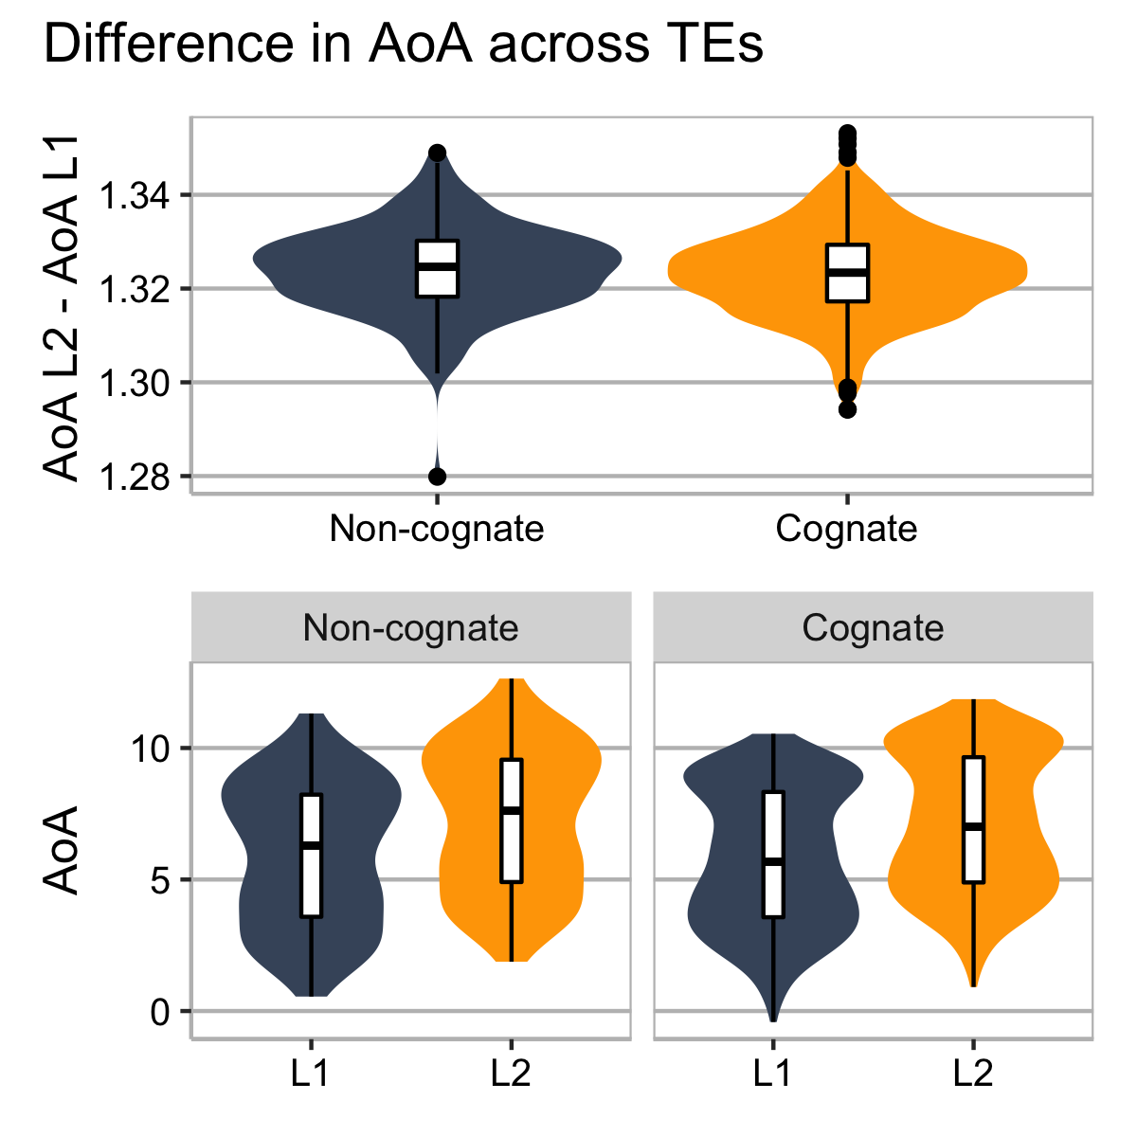
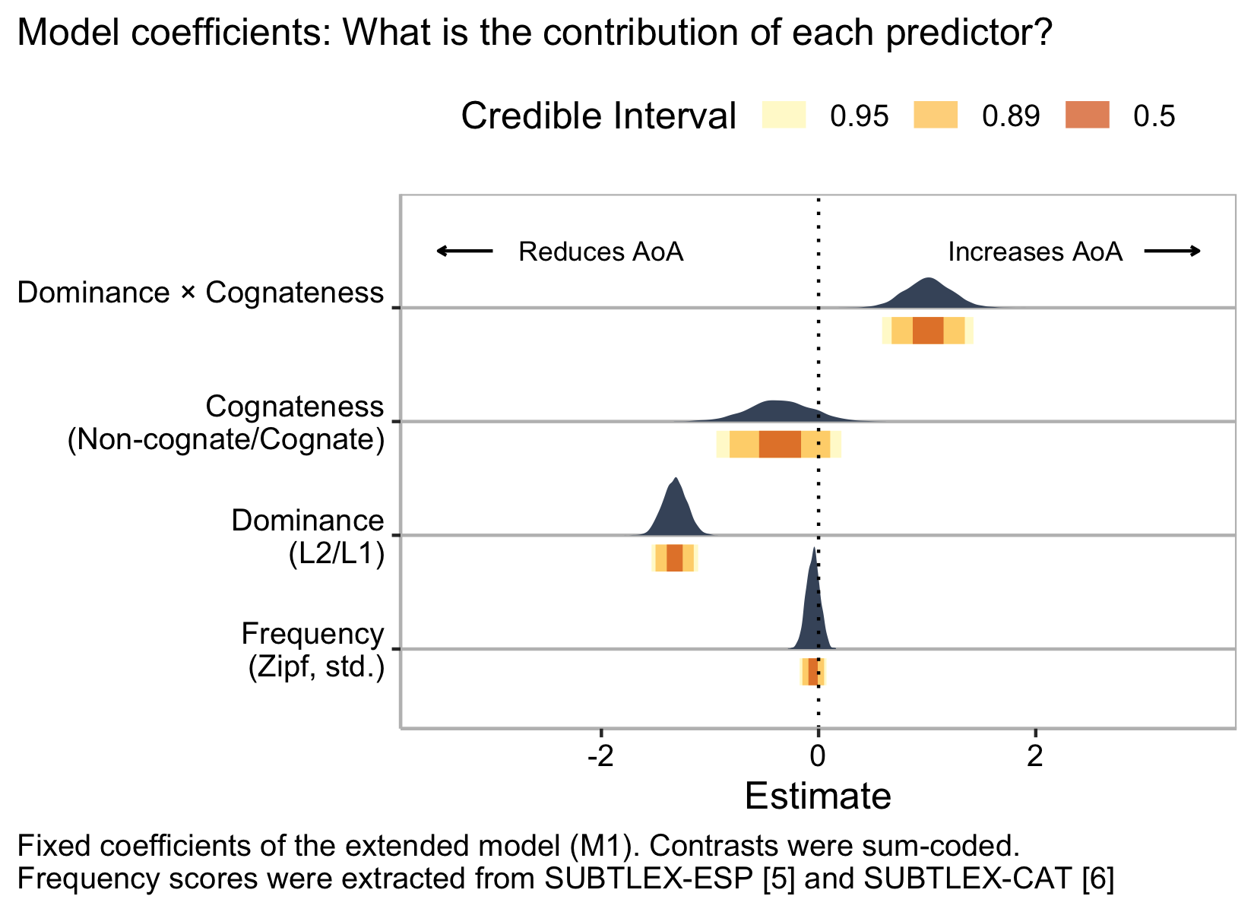
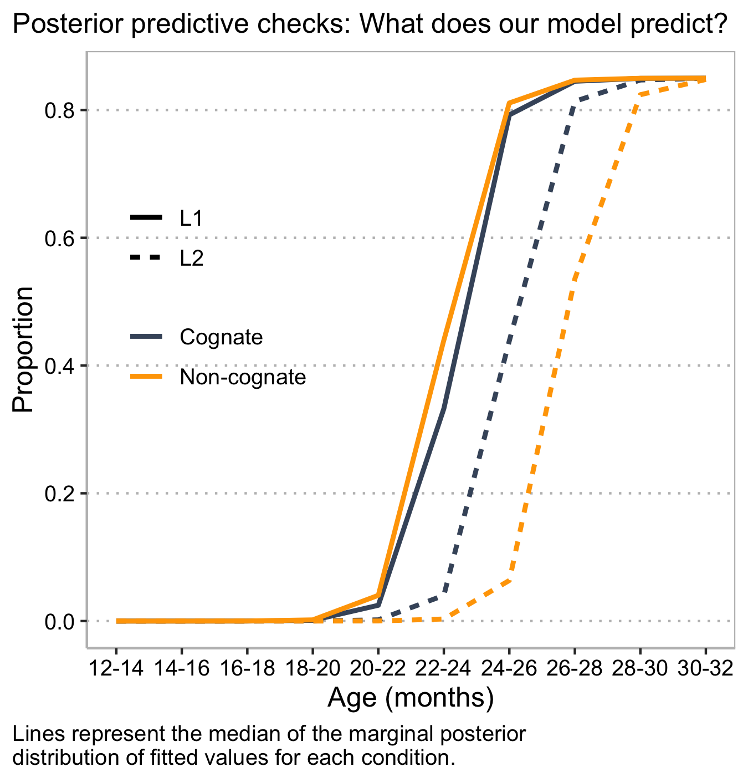
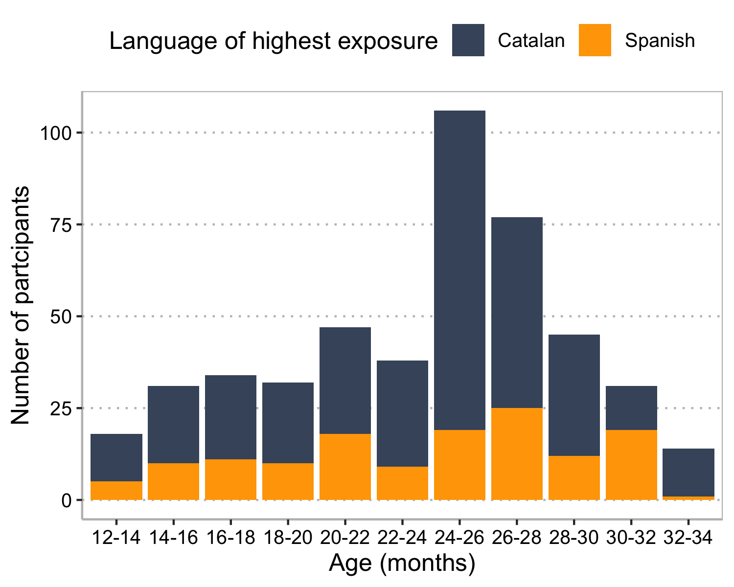
Does cognateness impact bilingual lexical acquisition?
@gongcastro
Gonzalo García-Castro, Daniela Avila-Varela & Nuria Sebastian-Galles | Center for Brain and Cognition, Universitat Pompeu Fabra
Background
Hypothesis 1: Are cognates acquired earlier?
Hypothesis 2: Are cognate TEs acquired closer in time?
Similarity between bilinguals’ two languages impacts their vocabulary size at 24 months olds¹
How the number of cognates affects lexical acquisition remains unknown.
Hypothesis 1: Age of Acquisition (AoA) is earlier for cognates vs. non-cognate word-forms.
Hypothesis 2: Cognate Translation Equivalents (TEs) are acquired closer in time than non-cognate TEs.
We used logistic curves to model the proportion of toddlers that were reported to understand/produce each of the Spanish and Catalan forms of 718 TEs.
We calculated the difference in AoA for each TE
AoA = predicted Mid-point
AoA_{diff} = AoA_{L2} – AoA_{L1}
Bayesian ANOVA⁸
Strong support for H0 absence of cognateness effect (BF: 0.13)
↑ Cognates ↑ Vocabulary size
We estimated the mid-point (age at which the proportion increased the fastest) using a Bayesian logistic model, generating priors fro Wordbank.^{2, 3, 4}
Model selection (LOO-PSIS cross-validation)⁷
Extended model (M1) vs. null model (M0) not including Cognateness as predictor)
Moderate support for M1 (ELPD_{diff} = -14.4, SE_{diff} = 3.2)
Conclusions
Moderate but inconclusive evidence that cognates are aquired ealier than non-cognates.
Strong evidence against the hypothesis that cognate TEs are acquired closer in time.
Data collection is still ongoing.
Productive vocabulary data still to be analysed.
AoA house | Earlier, closer | Later, more distant
Spanish | casa /’ka.zə/ | mesa /’me.sa/
Catalan | casa /’ka.za/ | taula /’taw.ɫə/
Methods
334 bilinguals from Catalonia aged 12 to 34 mo
219 Catalan-dominant, 115 Spanish-dominant
50-90% exposure to L2
Comprehensive vocabulary data in Spanish and Catalan collected online.
REFERENCES: [1] Floccia et al. (2018), [2] Frank et al. (2017), [3] Mahr (2020), [4] Bürkner (2017), [5] Cuetos et al. (2011), [6] Boada et al. (2019), [7] Vehtari et al. (2017), [8] Morey & Rouder (2018)

