Slide 1
Cognateness, frequency, and vocabulary size
An interactive account of bilingual lexical acquisition GonzaloGarcia-Castro Daniela S.Ávila-Varela IgnacioCastillejo NúriaSebastian-Galles

Slide 2
Word acquisition

Slide 3
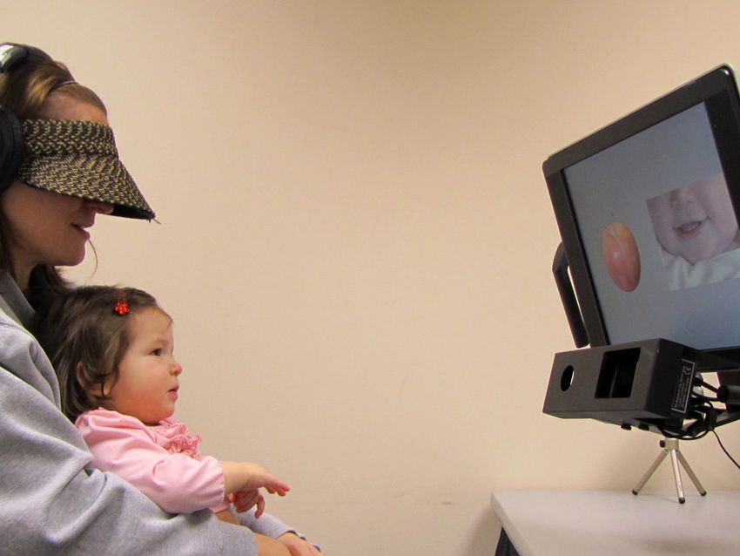
Associating a word-form to its referential context (and more)
Challenging task: ambiguity, variability
Earliest evidence of word acquisition: 6 months of age (Jusczyk and Aslin 1995; Bergelson and Swingley 2012)
Medical Xpress
Notes:
Leaning words is important
Accessing a world of concepts through fairly arbitrary perceptual objects
But it’s a hard task: ambiguity, variability
Infants show evidence of word-concept associations from 6 months

Slide 4
Word acquisition
Bilingual word acquisition: more than one word-form per referent
gos → DOG ← perro
Word acquisition
Notes:
Bilinguals face an even more difficult task
Learning more than two labels per referent

Slide 5
Vocabulary checklist: number/proportion of words checked by caregivers as Understands, and/or Says (e.g., CDI, Fenson et al. 1994)
 | Understands | Understands & Says
chair | [ x ] | [ ]
table | [ ] | [ ]
… | [ ] | [ x ]

Slide 6
Word acquisition
Notes:
In this talk, I will focus on a particular aspect of language acquisition: lexical development
Many ways of measuring lexical development: vocabulary size
Vocabulary size measured using vocabulary checklists
Caregivers fill a questionnaire indicating the words they think their child understands or produces

Slide 7
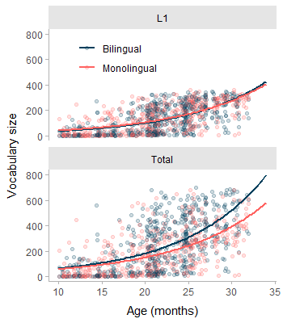
English-Spanish bilinguals: smaller English vocab. size compared to monolinguals, but similar total vocab. size (Hoff et al. 2012)
Mixed evidence on other language pairs: English-French, Catalan-Spanish, English-Dutch
Notes:
They do not seem to fall behind monolinguals, at least when both languages are summed together
As more language pairs are tested, evidence is more mixed (advantage?)
What mechanisms are in place?

Slide 8
Linguistic distance
Bilingual toddlers learning two typologically close languages: larger vocabulary sizes (Floccia et al. 2018)
Cognate: form-similar translation equivalents (TEs)
Bilinguals acquire TEs from early steps of vocabulary growth (Bilson et al. 2015; Tsui et al. 2022)
Cognates are acquired earlier than non-cognates (Mitchell, Tsui, and Byers-Heinlein 2022; Bosch and Ramon-Casas 2014)
Why would cognates be acquired earlier?
Parallel activation: candidate mechanism?
Notes:
One factor: linguistic or typological distance
Linguistically more similar languages share more cognates
Cognates are form-similar translation equivalents
Children acquire TEs early on: whether cognateness impacts vocabulary growth or not makes a great impact
Cognates are acquired at earlier ages,. May explain the facilitation of linguistic distance
But why would cognates be acquired earlier?

Slide 9

Lexical access is language non-selective:
Translation equivalents are co-activated, even in monolingual situations (e.g., Costa, Caramazza, and Sebastian-Galles 2000)
Dissociation between models of bilingual word processing and word acquisition
Notes:
We can try to explain this from the language non-selective hypothesis of lexical access
States that bilinguals activate both languages even in monolingual situations
The activation of a word in the lexicon may lead to the activation of its translation
Cognates provide evidence of this
To data, the cognate facilitation has been embedded in models of word comprehension and production, but not acquisition
In this study, we provide a theoretical framework for the cognate facilitation on word acquisition, capitalising on accumulator models of language acquisition

Slide 10
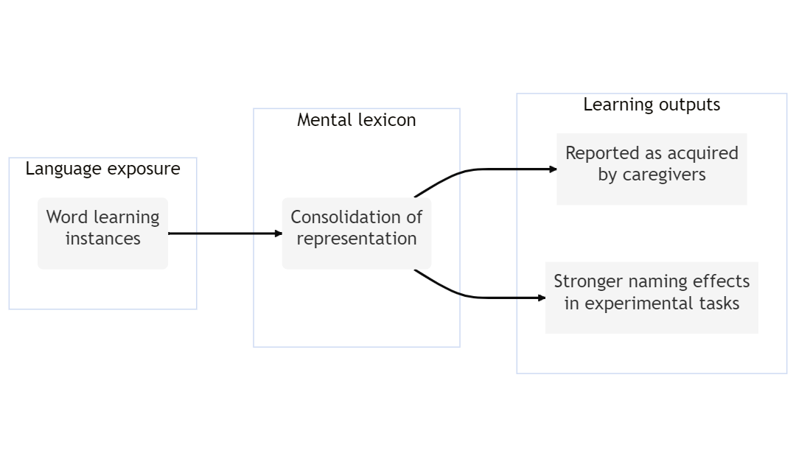
Accumulator models
Word acquisition as a continuous process of lexical consolidation (Hidaka 2013; Mollica and Piantadosi 2017)
Notes:
Accumulator models devise word acquisition as a continuous process
As the child receives language exposure, they encounter word-forms
Some of those encounters represent learning instances (right referential context)
Accumulating learning instances with a word, its lexical representation consolidates
This is reflected in measurable learning outputs
We are aware that word learning involves more than association. We assume it involves, at least, association

Slide 11
Simulating word acquisition
Monolingual word acquisition

Slide 12
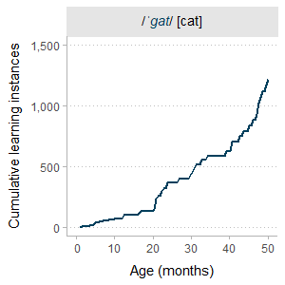
For participant $i$ and word $j$:
$$\begin{matrix}{\text{Learning instances}}_{ij} & ={\text{Age}}_{i}⋅{\text{Frequency}}_{j} \\ {\text{Frequency}}_{j} & ∼\text{Poisson}\left(λ\right) \\ \\ \text{For simulations:} λ & =50\end{matrix}$$
Notes:
LI: function of age and frequency
Frequency: around 50 times per month, following Poisson distribution

Slide 13
Monolingual word acquisition

Slide 14
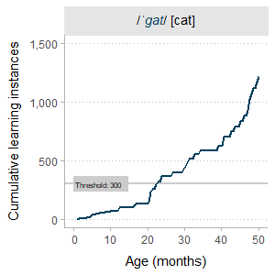
For participant $i$ and word $j$:
$$\begin{matrix}{\text{Learning instances}}_{ij} & ={\text{Age}}_{i}⋅{\text{Frequency}}_{j} \\ {\text{Frequency}}_{j} & ∼\text{Poisson}\left(λ\right) \\ \\ \text{For simulations:} \\ λ & =50 \\ \text{Threshold} & =300\end{matrix}$$
Notes:
Threshold: theoretical number of cumulative learning instances at which the lexical representation is consolidated
Set at 300 for simulation purposes

Slide 15
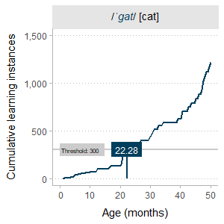
Monolingual word acquisition
For participant $i$ and word $j$:
$$\begin{matrix}{\text{Learning instances}}_{ij} & ={\text{Age}}_{i}⋅{\text{Frequency}}_{j} \\ {\text{Frequency}}_{j} & ∼\text{Poisson}\left(λ\right) \\ \\ \text{For simulations:} \\ λ & =50 \\ \text{Threshold} & =300 \\ \\ {\text{Age of Acquisition}}_{ij} & ={\text{Age}}_{i [\text{Threshold]}}\end{matrix}$$
Notes:
Finally, age of acquisition is the age at which learning instances meet the threshold
At this age, lexical representation is consolidated and this is observed in learning outputs

Slide 16
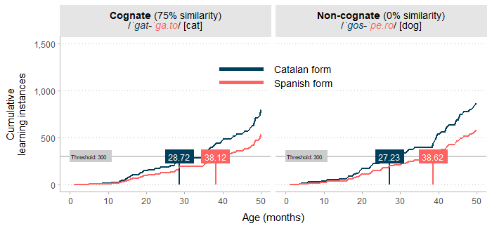
Bilingual word acquisition
No parallel activation
Bilingual word acquisition
No parallel activation
Notes:
In the case of bilinguals, we need to consider the dual language exposure
Bilinguals are exposed to quantitatively less linguistic input in each language
Will accumulate learning instances more slowly than monolingual
Here’s an example
Because the child is exposed most of the time to Catalan, they will accumulate learning instances in Catalan faster than in Spanish

Slide 17
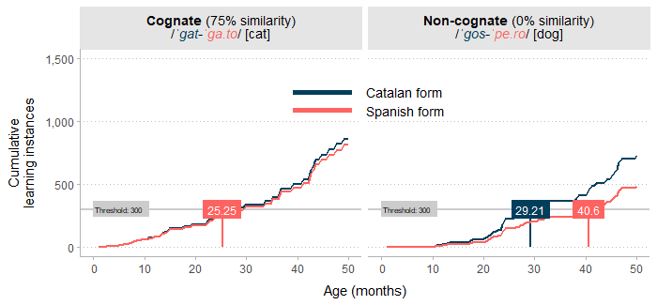
Bilingual word acquisition
Parallel activation
Hypothesis: word-representations receive learning instances from their translations
Increment in learning instances: proportional to form-similarity (cognateness)
Cognate
Non-cognate
Bilingual word acquisition
Parallel activation
Including learning instances from parallel activation
Hypothesis: word-representations receive learning instances from their translations
Proportional to the amount of form-similarity (cognateness)
$$\begin{matrix}\text{Monolinguals:} \\ {\text{Learning instances}}_{ij} & =Age_{i}⋅Frequency_{j}\end{matrix}$$
$$\begin{matrix}\text{Bilinguals:} \\ {\text{Learning instances}}_{ij} & ={\text{Age}}_{i}⋅{\text{Frequency}}_{j}⋅{\text{Exposure}}_{i}+ \\ & \left({\text{Cognateness}}_{j}⋅{\text{Learning instances}}_{ij′}\right)\end{matrix}$$
Bilingual word acquisition
Parallel activation

Slide 18
Testing predictions (observed data)
Questionnaire

Slide 19
Barcelona Vocabulary Questionnaire (BVQ)
On-line, implemented in formr (Arslan, Walther, and Tata 2020)
Inspired in MacArthur-Bates CDI (Fenson et al. 1994)
~1,600 items/words (800 Catalan + 800 Spanish)

Slide 20
Participants filled one of four versions of the questionnaire: - 500 items: 250 Catalan + 250 Spanish
Short-listed (nouns): 302 translation equivalents (TE)
Participants

Slide 21
138,078 item responses from 366 participants
1 time | 2 times | 3 times | 4 times
312 | 42 | 8 | 4

Slide 22
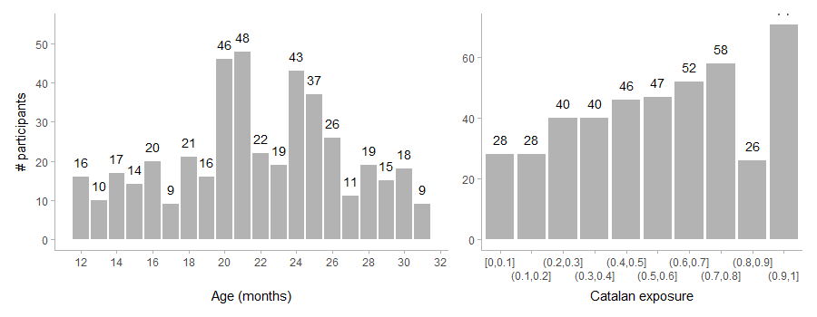

Slide 23
Data analysis
Model structure
Ordinal regression model: $P\left(Understands\right)$, $P\left(Says\right)$
No < Understands < Understands and Says
Multilevel: Crossed-random effects
Participant and Translation equivalent as grouping variables
Bayesian: probability of parameter values
$$P\left(\text{model}|\text{data}\right)∝P\left(\text{data}|\text{model}\right)×P\left(\text{model}\right)$$

Slide 24
Predictor | Example
Age | Months
Length | Number of phonemes
Exposure | Lexical frequency $×$ Language exposure
Cognateness | Levenshtein similarity between a word-form and its translation
Two-way and three-way interactions between age, exposure, and cognateness
Predictors

Slide 25
Results
Predictor | Estimate | 95% HDI | p(H0)
Intercepts
Comprehension and Production | 0.438 | [-0.5, 0.5] | 0.088
Comprehension | 0.936 | [2.44, 0.95] | 0.000
Slopes
Age (+1 SD, 4.87, months) | 0.405 | [1.43, 0.45] | 0.000
Exposure (+1 SD, 1.81) | 0.233 | [0.8, 0.27] | 0.000
Cognateness (+1 SD, 0.26) | 0.058 | [0.06, 0.1] | 0.037
Length (+1 SD, 1.56 phonemes) | -0.062 | [-0.35, -0.04] | 0.000
Age × Exposure | 0.071 | [0.16, 0.1] | 0.000
Age × Cognateness | 0.014 | [0, 0.03] | 0.985
Exposure × Cognateness | -0.057 | [-0.28, -0.05] | 0.000
Age × Exposure × Cognateness | -0.018 | [-0.11, -0.01] | 0.975
Posterior distribution

Slide 26
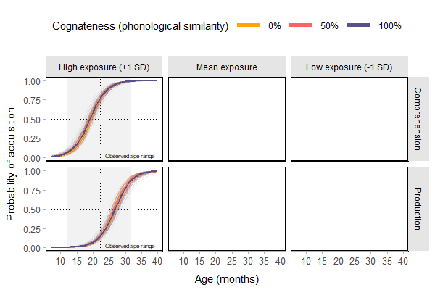
Posterior predictions

Slide 27
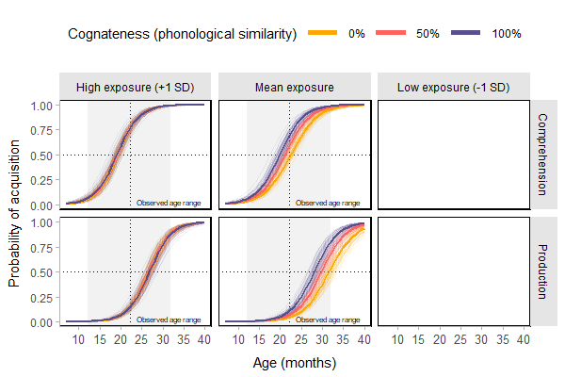
Posterior predictions

Slide 28
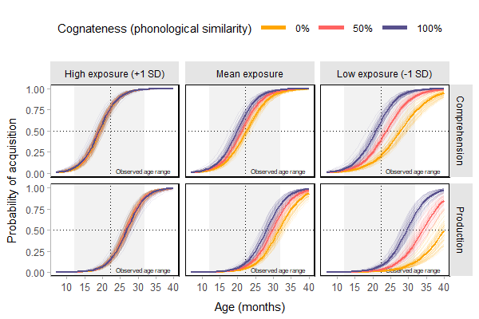
Posterior predictions

Slide 29
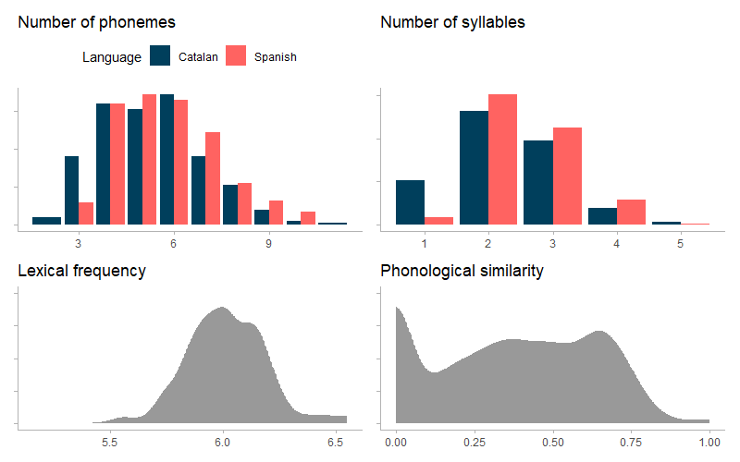
Discussion
Cognateness facilitates word acquisition
Only low-exposure words benefit from their cognate status: less dominant language receives more facilitation
Parallel activation as mechanism that boosts lexical consolidation: increment in cumulative learning instances
Catalan-Spanish: very specific population
Next steps: word-learning, formalisation
Appendix
Item properties

Slide 30
 | Orthography | Phonology | String
Catalan | porta | /ˈpɔɾ.tə/ | pɔɾtə
Spanish | puerta | /ˈpweɾ.ta/ | pweɾta
Levenshtein similarity
Phonological similarity
Levenshtein distance: number of edits for two character strings to become identical

Slide 31
Catalan | Spanish | Levenshtein
porta (/ˈpɔɾ.tə/) | puerta (/ˈpweɾ.ta/) | 0.50 (3)
taula (/ˈtaw.lə/) | mesa* (/ˈmesa/) | 0.00 (5)
cotxe (/ˈkɔ.t͡ʃə/) | coche (/ˈkot͡ʃe/) | 0.40 (3)
… | … | …
Levenshtein similarity
$$1−\frac{lev\left(A,B\right)}{Max\left(length\left(A\right),length\left(B\right)\right)}$$

Slide 32
Thank you
References
Arslan, Ruben C., Matthias P. Walther, and Cyril S. Tata. 2020. “Formr: A Study Framework Allowing for Automated Feedback Generation and Complex Longitudinal Experience-Sampling Studies Using R.” Behavior Research Methods 52 (1): 376–87. https://doi.org/10.3758/s13428-019-01236-y.
Bergelson, Elika, and Daniel Swingley. 2012. “At 6–9 Months, Human Infants Know the Meanings of Many Common Nouns.” Proceedings of the National Academy of Sciences 109 (9): 3253–58. https://doi.org/10.1073/pnas.1113380109.
Bilson, Samuel, Hanako Yoshida, Crystal D Tran, Elizabeth A Woods, and Thomas T Hills. 2015. “Semantic Facilitation in Bilingual First Language Acquisition.” Cognition 140: 122–34.
Bosch, Laura, and Marta Ramon-Casas. 2014. “First Translation Equivalents in Bilingual Toddlers’ Expressive Vocabulary: Does Form Similarity Matter?” International Journal of Behavioral Development 38 (4): 317–22. https://doi.org/10.1177/0165025414532559.
Costa, Albert, Alfonso Caramazza, and Nuria Sebastian-Galles. 2000. “The Cognate Facilitation Effect: Implications for Models of Lexical Access.” Journal of Experimental Psychology: Learning, Memory, and Cognition 26: 1283–96. https://doi.org/10.1037/0278-7393.26.5.1283.
Fenson, Larry, Philip S. Dale, J. Steven Reznick, Elizabeth Bates, Donna J. Thal, Stephen J. Pethick, Michael Tomasello, Carolyn B. Mervis, and Joan Stiles. 1994. “Variability in Early Communicative Development.” Monographs of the Society for Research in Child Development 59 (5): i–185. https://doi.org/10.2307/1166093.
Floccia, Caroline, Thomas D. Sambrook, Claire Delle Luche, Rosa Kwok, Jeremy Goslin, Laurence White, Allegra Cattani, et al. 2018. “I: Introduction.” Monographs of the Society for Research in Child Development 83 (1): 7–29. https://doi.org/10.1111/mono.12348.
Hidaka, Shohei. 2013. “A Computational Model Associating Learning Process, Word Attributes, and Age of Acquisition.” PLOS ONE 8 (11): e76242. https://doi.org/10.1371/journal.pone.0076242.
Hoff, Erika, Cynthia Core, Silvia Place, Rosario Rumiche, Melissa Señor, and Marisol Parra. 2012. “Dual Language Exposure and Early Bilingual Development*.” Journal of Child Language 39 (1): 1–27. https://doi.org/10.1017/S0305000910000759.
Jusczyk, P. W., and R. N. Aslin. 1995. “Infants′ Detection of the Sound Patterns of Words in Fluent Speech.” Cognitive Psychology 29 (1): 1–23. https://doi.org/10.1006/cogp.1995.1010.
Mitchell, Lori, Rachel K. Y. Tsui, and Krista Byers-Heinlein. 2022. “Cognates Are Advantaged in Early Bilingual Expressive Vocabulary Development.” PsyArXiv. https://doi.org/10.31234/osf.io/daktp.
Mollica, Francis, and Steven T. Piantadosi. 2017. “How Data Drive Early Word Learning: A Cross-Linguistic Waiting Time Analysis.” Open Mind 1 (2): 67–77. https://doi.org/10.1162/OPMI_a_00006.
Tsui, Rachel Ka-Ying, Ana Maria Gonzalez-Barrero, Esther Schott, and Krista Byers-Heinlein. 2022. “Are Translation Equivalents Special? Evidence from Simulations and Empirical Data from Bilingual Infants.” Cognition 225 (August): 105084. https://doi.org/10.1016/j.cognition.2022.105084.

