Slide 1
The role of cognateness in native spoken word recognition
Gonzalo García-Castro Serene Siow Kim Plunkett Nuria Sebastian-Galles

Slide 2
assets/tiktok.mp4
Source: https://www.youtube.com/watch?v=8FXQ38-ZQK0&t=11s, Tiktok: kegan_stiles

Slide 3
assets/benny-lava.mp4
https://www.youtube.com/watch?v=sdyC1BrQd6g&list=PL217-5XHnpx1Tb3FRXqWmPZX2UV4m2I-2

Slide 4
assets/soramimi.mp4
https://www.youtube.com/watch?v=7bYG7duRYV0&t=1s

Slide 5
assets/yunomi.mp4
https://www.youtube.com/watch?v=EW_Q4IYpbWE
Homophonic translation
Words/phrases in one language are translated to similar-sounding phrases without necessarility preserving its meaning
Intentional (literary figure, e.g., poetry) (Gasparov 2006) or spontaneous
What are the psycholinguistic foundations of spontaneous homophonic translation?

Slide 6
Process | English word | Japanese word
Insertion | cry /ˈkɹaɪ/ | kurai (くらい) /ˈkɯ̟ɾa̠i/ [dark]
Deletion | go /ˈɡoʊ/ | go (*ご) /ˈɡo̞/ [go (board game)]
Alternation | low /ˈloʊ/ | rou (ろう) /ˈɾo̞ː/ [wax]
Homophonic translation
Otake (2017): analysed 194 instances of Soramimi broadcaster between 1992 and 2007 by the TV show Soramimi hour
English song lyrics to words (4%) and phrases (96%) in Japanese
English phonetic features preserved with varying degrees in their Japanese translations
Homophonic translation
Otake (2017): Japanese listeners accommodated English input strings to Japanese phonology (Peperkamp, Vendelin, and Nakamura 2008; Dupoux et al. 1999).

Slide 7
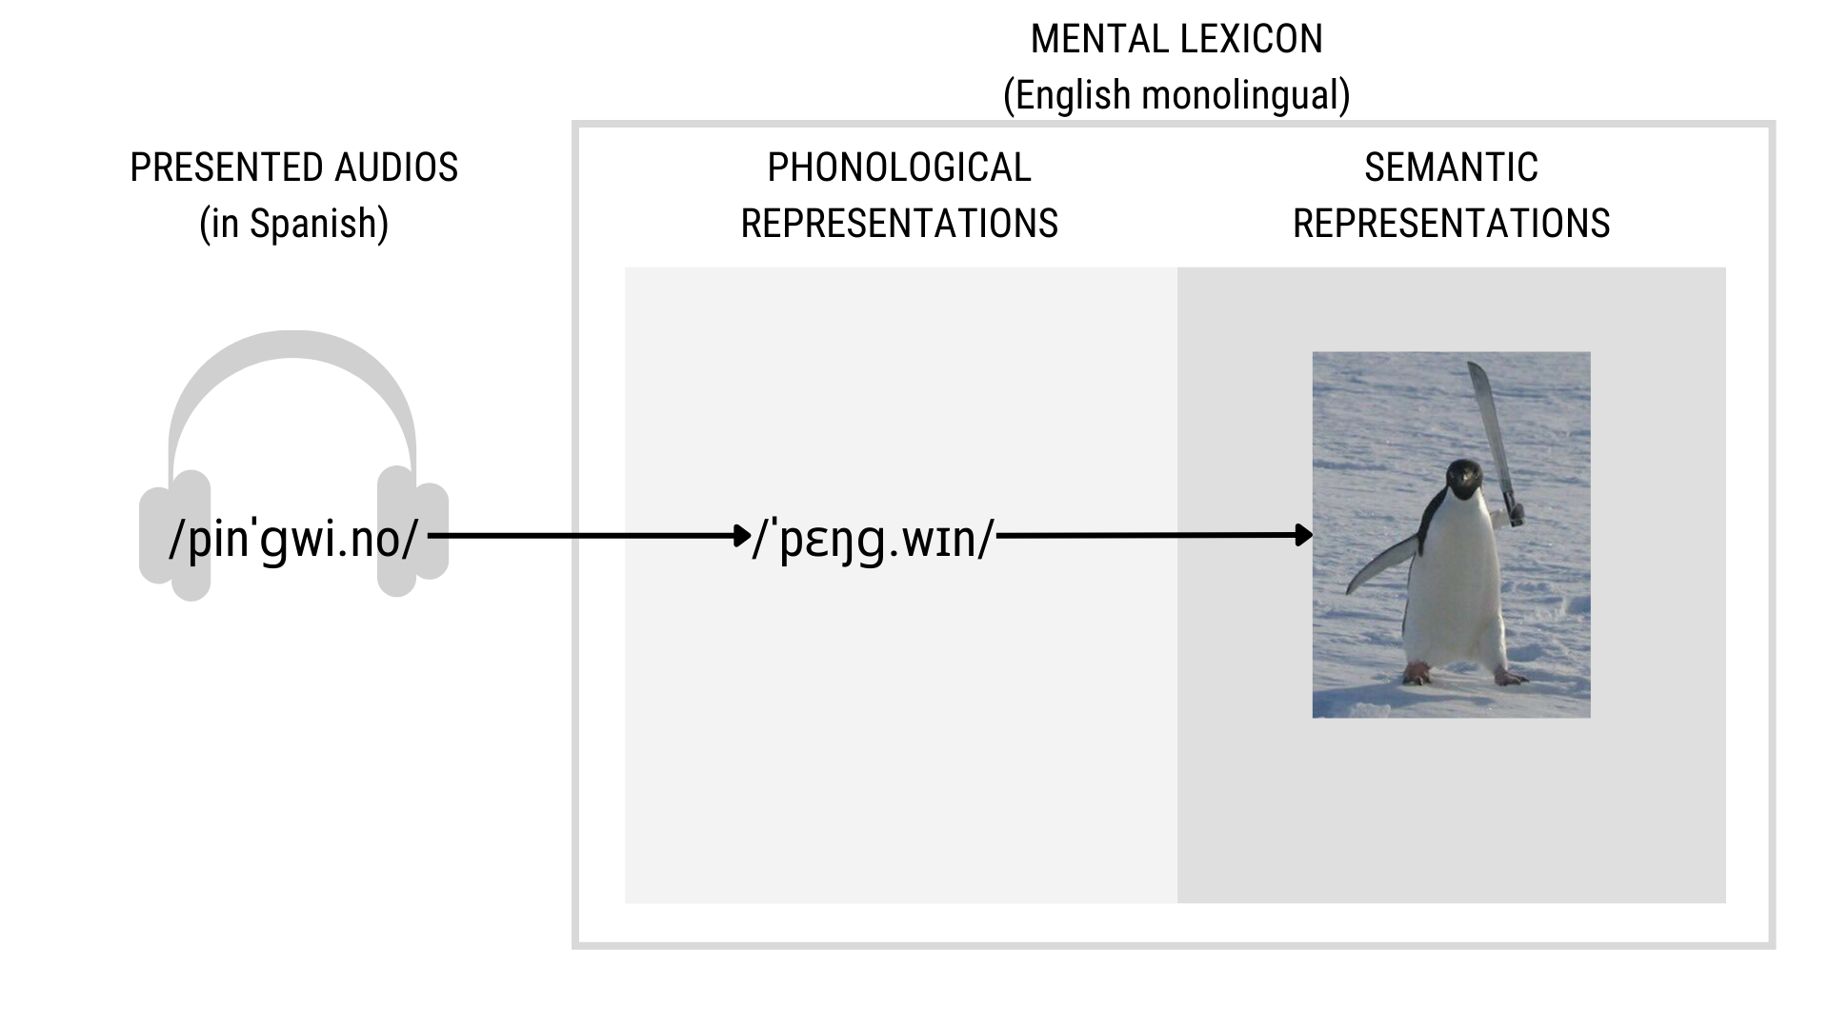
Our study
Characterise the psycholinguistic bases of homophonic translation
What leads to a correct homophonic translation (i.e., homophonic translation with preservation of meaning)?
Interplay between phonological similarity and phonological neighbourhood density
Our study
More phonological similarity (i.e., cognateness), higher probability of correct translation
More phonological neighbours, lower probability of correct translation
Phonological similarity
Levenshtein similarity (Similarity) between the phonological representation of two word-forms
Levenshtein distance: number of edits (additions, deletions, substitutions) needed to make both strings identical.
$\text{Similarity}=1−\frac{\text{Levenshtein}\left({\text{Word}}_{1}, {\text{Word}}_{2}\right)}{max\left(\text{Length}\left({\text{Word}}_{1}\right), \text{Length}\left({\text{Word}}_{2}\right)\right)}$
$\text{Similarity}\left(\text{pinɡwino},\text{pɛŋɡwɪn}\right)=1−\frac{4}{8}=0.5$
Phonological similarity

Slide 8
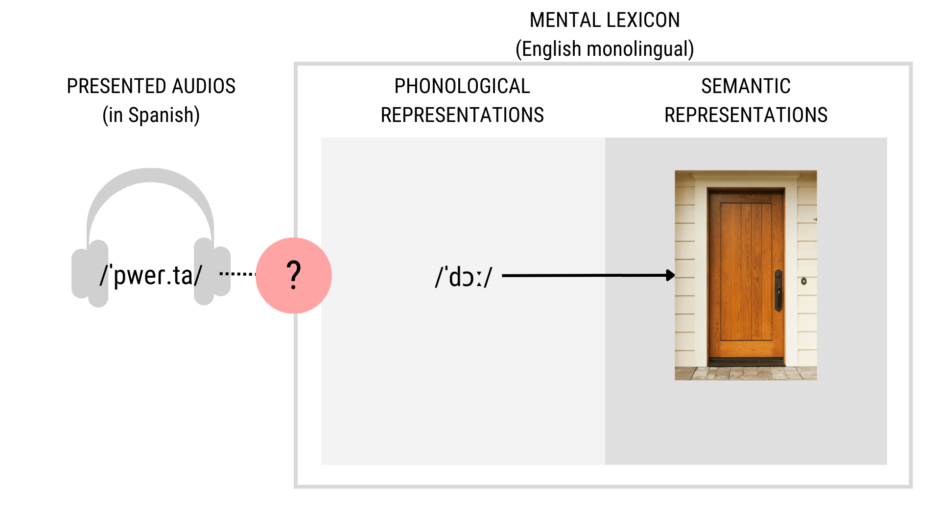
Phonological similarity

Slide 9
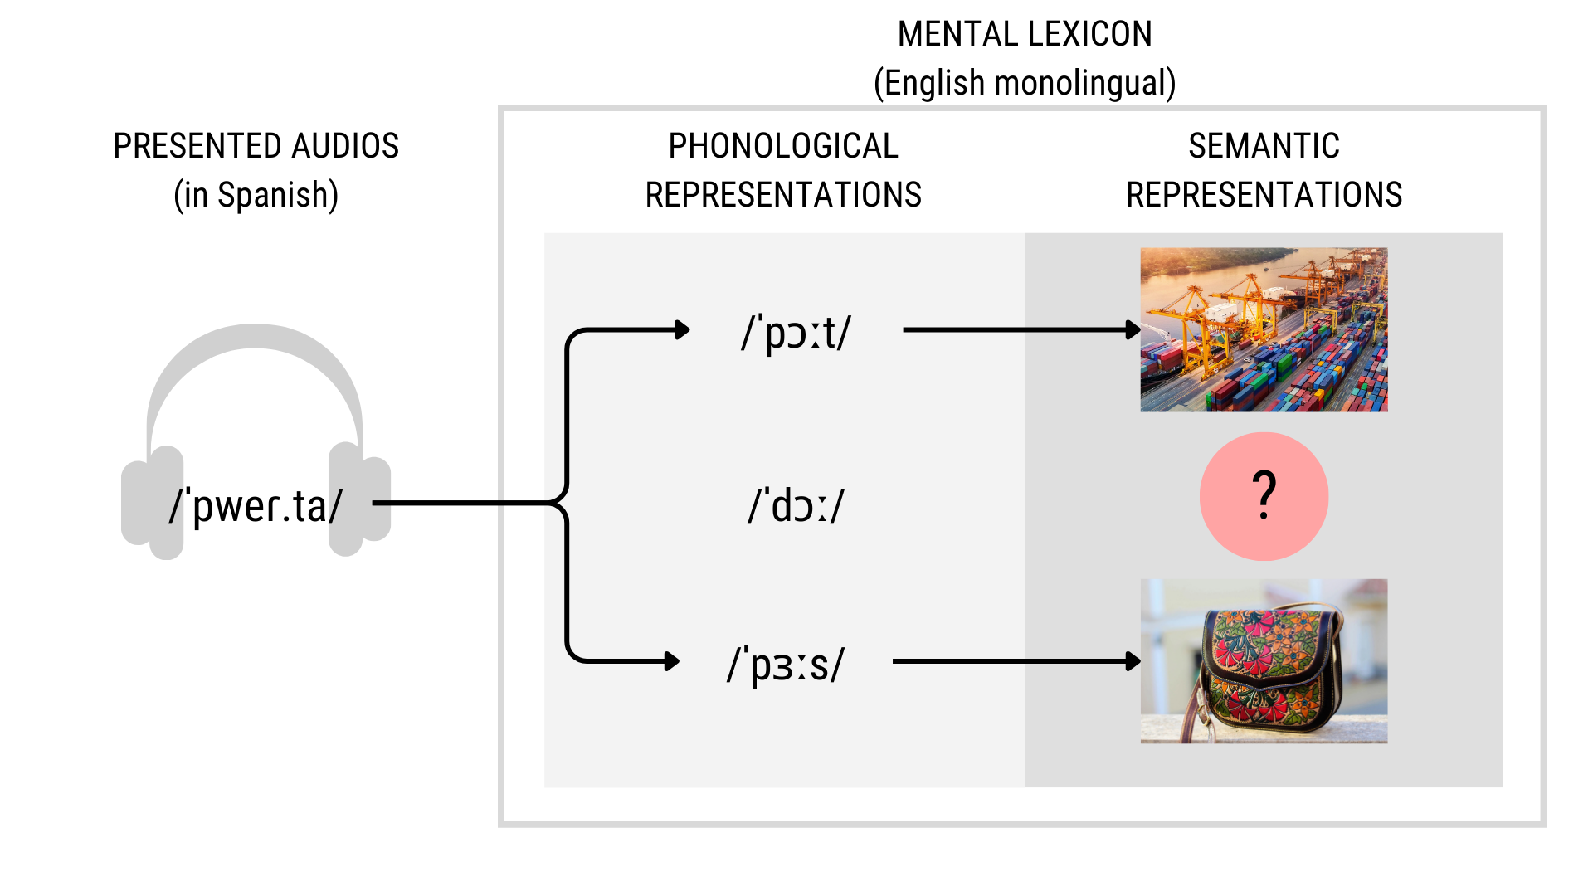
Phonological neighbourhood density
Cross-linguistic Phonological Neighbours (CLPN)
Number of words in the native language that are one phoneme apart from the presented word (phonological neibourhoods).
Only counting CLPN with higher lexical frequency than the correct translation.
Phonological neighbourhood density

Slide 10
Experiment 1
 | N¹ | Age |  | L2
 |  | Mean ± SD | Range
spa-ENG | 35 (8) | 21.80 ± 2.08 | 18–26 | Russian (1)
cat-ENG | 36 (4) | 21.72 ± 2.25 | 18–25 | French (1), German (1), Italian (1), Punjabi (1), Several (1)
¹ Number of included participants (number of excluded participants.)
English participants listening to Catalan (cat-ENG) or Spanish (spa-ENG).
Participants
British English native adults living in the UK
Recruited from Prolific
No prior relevant familiarity with Catalan, Spanish or any other Romance language (self-reported).

Slide 11
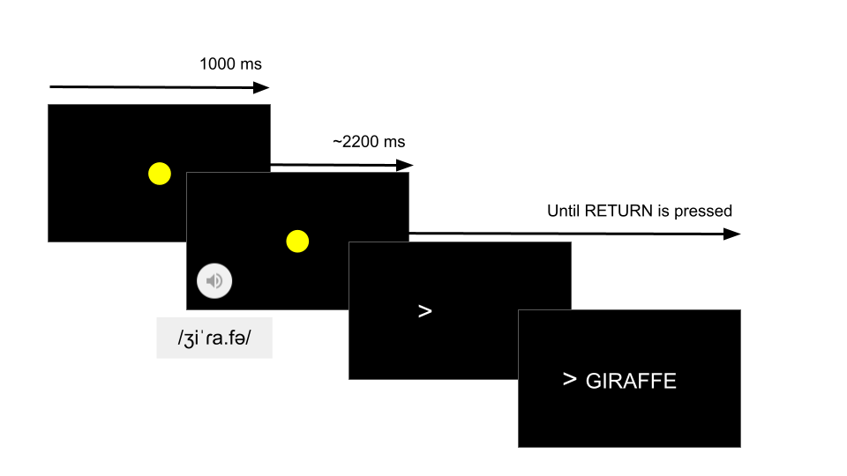
Task design
Implemented in Psychopy, deployed online via Pavlovia.

Slide 12
Stimuli
High-frequency Catalan and Spanish nouns
Recorded by a Catalan-Spanish proficient bilingual in a child-directed manner

Slide 13
Catalan list (n = 94)
6.67 phon (SD = 2.06, Range = 2-11) English translations: 5.12 char long (SD = 1.56, Range = 3-9)
Spanish list (n = 105)
7.27 phon long (SD = 2.05, Range = 3-13) English translations: 5.29 char long (SD = 1.77, Range = 3-12).

Slide 14
Results
Manual coding of responses as:

Slide 15
Valid responses Included in dataset
Correct¹ (1)
Incorrect (0)
Invalid responses Excluded from dataset
Blank, comments to experimenters, responses in languages other than English, etc.

Slide 16
 | N | Accuracy (%) |  |  |  | Valid trials
 |  | Mean | SD | SE | Range | Mean | N trials | SD | Range
spa-ENG | 27 | 15.86 | 5.20 | 3.05 | 8.82–28.71 | 96.37 | 2,602 | 2.88 | 87–98
cat-ENG | 32 | 18.48 | 4.89 | 3.27 | 10.84–32.56 | 81.38 | 2,604 | 3.17 | 71–83
Sum | 59 | — | — | — | — | — | 5,206 | — | 158
Mean | — | 17.17 | 5.05 | 3.16 | — | 8,887.27 | — | 302.71 | —
Results

Slide 17
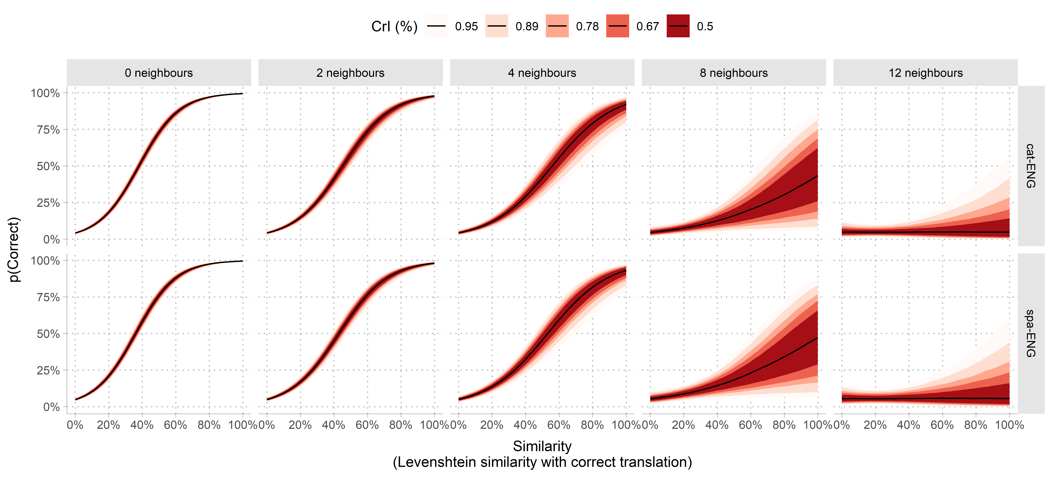
Results
Bayesian generalised linear mixed model (brms).
$$\begin{matrix} & \text{Likelihood} \\ y_{i}∼ & \text{Bernoulli}\left(p_{i}\right) \\ & \text{Parameters} \\ \text{Logit}\left(p_{i}\right)= & β_{0\left[p,w\right]}+β_{1\left[p\right]}{\text{Frequency}}_{i}+β_{2\left[p\right]}{\text{PTHN}}_{i}+ \\ & β_{3\left[p\right]}{\text{Similarity}}_{i}+β_{4\left[p\right]}\left({\text{PTHN}}_{i}×{\text{Similarity}}_{i}\right) \\ β_{0−6\left[p,w\right]}∼ & N\left(μ_{β_{j}},σ_{β_{j}}\right)\text{, for participant }p\text{ in 1, ..., }P\text{ and word }w\text{ in 1, ..., }W \\ β_{1−6\left[p\right]}∼ & N\left(μ_{β_{j}},σ_{β_{j}}\right)\text{, for participant }p\text{ in 1, ..., }P \\ & \text{Prior} \\ μ_{β_{p,w}}∼ & N\left(0,0.1\right) \\ σ_{β_{p}},σ_{β_{w}}∼ & \text{HalfCauchy}\left(0,0.1\right) \\ ρ_{p},ρ_{w}∼ & \text{LKJCorr}\left(8\right) \\ \end{matrix}$$
Results
Figure 1

Slide 18
Discussion
Word-forms in an unfamiliar language activate their translation equivalents in the native language, provided:
Some phonological similarity between both words
Few phonological neighbors of higher frequency
Participants surprisingly good at translating words from Catalan and Spanish (two unfamiliar languages)
Do speakers of typologically closer languages to Catalan and Spanish benefit even more strongly from phonological similarity in the same task?
Discussion
English shares fewer phonologically similar translations with Romance languages than Romance languages share with each other.
Is the probability of homophonic translations higher in unfamiliar languages from the same typological family as the native language?

Slide 19
Experiment 2
Spanish participants listening to Catalan (cat-SPA)

Slide 20
 | n | N¹ | Age |  | L2
 |  |  | Mean ± SD | Range
cat-SPA | 33 | 33 (12) | 21.85 ± 3.00 | 18–33 | French (9), German (1), Italian (2)
¹ Number of included participants (number of excluded participants.)
Experiment 2

Slide 21
 | N | Accuracy (%) |  |  |  | Valid trials
 |  | Mean | SD | SE | Range | Mean | N trials | SD | Range
cat-SPA | 21 | 48.30 | 5.29 | 10.54 | 38.27–58.97 | 79.14 | 1,662 | 3.14 | 72–82
Sum | 21 | — | — | — | — | — | 1,662 | — | 72
Mean | — | 48.30 | 5.29 | 10.54 | — | 7,914.29 | — | 313.51 | —
Stimuli: Spanish list from Experiment 1.
Same as in Experiment 1.
Results

Slide 22
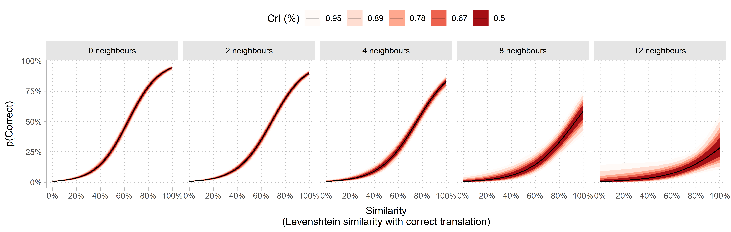
Results
Figure 2

Slide 23
Translation | IPA | Accuracy (%) | SE
Experiment 1 (cat-ENG)
cavall - horse | kə’baʎ - hɔːs | 17.14 | 6.37
llibre - book | ˈʎi.βɾə - bʊk | 17.14 | 6.37
camisa - shirt | ka.’mi.za - ʃɜːt | 16.67 | 6.21
poma - apple | ˈpo.ma - ˈæpl | 16.67 | 6.21
cama - leg | ˈka.mə - lɛg | 11.11 | 5.24
Experiment 2 (spa-ENG)
pantalon - trousers | paŋ.taˈlon - ˈtraʊzəz | 77.42 | 7.51
naranja - orange | naˈɾaŋ.xa - ˈɒrɪnʤ | 41.94 | 8.86
leche - milk | ˈle.t͡ʃe - mɪlk | 35.48 | 8.59
toro - bull | ˈto.ɾo - bʊl | 33.33 | 8.61
libro - book | ˈli.βɾo - bʊk | 30.00 | 8.37
cebra - zebra | ˈθe.bɾa - ˈziːbrə | 29.03 | 8.15
pan - bread | pan - brɛd | 29.03 | 8.15
pollo - chicken | ˈpo.ʎo - ˈʧɪkɪn | 26.67 | 8.07
jirafa - giraffe | xi’ɾa.fa - ʤɪˈrɑːf | 20.69 | 7.52
perro - dog | pe.ro - dɒg | 16.13 | 6.61
pluma - feather | plu.ma - ˈfɛðə | 16.13 | 6.61
puerta - door | pwer.ta - dɔː | 16.13 | 6.61
pie - foot | pje - fʊt | 12.90 | 6.02
caballo - horse | kaˈβa.ʎo - hɔːs | 10.34 | 5.66
bocadillo - sandwich | bo.kaˈdi.ʎo - ˈsænwɪʤ | 10.00 | 5.48
globo - balloon | ˈɡlo.βo - bəˈluːn | 10.00 | 5.48
Experiment 3 (cat-SPA)
fulla - hoja | ˈfu.ʎə - ˈo.xa | 30.43 | 9.59
ull - ojo | uʎ - ˈo.xo | 21.74 | 8.60
got - vaso | ˈɡɔt - ˈba.so | 20.00 | 8.00
entrepa - bocadillo | ˌen.tɾəˈpa - bo.kaˈdi.ʎo | 13.04 | 7.02
mirall - espejo | miˈɾaʎ - es’pe.xo | 12.50 | 6.75
Discussion
Spanish natives exploited phonological similarity to translate unfamiliar Catalan words
Positive impact of phonological similarity more resilient to interference from phonological neighbours
Low-similarity Catalan and Spanish words in Experiments 1 and 2 were responded to with surprising accuracy
Discussion

Slide 24
Experiment 3
 | n | N¹ | Age |  | L2
 |  |  | Mean ± SD | Range
spa-ENG | 32 | 32 (1) | 21.72 ± 2.59 | 18–26 | German (2), Japanese (1)
cat-ENG | 32 | 32 (0) | 22.31 ± 2.39 | 18–26 | Cantonese (1), Irish (1)
¹ Number of included participants (number of excluded participants.)
English participants listening to Catalan (cat-ENG) or Spanish (spa-ENG) [Now with confidence reports]
Experiment 3
Collected additional data about participants’ prior familiarity with the presented Catalan and Spanish words

Slide 25
Group | Reported knowledge | Confidence (0-8)
cat-ENG | Yes (14.18%) | 5.05 ± 1.94
 | No (85.82%) | 1.13 ± 1.38
spa-ENG | Yes (7.18%) | 4.79 ± 1.82
 | No (92.82%) | 1.25 ± 1.66
Stimuli: same as in Experiment 1.
Task design: same task design as in Experiment 1. After each trial, binary rating of previous knowledge of the meaning of the presented word.
Results

Slide 26
 | N | Accuracy (%) |  |  |  | Valid trials
 |  | Mean | SD | SE | Range | Mean | N trials | SD | Range
spa-ENG | 31 | 20.92 | 8.29 | 3.76 | 5.88–44.12 | 97.45 | 3,021 | 1.80 | 88–98
cat-ENG | 32 | 19.74 | 4.94 | 3.49 | 10.34–27.91 | 82.75 | 2,648 | 0.44 | 82–83
Sum | 63 | — | — | — | — | — | 5,669 | — | 170
Mean | — | 20.33 | 6.62 | 3.62 | — | 9,010.08 | — | 112.22 | —
We removed answers in which participants reported prior knowledge of word meaning.
Results

Slide 27
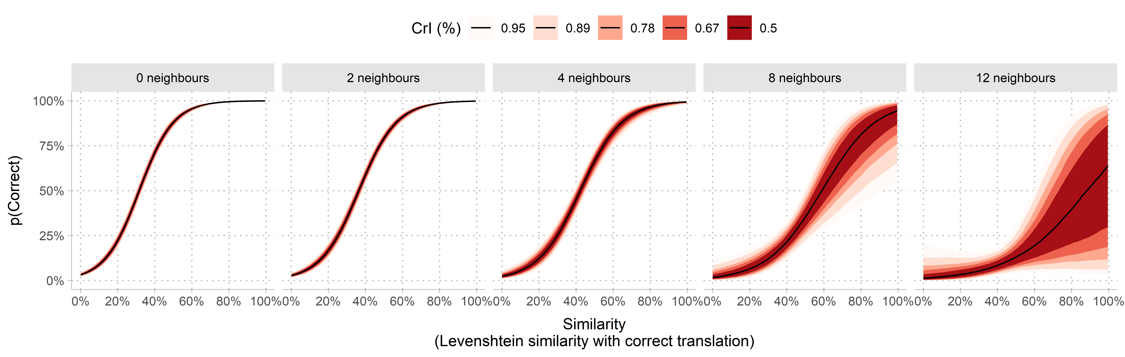
Results
Figure 3

Slide 28
Discussion
After removing responses with reported prior knowledge, results are equivalent to Experiment 1
In the absence of prior knwledge, participants exploit phonological similarity to provide correct translations

Slide 29
General discussion
We explored the psycholinguistic bases of homophonic translation
Auditory words from an unfamiliar language trigger native-like dynamics of lexical activation and selection
Listeners are able to exploit to non-native speech signal to translate unfamiliar words with surprisingly high accuracy
When presented language and native language are typologically close, participants benefited from phonological similarity more strongly
Larger pool of words and word-pairs
References
Dupoux, Emmanuel, Kazuhiko Kakehi, Yuki Hirose, Christophe Pallier, and Jacques Mehler. 1999. “Epenthetic Vowels in Japanese: A Perceptual Illusion?” Journal of Experimental Psychology: Human Perception and Performance 25 (6): 1568.
Gasparov, Mikhail Leonovich. 2006. Semen Kirsanov. Semen. Stikhotvorenija i poemy. Sankt-Peterburg: Akademicheskij proekt.
Peperkamp, Sharon, Inga Vendelin, and Kimihiro Nakamura. 2008. “On the Perceptual Origin of Loanword Adaptations: Experimental Evidence from Japanese.” Phonology 25 (1): 129–64.

Slide 30
Notes
1. Typos up to 1 edit distance counted as correct.

