Slide 1
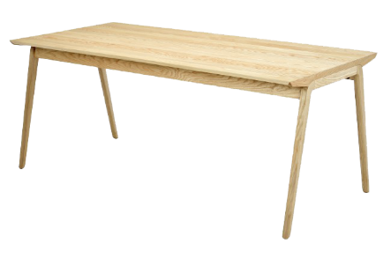

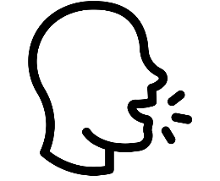
Semantic representations
Phonological representations
Spanish
Visual recognition
Phonological retrieval
/’me.sa/
Articulation

Slide 2
Semantic representations
Phonological representations
Spanish
/’me.sa/
Articulation
Visual recognition
Phonological retrieval
/’taw.lə/
Catalan

Slide 3
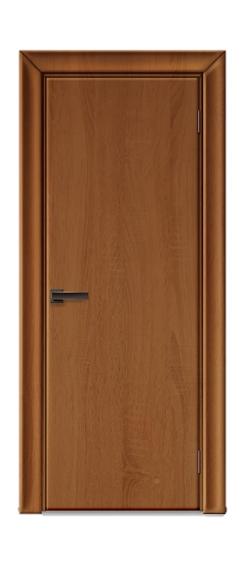
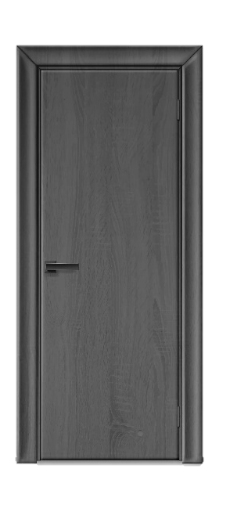
Semantic representations
Phonological representations
Spanish
/’pweɾ.ta/
Articulation
Visual recognition
Cross-language activation
Phonological retrieval
/’pɔɾ.tə/
Catalan

Slide 4


Phonological representations
Semantic representations
Spanish
Repeated exposure
Word learning
/’me.sa/
/’me.sa/
1
2

Slide 5
Phonological representations
Semantic representations
Spanish
/’taw.lə/
/’me.sa/
/’me.sa/
/’taw.lə/
Catalan

Slide 6
Phonological representations
Semantic representations
Spanish
/’me.sa/
/’me.sa/
Cross-language link
/’taw.lə/
/’taw.lə/
Catalan

Slide 7
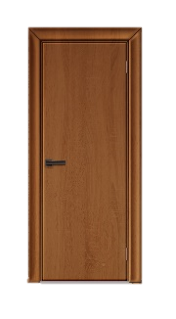
Phonological representations
Semantic representations
Spanish
/’pweɾ.ta/
/’pweɾ.ta/
/’pɔɾ.tə/
/’pɔɾ.tə/
Catalan

