Slide 1
Low proficiency
High proficiency

Slide 2
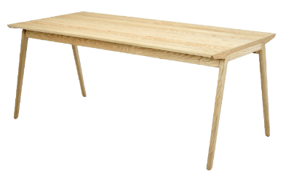
Concept
Comprehension
Production
table
Word (L1)

Slide 3
Concept
Comprehension
Comprehension
Production
Production
table
mesa
Word (L1)
Word (L2)

Slide 4
Concept
table
mesa
Word (L1)
Word (L2)

Slide 5
Concept
Conceptual route
table
mesa
Word (L1)
Word (L2)

Slide 6
Concept
Conceptual route
table
mesa
Word (L1)
Lexical route
Word (L2)

Slide 7
Concept
Conceptual route
table
mesa
Word (L1)
Lexical route
Word (L2)

