Slide 1
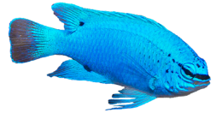
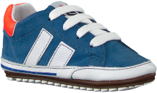
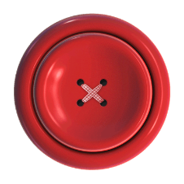
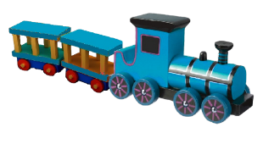
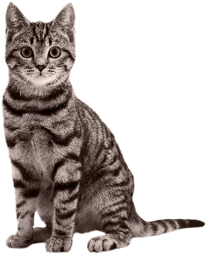



PRIME
0-1,500 ms
INTERVENING
1,500-3,000 ms
TARGET-DISTRACTOR
3,000-5,000 ms
“¡mira!” [look!]
Related - Word
“botón” [button]
“¡mira!” [look!]
Unrelated - Word
“gato” [cat]
“¡mira!” [look!]
Related - Tone
“beep”
“¡mira!” [look!]
Unrelated - Tone

Slide 2


Monolingual
1 concept, 1 label
Bilingual
1 concept, 2 labels
“gato”
“gato”
“cat”

Slide 3

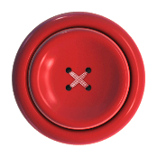

BSI
Delayed response to category A
ANIMALS
CLOTHES
ANIMALS

