Slide 1




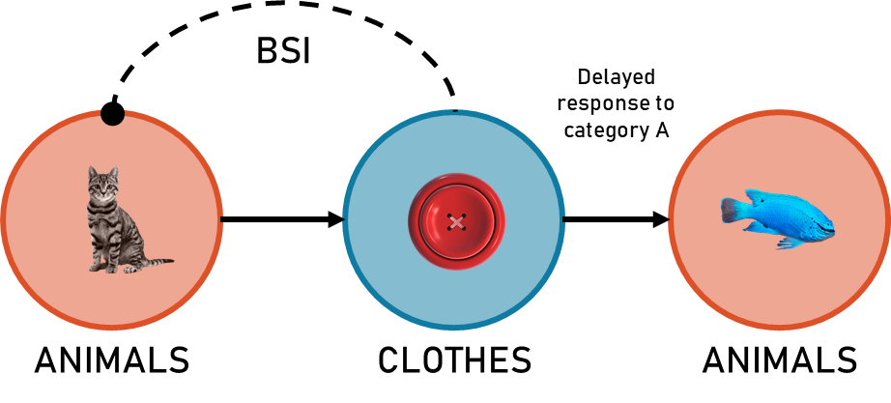
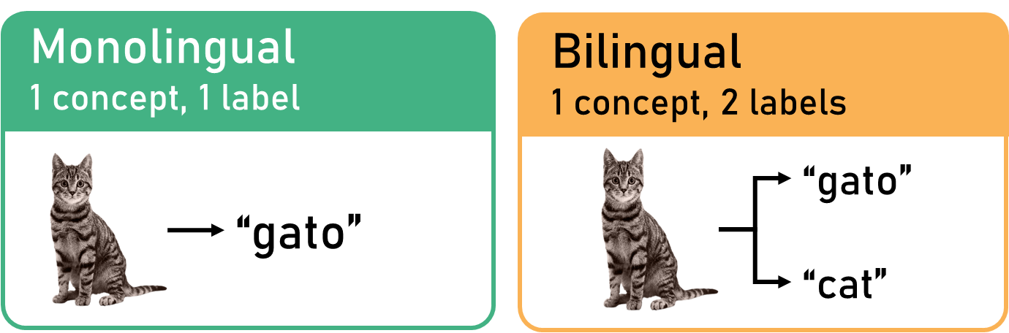
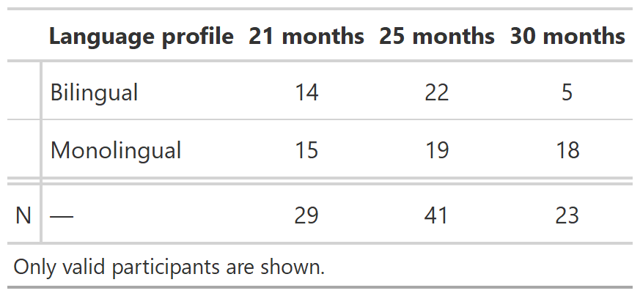
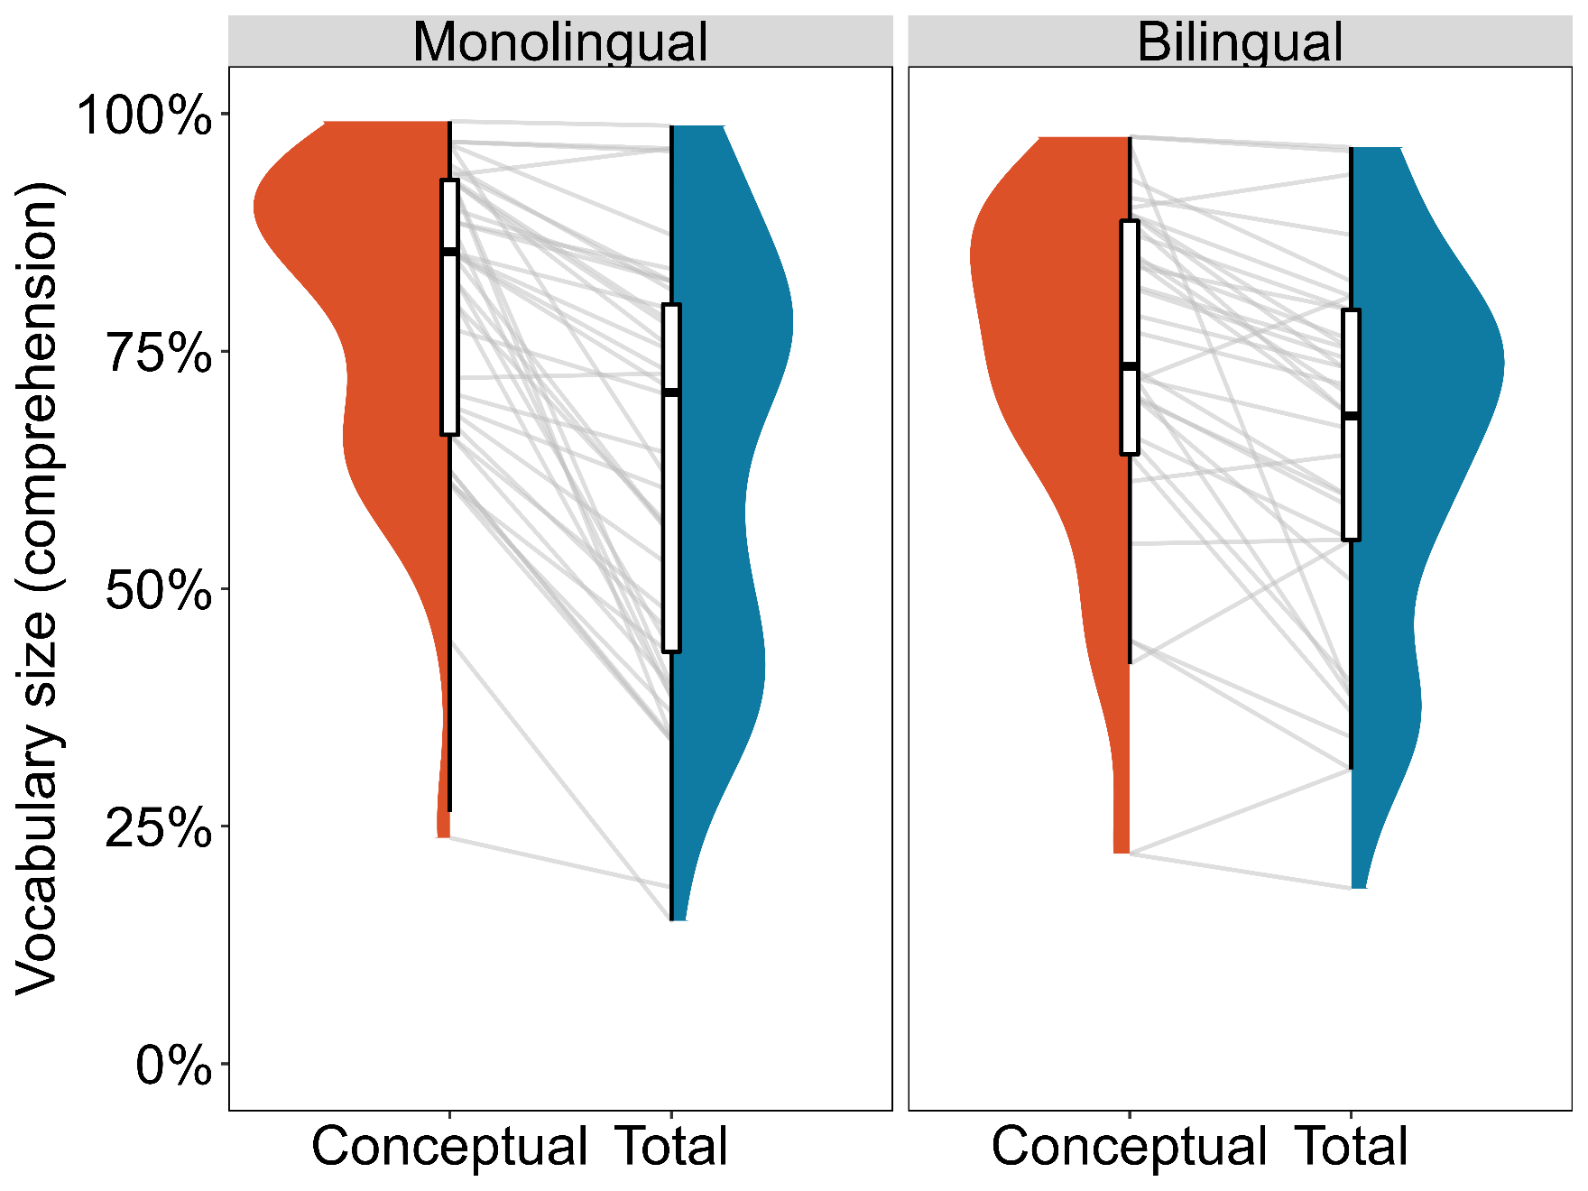
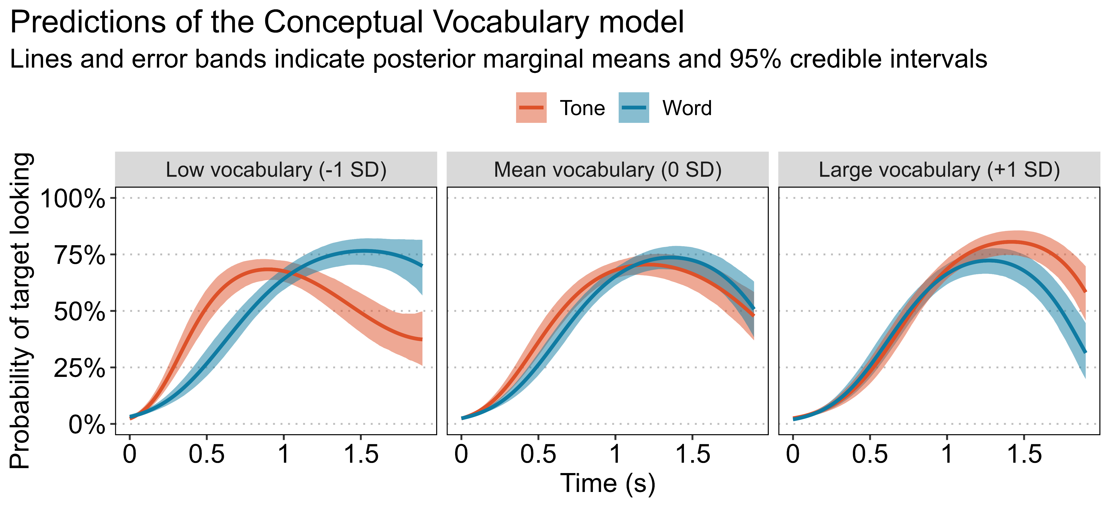
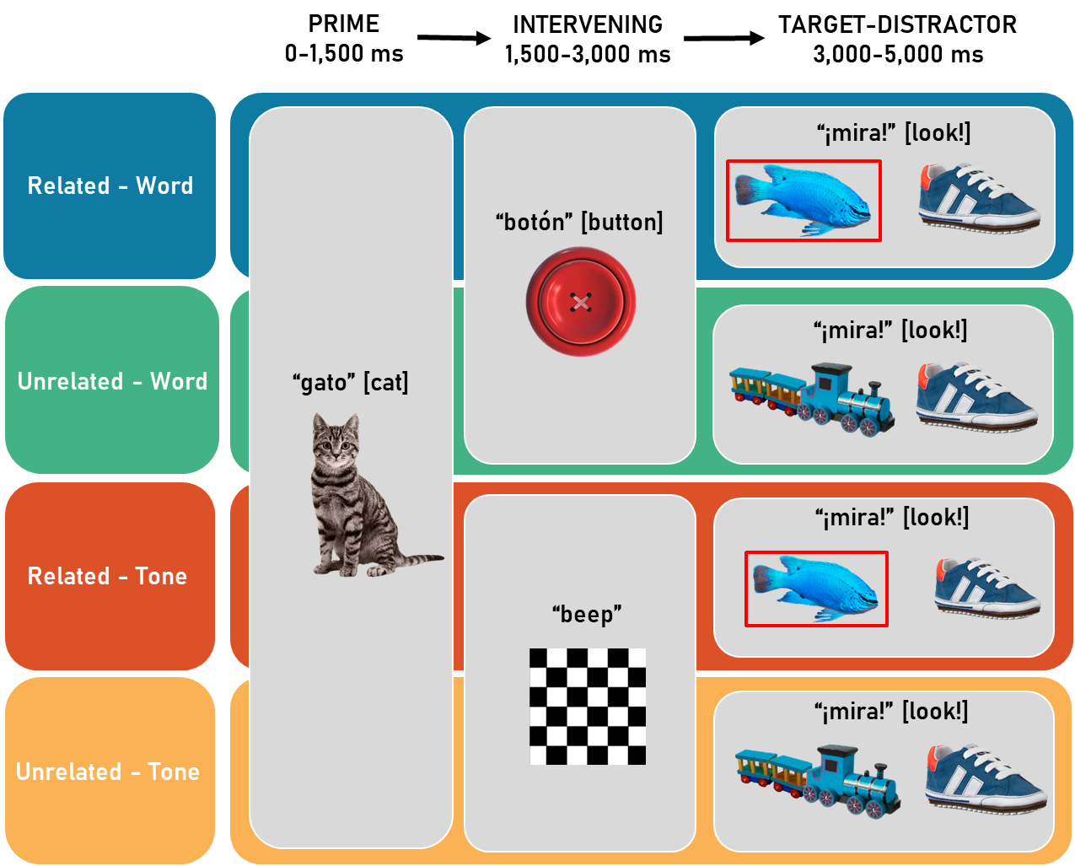

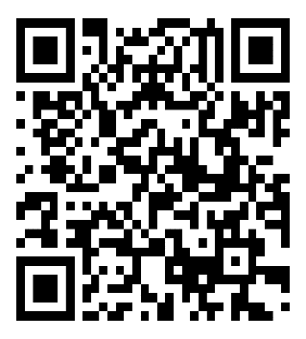


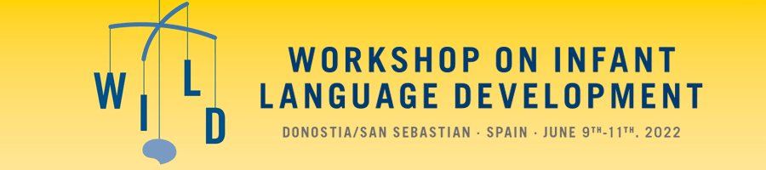
The emergence of inhibitory links in the developing lexicon: Insights from bilingual participants
gonzalo.garciadecastro@upf.edu
@gongcastro
Gonzalo Garcia-Castro, Serene Siow, Irina Lepadatu, Nicola A. Gillen, Daniela S. Avila-Varela, Núria Sebastian-Galles & Kim Plunkett
Introduction
It was proposed that a sufficiently large vocabulary size is required for strong semantic categories to form, and trigger inhibition between categories [4].
But previous studies are based on monolingual samples.
Inhibitory links between mental representations are a key developmental milestone in language acquisition. [1]
Backward Semantic Inhibition (BSI)
After switching attention from semantic category A (cat, animals) to category B (button), returning to A (fish) is inhibited. [2]
Emerges between 18 and 24 months [3].
For monolinguals, the # of acquired concepts should be equal to the # of words they know
For bilinguals we can differentiate between [5]:
Total vocabulary: # of acquired words
Conceptual vocabulary: # of concepts for which a word has been acquired
Is BSI driven by the growth of total or conceptual vocabulary?
Participants
Tested longitudinally in Barcelona (Spain)
Bilingual if >80% L2 exposure
Vocabulary size computed from the % words participants were reported to understand from a vocabulary checklist.
Results
Bayesian multilevel logistic regression model in {brms} [6]
Growth Curve Analysis [7]
Conceptual vocabulary size model has slighly better predictive performance than total vocabulary model, given the data (LOO_{diff} = -2.5, SE = 1.9)
Intervening words decreased the probability of target looking, compared to intervening tones only in low vocabulary participants.
Related trials
Design
Target fixations measured using an eye-tracker
Related - Word
Category shift
animals-clothes-animals
BSI expected
Conclusions
Inhibitory links between semantic categories more likely driven by conceptual vocabulary rather than total vocabulary size
Contrary to our predictions, lower vocabulary sizes are associated with stronger BSI effects
Future research will investigate the underlying mechanisms behind this unexpected effect
Related - Tone
No category shift
animals-X-animals
BSI not expected
References
[1] Willits, J. A., Wojcik, E. H., Seidenberg, M. S., & Saffran, J. R. (2013). Toddlers activate lexical semantic knowledge in the absence of visual referents: Evidence from auditory priming. Infancy, 18(6), 1053-1075.
[2] Fuentes, L. J., Vivas, A. B., & Humphreys, G. W. (1999). Inhibitory mechanisms of attentional networks: Spatial and semantic inhibitory processing. Journal of Experimental Psychology: Human perception and performance, 25(4), 1114.
[3] Chow, J., Aimola Davies, A. M., Fuentes, L. J., & Plunkett, K. (2016). Backward semantic inhibition in toddlers. Psychological Science, 27(10), 1312-1320.
[4] Chow, J., Aimola Davies, A. M., Fuentes, L. J., & Plunkett, K. (2019). The vocabulary spurt predicts the emergence of backward semantic inhibition in 18‐month‐old toddlers. Developmental science, 22(2), e12754.
[5] Core, C., Hoff, E., Rumiche, R., & Señor, M. (2013). Total and conceptual vocabulary in Spanish–English bilinguals from 22 to 30 months: Implications for assessment.
[6] Bürkner, P. C. (2017). Advanced Bayesian multilevel modeling with the R package brms. arXiv preprint arXiv:1705.11123.
[7] Mirman, D. (2017). Growth curve analysis and visualization using R. Chapman and Hall/CRC.
PGC2018-101831-B-I00

