Slide 1
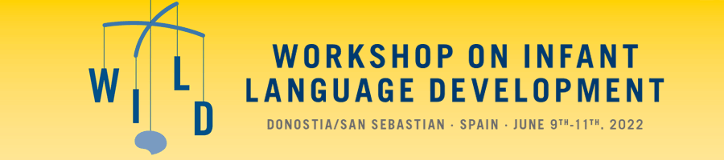
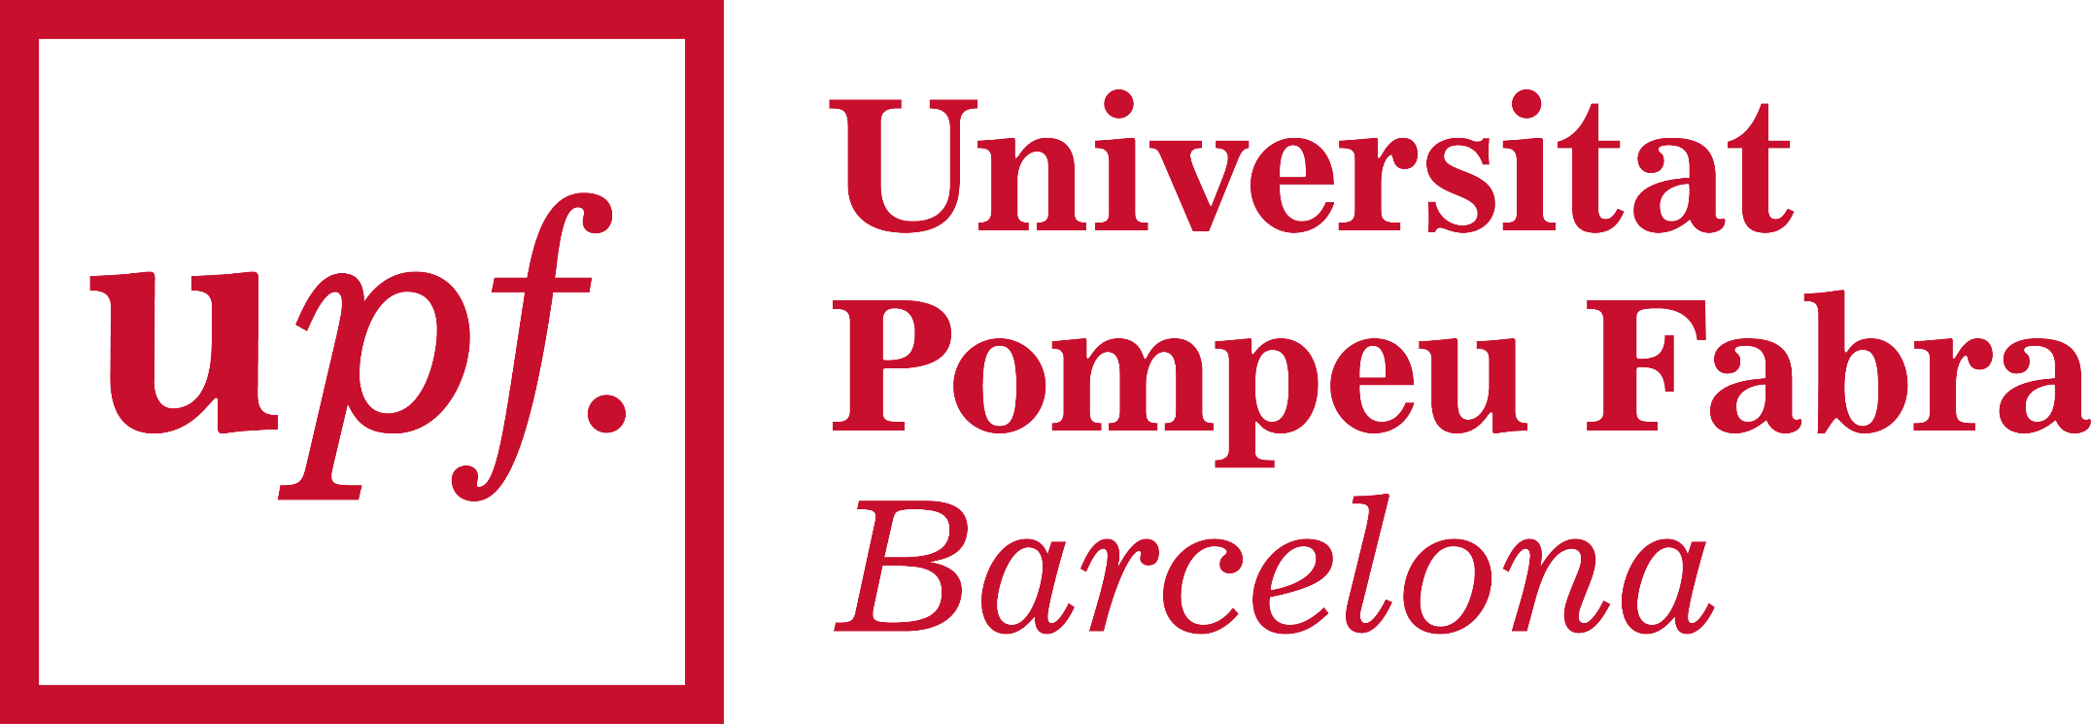


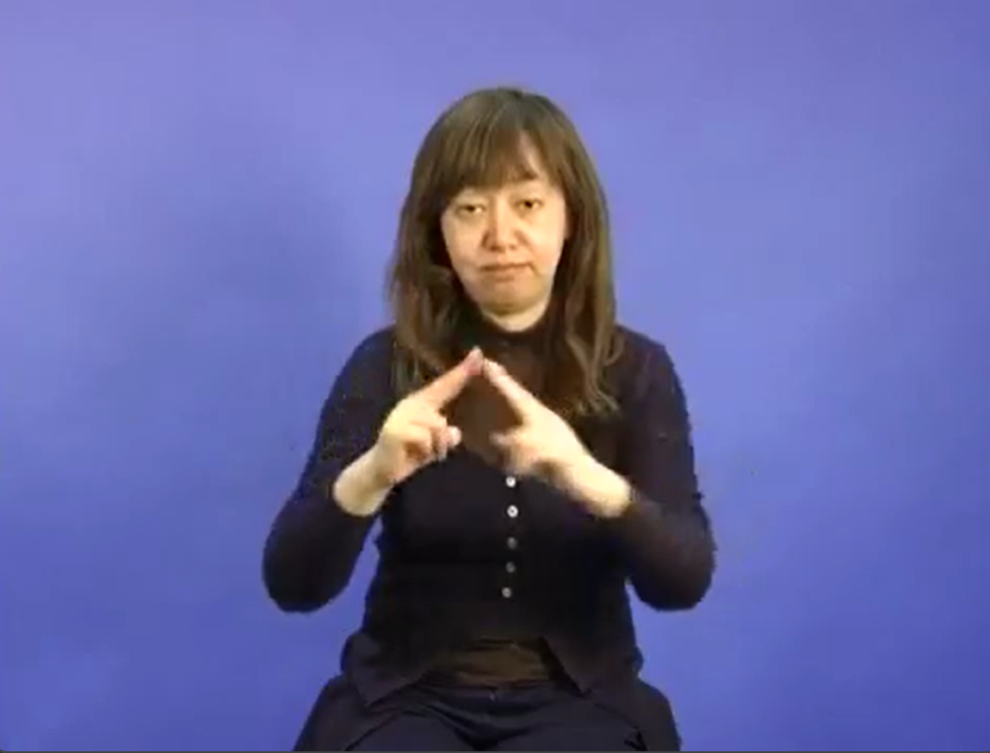
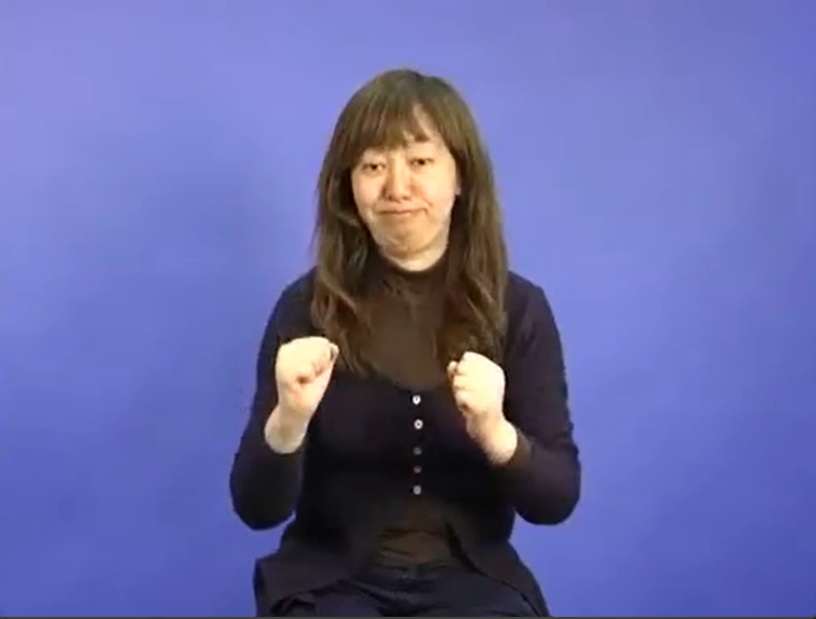

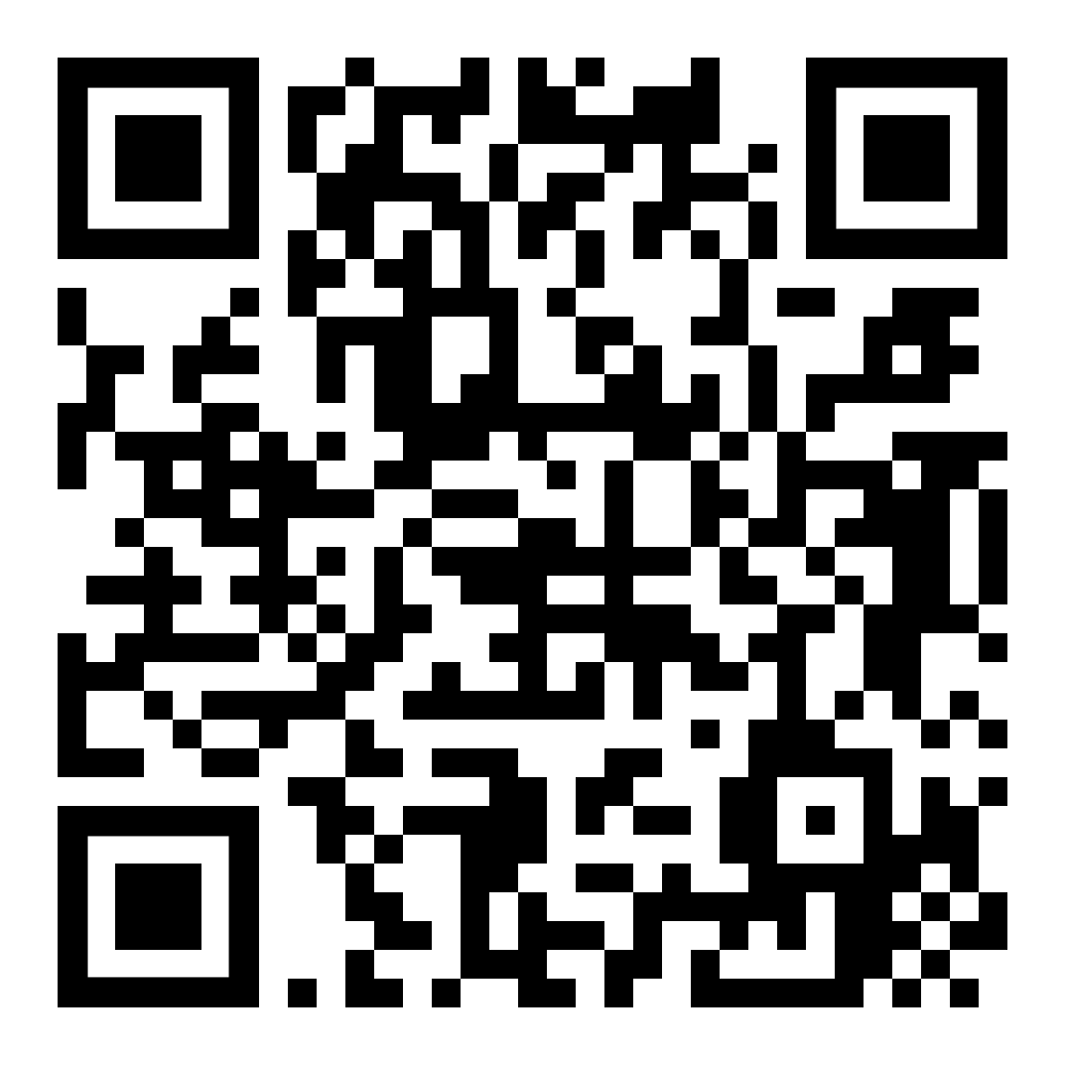
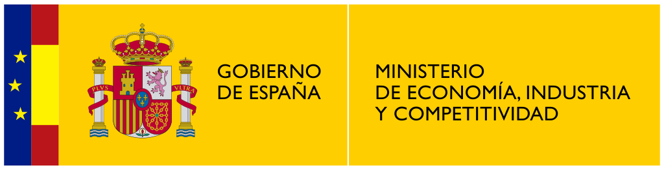

Selective attention to the mouth of signing faces
Konstantina Zacharaki¹ , Gonzalo Garcia-Castro¹ & Nuria Sebastian-Galles¹
¹ Center for Brain and Cognition, Universitat Pompeu Fabra
konstantina.zacharaki@upf.edu
@KZacharaki
@gongcastro
Introduction
Data analysis
Infants show a U-shaped scanning pattern of talking faces: preference to the mouth increases, then decreases with age¹
Bilinguals (BIL) look longer to the mouth than monolinguals (MON) ^{2, 3}
Sign language is predominantly visual
Generalized Bayesian multilevel model in brms
Zero-inflated Beta link distribution
ptlt ~ aoi * age_group * lang_profile + (1 + aoi | id)
ptlt: proportion of total looking time
aoi: Area of interest (eyes vs. mouth)
age_group: 8 months vs. 12 months
lang_profile: Monolinguals vs. Bilinguals
id: participant index
Research question
Will 8- and 12-month-old MON and BIL infants look similarly to a person signing?
Results
Methods
Stimuli
British SL
Japanese SL
Participants
Age | Monolinguals | Bilinguals
8 mo | 13 | 14
12 mo | 17 | 11
Procedure
Watch short videos on a 24’’ screen in blocks of 5 in each language (BSL/JSL) (max. 11 min)
Gaze registered using eye-tracker
References
[1] Lewkowicz, D. J., & Hansen-Tift, A. M. (2012). Infants deploy selective attention to the mouth of a talking face when learning speech. Proceedings of the National Academy of Sciences, 109(5), 1431–1436. https://doi.org/10.1073/pnas.1114783109
[2] Ayneto, A., & Sebastian‐Galles, N. (2017). The influence of bilingualism on the preference for the mouth region of dynamic faces. Developmental Science. https://doi.org/10.1111/desc.12446
[3] Pons, F., Bosch, L., & Lewkowicz, D. J. (2015). Bilingualism Modulates Infants’ Selective Attention to the Mouth of a Talking Face. Psychological Science. https://doi.org/10.1177/0956797614568320
Conclusions
Poster, materials and code here!
Mouth preference in all groups, which increases with age
No shift back to eye preference at 12 mo: sign language perceived as non-native speech?

