Slide 1




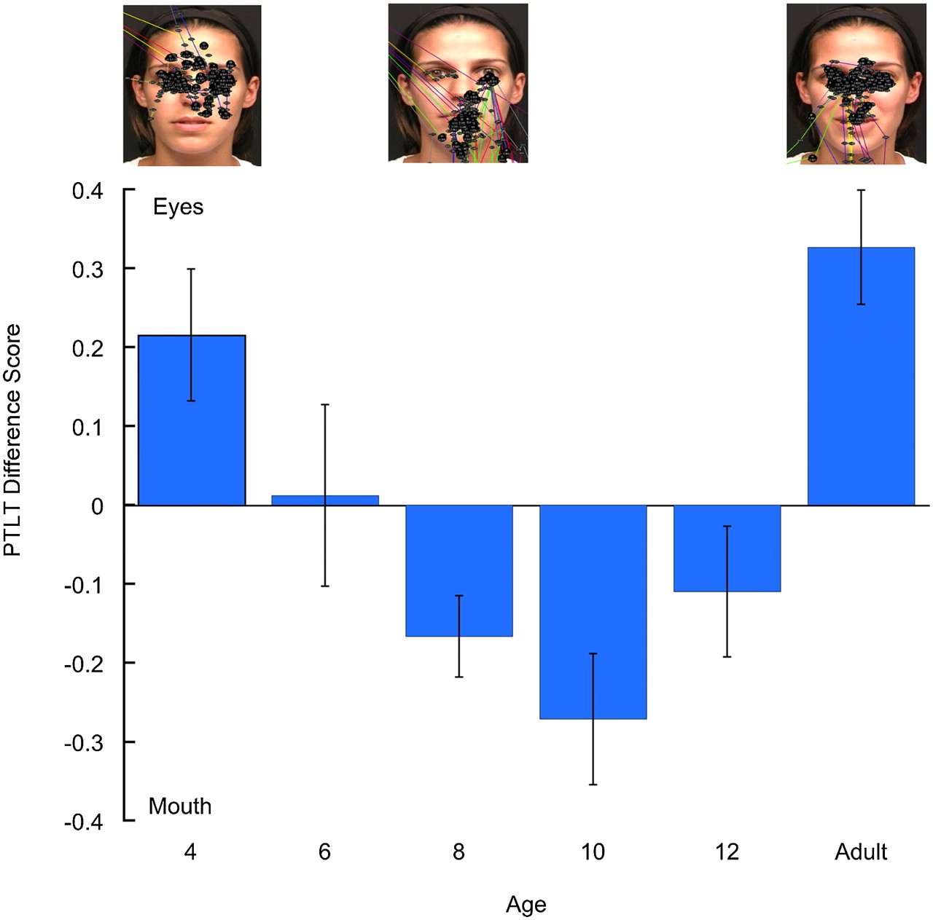
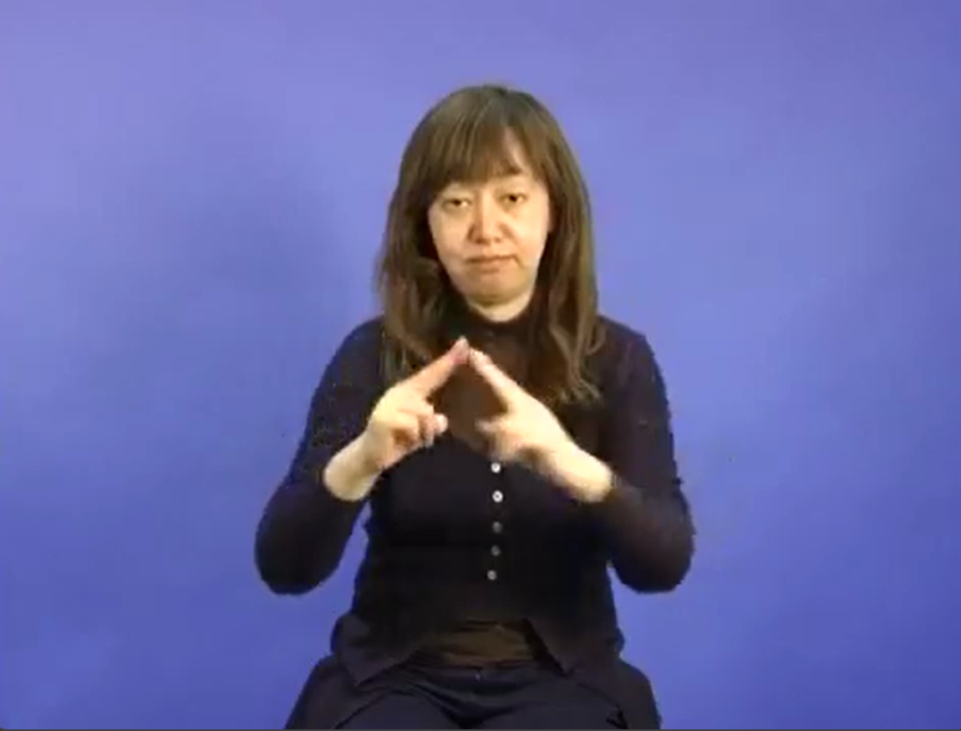




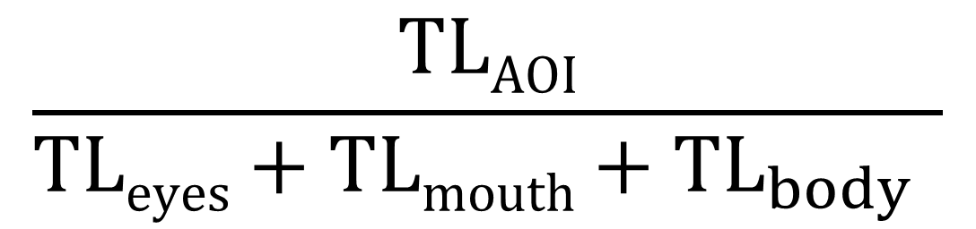
Selective attention to the mouth of signing faces
Konstantina Zacharaki¹ , Gonzalo Garcia-Castro¹ & Nuria Sebastian-Galles¹
¹ Center for Brain and Cognition, Universitat Pompeu Fabra
konstantina.zacharaki@upf.edu
@KZacharaki
@gongcastro
Introduction
Procedure
Infants show a U-shaped scanning pattern of talking faces¹
Passive watching of ∼10 secs videos of a person signing in each language (27 videos in BSL/ 27 videos in JSL) presented in blocks of 5 (max. 11 min)
Similar patterns with non-linguistic videos²
Gaze registered using eye-tracker (Tobbi Pro Spectrum).
PTLT formula (Pons et al., 2015)
$$\frac{TLAOI}{TLeyes+TLmouth+{TL}_{body} }$$
Sign language is predominantly visual
AOIs: eyes, mouth, body
Results
Nacar et al. (in prep.) found that 8 mo but not 12 mo can discriminate BSL from JSL
Generalized Bayesian multilevel model in brms
Zero-inflated Beta link distribution
ptlt ~ aoi * age_group + (1 + aoi | participant)
No effect of bilingualism
Where will 8 and 12 mo infants look at when seeing a person signing?
Will this effect be modulated by bilingualism as sometimes reported in other types of audiovisual processing^{2, 3}
Participants
Age | Monolinguals | Bilinguals
8 mo | 13 | 14
12 mo | 17 | 11
References
[1] Lewkowicz, D. J., & Hansen-Tift, A. M. (2012). Infants deploy selective attention to the mouth of a talking face when learning speech. Proceedings of the National Academy of Sciences, 109(5), 1431–1436. https://doi.org/10.1073/pnas.1114783109
[2] Ayneto, A., & Sebastian‐Galles, N. (2017). The influence of bilingualism on the preference for the mouth region of dynamic faces. Developmental Science. https://doi.org/10.1111/desc.12446
[3] Pons, F., Bosch, L., & Lewkowicz, D. J. (2015). Bilingualism Modulates Infants’ Selective Attention to the Mouth of a Talking Face. Psychological Science. https://doi.org/10.1177/0956797614568320
Conclusions
Poster, materials and code here!
Mouth preference in all groups, which increases with age
No shift back to the eyes
Gaze patterns were not modulated by languauge profile

