Slide 1
Biological Sequence Analysis
Genomic medicine

Slide 2
Outline
Applications of bioinformatics (NGS in particular) in the pharmaceutical industry
  Use the field of oncology as an example
    Pre-clinical research
    Drug development
    Disease diagnosis
Frontiers of genomics
Towards the future of Genomic Medicine

Slide 3
Drug development process
Drug Discovery and target validation
Preclinical Research
Clinical Trials
New Drug Application and FDA Approval
For all the three major steps leading to a new drug application (drug discovery and target validation, preclinical research and clinical trials), genomics and bioinformatics are needed.

Slide 4
Genomics and Bioinformatics in drug discovery and target validation
A drug company chooses a gene or protein to target with a drug molecule. The company needs to confirm that the gene or protein is indeed involved with the disease in question.
The availability of large genomics datasets such as the TCGA data and Depmap data offers the opportunity of “virtual” hypothesis generation and testing, which enables better selection of targets based on genomics and “virtual” target validation.

Slide 5
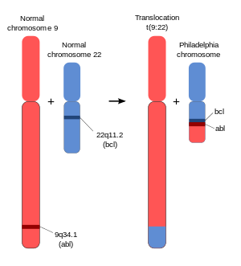
Genomics enables better selection of drug target
Case Study 1
The so-called Philadelphia chromosom is a translocation, in which parts of chromosomes 9 and 22 swap places. The resulting fusion gene is created by juxtaposing the ABL1 genes to a part of the BCR gene.
The Abl gene expresses a membrane-associated protein, a tyrosine kinase, and the BCR-ABL transcript is also translated into a tyrosine kinase.
https://en.wikipedia.org/wiki/Philadelphia_chromosome

Slide 6
Genomics enables better selection of drug target
Case Study 1
Philadelphia chromosomes are often found in acute lymphoblastic leukemia (ALL) or chronic myeloid leukemia (CML).
Philadelphia chromosomes are NOT present in healthy cells, and they are only present in tumor cells.
Imatinib (Gleevec) blocks the activity of the BCR-ABL fusion protein, and has been successfully used to treat CML and ALL patients that are Philadelphia chromosome-positive (Ph+).
https://www.cancer.gov/research/progress/discovery/gleevec

Slide 7
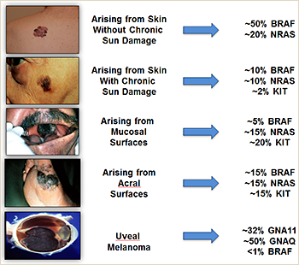
Genomics enables better selection of drug target
Case Study 2
BRAF is the most commonly mutated gene in melanoma.
https://www.mycancergenome.org/content/disease/melanoma/

Slide 8
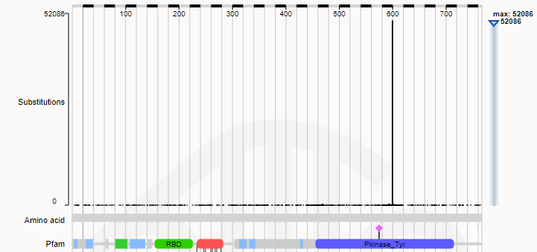
Genomics enables better selection of drug target
Case Study 2
The majority of BRAF mutations in melanoma is V600E.
https://cancer.sanger.ac.uk/cosmic/gene/analysis?ln=BRAF

Slide 9
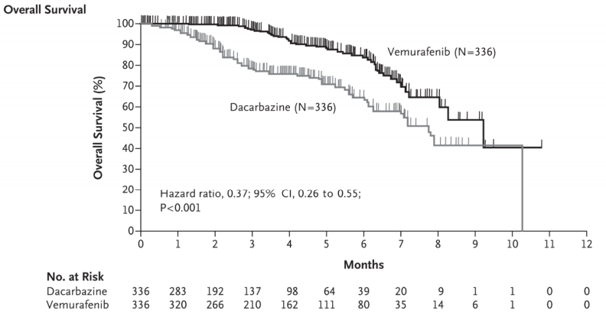
Genomics enables better selection of drug target
Case Study 2
BRAF V600E specific inhibitor (Vemurafenib) offers better treatment outcomes than Dacarbazine (chemotherapy agent in standard of care) for patients with metastatic melanoma with the BRAF V600E mutation
Chapman et al. N Engl J Med, 2011

Slide 10
Genomics and Bioinformatics in preclinical research
The safety and efficacy of the drug molecule are evaluated in vitro and in vivo: in test tubes and on animal models and cell cultures.
Genomics are very useful in preclinical research for drug development: determination of mechanism of action (MOA), and characterization of resistance mechanisms.

Slide 11
MOA characterization using RNA-Seq
RNA-Seq is commonly used in the pharmaceutical industry to characterize the MOA of drug molecules:
Samples
Treated by drug
Samples with No Treatment
RNASeq
Differential gene expression and pathway analysis

Slide 12
Characterization of resistance mechanisms using DNA-Seq
Tumors often develop resistance after a certain treatment.
Many (not all) resistances are caused by new mutations in the tumor DNA. Identification of these mutations can offer insights into the resistance mechanism and new targets for drug development.
DNA-Seq can be used to characterize the mutations in the resistant tumors.

Slide 13
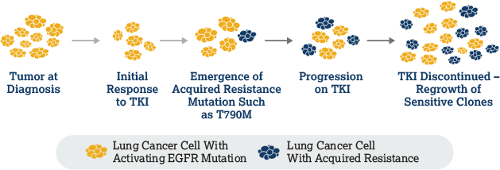
Characterization of resistance mechanisms using DNA-Seq
Case Study 3
Many non-small cell lung cancer (NSCLC) tumors develop acquired drug resistance to 1st/2nd generation EGFR-TKI therapy (TKI, tyrosine kinase inhibitor).
https://www.diagnosticnavigator.com/e-learning/play-course.html?moduleId=module-us3&chapterId=egfr-chapter-3&index=0

Slide 14
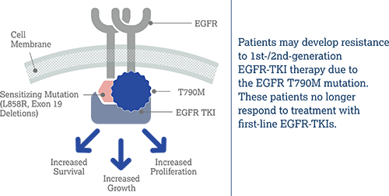
Characterization of resistance mechanisms using DNA-Seq
Case Study 3
As many as 2 out of 3 patients who become resistant to 1st-/2nd-generation EGFR-TKIs do so because of an acquired T790M mutation in the EGFR gene.
https://www.diagnosticnavigator.com/e-learning/play-course.html?moduleId=module-us3&chapterId=egfr-chapter-3&index=0

Slide 15
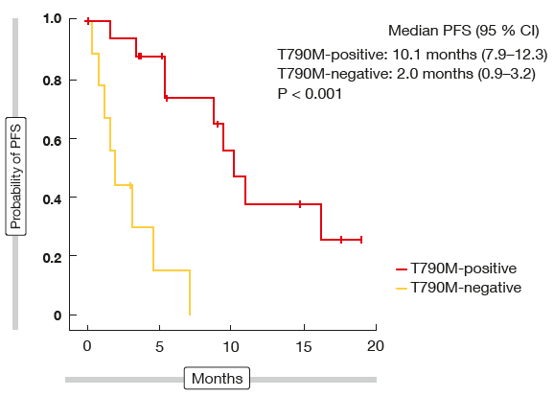
Characterization of resistance mechanisms using DNA-Seq
Case Study 3
Osimertinib, developed specifically for the T790M mutation, offered good treatment results for patient positive for this resistance mutation.
http://memoinoncology.com/congress-reports/wclc/taking-anti-egfr-drug-treatment-later-lines/

Slide 16
Genomics and Bioinformatics in clinical trials
The safety and efficacy of the drug molecule are evaluated in human patients enrolled in clinical trials.
Biomarkers are very important in clinical trials. There are many kinds of biomarkers, such as protein IHC, qPCR, NGS etc. NGS is becoming more and more important in clinical trial biomarkers.
Some of the application of NGS in clinical trial biomarkers are: patient stratification, longitudinal monitoring of allele frequencies using cfDNA and pharmacodynamics (PD) biomarker identification and profiling.

Slide 17
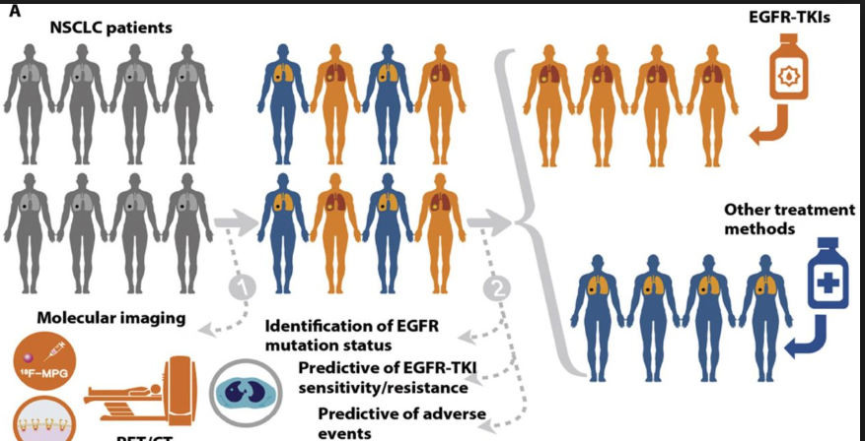
Patient stratification using EGFR mutation status
Sun et al. Science Translational Medicine, 2018

Slide 18
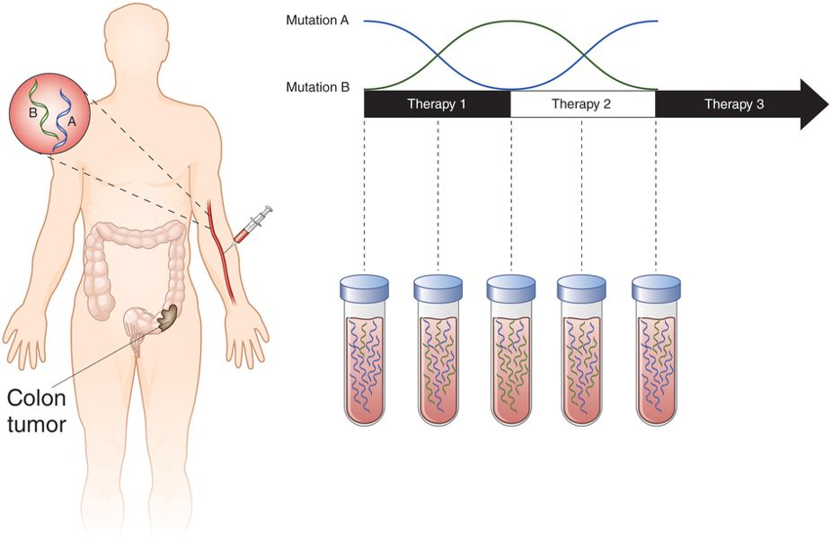
Mutation monitoring using liquid biopsy (cfDNA) in colon cancer patients
Meador and Lovly. Nature Medicine, 2015

Slide 19
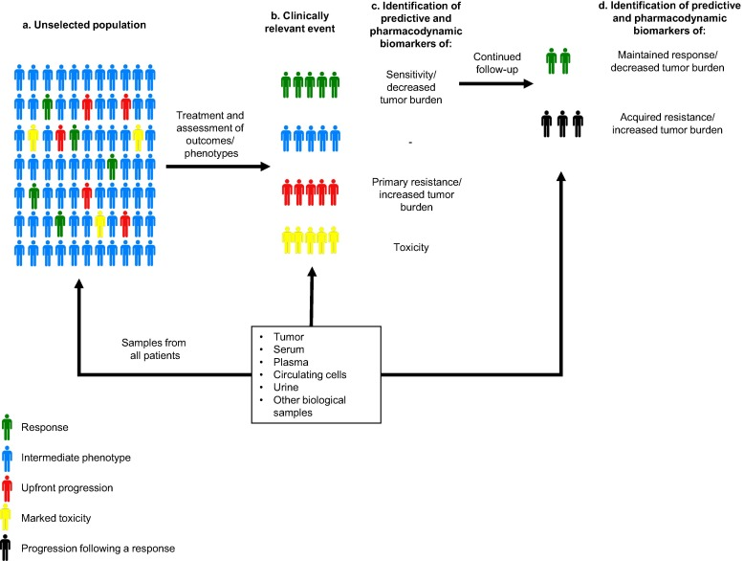
Identification of PD biomarkers
Perez-Gracia et al. Cancer Treatment Reviews, 2017

Slide 20
Frontiers of genomics/bioinformatics
There are many ongoing research frontiers in genomics and bioinformatics.
In terms of NGS, the most exciting research frontier lies in single cell sequencing.

Slide 21
The future of genomic medicine (oncology in particular)
Genomics-driven target selection and validation is the norm rather than the exception in the industry.
The integration of various NGS and –omics data is key to the successful application of genomics and bioinformatics.
With more and more data becoming available, machine learning algorithms, which learn from the data, are going to be more important.

