Slide 1
Biological Sequence Analysis
Basic analysis

Slide 2
Outline
Brief summary of Python Programming
  Basic data types
  Control flow
  Functions
  Random number generator (for simulation)
  Code efficiency assessment
Basic sequence analysis:
  Reverse, complement, reverse complement
  DNA to Protein in silico translation
  In silico PCR
  Find the most frequent k-mer in a sequence and in a list of sequences
  Edit distance between two sequences of the same length
  Simulation: a simple prokaryotic gene scanning algorithm
Python modules for bioinformatics
Other programming languages

Slide 3
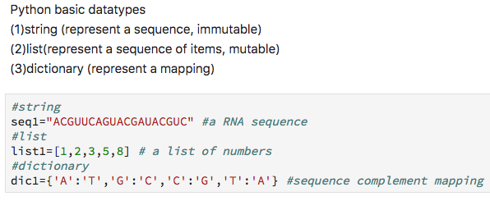
Python programming
Basic data type

Slide 4
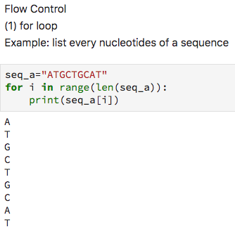
Python programming
Control flow

Slide 5
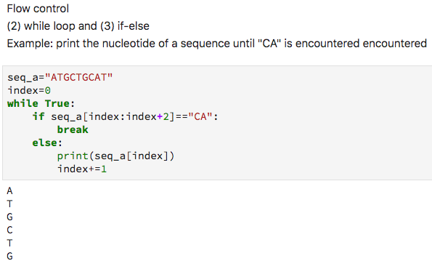
Python programming
Control flow

Slide 6
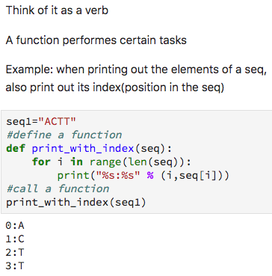
Python programming
Functions

Slide 7
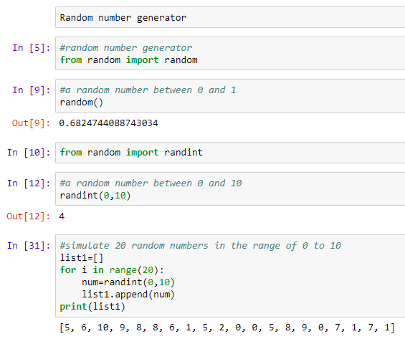
Python programming
Random number generator

Slide 8
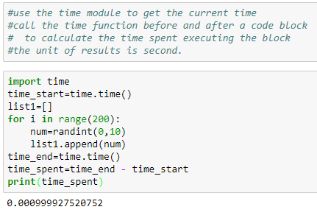
Python programming
Assess code efficiency

Slide 9
String search
Problem:
  Return the position of a substring in a given string, return (-1) if the substring is not found
  Just return the first matched position is enough.
Notes: python strings are 0-indexed, meaning that the first position is position 0.
Approaches to be evaluated:
  Brute force
  Default search algorithm in Python

Slide 10
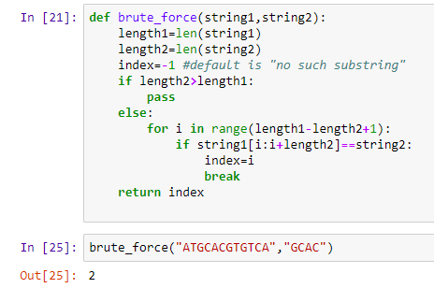
Python programming
Brute-force string search algorithm

Slide 11
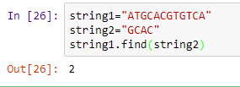
Python programming
Default string search algorithm in python
(the find function)

Slide 12
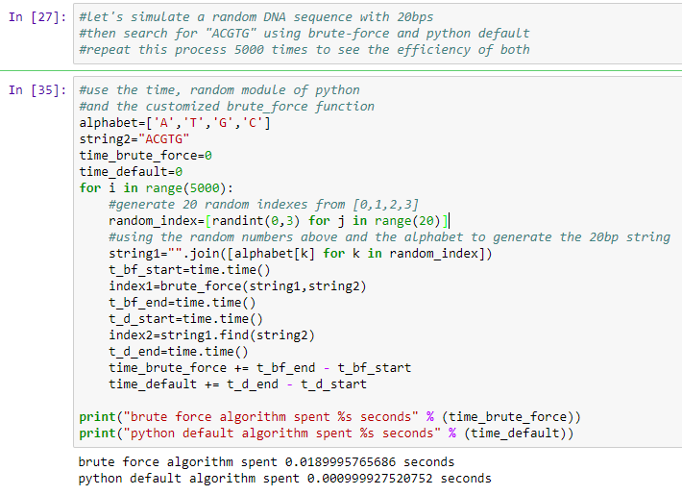
String algorithm comparison: brute-force vs python default

Slide 13
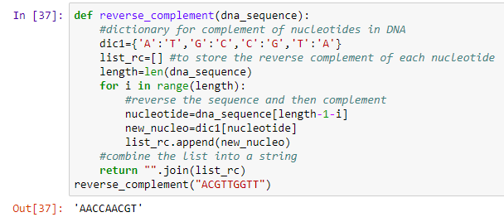
Sequence reverse complement

Slide 14
In silico translation
Given a RNA sequence, can you predict the corresponding protein sequence?
What data do you need for coming up with a computational solution?
Will your solution work for any RNA sequence? If not, why?

Slide 15
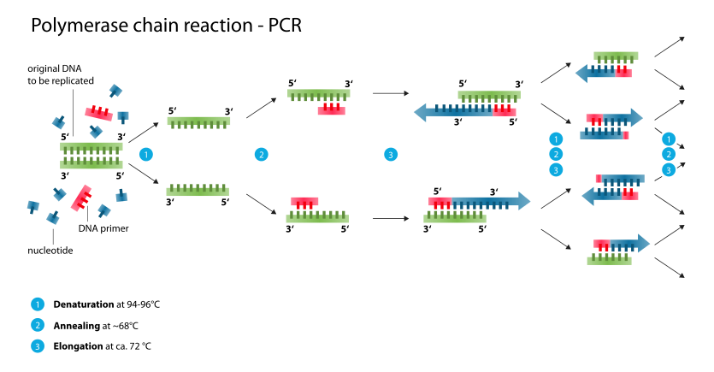
In silico PCR
Given two primers and a DNA sequence, can you come up with a function to return the in silico PCR product?

Slide 16
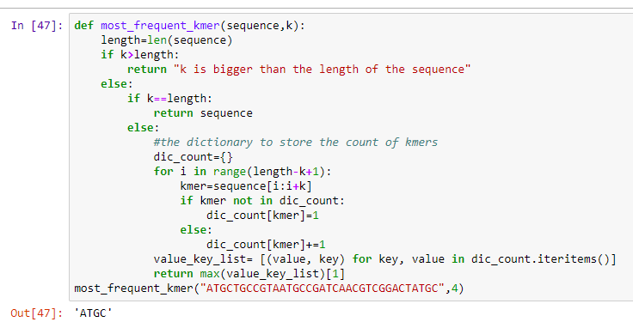
K-mer counting
Find the most frequent k-mer in a sequence
Can you modify the code above to find the most frequent k-mer in a list of sequences rather than just one sequence?

Slide 17
Edit distance
Edit distance is a measure of dissimilarity
position
1 | 2 | 3 | 4 | 5
A | T | G | C | C
A | C | G | C | T
Seq_a
Seq_b
For two sequences of the same length, I can define a distance function like this for example: distance(Seq_a,seq_b)=∑d(Seq_a[i], Seq_b[i]),
where d(Seq_a[i], Seq_b[i])=0 if Seq_a[i]=Seq_b[i]
and d(Seq_a[i}, Seq_b[i])=1 if Seq_a[i]≠Seq_b[i]
Can you implement a function to calculate the edit distance of two sequences of the same length using the distance function above?

Slide 18
Edit distance
Edit distance is a measure of dissimilarity
position
1 | 2 | 3 | 4 | 5
A | T | G | C | C
A | G | C | T
Seq_a
Seq_b
What would you do to calculate the dissimilarity of two sequences if they are not of the same length?

Slide 19
Gene scanning
Problem definition:
  Write a simple prokaryotic gene scanner (a python function); given a DNA sequence, return the open reading frame found in the sequence.
Hints:
  What is your gene model? In other words, how do you define a prokaryotic gene in the most simple way computationally (where to start, where to end, how long, genetic codon)?
  You do not need to use real data; you can just simulate a long random DNA sequence as the genome.

Slide 20
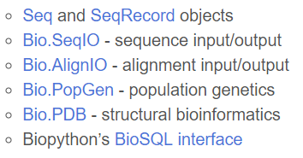
Python modules for bioinformatics
Biopython:
  https://biopython.org/
  Some key functionalies (https://biopython.org/wiki/Documentation):

Slide 21
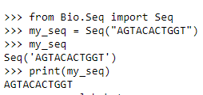
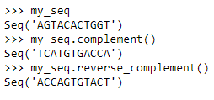
Biopython examples
Working with sequences
http://biopython.org/DIST/docs/tutorial

Slide 22
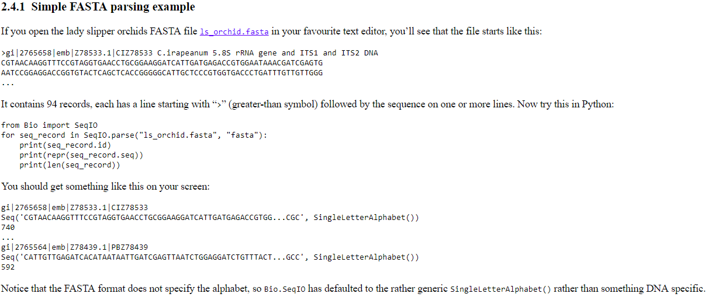
Biopython examples
File parsing
http://biopython.org/DIST/docs/tutorial

Slide 23
Other programming languages for bioinformatics
R:
  Python and R are the two most popular programming languages in bioinformatics and data science in general
Perl:
  Another popular scripting language in the bioinformatics community
Java
C/C++

Slide 24
Useful python modules
The following python modules are the most useful python modules for scientific computing and data science related tasks:
  Scipy
  Numpy
  Pandas
  Matplotlib

Slide 25
Additional resources
Practical coding books for bioinformatics (already recommended in week 1):
  A primer for computational Biology (both Python and R are included)
    http://library.open.oregonstate.edu/computationalbiology/
  Bioinformatics Programming Using Python:
    http://oez.es/Bioinformatics%20Programming%20Using%20Python.pdf

Slide 26
Summary
Python is a general purpose programming language that is also easy to learn and code.
Python is also very popular in the bioinformatics community.
There are many basic biological sequence analysis that could be done with python scripting. These toy examples not only help you learn how to apply python scripting to solve biological problems, but also lay the foundation for understanding more complex problems and algorithms.
There are other programming languages used in bioinformatics. R is another programming language that is very popular in bioinformatics.

