Slide 1
Biological Sequence Analysis
Sequence alignment

Slide 2
Outline
Pairwise sequence alignment
  Alignment between two sequences
Multiple sequence alignment
  Alignment of >2 sequences
Genomic alignment
  Aligning a sequence to the genome

Slide 3
Sequence alignment
Sequence alignment is a way of arranging two or more sequences (DNA, RNA, or protein) to identify regions of similarity.
How to define similarity or dissimilarity?

Slide 4
Similarity measure
How to measure the similarity between DNA sequences?
  Percentage of different nucleotides ?
  K-mer content correlation?
  Number of edit operations to change one sequence into another?
  Align the sequences and define distance functions based on the alignment?

Slide 5
Global and local alignment
Global alignment tries to find the best alignment between the entire length of one sequence and the entire length of another sequence, while local alignment can use just part of their sequences to obtain the optimal local matching (a maximum similarity score).
Both alignment methods use an approach called dynamic programming to store the alignment scores step by step in a table, and obtain the alignment by tracing the scores backwards in the table.

Slide 6


Global and local alignment
Example:
  Seq1: CGTGAATTCAT
  Seq2: GACTTAC
Global alignment
Local alignment
Global alignment tries to align the entirety of the sequences and is more tolerate of gaps, while local alignment tries to find the best local matches (subsequence matches) and has a higher punishment for alignment gaps.

Slide 7
Evaluating and inferring alignments
Edit distance
  Number of changes needed for converting a sequence (Seq1) into another (Seq2)
Scoring function
  Similarity(alignment) = score(mismatch)+ score(gap)+score(match)
Algorithm for inferring best alignment
  Dynamic programming

Slide 8
Dynamic programming
Create a table indexed by (i,j), the positions of Seq1 and Seq2
Fill the table from the start until the end with the score
The entire search space is guaranteed to be explored
The alignment could be obtained by tracing back the best scores step by step in the score matrix

Slide 9
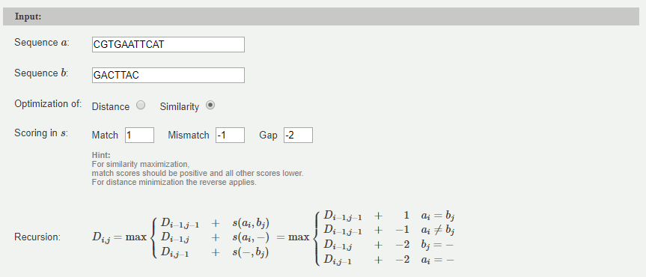
Global alignment
Needleman-Wunsch algorithm

Slide 10
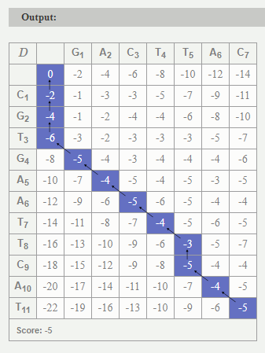

Global alignment
Needleman-Wunsch algorithm

Slide 11
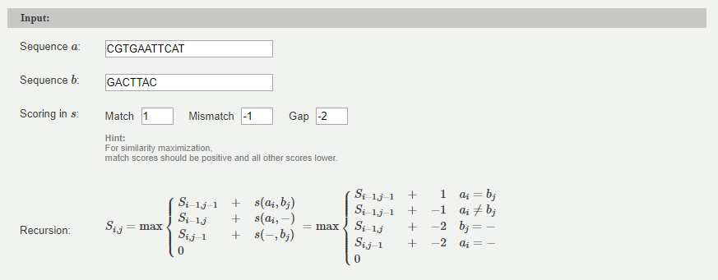
Local alignment
Smith-Waterman algorithm

Slide 12
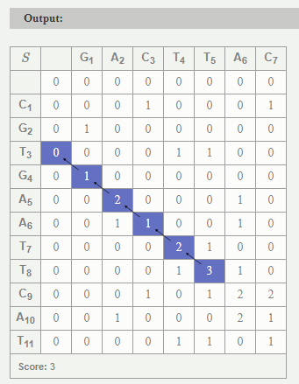

Local alignment
Smith-Waterman algorithm

Slide 13
Website to explore global and local alignment
You can use any two sequences and modify the scoring functions for match, mismatch and gap to see for yourself how alignment is performed.
Needleman-Wunsch
  http://rna.informatik.uni-freiburg.de/Teaching/index.jsp?toolName=Needleman-Wunsch
Smith-Waterman
  http://rna.informatik.uni-freiburg.de/Teaching/index.jsp?toolName=Smith-Waterman

Slide 14
Some applications of pairwise alignment
Check whether two sequences are homologous
Identify the conserved(shared) region/motif/domain
Characterize the differences of the two sequences (mutations, insertion or deletions)

Slide 15
Websites for pairwise alignment
http://www.sacs.ucsf.edu/Resources/sequenceweb.html
https://www.ebi.ac.uk/Tools/psa/

Slide 16
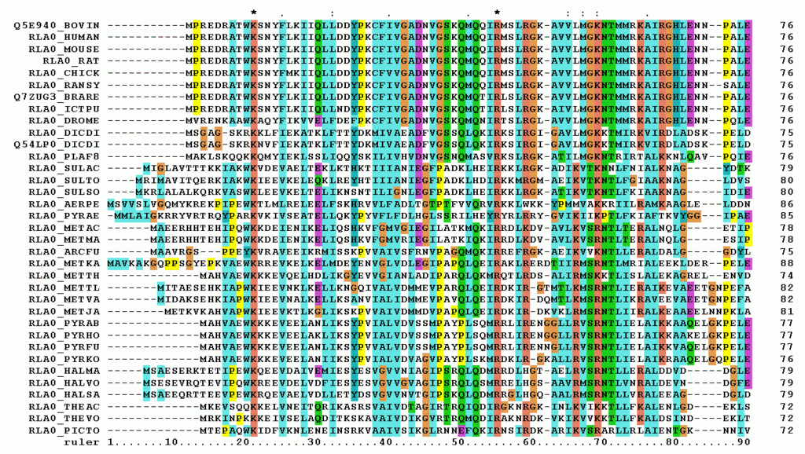
Multiple sequence alignment (MSA)
Alignments of more than two sequences
https://en.wikipedia.org/wiki/Multiple_sequence_alignment

Slide 17
Some applications of MSA
MSA of DNA sequences of the same gene from multiple species:
  Identify conserved regions (important coding and noncoding elements)
MSA of protein sequences of the same family:
  Locate important functional features such as catalytic domains
MSA of RNA sequences of the same gene from multiple species:
  Find conserved regions (potentially important for RNA secondary structure formations)

Slide 18
Websites for alignment tools
http://www.sacs.ucsf.edu/Resources/sequenceweb.html
https://www.ebi.ac.uk/Tools/msa/

Slide 19

MSA toy example
Use MUSCLE in the EBI website:
  https://www.ebi.ac.uk/Tools/msa/muscle/
Create an input fasta file
  Fasta format:https://en.wikipedia.org/wiki/FASTA_format
  Content of the example input file (in fasta format):
    >seq1
    ATGCCGTCGTAC
    >seq2
    ATGCCGAAGTTC
    >seq3
    ATCCCGTATAC
Output from MUSCLE:

Slide 20
MSA example
Find the TP53 protein sequences for human, mouse, rat and pig in the uniprot database (https://www.uniprot.org)
For example, the unitprot entry id for human TP53 is P04637.
  You can obtain its sequence in fasta format by pasting this url into the browser:
    https://www.uniprot.org/uniprot/P04637.fasta
  You can replace P04637 with another id to obtain the protein sequence
Use one of the MSA tools from the previous page to perform a MSA of these 4 sequences. What conclusion can you make out of the results in terms of conserved regions/domains? If you need to predict the functions of these conserved regions, what would you do?

Slide 21
Genomic alignment
You can think of genomic alignment as performing many (a lot!) pairwise alignment: in this case, one sequence is the query, while the other is the genome or transcriptome depending on the data.
This presents a computational challenge especially given the large numbers of reads in Next-Generation Sequencing(NGS) results. We will go into details of alignment tools in NGS in future lectures for DNASeq and RNASeq.

Slide 22
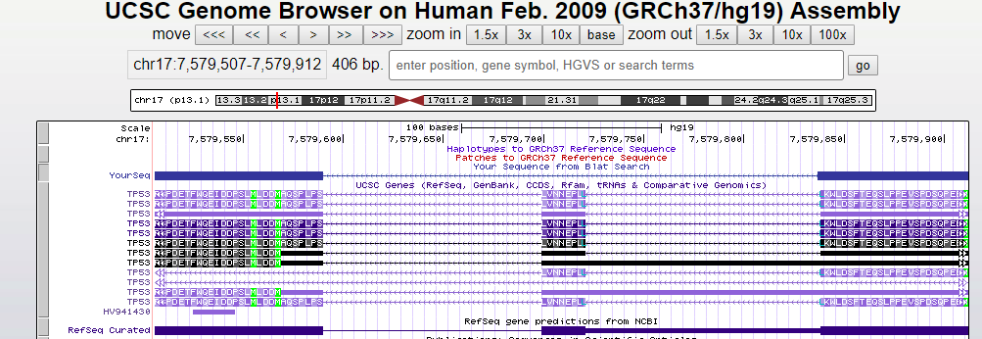
Examples of genomic alignment
Take the first 60 amino acids of human TP53 and then use BLAT to map it to the human genome;
  BLAT:
    https://genome.ucsc.edu/cgi-bin/hgBlat?command=start

Slide 23
Features of genomic alignment
Compared to a simple pairwise alignment of two sequences, genomic alignment has the following features:
  On a larger scale and therefore a greater computational challenge:
    Millions of reads (queries) and billion bps of the genome (reference)
  Many biological complications in the genome:
    Eukaryotic genes have exons and introns, and genes have alternative splicing isoforms.
    There are many repeat regions in the genome.
    Individual Genomes can have many changes different from the reference genome (for example, a cancer patient’s genome is quite different from that of a healthy individual).
  Many technical artifacts during sample preparation and sequencing:
    Sequencing machines can make errors during sequencing.
    Laboratory processes (such as PCR) can introduce errors in the DNA products.
  Many scientific limitations in bioinformatics:
    The human reference genome still has gaps!
    Everyone’s genome is different, but we are using just one reference genome.

Slide 24
Resources
Explanations on dynamic programming and sequence alignments:
  http://avatar.se/lectures/molbioinfo2001/dynprog/dynamic.html
  https://www.ibm.com/developerworks/library/j-seqalign/index.html
Short Journal article on dynamic programming in Plos Computational Biology
  Provided as pdf

Slide 25
Resources
Book:
  Neil C. Jones and Pavel A.Pevzner. An introduction to bioinformatics algorithms:
    http://bioinformaticsinstitute.ru/sites/default/files/an_introduction_to_bioinformatics_algorithms_-_jones_pevzner.pdf
    Chapter6: dynamic programming

Slide 26
Summary
The global and local alignment algorithms are the major types of algorithms for pairwise alignment.
There are many scientific applications of performing pairwise and multiple sequence alignments.
Many websites and online tools are provided to get you familiarized with the concepts and relevant tools.
The features and difficulties of genomic alignment are mentioned. NGS will be introduced in week 5, and we will go into details on NGS related data analysis including genomic alignment.

