Slide 1
Biological Sequence Analysis
Motif discovery

Slide 2
Outline
Exact string search algorithm
  Naïve algorithm
  KMP algorithm
  RK algorithm
Motif discovery
  Example
  Motif discovery methods and common tools

Slide 3
String searching or matching
In bioinformatics, string search means finding the occurrence of a sequence (query, with the length m) or a pattern within another sequence (target, with the length n). The sequences could be DNA, RNA or protein.
Many bioinformatics analysis need string searching or matching. For example, checking whether a sequence contains a particular motif requires string matching.

Slide 4
Common exact string search algorithm
Brute force algorithm
Knuth-Morris-Pratt algorithm
Rabin-Karp algorithm

Slide 5
Brute force string search algorithm
The brute force algorithm, also called the naïve algorithm, checks at all positions in the target between 0 and n-m to determine whether there is an occurrence of the query starting there.
Target
Query

Slide 6
Brute force algorithm
Target
Query
Step 1
Step 2
Step 3
Step 4
Shift the query
Step 5
Step 6, bingo!

Slide 7
Knuth-Morris-Pratt algorithm
Slide a sliding window of length m (query) over the target (of length n) from left to right.
Within the window, compare successive characters from left to right until a mismatch is hit.
When a mismatch hits, the query itself is used to determine where to jump to the next meaningful position to continue.

Slide 8
Knuth-Morris-Pratt algorithm
Smart skip
Target
Query
Step 1
Step 2, bingo!
Shift the query
For more details on how a smart skip is achieved, check out the example here: https://en.wikipedia.org/wiki/Knuth%E2%80%93Morris%E2%80%93Pratt_algorithm#KMP_algorithm

Slide 9
Rabin-Karp algorithm
Rabin-Karp algorithm uses hashing to speed up string search.
Hashing converts a string (hash key) into a numeric value (hash value). If two strings are the same, their hash values are also the same (the opposite is not true).
We can compute the hash value of the query as well as the hash values of all the substrings of the target. We can check the hash values to find substrings within the target that matches with the query (the sequences of the hit and the query will be compared to get rid of the false ones, because the same hash value does not always correspond to the same hash keys ).

Slide 10
Toy example of Rabin-Karp algorithm
The choice of a good hash function is key for the Rabin-Karp algorithm.
Here, I am just going to use a very simple hash function to illustrate the algorithm. For a DNA string, its hash value equals the sum of the mappings of each nucleotide, where the mapping is {‘A’:1,’T’:2,’G’:3,’C’:4}

Slide 11

Toy example of Rabin-Karp algorithm
Target
Mapping:
{‘A’:1,’T’:2,’G’:3,’C’:4}
Query
Hash(query=GCC) =3+4+4 = 11
Table of hash values for the target
position | 0 | 1 | 2 | 4
Sequence (hash key) | ATG | TGC | GCC | CCC
Hash value | 6 (=1+2+3) | 9 (=2+3+4) | 11 (=3+4+4) | 12 (=3+4+4)
Bingo!

Slide 12
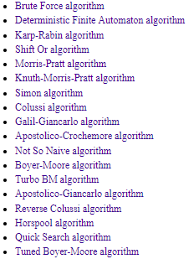
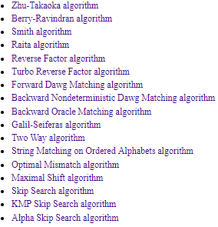
A collection of exact string search algorithms
  http://www-igm.univ-mlv.fr/~lecroq/string/
  Each algorithm comes with a description, an implementation in C and an example
  Available methods:

Slide 13
Implement two algorithms
Two algorithms
  Brute force algorithm
  Rabin-Karp algorithm
Evaluate their efficiencies in terms of speed

Slide 14
Sequence motif
A sequence motif is a DNA, RNA or protein sequence pattern.
When a sequence pattern is known, we can use string search algorithms (such as Boyer-Moore, Rabin-Karp, etc.) to find it in the sequences of interest .
How can we discover the motif?

Slide 15
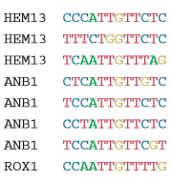
An example of DNA motifs:ROX1
ROX1 is a transcriptional repressor, which binding to the promoter region of many genes. Its DNA binding motif can be identified using known DNA binding sequences.
Eight known genomic binding sites in three S. cerevisiae genes
D’haeseleer. Nature biotechnology, 2006

Slide 16
Identify conserved regions by alignment
The sequences below are usually constructed from a local alignment, where the highly conserved regions are isolated.
Eight known genomic binding sites in three S. cerevisiae genes
D’haeseleer. Nature biotechnology, 2006

Slide 17
Build consensus sequence
A degenerate consensus sequence can be derived from the previous sequences.
(b) Degenerate consensus sequence
D’haeseleer. Nature biotechnology, 2006

Slide 18

Frequency of each residues per position can be calculated after aligning the conserved regions
Frequencies of nucleotides at each position:
D’haeseleer. Nature biotechnology, 2006

Slide 19

Graphical representation of a consensus sequence
The consensus sequence of a motif is often graphically represented by a so-called “sequence logo”.
D’haeseleer. Nature biotechnology, 2006

Slide 20
Methods for motif discovery
Alignment-based
  Aligning the sequences to get the conserved regions followed by a probabilistic model to find motifs common to all inputs.
Enumeration-based
  Exhaustive enumeration of words (substrings or patterns) up to some maximum size.

Slide 21
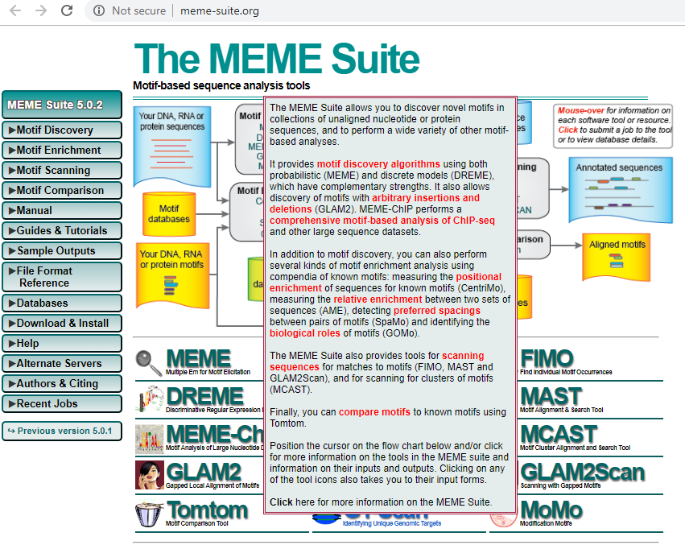
A commonly used motif discovery tool
MEME
  Website: http://meme-suite.org/tools/meme

Slide 22
Resources
The journal articles for DNA sequence motifs is attached as pdf.
The publication on the software tool MEME is attached as pdf.
The journal article entitled “String Matching Algorithms and their Applicability in various Applications” has information on the performance of the common string search algorithms using big-O annotation. It is also attached as pdf.

Slide 23
Summary
String searching is very important in bioinformatics. Several common algorithms for string searching were explained in details. There are many more algorithms, and a collection of them are provided in the lecture. I would encourage you to explore them.
Motif discovery is very important for identifying conserved sequence elements for many biological events, including transcriptional factor binding , RNA-binding protein preferences, microRNA-targeting principles, etc.

