Slide 1
Biological Sequence Analysis
Advanced analysis and NGS

Slide 2
Outline
Advanced sequence analysis
  History of Next generation sequencing (NGS), also called 2nd generation sequencing
  DNA sequences (mutation calling, protein binding site , copy number changes, etc.)
  RNA sequences (gene expression analysis, secondary structure prediction, protein binding site, etc.)
  Long read sequencing

Slide 3
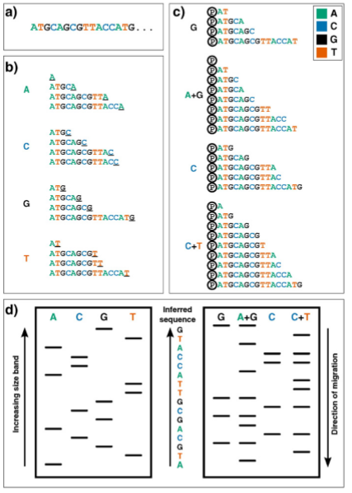
First generation sequencing
b) Sanger sequencing
c) Gilbert sequencing
Low-throughput
Heather and Chain. Genomics, 2016

Slide 4
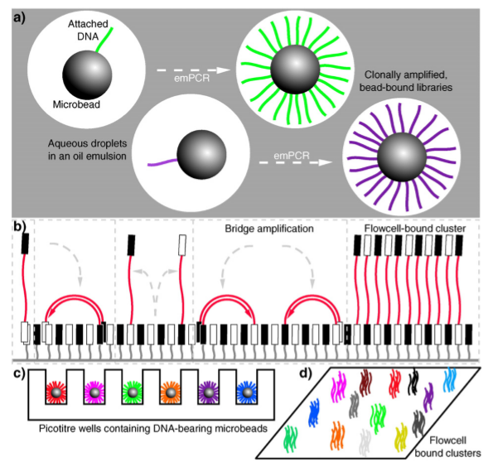
NGS DNA sequencing parallelized amplifications
High throughput
Heather and Chain. Genomics, 2016

Slide 5
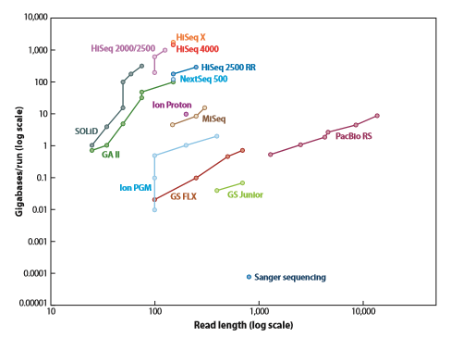
Development of high-throughput sequencing
NGS has much higher throughput than sanger sequencing (the representative 1st generation sequencing).
PacBio is often considered to be part of 3rd generation sequencing.
Levy and Myers. Annual Review of Genomics and Human Genetics, 2016

Slide 6
Two types of NGS sequencing
Sequencing by ligation:
  SOliD and Complete Genomics
Sequencing by synthesis:
  Single-nucleotide addition:
    454, Ion Torrent
  Cyclic reversible termination (CRT):
    Illumina, Qiagen
Illumina machines have the largest market share in NGS.

Slide 7
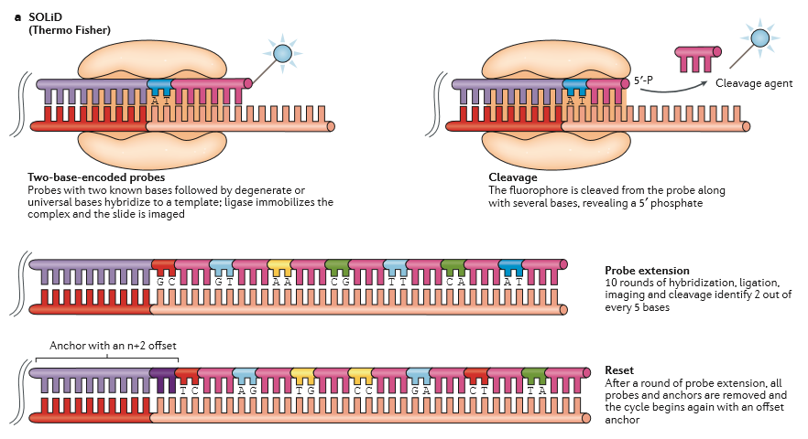
SOLiD (Thermo Fisher)
Goodwin et al. Nature Review Genetics, 2016

Slide 8
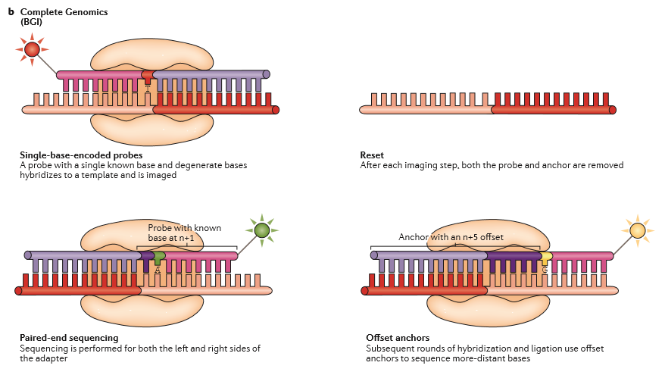
Complete Genomics (BGI)
Goodwin et al. Nature Review Genetics, 2016

Slide 9
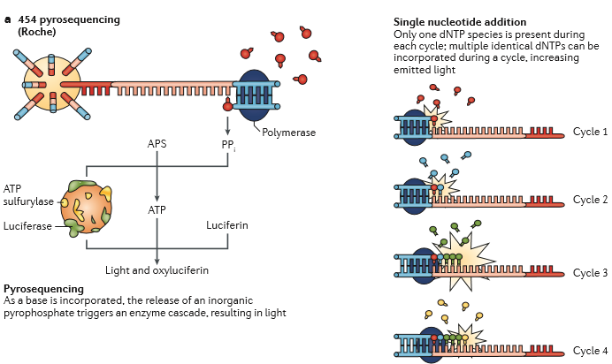
454 Pyrosequencing (Roche)
Goodwin et al. Nature Review Genetics, 2016

Slide 10
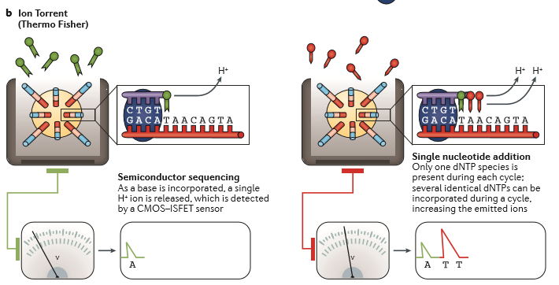
Ion Torrent (Thermo Fisher)
Goodwin et al. Nature Review Genetics, 2016

Slide 11
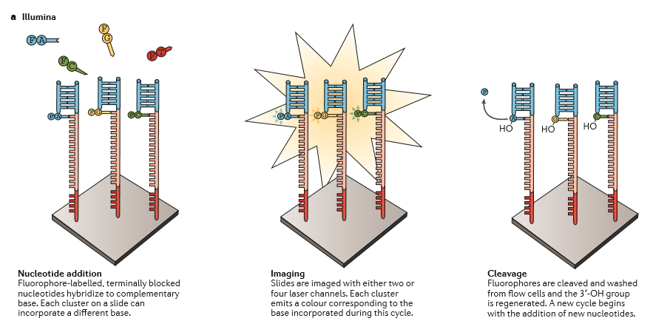
Illumina
Goodwin et al. Nature Review Genetics, 2016

Slide 12
NGS
Comparison with 1st generation sanger sequencing:
  The reads are shorter (but it is already in the hundreds of bps range)
  The throughput is way higher, enabling high throughput genomics profiling for DNA and RNA (DNASeq and RNASeq)

Slide 13
Applications of NGS
DNASeq:
  Whole genome, whole exome and targeted DNA sequencing
  genome assembly, population SNP, and mutation discovery
CHIP-Seq:
  transcription factor binding sites
Bisulfide seq:
  DNA methylation sequencing
4C, HiC, ChIA-PET etc.:
  chromosomal 3D structures
RNASeq:
  gene expression profiling
CLIP-Seq
  Ribonucleoprotein binding sites
And many and many other applications

Slide 14
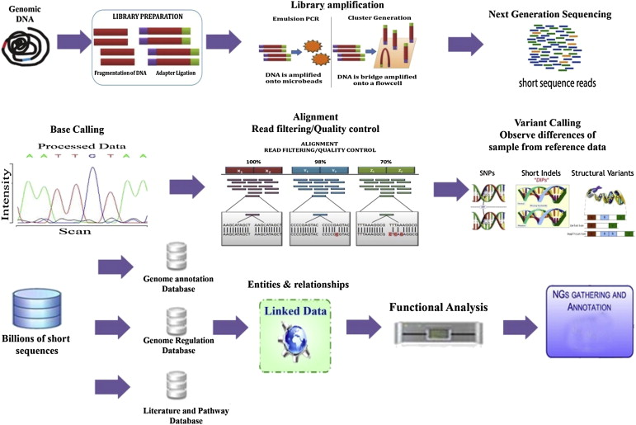
DNASeq workflow
Discover mutations
Nayarisseri et al. Drug Invention Today, 2013

Slide 15
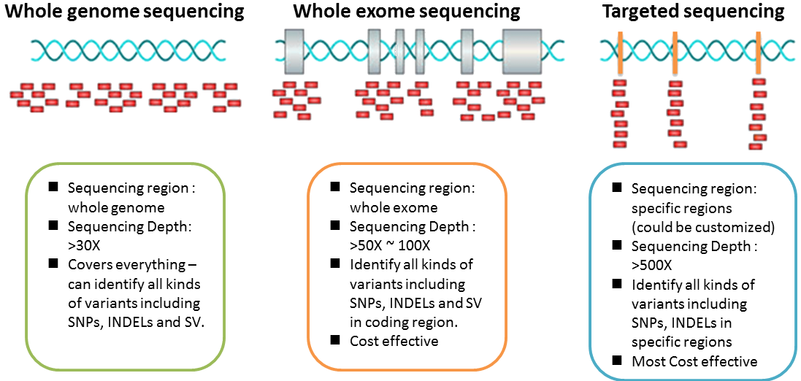
Differences among DNASeq
http://www.genomixlab.com/human-genome-sequencing/#.W-5U6-hKiUk

Slide 16
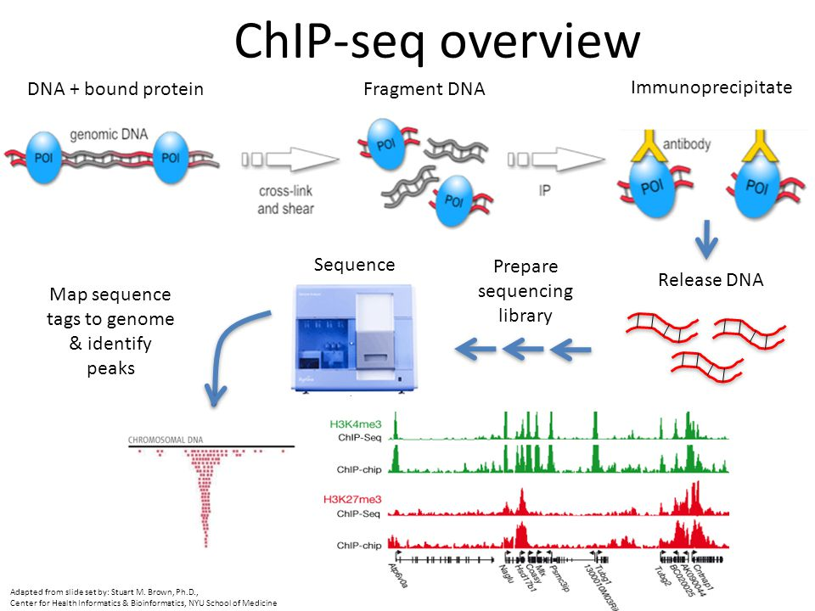
Find protein-binding sites in DNA
https://slideplayer.com/slide/3385783/

Slide 17
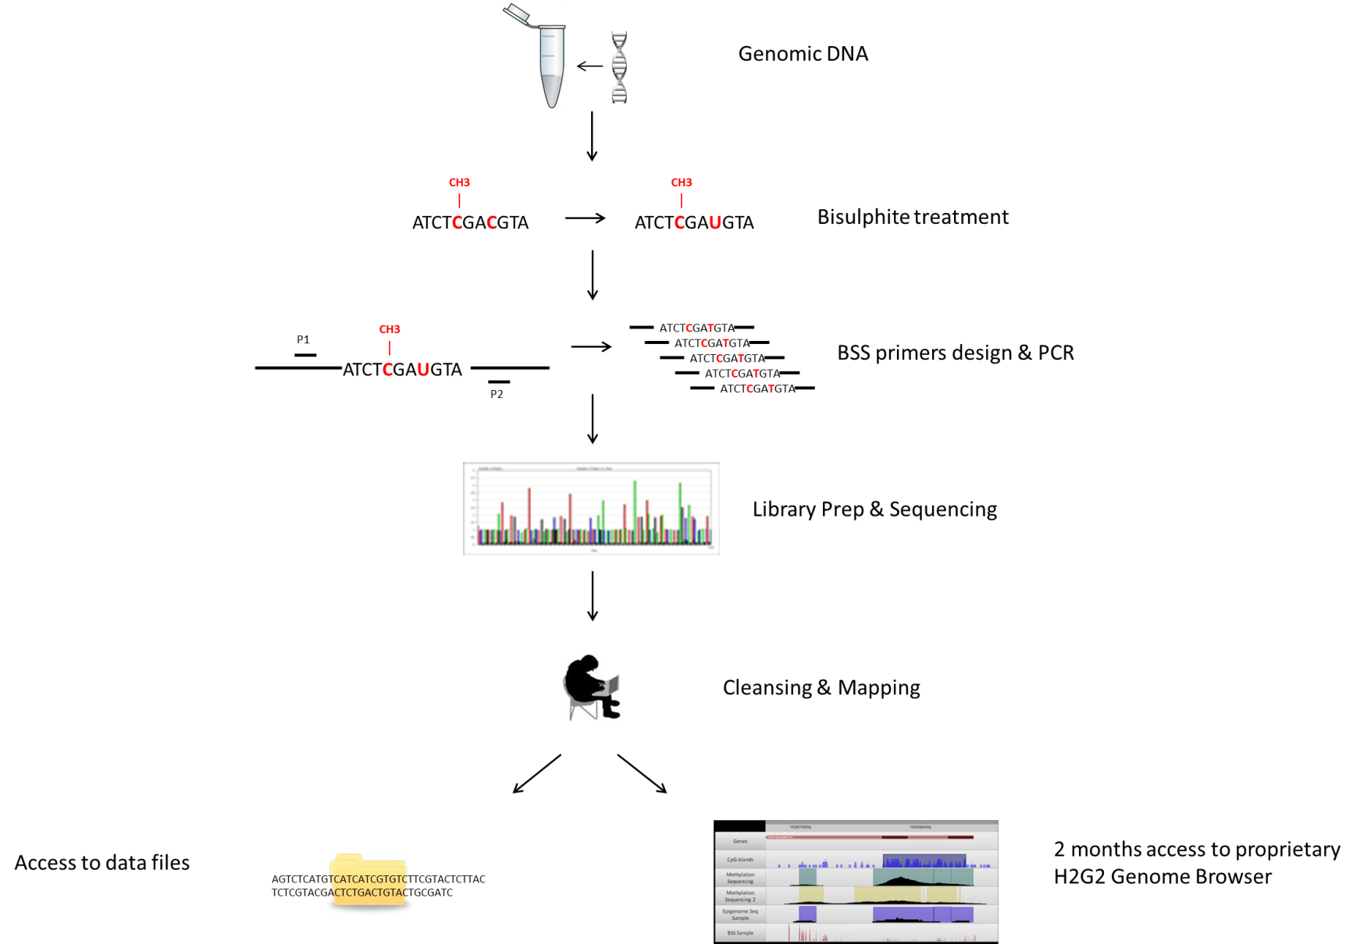
Bisulfide sequencing
Identify methylated nucleotides
http://www.nxt-dx.com/epigenetics/bisulfite-sequencing/

Slide 18
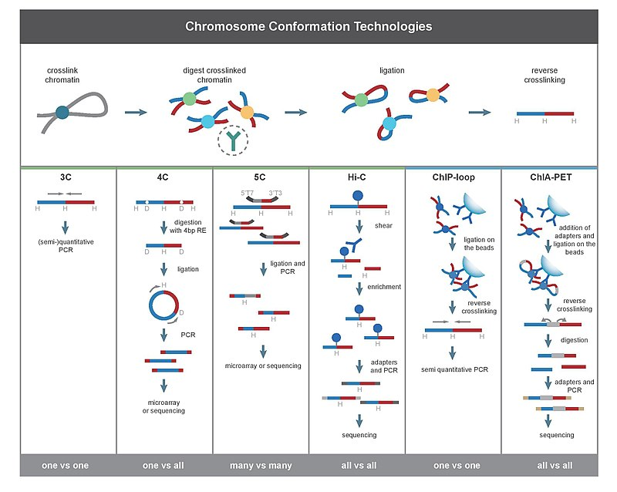
Chromosome conformation seq
Different colors represent different chromosomes.
These methods find regions of the genome that are close to each other spatially.
https://en.wikipedia.org/wiki/Chromosome_conformation_capture

Slide 19
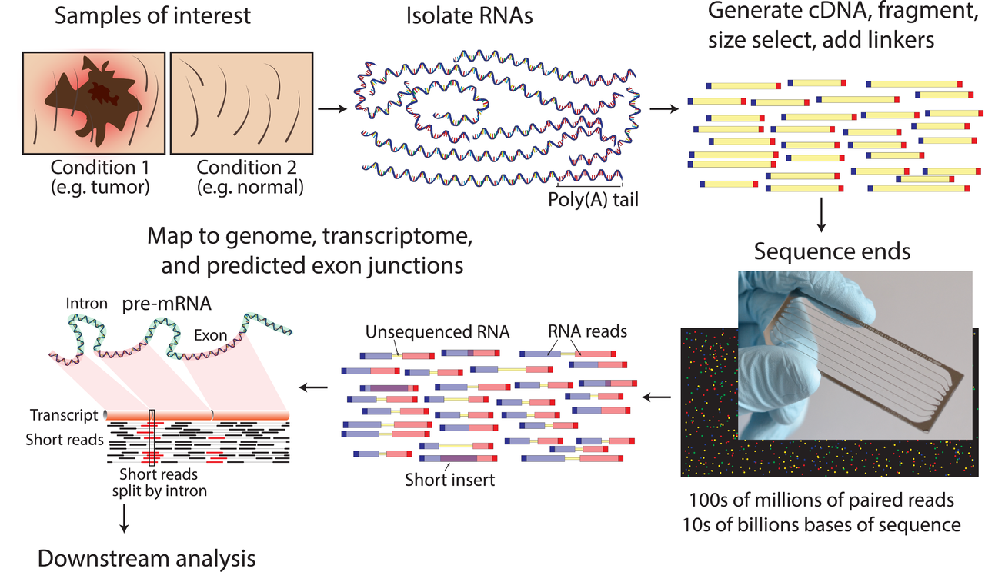
RNASeq
https://en.wikipedia.org/wiki/RNA-Seq
Profile the expression of all genes

Slide 20
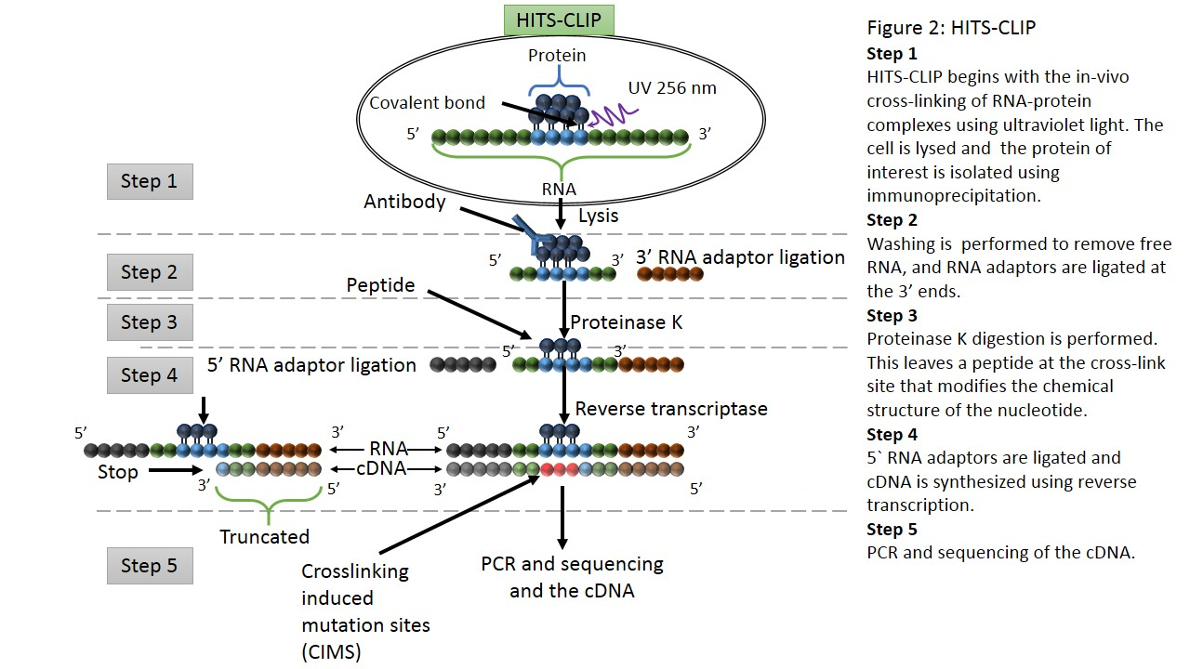
CLIP-Seq
https://en.wikipedia.org/wiki/CLIP
Identify protein binding sites in RNA

Slide 21
NGS applications
There are many applications of NGS in biology.
Different NGS applications usually need different data analysis.
Understanding the wet-lab aspects of NGS (such as the procedures in library preparation) is helpful for data analysis, results interpretation and trouble shooting.
In future lectures, we will dive into NGS data analysis.

Slide 22
Long read sequencing
Real-time 3rd generation sequencing (sometimes still being called NGS):
  Pacbio
  Oxford nanopore
Synthetic long read sequencing using 2nd generation sequencing (NGS) with barcodes:
  Illumina
  10X Genomics

Slide 23
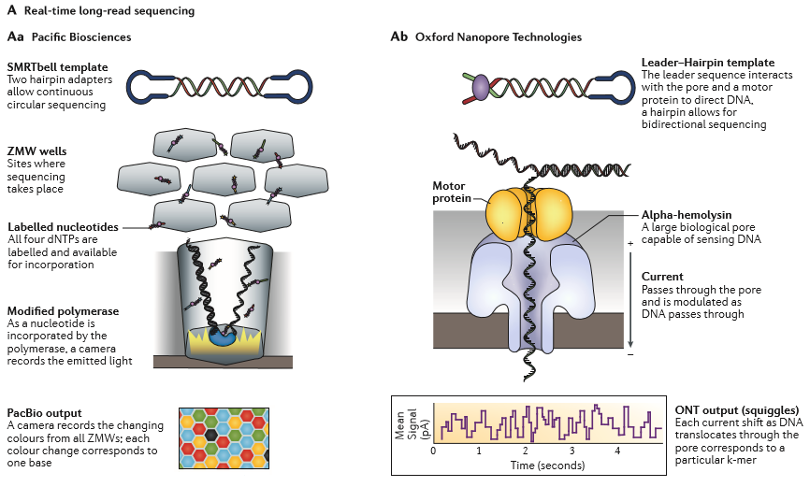
Real-time long read sequencing

Slide 24
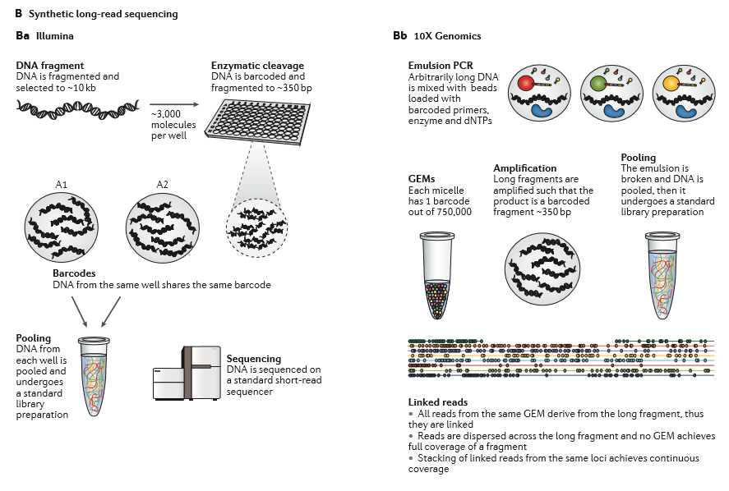
Synthetic long read sequencing

Slide 25
Some applications of long read sequencing
Genomic phasing (genome haplotype)
Complex structural variation detection
Resolve genomic regions that are highly repetitive
Immune receptor profiling
Transcript isoform discovery

Slide 26
Resources
The review papers cited in the slides are provided as pdfs.

Slide 27
Summary
The development of NGS has speeded up high throughput genomics profiling.
There are many applications of NGS, including various kinds of applications in DNASeq and RNASeq.
There are several long read sequencing technologies that are making progresses (although far from being satisfactory).
An emerging sub-field among NGS is single cell sequencing, which will be covered in future lectures.

