Slide 1
Biological Sequence Analysis
NGS Bioinformatics: workflows, file formats and tools

Slide 2
Outline
NGS applications and data analysis (alignment-based)
  Genotyping, DNA-Seq, RNA-Seq, CHIP-Seq, etc.
Data formats
  FASTA, FASTQ, BAM, BAI, BED
Tools:
  Sequence alignment, Mutation calling, Differential gene expression, Peak calling, Visualization

Slide 3
First step in NGS analysis
Sequence alignment
  Map every NGS read to a reference genome/transcriptome
Sequence assembly
  Assemble all NGS reads into contigs
Mapped Reads
Reference
Reads
Assembled contig

Slide 4
Applications following alignment of NGS reads: genotyping by DNA-Seq
Position 1
Position 2
Read 1
Read 2
Read 3
Read 4
Read 5
Read 6
Read 7
Read 8
Mapped Reads
Reference
 | Position 1
Read 1 | G
Read 2 | T
Read 3 | T
Read 4 | G
reference | T
 | Position 2
Read 5 | C
Read 6 | C
Read 7 | C
Read 8 | C
reference | C
Genotyping
Heterozygous genotype: T/G
Homozygous genotype: C/C
Using germline DNA as input for library preparation

Slide 5
Applications following alignment of NGS reads: somatic mutation calling by DNA-Seq
Position 1
Read 1
Read 2
Read 3
Read 4
Mapped Reads
Reference
 | Position 1
Read 1 | G
Read 2 | A
Read 3 | A
Read 4 | A
reference | G
Mutation
Calling
Somatic mutation: G>A
Using somatic DNA as input
(tumor tissues for cancer somatic mutation detection)

Slide 6
Applications following alignment of NGS reads: peak calling by CHIP-Seq
Mapped Reads
Reference
Peak
Calling
Peaks
(intensity of signals)
Reference
Use protein-bound DNA as input (e.g., transcriptional factor binding DNAs)

Slide 7
Applications following alignment of NGS reads: gene expression by RNASeq
Mapped Reads
Gene 1
Gene 2
Gene 3
Reference
Reads count
(gene expression analysis)
 | Reads count
Gene 1 | 3
Gene 2 | 5
Gene 3 | 1
Using RNA as input

Slide 8
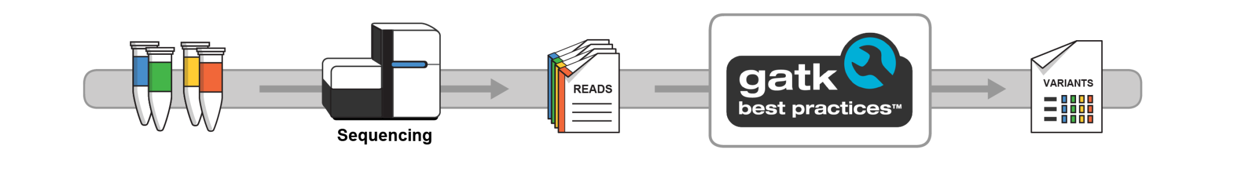
Variant discovery in NGS using GATK (Genome Analysis Toolkit)
The most commonly used toolkit in DNA-Seq analysis
https://software.broadinstitute.org/gatk/

Slide 9
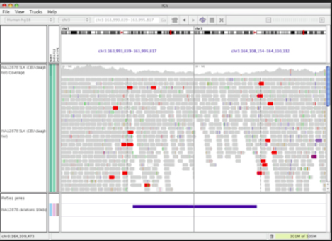
Simplified DNA-Seq variant analysis workflow example
Sequencing files
(FASTQ format)
Alignment step
Using BWA
Visualization using IGV
Alignment files
(BAM format)
Mutation calling step using GATK
Variant files
(VCF format)

Slide 10
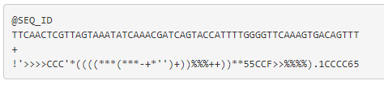
FASTQ file format
Example FASTQ file for one read (a typical FASTQ file contains millions of such reads, and one read consists of 4 lines of records as below )
Sequence identifier starting with @
Sequence
Line 3 starts with a “+” character and is optionally followed by the same sequence identifier
Sequence
quality
https://binf.snipcademy.com/lessons/sequence-file-formats/fastq

Slide 11
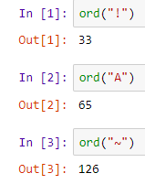
Quality score in FASTQ files
The 4th line encodes the quality scores per each base call. This line must have the same length as the sequence in line 2.
Scores range from “!” being the lowest quality and “~” being the highest. These values come from the ASCII table values 33~126 (next slide).
We can use python to map the FASTQ quality score to numeric values:
https://binf.snipcademy.com/lessons/sequence-file-formats/fastq

Slide 12
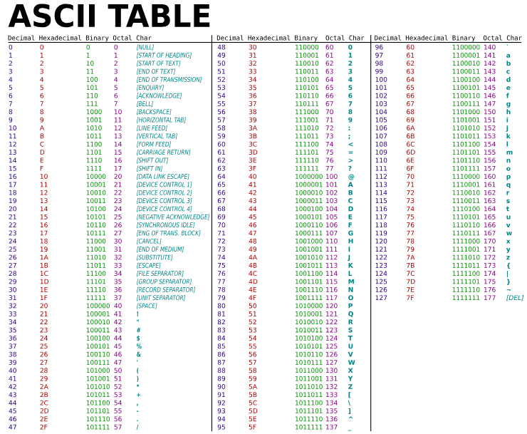
Quality score in FASTQ files
For more details about FASTQ files, check its wikipedia page: https://en.wikipedia.org/wiki/FASTQ_format#Quality
https://binf.snipcademy.com/lessons/sequence-file-formats/fastq

Slide 13
Commonly used tools for alignment related tasks
An alignment tool maps reads (FASTQ format) to a reference sequence and generates the alignment file (SAM format); SAM files can be converted into a binary representation (BAM format), which can be visualized and used for downstream analysis.
DNA-Seq aligners: BWA, Bowtie2
RNA-Seq aligners: STAR, Tophat
SAM/BAM file formats manipulations (conversion, index, sort, etc): Samtools
Alignment visualization: IGV

Slide 14
SAM file format
SAM stands for Sequence Alignment/Map format. It is a TAB-delimited text format consisting of a header section, which is optional and an alignment section.
Header lines start with “@”.
Each alignment line has 11 mandatory fields for essential alignment information such as mapping position and variable number of optional fields fir flexible or aligner specific information
https://samtools.github.io/hts-specs/SAMv1.pdf

Slide 15
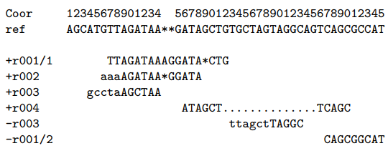
SAM file format example
Example:
  suppose we have the following alignment with bases in lower cases clipped from the alignment. Read r001/1 and r001/2 constitute a read pair; r003 is a chimeric read; r004 represents a split alignment.
https://samtools.github.io/hts-specs/SAMv1.pdf

Slide 16
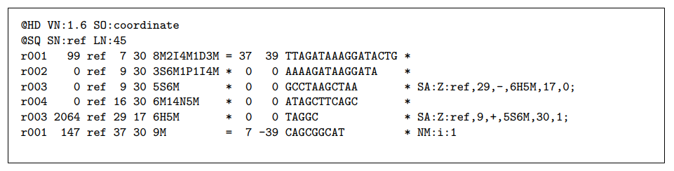
SAM file format example
The corresponding SAM format for the example in the last slide is:
https://samtools.github.io/hts-specs/SAMv1.pdf

Slide 17
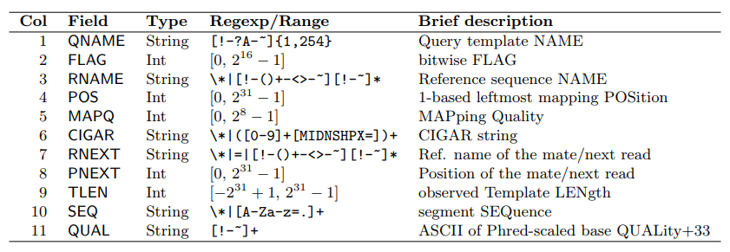
SAM file format
The mandatory fields in the alignment section:
For detailed explanations of the different fields as well as other details of the SAM format, check the pdf file listed below (the official samtools manual).
https://samtools.github.io/hts-specs/SAMv1.pdf

Slide 18
BAM file format
BGZF is block compression implemented on top of the standard gzip file format. The goal of BGZF is to provide good compression while allowing efficient random access to the BAM file for indexed queries.
A BAM file is a SAM file compressed in the BGZF format.
Indexing of a BAM file creates a BAI file (BAM index), which allows the BAM files to be randomly accessed and visualized.
https://samtools.github.io/hts-specs/SAMv1.pdf

Slide 19
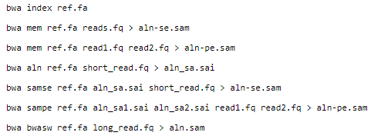
Sequence alignment using BWA
BWA: Burrows-Wheeler Alignment tool
Example usages:
http://bio-bwa.sourceforge.net/bwa.shtml

Slide 20
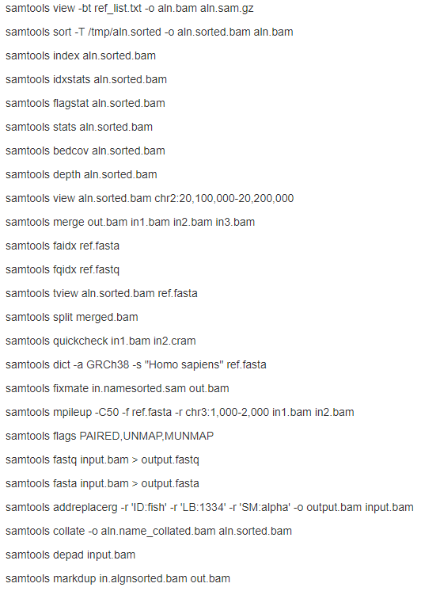
Manipulate SAM/BAM files with Samtools
Samtools: utilities for the Sequence Alignment/MAP (SAM) format
Example usages:
http://www.htslib.org/doc/samtools.html

Slide 21
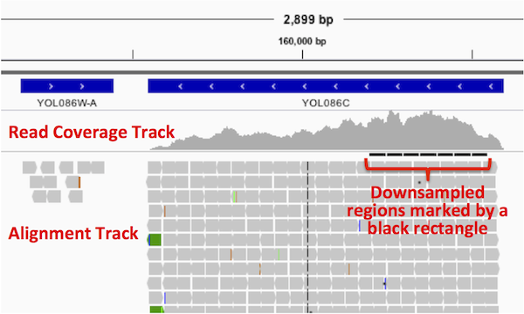
Visualize BAM files with IGV
http://software.broadinstitute.org/software/igv/AlignmentData

Slide 22
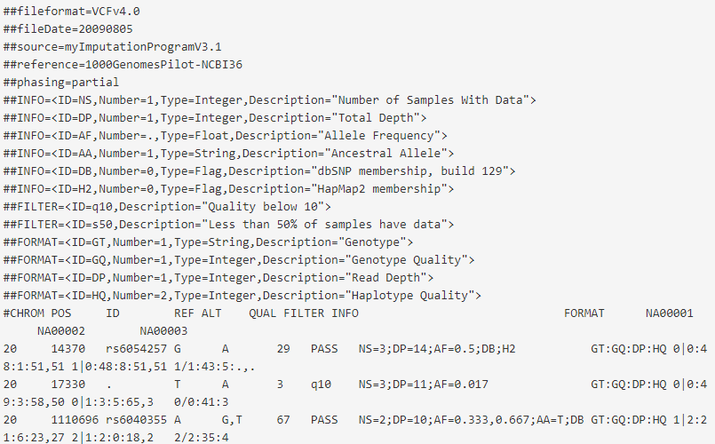
VCF file format
VCF is a text file format, which contains meta-information lines, a header line and then data lines each containing information about a position in the genome. Example:
http://www.internationalgenome.org/wiki/Analysis/vcf4.0/

Slide 23

Details of VCF file format
Meta-information lines
  Each line stars with “##”, often as key=value pairs
Header line syntax (has 8 fixed mandatory columns)
Data lines
  There are 8 fixed fields per record. The values of the different fields correspond to the header line
For more details, check the reference below.
http://www.internationalgenome.org/wiki/Analysis/vcf4.0/

Slide 24
Mutation calling
For variants analysis using DNA-Seq, we can call variants after sequence alignment using various algorithms. The called variants are often represented in the VCF format.
We will dive into the details of germline and somatic mutation calling next week.

Slide 25
BED format
BED stands for Browser Extensible Data format, which provides a flexible way to define the data lines that are displayed in an annotation track.
BED lines have three required fields and nine additional optional fields.
The number of fields per line must be consistent throughout any single set of data in an annotation track.
https://genome.ucsc.edu/FAQ/FAQformat.html#format1

Slide 26
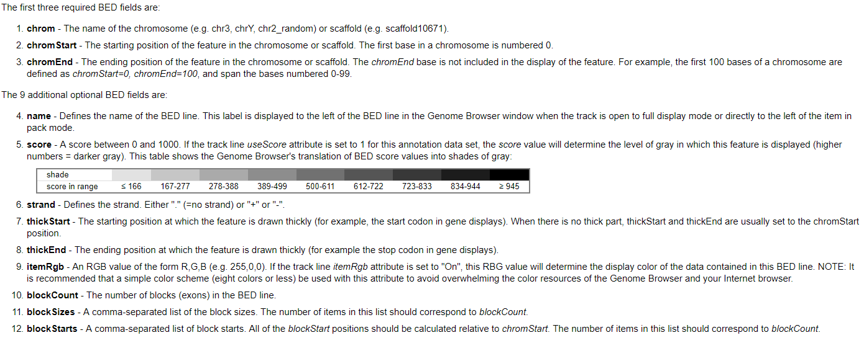
Details of the BED format
https://genome.ucsc.edu/FAQ/FAQformat.html#format1

Slide 27
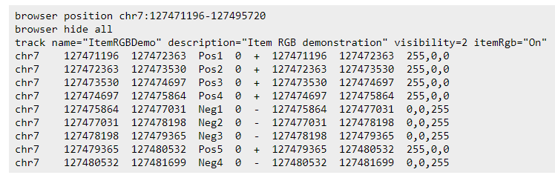
Example BED file
This example shows an annotation track that uses the itemRgb attribute to individually color each data line:
https://genome.ucsc.edu/FAQ/FAQformat.html#format1

Slide 28
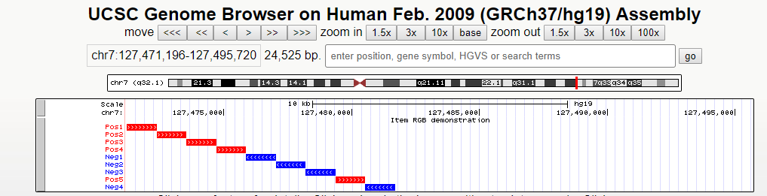
Visualize BED files with UCSC genome browser
Visualize the BED file in the previous slide:
https://genome.ucsc.edu/cgi-bin/hgTracks?db=hg19&lastVirtModeType=default&lastVirtModeExtraState=&virtModeType=default&virtMode=0&nonVirtPosition=&position=chr7%3A127471196-127495720&hgsid=700062233_xunK0ELZfPhtbEaGpwXbRkWD6H3a

Slide 29
Data representation using BED formats
BED files can be used to represent two major types of data:
  (1) Sequencing data: called peaks (such as CHIP-Seq), coverage tracks
  (2) Annotation/feature data: annotation information about genes, exons, promoter, etc.
By combining the sequencing data and annotation data, we can annotate the sequencing data according to our needs, such as gene annotation, promoter mapping, exonic region extraction, 3’UTR extraction, etc.
A very good software tool to perform such tasks is Bedtools.

Slide 30
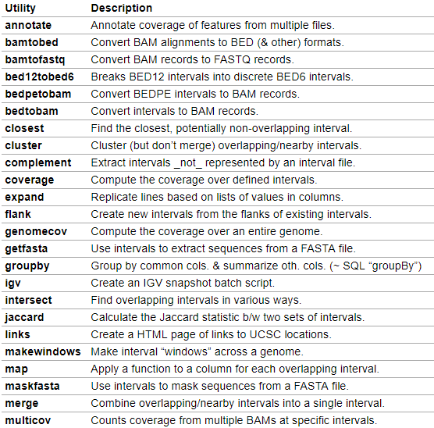
Manipulate BED files with BEDtools
Some of the many BEDtools utilities
https://bedtools.readthedocs.io/en/latest/content/overview.html

Slide 31
Example usage of BEDtools
All bedtools that compare features contained in two distinct files refer to one file as feature set “A” and the other file as feature set “B”. This is mainly in the interest of brevity, but it also has its roots in set theory.
As an example, if one wanted to look for SNPs (file A) that overlap with exons (file B), one would use bedtools intersect in the following manner:
https://bedtools.readthedocs.io/en/latest/content/overview.html

Slide 32
Summary
We covered many commonly used file types in bioinformatics: FASTQ, SAM, BAM, VCF, BED.
There are correspondingly many useful software tools: aligners (e.g., BWA), SAM/BAM manipulator (Samtools), mutation callers (such as GATK), BED handler (BEDtools) and visualizers (IGV and UCSC genome browser).

