Slide 1
Biological Sequence Analysis
Genomic variants and DNASeq

Slide 2
Outline
Somatic vs germline mutations
Different types of mutations: SNVs, Indels, CNVs and SVs
Important international genomics projects
DNA-Seq Mutation calling (for SNVs and Indels)
DNA-Seq analysis for more complex variants: CNVs and SVs

Slide 3
Somatic vs germline mutations
Genes and chromosomes can mutated in either somatic or germline tissues, and these changes are called somatic mutations and germline mutations respectively.
If a somatic mutation occurs in a single cell in developing somatic tissue, that cell is the progenitor of a population of identical mutant cells (of course, there could be additional mutation events in the progeny cells).
A germline mutation occurs in the germline, special tissue that is set aside in the course of development to form sex cells. If a mutant sex cell participates in fertilization, then the mutation will be passed on to the next generation.
https://www.ncbi.nlm.nih.gov/books/NBK21894/

Slide 4
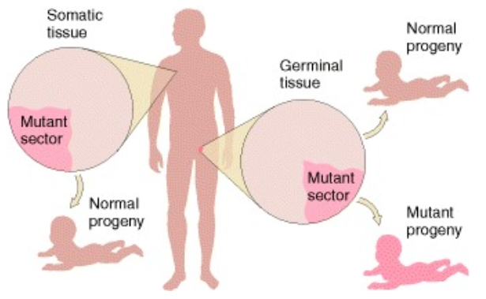
Somatic vs germline mutations
Somatic mutations are not transmitted to progeny, but germline mutations may be transmitted to some or all progeny.
https://www.ncbi.nlm.nih.gov/books/NBK21894/

Slide 5
Somatic vs germline mutations
Somatic mutations:
  The number of cells carrying the mutated gene depends on the stage of cell multiplication when the mutation occurs. If it occurs in a freshly dividing cell, more number of cells will receive the gene. If the mutation occurs in a postmitotic cell, then only a negligible number of cells will be affected.
  Somatic mutations occur in an individual and not in a population, since they are not passed down to the offspring. There could be individuals sharing the same somatic mutations, but these mutations all developed independently in each individual’s somatic cells.
Germline mutations:
  The effects of germline mutations are present in all cells since the embryo stage. This number of cells affected in the offspring cannot increase, since the mutation occurs in all the cells from the embryo stage itself.
  Germline mutations occur in a particular population since they are likely to be passed down from generation to generation.
https://biologywise.com/germline-mutation-vs-somatic-mutation

Slide 6
Different types of mutations
SNVs
  Stands for single nucleotide variation
  1bp in length, single nucleotide substitution
Indels
  Stands for insertion/deletions
  Usually refer to short insertion/deletions; long insertion and deletions are often included in SVs.
SVs
  Stands for structural variations
  Include insertions, deletions, inversions and translocations
CNVs
  Stands for copy number variations
  Copy number gain or copy number loss; CNVs are associated with SV events (for example, deletion can cause copy number loss of the deleted region).

Slide 7
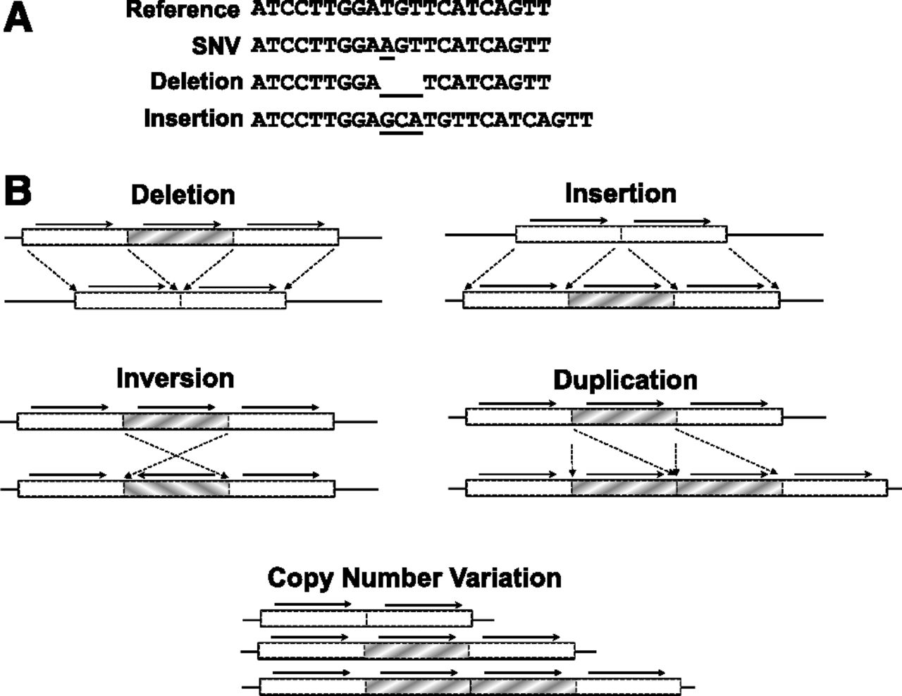
Schematic illustration of the different types of mutations
Johnsen et al. Blood, 2013

Slide 8
Important international genomics projects
Over the years, several important international genomics projects have really advanced our understanding of human genomes and other genomes.
The important milestones for the understanding of human genomes are listed below:
  Human genome project
  1000Genome Project
  TCGA project

Slide 9
Human genome project (HGP)
The International Human Genome Sequencing Consortium published the first draft of the human genome in the journal Nature in February 2001 with the sequence of the entire genome’s three billion based pairs some percent complete.
The HGP has revealed that there are probably about 20,500 human genes. The completed human sequence can now identify their locations. The ultimate product of the HGP has given the world a resource of detailed information about the structure, organization and function of the complete set of human genes.
https://www.genome.gov/12011238/an-overview-of-the-human-genome-project/

Slide 10
1000 Genomes project
The 1000 Genomes Project ran between 2008 and 2015, creating the largest public catalogue of human variation and genotype data.
The goal of the 1000 Genomes Project was to find most genetic variants with frequencies of at least 1% in the populations studied.
This project revealed the complexity of human genome and provided a global reference for human germline genetic variations.
http://www.internationalgenome.org/about

Slide 11
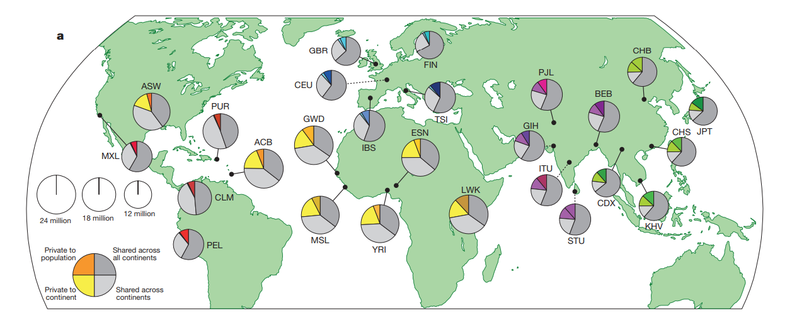
1000 Genomes project
Polymorphic variants within sampled populations.
The area of each pie is proportional to the number of polymorphisms within a population. Pies are divided into four slices, representing variants private to a population (darker colour unique to population), private to a continental area (lighter colour shared across continental group), shared across continental areas (light grey), and shared across all continents (dark grey). Dashed lines indicate populations sampled outside of their ancestral continental region
The 1000 Genomes Project Consortium. Nature, 2015.

Slide 12
The Cancer Genome Atlas (TCGA) project
There are at least 200 forms of cancer, and many more subtypes. Each of these is caused by errors in DNA that cause cells to grow uncontrolled. Identifying the changes in each cancer’s complete set of DNA – its genome – and understanding how such changes interact to drive the disease will lay the foundation for improving cancer prevention, early detection and treatmen
TCGA, a collaboration between the National Cancer Institute (NCI) and National Human Genome Research Institute (NHGRI), has generated comprehensive, multi-dimensional maps of the key genomic changes in 33 types of cancers. The TCGA dataset, 2.5 petabytes of data describing tumor tissue and matched normal tissues from more than 11,000 patients, is publically available.
This project provides a very comprehensive understanding of the somatic and germline mutations in human cancers.
https://cancergenome.nih.gov/abouttcga/overview

Slide 13
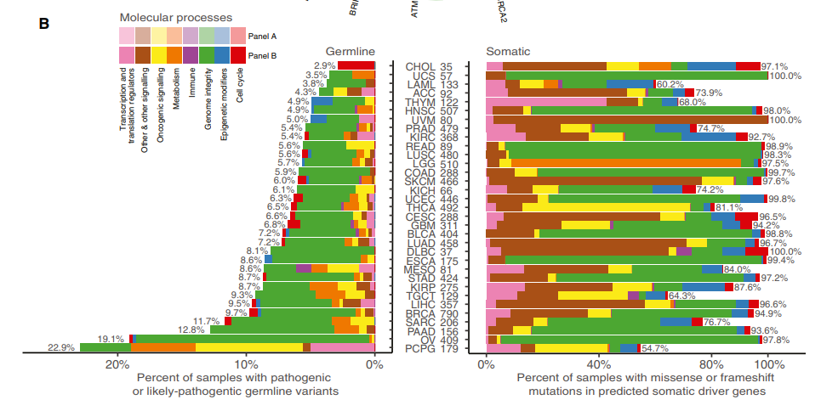
Somatic and germline driver genes for human cancers identified in TCGA
Ding et al. Cell, 2018

Slide 14
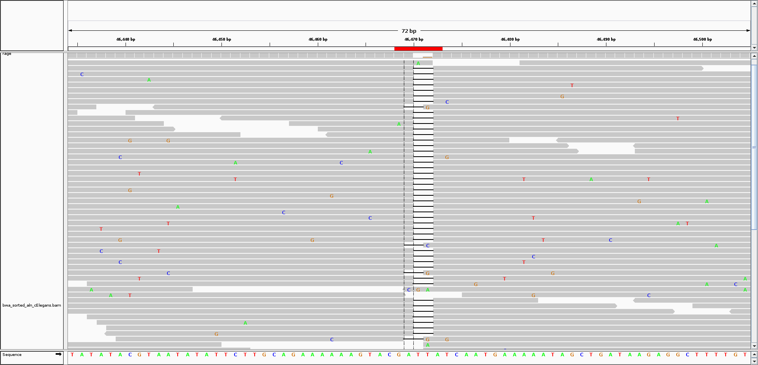
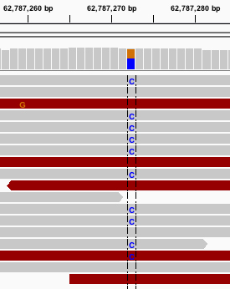
Example views of SNVs and Indels using IGV
Indel:
SNV:
https://github.com/lh3/samtools/issues/17
http://software.broadinstitute.org/software/igv/book/export/html/6

Slide 15
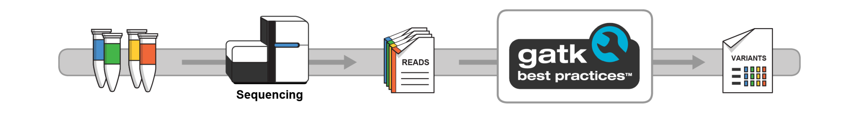
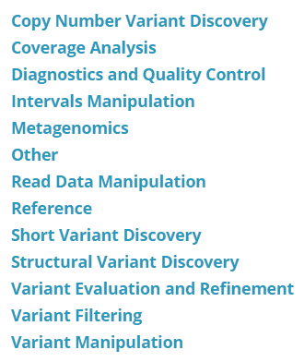
Short variants discovery in NGS using GATK (Genome Analysis Toolkit)
GATK is probably the most popular mutation calling tool for SNVs and Indels
There are many documentations about the capabilities of GATK from Broad Institute’s website.
https://software.broadinstitute.org/gatk/

Slide 16
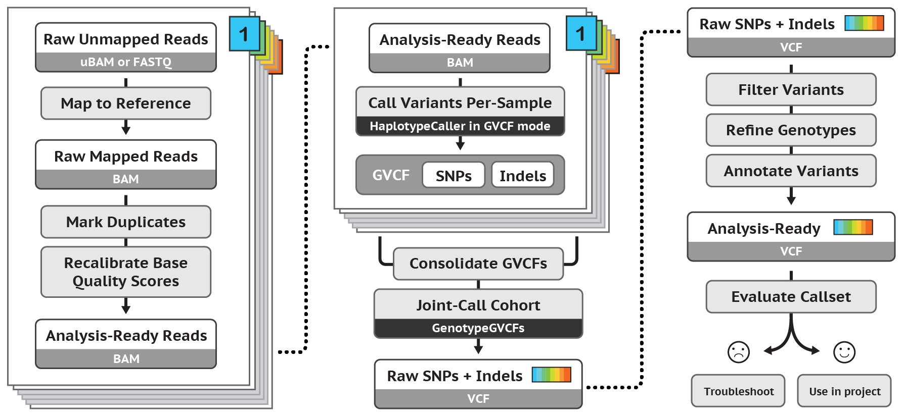
Germline short variant discovery (SNVs + Indels) using GATK
https://software.broadinstitute.org/gatk/best-practices/workflow?id=11145

Slide 17
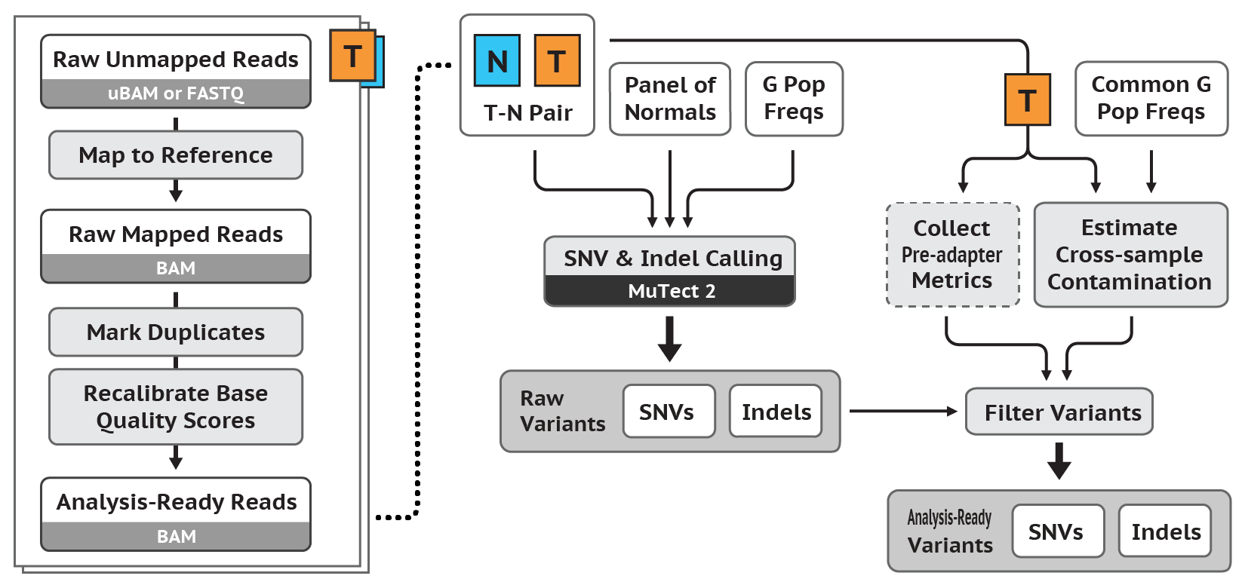
Somatic short variant discovery (SNVs + Indels) using GATK
T: tumor tissue
N: normal tissue
https://software.broadinstitute.org/gatk/best-practices/workflow?id=11146

Slide 18
Other commonly used tools for SNVs and Indels calling
There are many tools for SNVs and Indels calling.
Besides MuTect/MuTect2(the GATK mutation caller), here are a few that are also commonly used:
  Samtools
  VarDict
  FreeBayes
  LoFreq

Slide 19
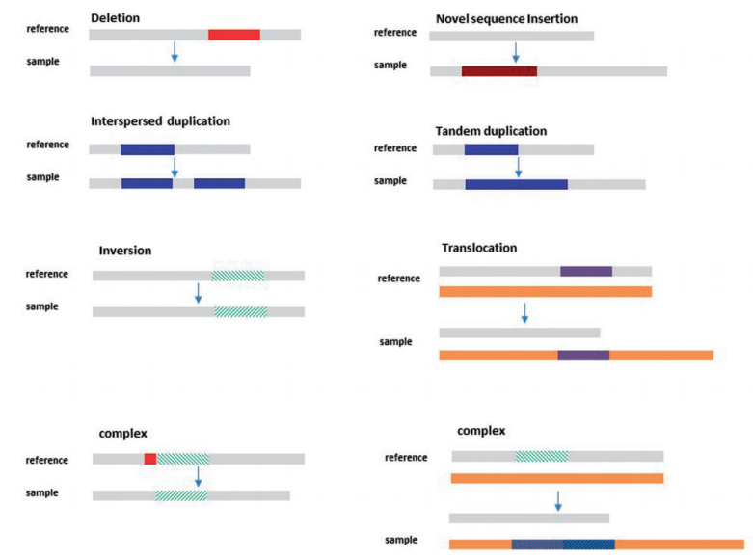
Types of SVs
Escaramis et al. Briefings in Functional Genomics, 2015

Slide 20
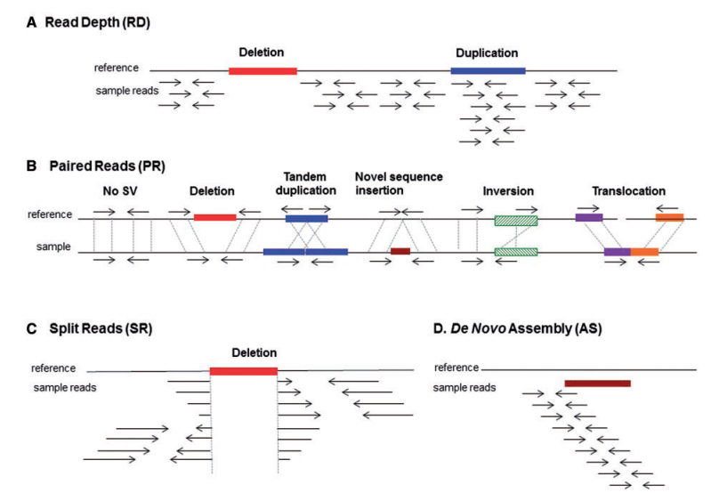
SVs calling methods
Escaramis et al. Briefings in Functional Genomics, 2015

Slide 21
Resources
The pdf article entitled “Massively parallel sequencing: the new frontier of hematologic genomics” has good explanations of different mutations.
The pdf article entitled “A global reference for human” is the publication by the 1000 genomes project, summarizing the germline variation of the human genomes across the globe.
The pdf article entitled “Perspective on Oncogenic Processes” includes many of the insights obtained from the TCGA project on human cancers.
The pdf article entitled “A review of somatic single nucleotide variant calling algorithms for next-generation sequencing data” provides a good summary of the variant calling process and available methods.
The pdf article entitled “A decade of structural variants” provides a good summary of the SVs calling methods.

Slide 22
Summary
It is essential to understand the differences between somatic and germline mutations as well as the many different types of mutations including SNVs, Indels, CNVs and SVs.
There are several public genome sequencing projects that really helped to advance our understanding of genomes, genes, germline variations and somatic mutations in human cancers.
In DNA-Seq analysis, the most routine analysis is mutation calling for SNVs and Indels. Analysis of CNVs and SVs are also often needed.

