Slide 1
Biological Sequence Analysis
Genome assembly

Slide 2
Outline
Coverage analysis
Genome assembly algorithms
Assess the quality of a genome assembly
Challenges in genome assembly

Slide 3
Genome assembly
  Assemble all NGS reads into contigs
Reads
Assembled contig

Slide 4
Coverage analysis
We want to assemble a genome from individual NGS reads. The average coverage “C” can be calculated below:
  C= NL/G
    N= Number of sequencing reads
    L= Length of each read
    G= Genome size (length of the genome)
  For example, for a genome size of 20 Million bps, a sequencing run of 10 Million reads with the read length of 100bp will have a coverage like this:
    C= 10 M * 100/ 20 M =50
      We usually say the coverage is 50X (X stands for fold).
The average coverage gives an estimate about the number of times a genome is covered by the sequencing run.

Slide 5
Genome assembly algorithms
Overlap-layout-consensus (OLC) algorithm
  Find overlaps among all the reads
  Carry out a layout of all the reads and overlaps information on a graph
  Infer the consensus sequence
De bruijin graph (DBG) algorithm
  Chopping reads into much shorter k-mers
  Form a de brujin graph using all the k-mers
  Infer the genome sequence
Li et al. Briefings in Functional Genomics, 2011

Slide 6

Sequence assembly
Example:
  There are 6 reads. The read length is 10bp. Assemble them into a contig if possible.

Slide 7

Overlap-layout-consensus (OLC) algorithm
If we let the cutoff of overlap length to be 5bp, it means that when there are >=5bp overlap, an edge will be added to the OLC graph.
Overlap
Li et al. Briefings in Functional Genomics, 2011

Slide 8
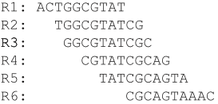
Overlap-layout-consensus (OLC) algorithm
Create the layout according to the OLC graph:
Overlap
Layout
Li et al. Briefings in Functional Genomics, 2011

Slide 9
Overlap-layout-consensus (OLC) algorithm
Build the consensus sequence based on the layout:
Overlap
Layout
Consensus
Li et al. Briefings in Functional Genomics, 2011

Slide 10
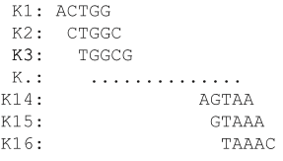
De bruijin graph (DBG) algorithm
The reads are chopped into k-mers (k=5bp). There are in total 16 different k-mers, most of which occur in more than one reads.
K-mers
Li et al. Briefings in Functional Genomics, 2011

Slide 11

De bruijin graph (DBG) algorithm
Build the DBG graph using the k-mers:
K-mers
DBG
Li et al. Briefings in Functional Genomics, 2011

Slide 12
De bruijin graph (DBG) algorithm
Infer the assembled sequence from the DBG graph:
K-mers
DBG
Assembled sequence
Li et al. Briefings in Functional Genomics, 2011

Slide 13
Genome Assembly
The toy example in the previous slides is helpful for explaining the two major classes of assembly algorithms. Some other aspects of genome assembly are missing from this toy example:
  There many complications, such as repeat sequences, sequencing errors etc. We will talk about them in the “challenges” section later in the lecture.
  We often can obtain many contigs from NGS reads. In order to obtain an even longer assembled sequence, the so-called “scaffold linkage” step orders and orients the contigs into scaffolds using paired-end reads.

Slide 14
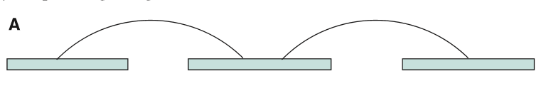
The scaffold linkage step in genome assembly
Each arc represents a pair of reads
Li et al. Briefings in Functional Genomics, 2011

Slide 15
Quality of the genome assembly
N50
  A standard metric to evaluate an assembly
  It is the length of the smallest contig, after they have been ranked from longest to smallest, such that the sum of contig lengths up to it covers 50% of the total size of all contigs.
  It is thus a measure of contiguity, with higher numbers indicating lower levels of fragmentation.
Del Angel et al. F1000Research, 2018

Slide 16
Challenges in genome assembly
Sequencing errors
Repeats
Heterozygosity
Ploidy level
GC-content

Slide 17
Sequencing errors
There are sequencing errors in real data. In Illumina NGS sequencing, it is about 0.1%.
Genome assembly, like other bioinformatics applications, needs to consider the sequencing errors and to perform error correction if possible.

Slide 18
Repeats
Repeats are genomic regions that occur in multiple copies in the genome.
Amount and distribution of repeats in a genome hugely influences the genome assembly results, because reads from these different repeats are very similar and the assembly tools cannot distinguish between them. This can lead to mis-assemblies, where regions that are distant in the genome are assembled together.
Real genomes have complex repeat structures including tandem repeats, inverted repeats, imperfect repeats, and repeats inserted within repeats.
Li et al. Briefings in Functional Genomics, 2011
Miller et al. Genomics, 2010

Slide 19
Heterozygosity
Assembly programs in general try to collapse allelic differences into one consensus sequence, so that the final assembly that is reported is haploid.
If the genome is highly heterozygous, sequence reads from homologous alleles can be too different to be assembled together and these alleles will then be assembled separately.
Highly heterozygous genomes can lead to more fragmented assemblies, or create doubt about the homology of the contigs.
Li et al. Briefings in Functional Genomics, 2011

Slide 20
Ploidy level
If possible, it is better to sequence haploid tissues since this will essentially remove problems caused by heterozygosity.
Diploid tissues, which will be the case for most animals and plants, is fine and usually manageable, while tetraploidy and above has the potential to greatly increase the number of present alleles, which likely will result in a more fragmented assembly.
Li et al. Briefings in Functional Genomics, 2011

Slide 21
GC-content
Extremely low or high GC-content in a genomic region is known to cause a problem for Illumina sequencing, resulting in low or no coverage in those regions.
This can be compensated by an increased coverage, or the use of a sequencing technology that does not exhibit that bias (i.e., PacBio or Nanopore). However, Pacbio and Nanopore have much higher sequencing errors thant Illumina sequencing.
Li et al. Briefings in Functional Genomics, 2011

Slide 22
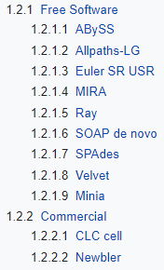
Genome assembly softwares
https://en.wikibooks.org/wiki/Next_Generation_Sequencing_(NGS)/De_novo_assembly

Slide 23
Summary
There are two major types of algorithms behind genome assembly softwares: overlap-layout-consensus algorithm and de bruijin graph assembly algorithm.
Coverage analysis gives a theoretical estimate of the sequencing depth.
N50 is a measure of genome assembly.
There are many challenges and complications in genome assembly such as sequencing errors and repeats.

