Slide 1
Biological Sequence Analysis
Functional annotations of sequences

Slide 2
Case study
We are going to pick a gene, say human “ESR1”, and then perform functional analysis for its protein, RNA and DNA sequences.
The list of tasks to be performed is NOT exhaustive because you can always come up with new analysis. But it should serve as an example to see how functional annotations are performed.

Slide 3
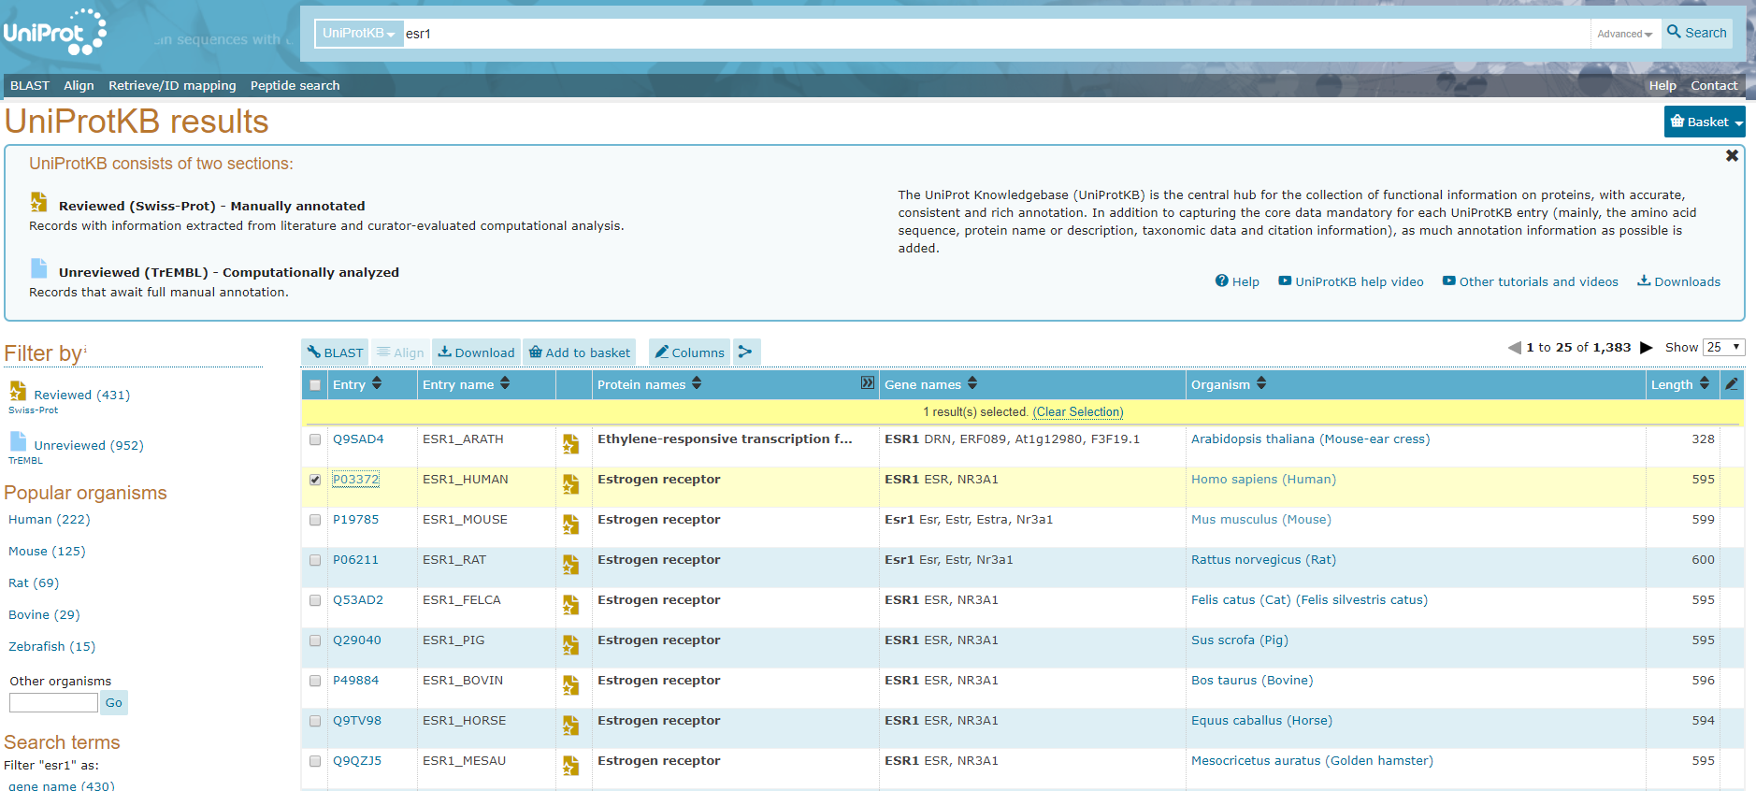
Obtain protein sequences
Search “ESR1” in Uniprot

Slide 4
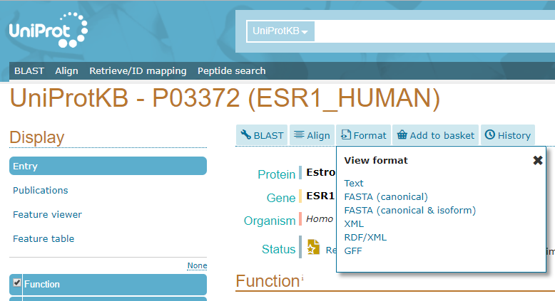
Canonical and isoforms of ESR1 available in UniProt

Slide 5
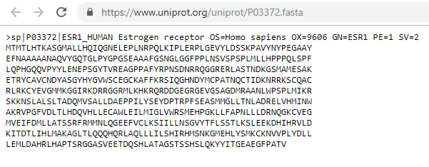
Fasta files of ESR1 protein (canonical)

Slide 6
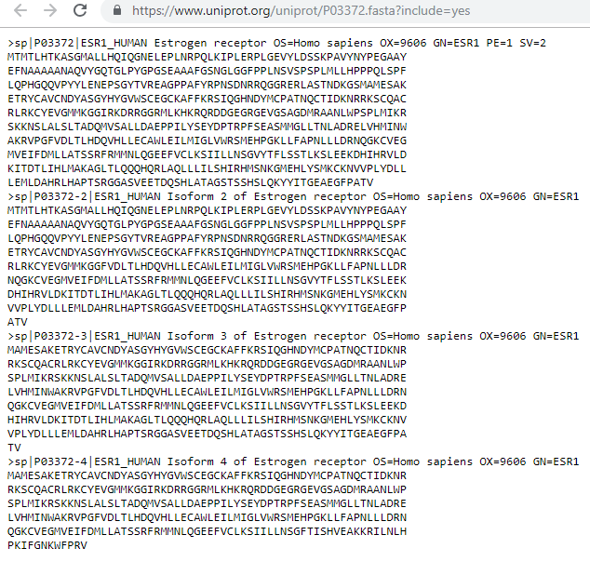
Fasta files of ESR1 protein (isoforms)

Slide 7
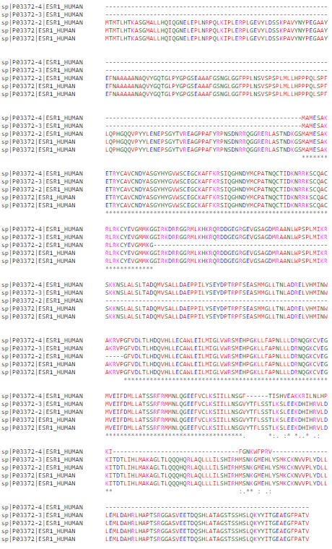
Multiple Sequence alignment of the proteins sequences of human ESR1 (canonical + isoforms)
Using MUSCLE from EBI:
https://www.ebi.ac.uk/Tools/msa/muscle/
This multiple sequence alignment gives a sense of overall differences between the different isoforms.
However, it is hard to conclude what functional differences these isoforms may have.

Slide 8

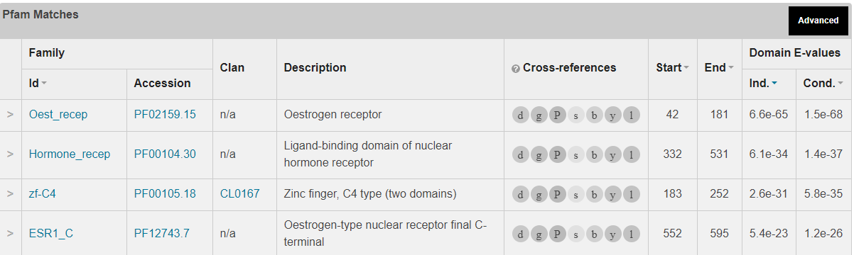
Use HMMER to find protein domains using ESR1 protein sequences
https://www.ebi.ac.uk/Tools/hmmer/search/hmmscan

Slide 9
Try HMMER
What do you get if you use the other four isoforms sequences of ESR1?
You can also download and run the program locally:
  http://hmmer.org/

Slide 10
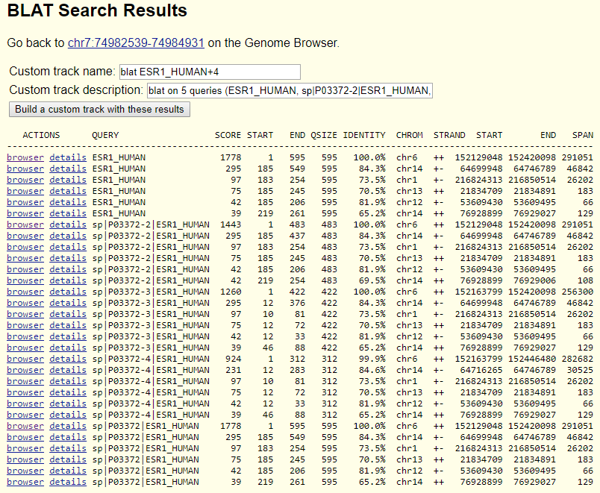
Use BLAT (in UCSC genome browser) to map the sequences to the human genome

Slide 11
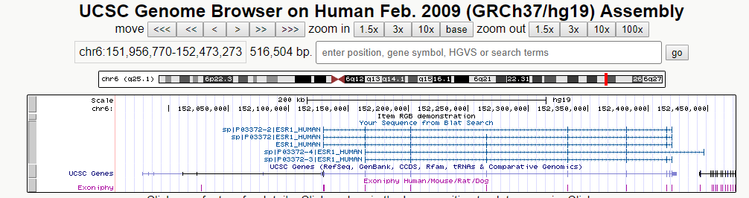
Visualize the BLAT results in UCSC genome browser
Build a custom track from the BLAT results:
Clearly, these sequences are mapped to the exonic regions of ESR1 in human genome, which makes sense because these sequences are protein sequences.
You can also see the isoform differences clearly.

Slide 12
UCSC genome browser
UCSC genome browser is not only a visualization tool, but also a platform that has lots of genomic annotations.
There are many kinds of genomic annotations information (tracks below the browser view) on UCSC genome browser, such as exon/intron, conservation, histone marks, etc.
I am going to showcase a few in the following slides.

Slide 13
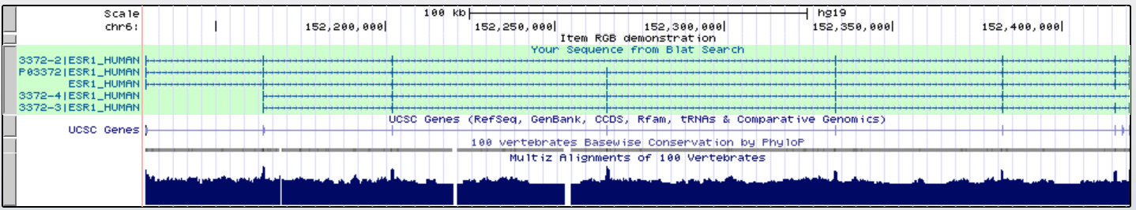
Conservation
There are conservation peaks corresponding to exons, suggesting the protein sequences are conserved during evolution.
But there are also some conservation peaks in the intron or other noncoding regions. Are they potentially import regulatory sequences?

Slide 14
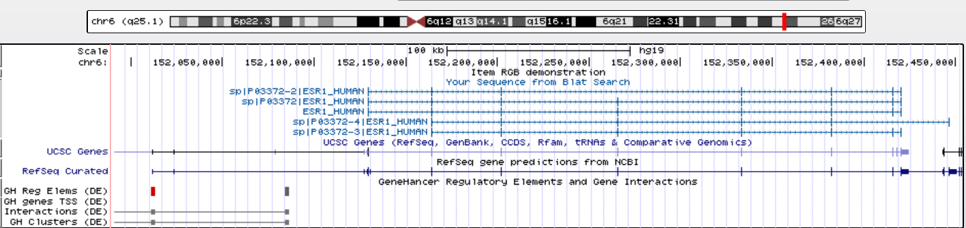
Enhancers using GeneHancer track

Slide 15
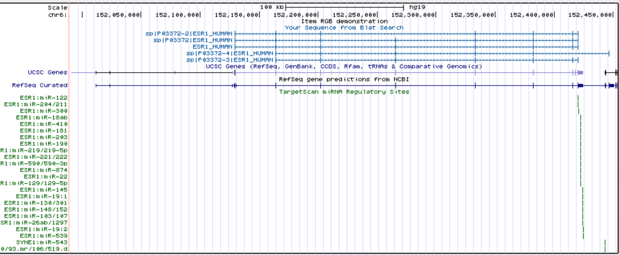
Predicted miRNA binding sites in the 3’UTR
Some of the predicted miRNA binding sites are for epithelial specific miRNAs such as miR-145 and miR-203. They might be functional.

Slide 16
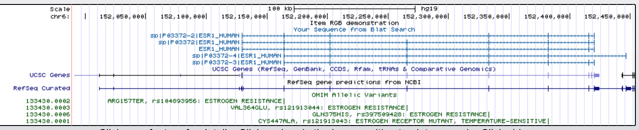
OMIM alleles
Estrogen resistance is a form of congenital estrogen deficiency or hypoestrogenism which is caused by a defective estrogen receptor.
The OMIM alleles associated with ESR1 are all related to estrogen resistance.

Slide 17
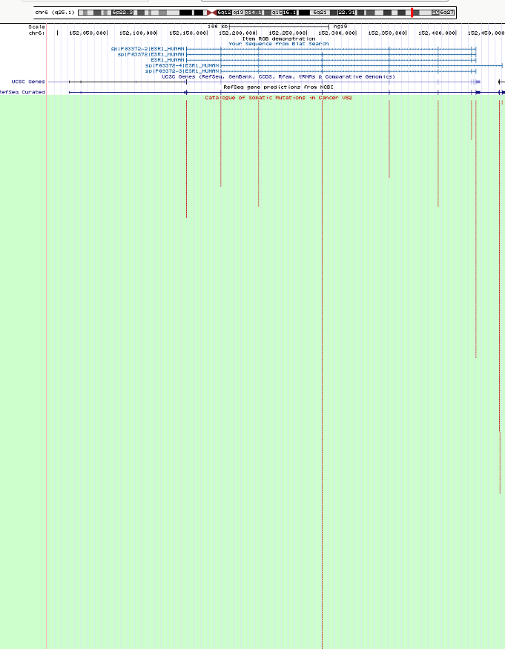
COSMIC mutations (cancer mutations)
The mutations in ESR1 that are found in cancers are located in the exons.
Interesting, the exon with the most mutations is in all the isoforms but not the canonical form.

Slide 18
BLAST search the ESR1 protein sequence in E.coli
ESR1 encodes the estrogen receptor in humans. I don’t think there are estrogenes in bacteria in E. coli.
So what do you think I would find by BLAST searching the ESR1 protein sequence in E. Coli? (https://blast.ncbi.nlm.nih.gov/Blast.cgi?PROGRAM=blastp&PAGE_TYPE=BlastSearch&LINK_LOC=blasthome)

Slide 19
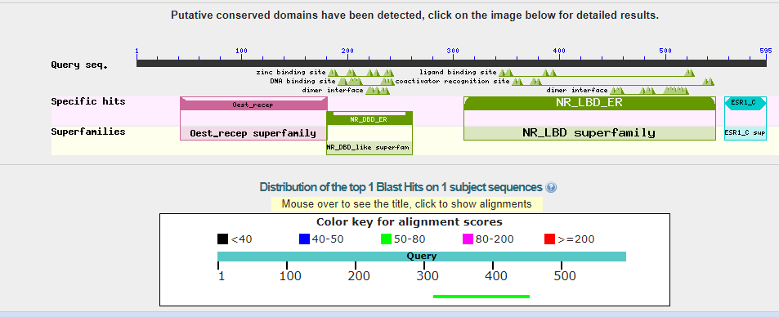
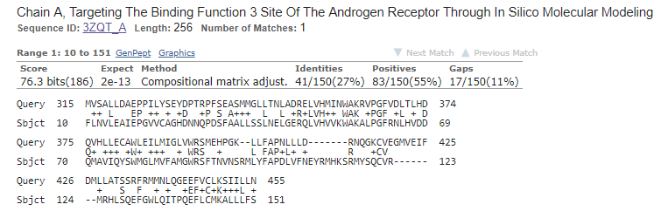
There is a hit in E. coli!

Slide 20
So what is this protein “Chain A, Targeting The Binding Function 3 Site Of The Androgen Receptor Through In Silico Molecular Modeling”?
It has a PDB id of “3ZQT_A”. Let’s check in the PDB database.

Slide 21
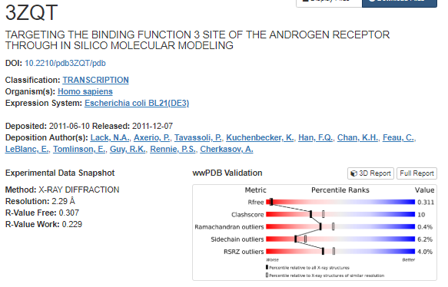
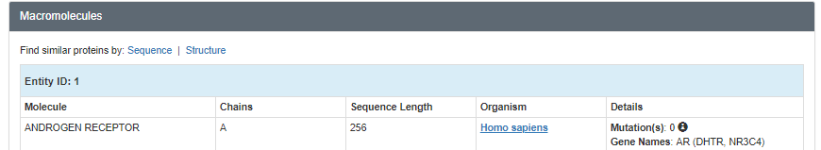
Apparently the hit is the human AR protein expressed in E.coli!
Although this exercise did not find any similar proteins to ESR1 in E.coli, we did find the human AR protein, which is known to be similar to the ESR1 protein.

Slide 22
Summary
There are many kinds of functional annotations that you can perform on biological sequences.
A case study using ESR1 proteins sequences was performed using online tools from EBI and UCSC genome browser. You can of course use other tools or write your own code to do similar or additional tasks.

