Slide 1
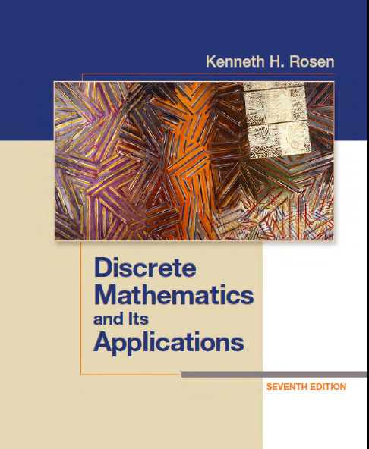
Discrete Math
Haiming Chen
Associate Professor, PhD
Department of Computer Science,
Ningbo University
http://www.chenhaiming.cn

Slide 2
What’s Discrete Math?
the part of mathematics devoted to the study of discrete objects
What is the shortest path between two cities using a transportation system?
How many valid Internet addresses are there?

Slide 3
Why is it important?
information is stored and manipulated by computing machines in a discrete fashion
provides the mathematical foundations for many computer science courses including data structures, algorithms, database theory, automata theory, formal languages, compiler theory, computer security, and operating systems

Slide 4
Goals
Think logically and mathematically
Mathematical Reasoning
Combinatorial Analysis
Discrete Structures
Algorithmic Thinking
Applications and Modeling

Slide 5
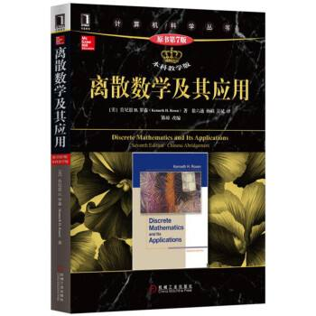
Content
Part I：Logic （Thinking in Mathematics）
Propositional Logic, Predicates and Quantifiers
Definition, Theorem, Corollary and Proofs (Induction)
Part II：Counting
Number Theory
Discrete Probability
Lists and Sequences (Recursive Definition & Recurrence)
Permutation and Combination (Counting)
Part III: Discrete Structure
Sets
Relations
Functions
Trees
Graphs
Algorithms (Recursive)
Modeling Computation
Part IV: Algebra
Algebra (Groups) *
Boolean Algebra
a discrete set of skills

Slide 6
Textbook
800 examples
4000 exercises
150 computer projects
600 North American schools

Slide 7
Homework
8 students each group
Prepare 2 notebooks for homework
Every Tuesday, before class, hand in your homework to your group
Check homework each other
Every Friday, before class, return the homework to TA
Next Tuesday, before class, return the homework to you

Slide 8
Quiz
3 times
Randomly
Without notice in advance

Slide 9
Score
Homework:20%
Quiz (attendance): 10%
Final exam: 70%

Slide 10
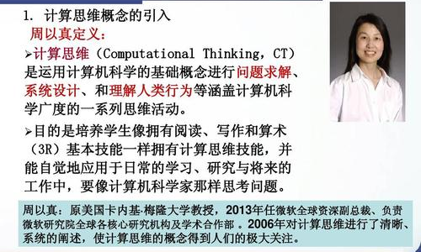
Note

