Slide 1
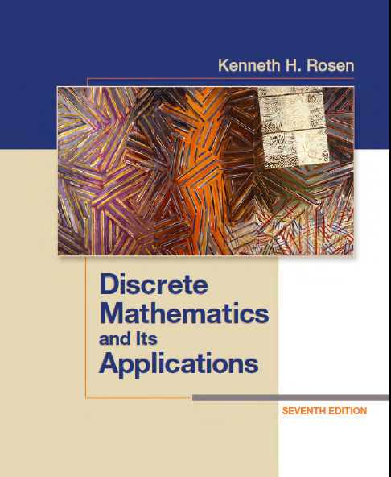
Discrete Math
Haiming Chen
Associate Professor, PhD
Department of Computer Science,
Ningbo University
http://www.chenhaiming.cn

Slide 2
Logic and Proofs
Propositional Logic
Predicates and Quantifiers
Inference
Proof (Mathematical argument )
Notes:
Mathematical argument 数学论证 proof
Conjecture 推测

Slide 3
What’s Proposition?
1+1=2
Today is Sunday
There exists an integer that is not the sum of two squares.
For every positive integer n, the sum of the positive integers not exceeding n is n(n + 1)/2

Slide 4
What’s Proposition?
A proposition is a declarative sentence (that is, a sentence that declares a fact) or a mathematical statement that is either true or false, but not both.
How to prove a mathematical statement true or false?
makes up a correct mathematical argument
How to?

Slide 5
What’s Logic?
Rules which are used to distinguish between valid and invalid mathematical arguments

Slide 6
What’s Logic?
The land is wet, so today is rainy.
For every positive integer n, the sum of the positive integers not exceeding n is n(n + 1)/2
declarative sentence
mathematical statement
theorem

Slide 7
Logic
Logic is the basis of all mathematical reasoning, and of all automated reasoning
Applications
design of computer circuits
construction of computer programs
verification of the correctness of programs
artificial intelligence

Slide 8
Propositional Logic
The area of logic that deals with propositions
basic building blocks of logic—propositions
propositional variables (or statement variables), like p, q, r, s
truth value, which is T or F
compound propositions, formed from existing propositions using logical operators

Slide 9
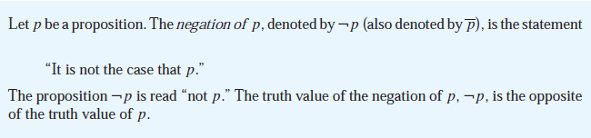

logical operator 1: negation

Slide 10

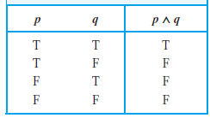
logical operator 2: conjunction

Slide 11

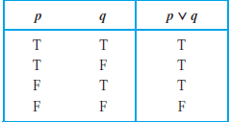
logical operator 3: disjunction
inclusive or

Slide 12
or
“Students who have taken calculus or computer science can take this class.”
“Students who have taken calculus or computer science, but not both, can enroll in this class.”
inclusive or
exclusive or

Slide 13

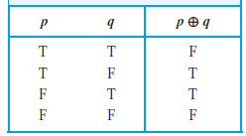
Exclusive or

Slide 14
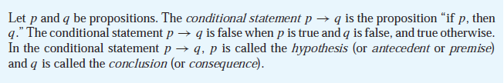
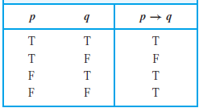
logical operator 4: implication
“p implies q”
“if p, then q”
“p is sufficient for q”
“q is necessary for p”

Slide 15
Implication: Examples
p: The land is wet.
q: It was rainy.
p: you can get the bachelor degree.
q: you pass the graduate defense.
r: you pass all the courses.
s: you pass the CET4.

Slide 16
Implication: related conditional statements
Conditional Statement: p → q
Its Contrapositive: ￢q →￢p
Its Converse: q → p
Its Inverse: ￢p →￢q
the contrapositive, ￢q →￢p, of a conditional statement p → q always
has the same truth value as p → q.

Slide 17
Equivalent
When two compound propositions always have the same truth value
p | q | ￢q | ￢p | ￢q →￢p
T | T | F | F | T
T | F | F | T | F
F | T | T | F | T
F | F | T | T | T

Slide 18
Equivalent
Conditional Statement: p → q
Its Converse: q → p
Its Inverse: ￢p →￢q
p | q | p →q | q →p | （p →q )∧(q →p)
T | T | T | T | T
T | F | F | T | F
F | T | T | F | F
F | F | T | T | T

Slide 19

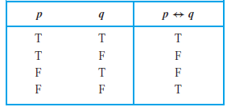
logical operator 5: bi-implications
“p is necessary and sufficient for q”
“if p then q, and conversely”
“p iff q.”

Slide 20
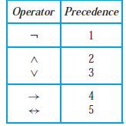
Precedence of Logical Operators

Slide 21

compound proposition
Construct the truth table of the compound proposition

Slide 22
Translating English Sentences
Express these system specifications using the propositions
p “The message is scanned for viruses” and q “The
message was sent from an unknown system” together
with logical connectives (including negations).
a) “The message is scanned for viruses whenever the
message was sent from an unknown system.”
b) “The message was sent from an unknown system but
it was not scanned for viruses.”
c) “It is necessary to scan the message for viruses whenever it was sent from an unknown system.”
d) “When a message is not sent from an unknown system
it is not scanned for viruses.”

Slide 23
Exercise 13
Let p and q be the propositions
p :You drive over 65 miles per hour.
q :You get a speeding ticket.
Write these propositions using p and q and logical connectives (including negations).
a) You do not drive over 65 miles per hour.
b) You drive over 65 miles per hour, but you do not get a speeding ticket.
c) You will get a speeding ticket if you drive over 65 miles per hour.
d) If you do not drive over 65 miles per hour, then you will not get a speeding ticket.
e) Driving over 65 miles per hour is sufficient for getting a speeding ticket.
f ) You get a speeding ticket, but you do not drive over 65 miles per hour.
g) Whenever you get a speeding ticket, you are driving over 65 miles per hour.

Slide 24
Excise8
Let p and q be the propositions
p : I bought a lottery ticket this week.
q : I won the million dollar jackpot.
Express each of these propositions as an English sentence.
a) ￢p
b) p ∨ q
c) p → q
d) p ∧ q e) p ↔ q f ) ￢p →￢q
g) ￢p ∧￢q h) ￢p ∨ (p ∧ q)

Slide 25
Exercise 32
Construct a truth table for each of these compound propositions.
(q →￢p) ↔ (p ↔ q)
(p → q) ↔ (￢q →￢p)

Slide 26

Propositional Equivalences
Logical Equivalences
(p → q) ⇔ (￢q →￢p)
The symbol ⇔ is sometimes used instead of ≡ to denote logical equivalence.

Slide 27
Propositional Equivalences
To prove that p and q are logically equivalent , we should demonstrate that p ↔q is a tautology.
How to demonstrate?
By truth table
Logical Equivalences

Slide 28
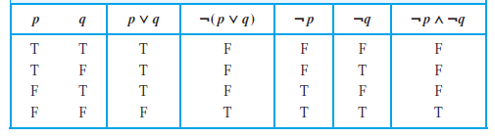
By truth table
￢(p ∨ q) ⇔ (￢p ∧￢q)
De Morgan laws
￢(p ∧ q) ⇔ ￢p ∨￢q

Slide 29
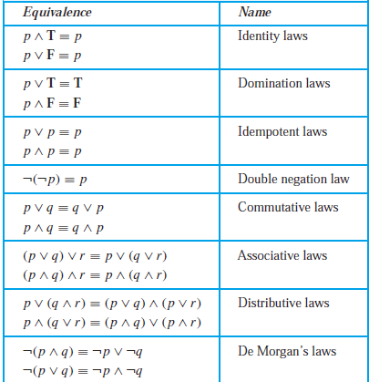
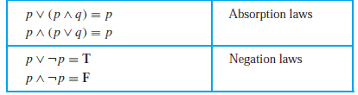
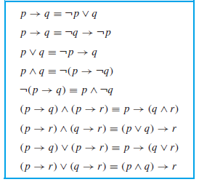
Logical Equivalences

Slide 30
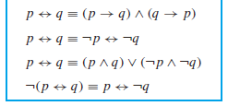
Logical Equivalences

Slide 31
Examples
Show that ￢(p ∨ (￢p ∧ q)) and ￢p ∧￢q are logically equivalent by developing a series of logical equivalences.
Show that (p ∧ q) → (p ∨ q) is a tautology.

Slide 32
Propositional Satisfiability
Acompound proposition is satisfiable if there is an assignment of truth values to its variables that makes it true.
such an assignment is called a solution of this particular satisfiability problem.

Slide 33
Solving Satisfiability Problems
truth table
2^{n} raws

Slide 34
Exercise 61
Determine whether each of these compound propositions is satisfiable.
(p → q) ∧ (p →￢q) ∧ (￢p → q) ∧ (￢p →￢q)

Slide 35
Applications of Satisfiability
Sudoku puzzle
Learn by yourself

Slide 36
Applications of Propositional Logic
System Specifications
Boolean Searches
Logic Puzzles
Logic Circuits
“The automated reply cannot be sent when the file system is full”

Slide 37


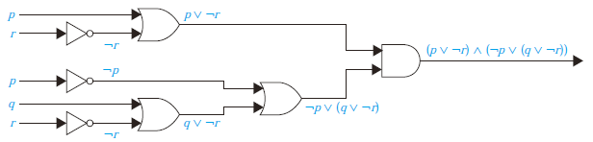
Logic Circuits

Slide 38
Homework
Review the Chapter 1.1, 1.2, 1.3
Chapter 1.1 Exercise 32(c), (e); 38;
Chapter 1.2 Exercise 8, 12, 36, 40
Chapter 1.3 Exercise 22, 26; 30; 58; 62(b)

