Slide 1
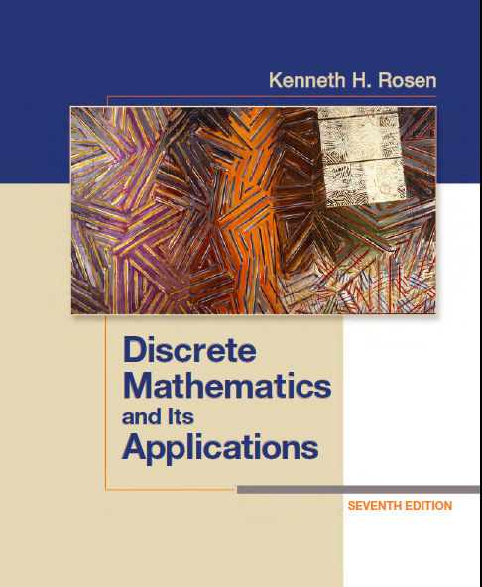
Discrete Math
Haiming Chen
Associate Professor, PhD
Department of Computer Science,
Ningbo University
http://www.chenhaiming.cn

Slide 2
Content
Part I：Logic （Thinking in Mathematics）
Propositional Logic, Predicates and Quantifiers
Definition, Theorem, Corollary and Proofs (Induction)
Part II：Combinatorial Counting
The Basic of Counting
The Pigeonhole Principle
Permutation and Combination
Binomial Coefficients and Combinations
Lists and Sequences (Recursive Definition /Recurrence Relations)
Part III: Discrete Structure
Sets
Functions
Relations
Trees
Graphs
Part IV: Algebra
Algebra (Groups) *
Boolean Algebra

Slide 3
Outline
Sets
Set Operations
Cardinality of Sets
Function

Slide 4
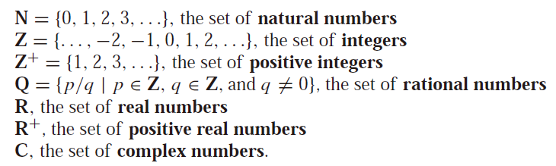
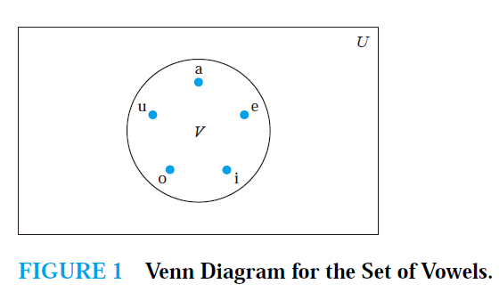
Sets (review)

Slide 5


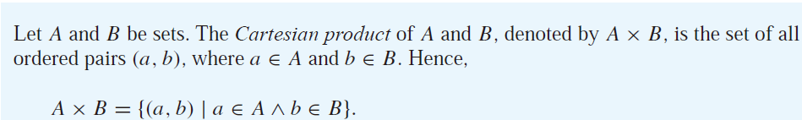
Sets (review)
Subsets
Power sets
Cartesian Products

Slide 6


Cartesian Products
ordered n-tuples

Slide 7
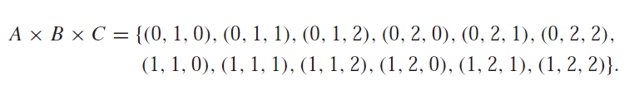
Cartesian Products

Slide 8
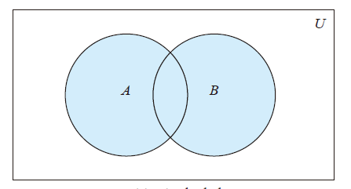

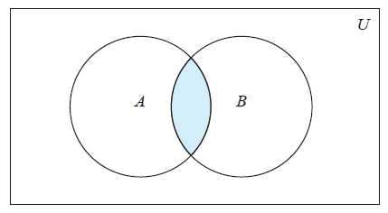

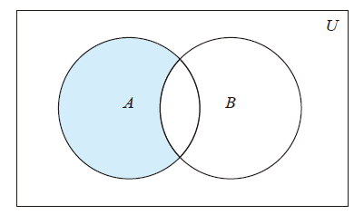

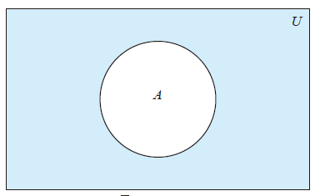

Set Operations
union
intersection
difference
complement

Slide 9
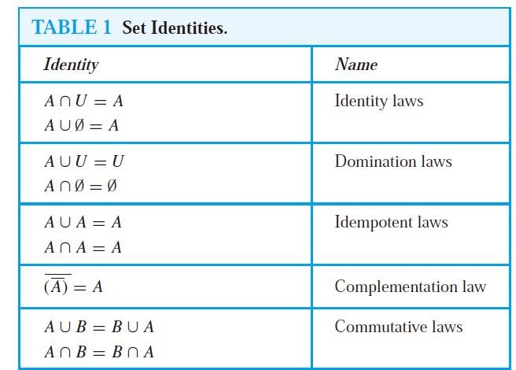
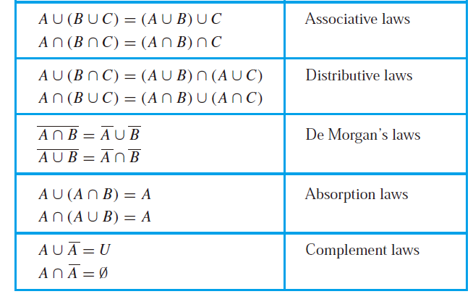
Set Operations

Slide 10
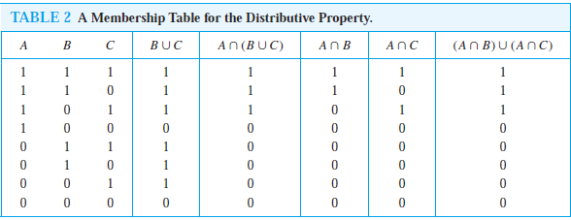
Membership Table

Slide 11
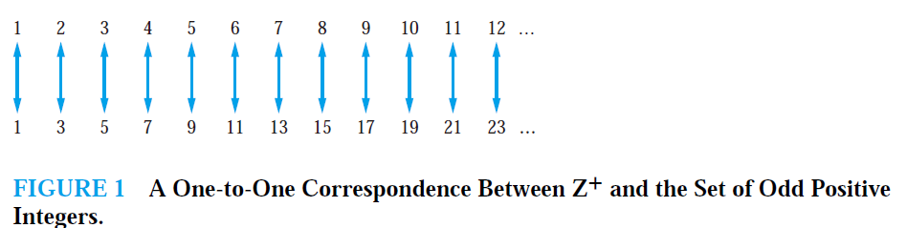
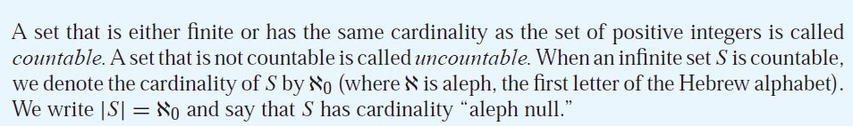

Cardinality of Sets
cardinality of a finite set as the number of elements in the set
Countable?
Set of Odd Positive Integers

Slide 12
Cardinality of Sets
the set of real numbers is an uncountable set.

Slide 13
Computer Representation of Sets
Let the universal set U = {1, 2, 3, 4, 5, 6, 7, 8, 9, 10}, and the ordering of elements of U has the elements in increasing order; that is, a_{i} = i. What bit strings represent the subset of all odd integers in U, the subset of all even integers in U, and the subset of integers not exceeding 5 in U?

Slide 14
Computer Representation of Sets
The bit strings for the sets {1, 2, 3, 4, 5} and {1, 3, 5, 7, 9} are 1111100000 and 101010 1010, respectively. Use bit strings to find the union and intersection of these sets.

Slide 15
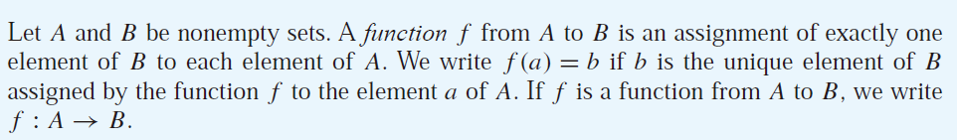
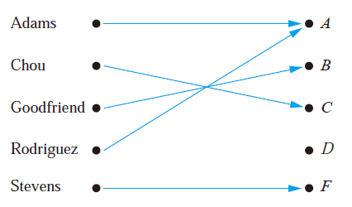
Functions
Functions are sometimes also called mappings or transformations

Slide 16

Functions
Functions are specified in many different ways
Assignments
Formula
Computer program
a relation from A to B
a subset of A × B.
int max (int x, int y)
{ int z;
z=y;
if (x>y) z=x;
return (z);
}
for every element a ∈ A,
contains one, and only one, ordered pair (a, b)

Slide 17
Functions
Write the function illustrated by the figure in a relation
Preimage of A
Image of Adams
f
f
Domain of f
Codomain of f
f
range of function: {A,B, C, F}

Slide 18
Equal Function
Same domain
Same codomain
Map each element of their common domain to the same element in their common codomain

Slide 19
Example
Domain: A={Abdul, Brenda, Carla, Desire, Eddie, Felicia}
Codomain: B={y | y is a positive integer less than 100}
Range: {21, 22, 24}

Slide 20
Example
Let f be the function that assigns the last two bits of a bit string of length 2 or greater to that string.
Domain: S={bs| bs is a bit string of length 2 or greater}
Codomain: B={00, 01, 10, 11}
Range: {00, 01, 10, 11}

Slide 21
Example
What’s the domain, codomain, and range of the function max?
int max (int x, int y)
{ int z;
z=y;
if (x>y) z=x;
return (z);
}
integer-valued
real-valued

Slide 22
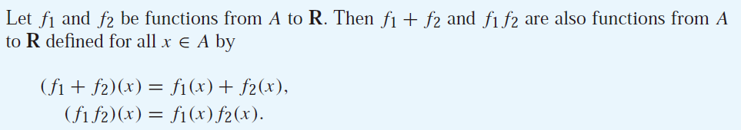
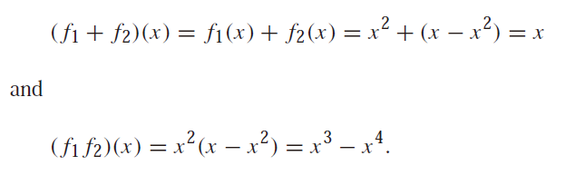
Function

Slide 23

Function
Let f be a function from A to B and let S be a subset of A.

Slide 24
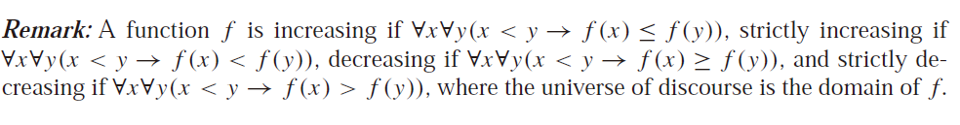
Function

Slide 25
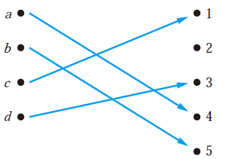
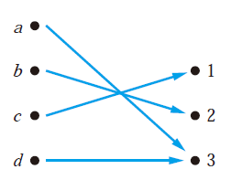
Function
One-to-one (injective) function
For two different domain elements, they are never assigned to the same value.

Slide 26





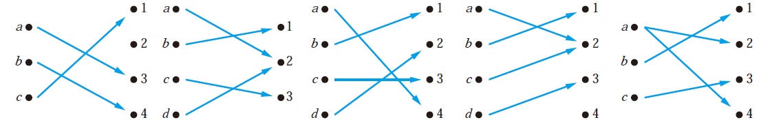
Function
Onto (surjective) function
every member of the codomain is the image of some element of the domain
one-to-one correspondence, or a bijection

Slide 27
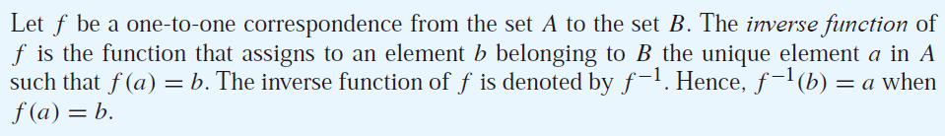
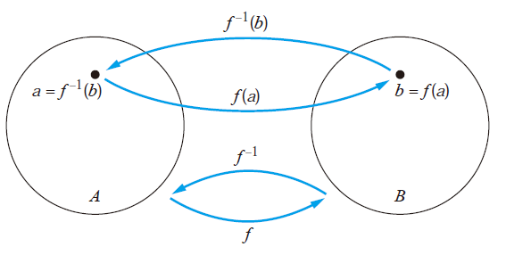
Inverse Functions

Slide 28
Example

Slide 29
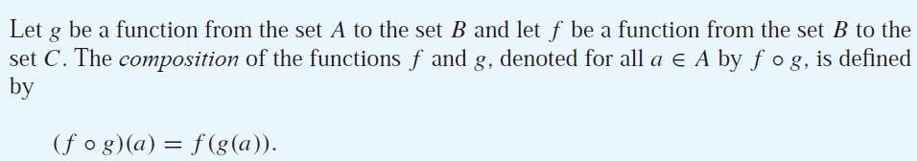
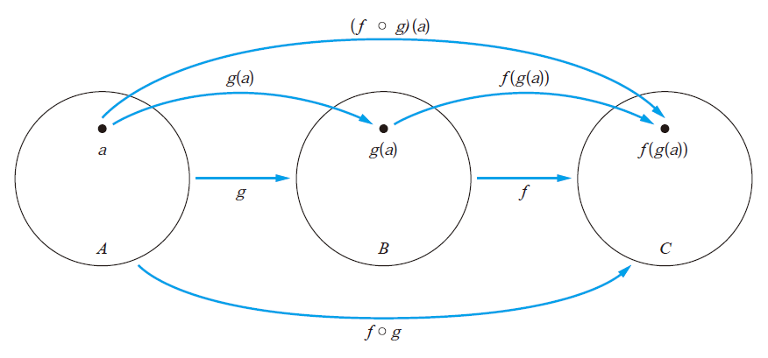
Compositions of Functions

Slide 30
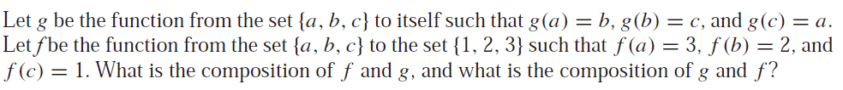

Examples

Slide 31
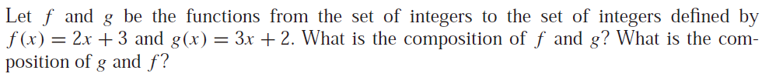
Example

Slide 32
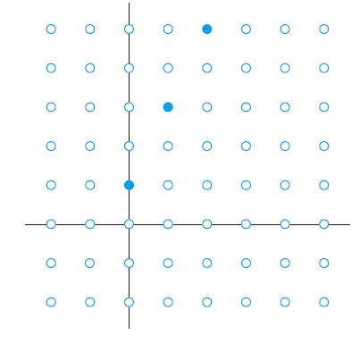
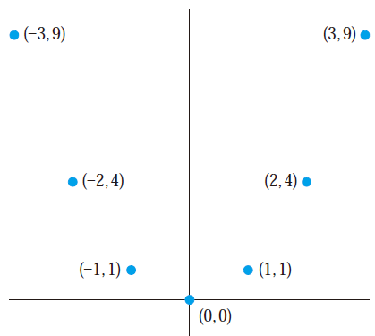


Graphs of Functions

Slide 33



Floor and ceiling functions
The floor function assigns to the real number x the largest integer that is less than or equal to x.
The ceiling function assigns to the real number x the smallest integer that is greater than or equal to x.

Slide 34
Homework-Sets
Review Chapter 2.1, 2.2
Chapter 2.1, Exercise 14, 20, 32(a)(b), 42
Chapter 2.2, Exercise 4, 14, 36, 52

Slide 35
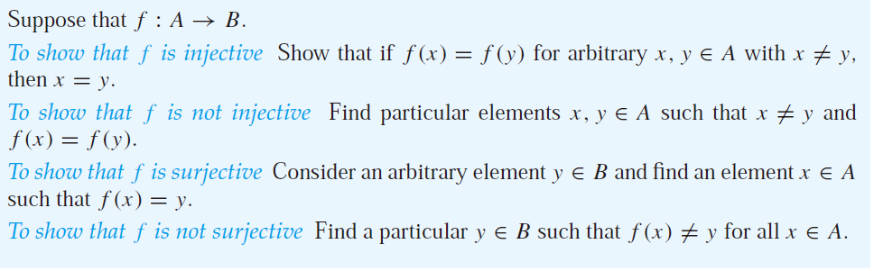
Homework-Function
Review Chapter 2.3 and 2.5
Chapter 2.3, Exercise 14 (a)(b), 22(a) (b), 36, 66

