Slide 1
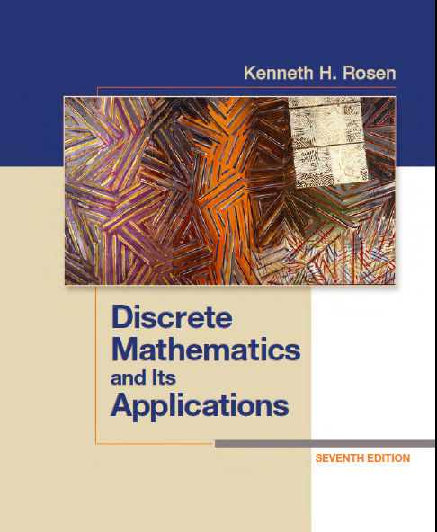
Discrete Math
Haiming Chen
Associate Professor, PhD
Department of Computer Science,
Ningbo University
http://www.chenhaiming.cn

Slide 2
Content
Part I：Logic （Thinking in Mathematics）
Propositional Logic, Predicates and Quantifiers
Definition, Theorem, Corollary and Proofs (Induction)
Part II：Combinatorial Counting
The Basic of Counting
The Pigeonhole Principle
Permutation and Combination
Binomial Coefficients and Combinations
Lists and Sequences (Recursive Definition /Recurrence Relations)
Part III: Discrete Structure
Sets
Functions
Relations
Trees
Graphs
Part IV: Algebra
Algebra (Groups) *
Boolean Algebra

Slide 3
Permutation
A permutation of a set of distinct objects is an ordered arrangement of these objects.
An ordered arrangement of r elements of a set is called an r-permutation.
The number of r-permutations of a set with n elements is denoted by P(n, r).

Slide 4
Example 1
In how many ways can we select three students from a group of five students to stand in line for a picture? In how many ways can we arrange all five of these students in a line for a picture?

Slide 5


Permutation
We can find P(n, r) using the product rule.
P(n, 0) = 1

Slide 6
Example 2
How many permutations of the letters ABCDEFGH contain the string ABC ?

Slide 7
Combinations
Counting unordered selections of objects
An r-combination of elements of a set is an unordered selection of r elements from the set
The number of r-combinations of a set with n distinct elements is denoted by C(n, r), also denoted by .

Slide 8
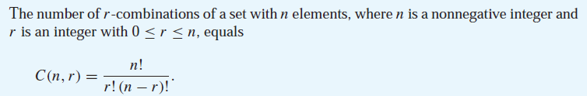



Combinations

Slide 9
Example 3
How many poker hands of five cards can be dealt from a standard deck of 52 cards? Also, how many ways are there to select 47 cards from a standard deck of 52 cards?

Slide 10


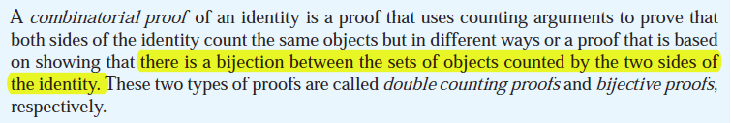
Combinations

Slide 11
Example 4
How many bit strings of length n contain exactly r 1s?

Slide 12
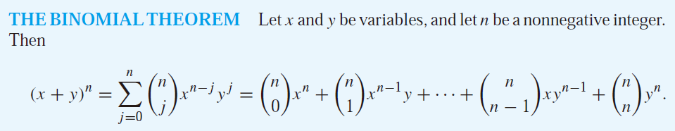
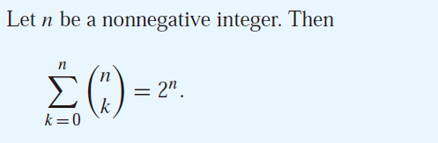
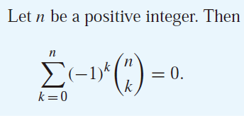
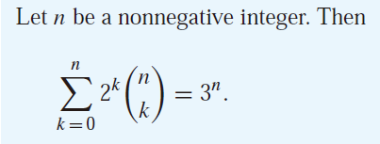
Binomial Coefficients and Identities

Slide 13
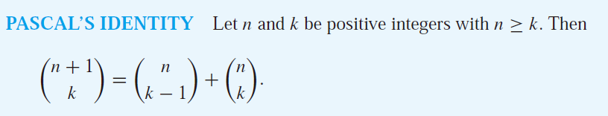
Pascal’s Identity

Slide 14
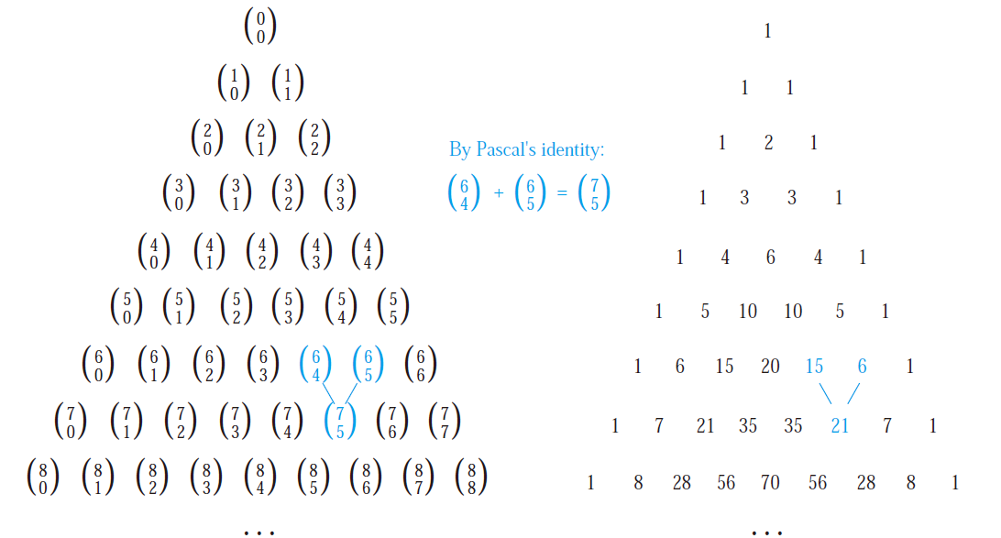
Pascal’s Triangle

Slide 15
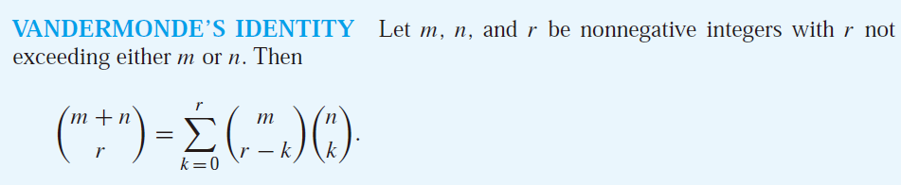
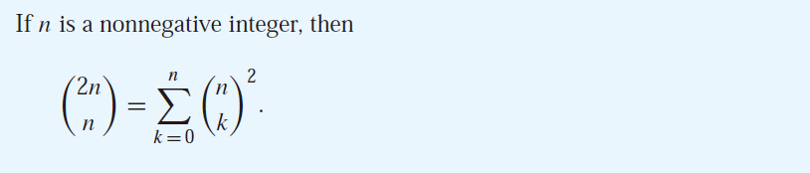
Vandermonde’s Identity

Slide 16
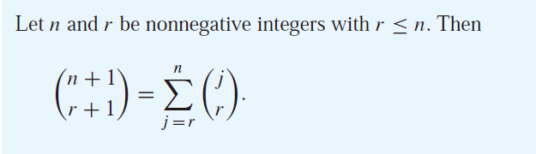
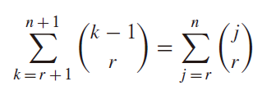
Other Identities Involving Binomial Coefficients

Slide 17
Generalized Permutations and Combinations
Permutations with Repetition
How many strings of length r can be formed from the uppercase letters of the English alphabet?

Slide 18

Generalized Permutations and Combinations
Combinations with Repetition
How many ways are there to select four pieces of fruit from a bowl containing apples, oranges, and pears if the order in which the pieces are selected does not matter, only the type of fruit and not the individual piece matters, and there are at least four pieces of each type of fruit in the bowl?

Slide 19
Example 2
How many ways are there to select five bills from a cash box containing $1 bills, $2 bills, $5 bills, $10 bills, $20 bills, $50 bills, and $100 bills? Assume that the order in which the bills are chosen does not matter, that the bills of each denomination are indistinguishable, and that there are at least five bills of each type.

Slide 20
Example 3
Suppose that a cookie shop has four different kinds of cookies. How many different ways can six cookies be chosen? Assume that only the type of cookie, and not the individual cookies or the order in which they are chosen, matters.

Slide 21
Example 4
How many solutions does the equation
x₁ + x₂ + x₃ = 11
have, where x₁, x₂, and x₃ are nonnegative integers?
x₁ ≥ 1, x₂ ≥ 2, and x₃ ≥ 3

Slide 22
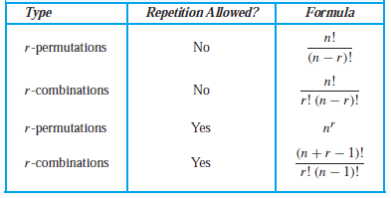
Summary

Slide 23
Homework
Review Chapter 6.3, 6.4
Chapter 6.3 Exercises 12, 18, 34
Chapter 6.4 Exercises 8, 18, 22
Chapter 6.5 Exercises 6, 14,

