Slide 1
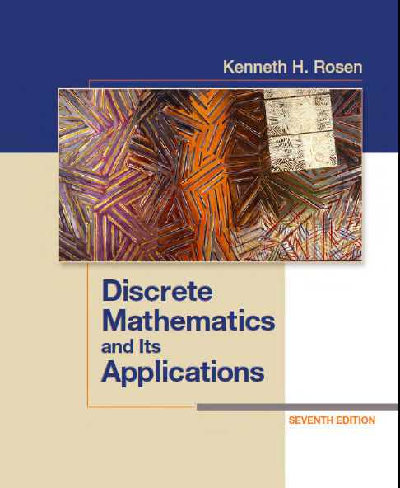
Discrete Math
Haiming Chen
Associate Professor, PhD
Department of Computer Science,
Ningbo University
http://www.chenhaiming.cn

Slide 2
Content
Part I：Logic （Thinking in Mathematics）
Propositional Logic, Predicates and Quantifiers
Definition, Theorem, Corollary and Proofs (Induction)
Part II：Combinatorial Counting
The Basic of Counting
The Pigeonhole Principle
Permutation and Combination
Binomial Coefficients and Combinations
Lists and Sequences (Recursive Definition /Recurrence Relations)
Part III: Discrete Structure
Sets
Functions
Relations
Trees
Graphs
Part IV: Algebra
Algebra (Groups) *
Boolean Algebra

Slide 3
Generating Permutations
based on the lexicographic (or dictionary) ordering
the permutation a₁a₂ · · · a_{n} precedes the permutation of b₁b₂ · · · b_{n}, if for some k, with 1 ≤ k ≤ n, a₁ = b₁, a₂ = b₂, . . . , a_{k−1} = b_{k−1}, and a_{k} < b_{k}
Example
The permutation 23415 of the set {1, 2, 3, 4, 5} precedes the permutation 23514

Slide 4
Generating Permutations
How to constructs the next permutation in lexicographic order following a given permutation a₁a₂ · · · a_{n}?
Example: the next larger permutation after 234156 is 234165
the next larger permutation after 234165 is 234516.
1. Find the last pair of adjacent integers in the permutation where the first integer in the pair is smaller than the second.
2. the next larger permutation in lexicographic order is obtained by putting in the j^{th} position the least integer among a_{j+1}, a_{j+2}, . . . , and a_{n} that is greater than a_{j} and listing in increasing order the rest of the integers a_{j}, a_{j+1}, . . . , a_{n} in positions j + 1
to n.

Slide 5
Examples
What is the next permutation in lexicographic order after 362541?
Generate the permutations of the integers 1, 2, 3 in lexicographic order.

Slide 6
Generating Combinations
Use the correspondence between subsets of {a₁, a₂, . . . , a_{n}} and bit strings of length n
Method
locating the first position from the right that is not a 1
changing all the 1s to the right of this position to 0s
making this first 0 (from the right) a 1
Example
Find the next bit string after 10 0010 0111
10 0010 1000

Slide 7
Generating Combinations
the first r-combination is {1, 2, . . . , r − 1, r}
the last r-combination is {n − r + 1, n − r + 2, . . . , n − 1, n}.
1. locate the last element a_{i} in the sequence such that a_{i} ≠ n − r + i.
2. replace a_{i} with a_{i + 1} and a_{j} with a_{i} + j − i + 1,
for j = i + 1, i + 2, . . . , r.

Slide 8
Example
Find the next larger 4-combination of the set {1, 2, 3, 4, 5, 6} after {1, 2, 5, 6}.

Slide 9
Sequences
A sequence is a function from a subset of the set of integers (usually either the set {0, 1, 2, . . .} or the set {1, 2, 3, . . .}) to a set S. We use the notation a_{n} to denote the image of the integer n. We call a_{n} a term of the sequence.

Slide 10
Geometric progression
A geometric progression is a sequence of the form a, ar, ar², . . . , ar^{n}, . . ., where the initial term a and the common ratio r are real numbers.

Slide 11
Examples
{b_{n}} with b_{n} = (−1)^{n},
{c_{n}} with c_{n} = 2 ・ 5^{n},
{d_{n}} with d_{n} = 6 ・ (1/3)^{n}

Slide 12
Arithmetic progression
An arithmetic progression is a sequence of the form a, a + d, a + 2d, . . . , a + nd, . . .，where the initial term a and the common difference d are real numbers.

Slide 13
Examples
{s_{n}} with s_{n} = −1 + 4n
{t_{n}} with t_{n} = 7 − 3n

Slide 14
Special Integer Sequences
Find formulae for the sequences with the following first five terms:
(a) 1, 1/2, 1/4, 1/8, 1/16
(b) 1, 3, 5, 7, 9
(c) 1, −1, 1, −1, 1.
How can we produce the terms of a sequence if the first 10 terms are 1, 2, 2, 3, 3, 3, 4, 4, 4, 4?
Conjecture a simple formula for a_{n} if the first 10 terms of the sequence {a_{n}} are 1, 7, 25, 79, 241, 727, 2185, 6559, 19681, 59047

Slide 15
Recurrence Relations
one or more initial terms——initial conditions
a rule for determining subsequent terms from those that precede them
A recurrence relation for the sequence {a_{n}} is an equation that expresses a_{n} in terms of one or more of the previous terms of the sequence, namely, a₀, a₁, . . . , a_{n−1}, for all integers n with n ≥ n₀, where n₀ is a nonnegative integer.
Let {a_{n}} be a sequence that satisfies the recurrence relation a_{n} = a_{n−1} − a_{n−2} for n = 2, 3, 4, . . . , and suppose that a₀ = 3 and a₁ = 5.

Slide 16
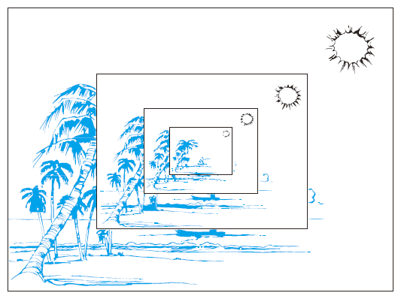
Recursive Definitions

Slide 17
Lucas Sequence
1, 3, 4, 7, 11, 18, 29, 47, 76, 123

Slide 18
Fibonacci Sequence
The Fibonacci sequence, f₀, f₁, f₂, . . . , is defined by the initial conditions f₀ = 0, f₁ = 1, and the recurrence relation
f_{n} = f_{n−1} + f_{n−2,} for n = 2, 3, 4, . . . .

Slide 19
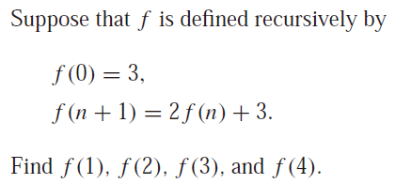
Recursively Defined Functions
BASIS STEP: Specify the value of the function at zero.
RECURSIVE STEP: Give a rule for finding its value at an integer from its values at smaller integers.

Slide 20
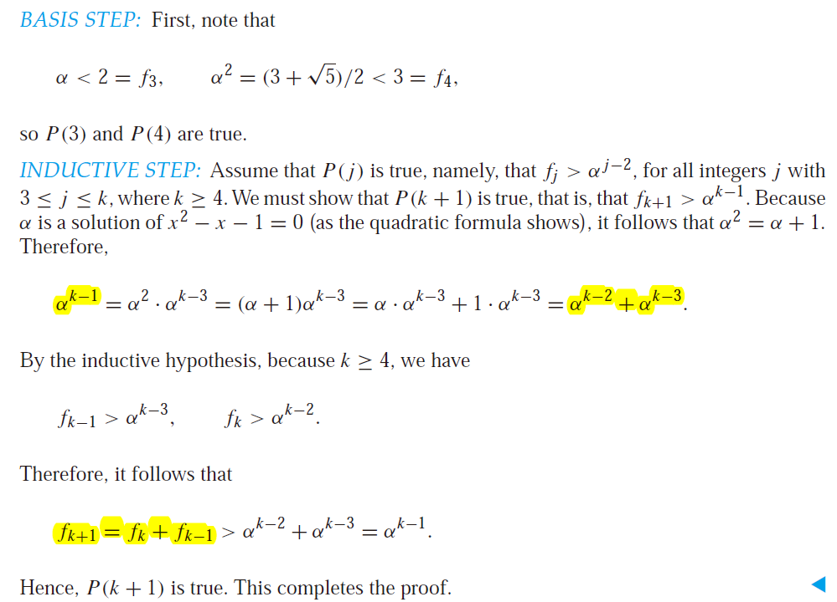
Property of Fibonacci Sequence Numbers （5.3）
use strong induction to prove this inequality.

Slide 21
Solve Recurrence Relations
Closed Formula: an explicit formula for the terms of the sequence.

Slide 22
Iteration
Forward substitution
Backward substitution
What’s the solution of the recurrence relation a_{n} = 2a_{n−1} − a_{n−2} for n = 2, 3, 4, . . . ., a₀=0, a₁=3
a_{n} = na_{n−1} is the sequence of integers defined by a_{n} = n!, a₁=1

Slide 23
Compound Interest
Suppose that a person deposits $10,000 in a savings account at a bank yielding 11% per year with interest compounded annually. How much will be in the account after 30 years?
let P_{n} denote the amount in the account after n years
P_{n} = P_{n−1} + 0.11P_{n−1} = (1.11)P_{n−1}
P_{n} = (1.11)P_{n−1} = (1.11)^{n}P₀

Slide 24
Homework
Chapter 6.6 Exercise 6(b)(d)(f), 9
Chapter 2.4 Exercise 12, 14(a)(c)(e)(g), 16(b)(d)(f)
Chapter 5.3 8(a)(d), 10, 26

