Slide 1
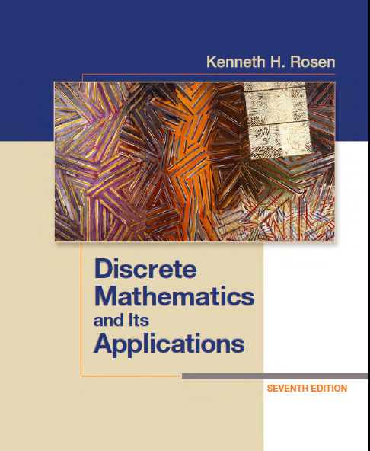
Discrete Math
Haiming Chen
Associate Professor, PhD
Department of Computer Science,
Ningbo University
http://www.chenhaiming.cn

Slide 2
Content
Part I：Logic （Thinking in Mathematics）
Propositional Logic, Predicates and Quantifiers
Definition, Theorem, Corollary and Proofs (Induction)
Part II：Combinatorial Counting
The Basic of Counting
The Pigeonhole Principle
Permutation and Combination
Binomial Coefficients and Combinations
Lists and Sequences (Recursive Definition /Recurrence Relations)
Part III: Discrete Structure
Sets
Functions
Relations
Trees
Graphs
Part IV: Algebra
Algebra (Groups) *
Boolean Algebra

Slide 3
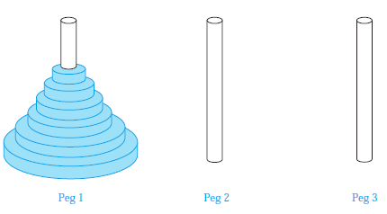

Applications of Recurrence Relations
The Tower of Hanoi: The rules of the puzzle allow disks to be moved one at a time from one peg to another as long as a disk is never placed on top of a smaller disk. Let H_{n} denote the number of moves needed to solve the Tower of Hanoi problem with n disks. Set up a recurrence relation for the sequence {H_{n}}.
H_{n} = 2H_{n−1} + 1
more than 500 billion years

Slide 4
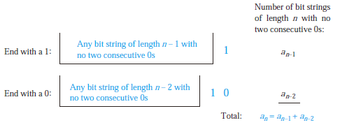
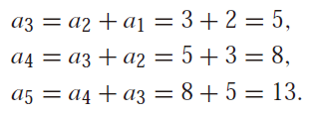
Applications of Recurrence Relations
Find a recurrence relation and give initial conditions for the number of bit strings of length n that do not have two consecutive 0s. How many such bit strings are there of length five?

Slide 5

Applications of Recurrence Relations
Codeword Enumeration A computer system considers a string of decimal digits a valid codeword if it contains an even number of 0 digits. Let a_{n} be the number of valid n-digit codewords. Find a recurrence relation for a_{n}.
a₁ = 9

Slide 6

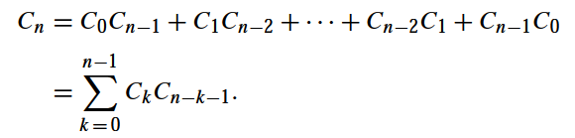
Applications of Recurrence Relations
Find a recurrence relation for C_{n}, the number of ways to parenthesize the product of n + 1 numbers, x₀ , x₁ , x₂ · · · · · x_{n}, to specify the order of multiplication.
C₃
1, 1, 2, 5, 14, 42, 122
Catalan numbers

Slide 7
Solving Linear Recurrence Relations
Constant Coefficients
Solving Linear Homogeneous Recurrence Relations
Linear Nonhomogeneous Recurrence Relations
Generating Functions （Chapter 8.4 Self-study*）

Slide 8
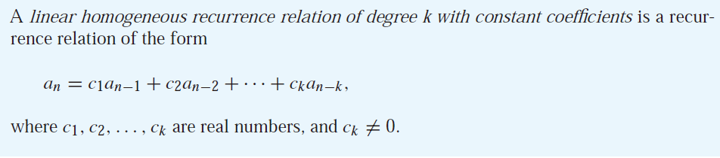
Solving Linear Homogeneous Recurrence Relations
The degree is k because a_{n} is expressed in terms of the previous k terms of the sequence.
P_{n} = (1.11)P_{n−1}
f_{n} = f_{n−1} + f_{n−2}
a_{n} = a_{n−5}

Slide 9

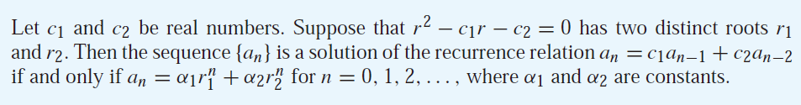
Solving Linear Homogeneous Recurrence Relations
a_{n} = r^{n}
characteristic equation
characteristic roots

Slide 10
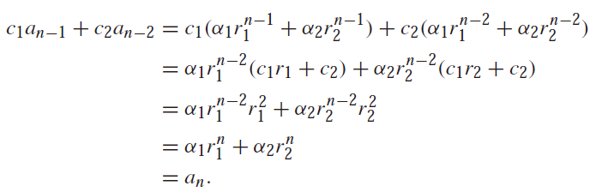
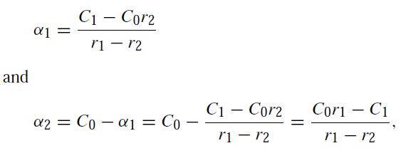

Solving Linear Homogeneous Recurrence Relations
r₁ and r₂ are roots of r² − c₁r − c₂ = 0, it follows that r₁²= c₁r₁ + c₂, r₂²= c₁r₂ + c₂.

Slide 11
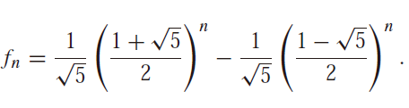
Example 1
Find an explicit formula for the Fibonacci numbers.
The initial conditions f₀ = 0 and f₁ = 1

Slide 12
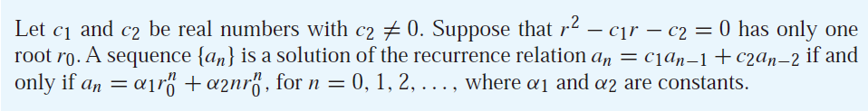
Solving Linear Homogeneous Recurrence Relations
Prove it as an exercise.
Hint: (r-r₀)²=0, c₁=2r₀, c₂=-r₀²

Slide 13

Example 2
What is the solution of the recurrence relation？
a_{n} = 6a_{n−1} − 9a_{n−2}
with initial conditions a₀ = 1 and a₁ = 6?

Slide 14
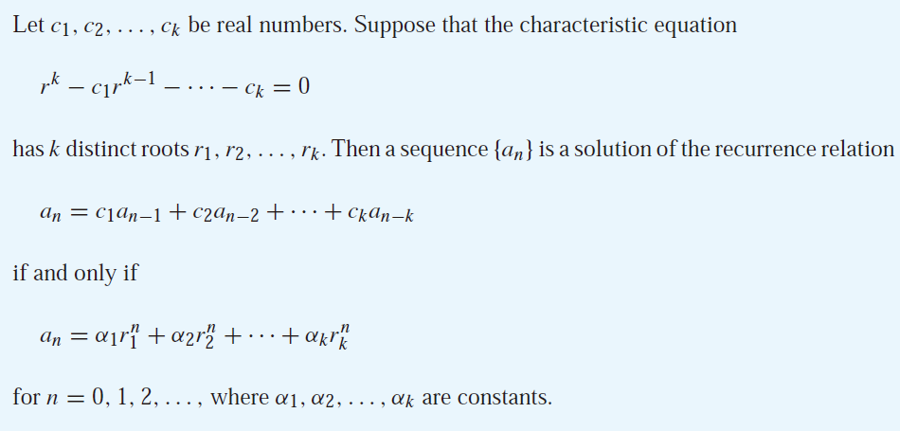
Solving Linear Homogeneous Recurrence Relations

Slide 15

Example 3
Find the solution to the recurrence relation
a_{n} = 6a_{n−1} − 11a_{n−2} + 6a_{n−3}
with the initial conditions a₀ = 2, a₁ = 5, and a₂ = 15.

Slide 16
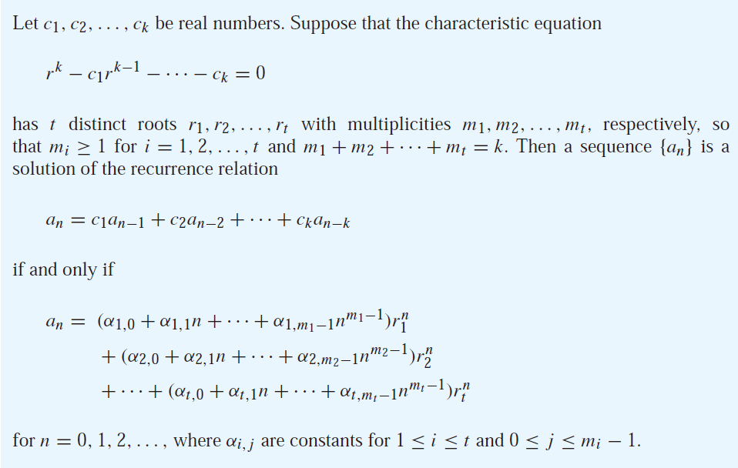
Solving Linear Homogeneous Recurrence Relations

Slide 17
Example 4
Suppose that the roots of the characteristic equation of a linear homogeneous recurrence relation are 2, 2, 2, 5, 5, and 9 (that is, there are three roots, the root 2 with multiplicity three, the root 5 with multiplicity two, and the root 9 with multiplicity one). What is the form of the general solution?

Slide 18

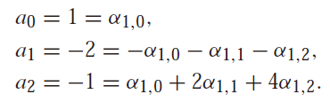

Example 5
Find the solution to the recurrence relation
a_{n} = −3a_{n−1} − 3a_{n−2} − a_{n−3}
with initial conditions a₀ = 1, a₁ = −2, and a₂ = −1.

Slide 19
Linear Nonhomogeneous Recurrence Relations with Constant Coefficients
associated homogeneous recurrence relation every solution is the sum of a particular solution and a solution of the associated linear homogeneous recurrence relation,

Slide 20
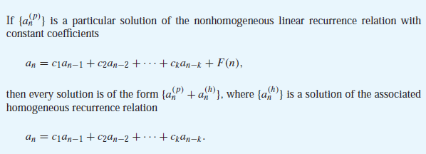
Linear Nonhomogeneous Recurrence Relations with Constant Coefficients

Slide 21

Example 6
Find all solutions of the recurrence relation a_{n} = 3a_{n−1} + 2n. What is the solution with a₁ = 3?
p_{n} = cn + d

Slide 22

Example 7
Find all solutions of the recurrence relation
a_{n} = 5a_{n−1} − 6a_{n−2} + 7^{n}
P_{n} = C · 7^{n},

Slide 23
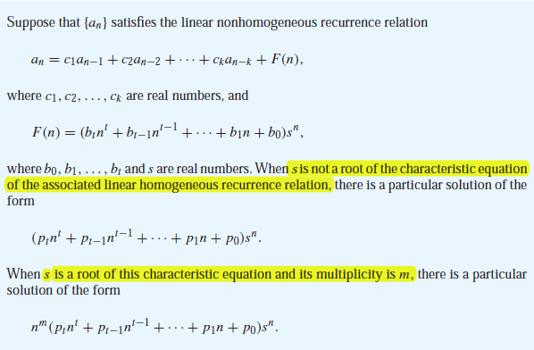
Linear Nonhomogeneous Recurrence Relations with Constant Coefficients

Slide 24
Example 8
What form does a particular solution?
a_{n} = 6a_{n−1} − 9a_{n−2} + F(n)
F(n) = 3^{n},
F(n) = n3^{n},
F(n) =(n² + 1)3^{n}
F(n) = n²2^{n},
n²p₀3^{n}
n²(p₁n + p₀)3^{n}
n²(p₂n² + p₁n + p₀)3^{n}
(p₂n² + p₁n + p₀)2^{n}

Slide 25
Homework
Chapter 8.1 Exercise 2, 4, 8
Chapter 8.2 Exercise 4(b), 10, 12, 20, 26(b)(d)(f) , 34

