Slide 1
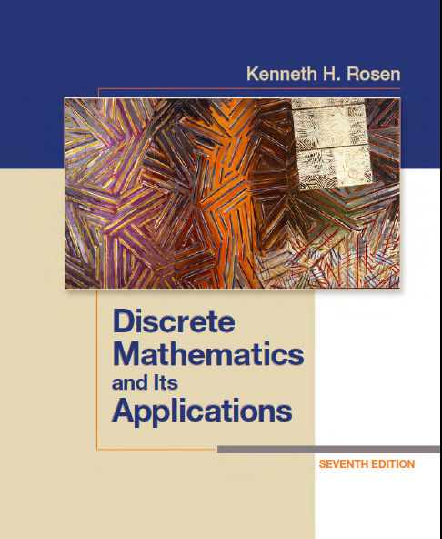
Discrete Math
Haiming Chen
Associate Professor, PhD
Department of Computer Science,
Ningbo University
http://www.chenhaiming.cn

Slide 2
Content
Part I：Logic （Thinking in Mathematics）
Propositional Logic, Predicates and Quantifiers
Definition, Theorem, Corollary and Proofs (Induction)
Part II：Combinatorial Counting
The Basic of Counting
The Pigeonhole Principle
Permutation and Combination
Binomial Coefficients and Combinations
Lists and Sequences (Recursive Definition /Recurrence Relations)
Part III: Discrete Structure
Sets
Functions
Relations
Trees
Graphs
Part IV: Algebra
Algebra (Groups) *
Boolean Algebra

Slide 3
Relations
Relations between elements of sets
represented using the structure called a relation, which is a subset of the Cartesian product of the sets
e.g. A╳B, where A is a set of companies, and B is a set of telephones
A={Intel, Lenovo, ICBC}, B={07548888, 01006666, 0209999}

Slide 4
Relations
If two sets, the relation is represented by a set of ordered pairs
Binary relations
A={Intel, Lenovo, ICBC}, B={07548888, 01006666, 0209999}
{{Intel, 05748888}, {Lenovo, 010006666}, {ICBC, 0209999}}

Slide 5
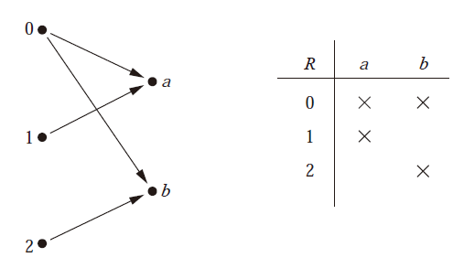
Graphical representation of relationship

Slide 6
Functions as Relations
an element a of A is assigned to the unique element b ∈ B such that (a, b) ∈ R
not a function
one-to-many relationship

Slide 7

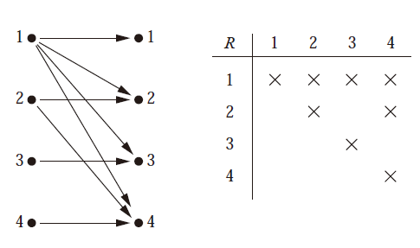
Relations on a set
Let A be the set {1, 2, 3, 4}. Which ordered pairs are in the relation R = {(a, b) | a divides b}?

Slide 8
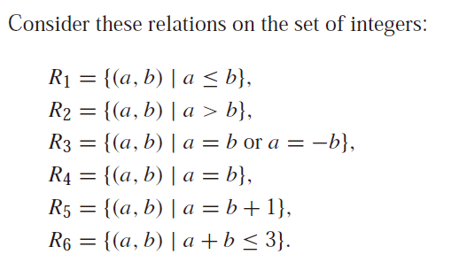
Relations on a set
Which of these relations contain each of the pairs (1, 1), (1, 2), (2, 1), (1,−1), and (2, 2)?

Slide 9
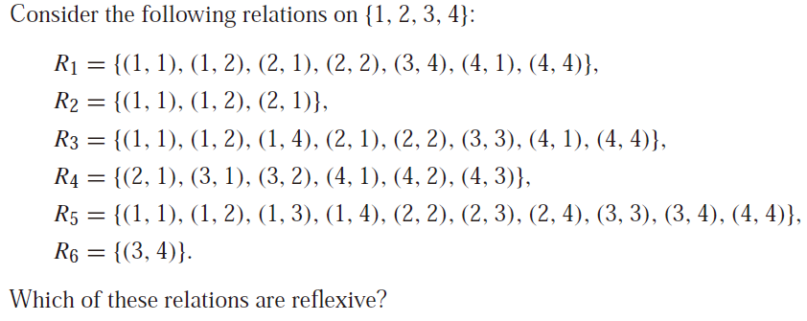
Properties of Relations
The relation R on the set A is reflexive if ∀a((a, a) ∈ R)

Slide 10
Properties of Relations
The relation R on the set A is reflexive if ∀a((a, a) ∈ R)

Slide 11
Properties of Relations
the relation R on the set A is symmetric if ∀a∀b((a, b) ∈ R → (b, a) ∈ R).
if and only if a is related to b implies that b is related to a.
the relation R on the set A is antisymmetric if ∀a∀b(((a, b) ∈ R ∧ (b, a) ∈ R) → (a = b)).
if and only if there are no pairs of distinct elements a and b with a related to b and b related to a
a relation can lack both of these two properties
symmetric
symmetric
antisymmetric
antisymmetric
antisymmetric

Slide 12
Properties of Relations
antisymmetric
antisymmetric
symmetric
symmetric
antisymmetric
antisymmetric
symmetric
a relation can have both of these two properties
symmetric and antisymmetric are not opposites

Slide 13
Properties of Relations
Using quantifiers we see that the relation R on a set A is transitive if we have
∀a∀b∀c(((a, b) ∈ R ∧ (b, c) ∈ R) → (a, c) ∈ R).
transitive
transitive
transitive

Slide 14
Properties of Relations
transitive
transitive
transitive
transitive

Slide 15




Combining Relations
Let A = {1, 2, 3} and B = {1, 2, 3, 4}. The relations R₁ = {(1, 1), (2, 2), (3, 3)} and R₂ = {(1, 1), (1, 2), (1, 3), (1, 4)} can be combined to obtain
={(1,2), (1,3), (1,4),(2,2),(3,3)}

Slide 16
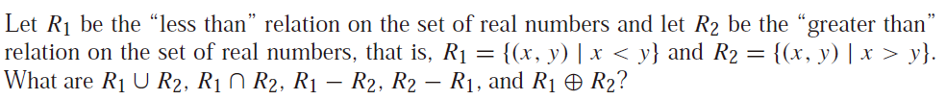



Combining Relations

Slide 17
Combining Relations
Let R be a relation from a set A to a set B and S a relation from B to a set C. The composite of R and S is the relation consisting of ordered pairs (a, c), where a ∈ A, c ∈ C, and for which there exists an element b ∈ B such that (a, b) ∈ R and (b, c) ∈ S. We denote the composite of R and S by S ◦R.

Slide 18


Combining Relations

Slide 19
n-ary Relations and Their Applications
airline flight number {CA101, CZ203}
starting point {BJ, SH, NB}
destination {HZ, GZ, SZ}
departure time {8:00, 12:00}
arrival time {10:00, 15:00}

Slide 20
Examples
(A, N, S, D, T ) representing airplane flights, where A is the airline, N is the flight number, S is the starting point, D is the destination, and T is the departure time.
N × N × N consisting of triples (a, b, c), where a, b, and c are integers with a < b < c
Z × Z × Z consisting of all triples of integers (a, b, c), if and only if there is an integer k such that b = a + k and c = a + 2k
Z × Z × Z⁺ , consisting of triples (a, b, m), where a, b, and m are integers with m ≥ 1 and a ≡ b (mod m)

Slide 21
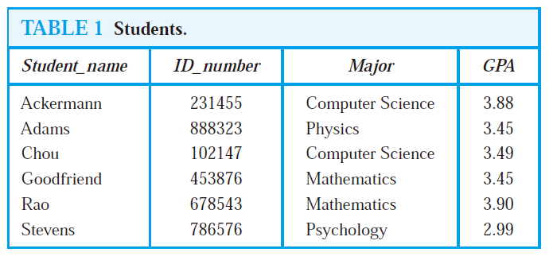
Databases and Relations
the value of the n-tuple from
this domain determines the n-tuple
relational data model
primary key
Field/ attribute
record
(Stevens, 786576, Psychology, 2.99) n-tuples
composite key

Slide 22
Operations on n-ary Relations
form new n-ary relations

Slide 23
Operations on n-ary Relations
Selection operator
answer queries on databases that ask for all n-tuples that satisfy certain conditions
find the records of all computer science majors who have a grade point average above 3.5.

Slide 24
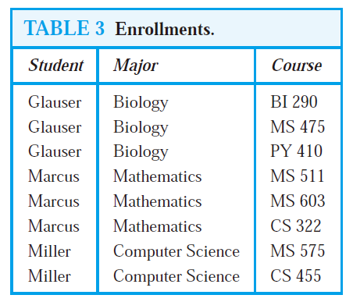
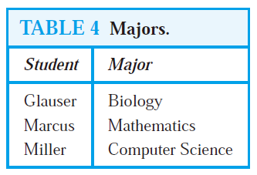
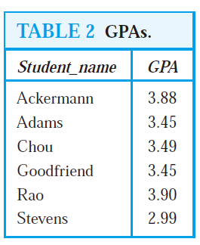
Operations on n-ary Relations
Projection
maps the n-tuple (a₁, a₂, . . . , a_{n}) to the m-tuple (a_{i1} , a_{i2}, . . . , a_{im}), where m ≤ n.
P_{1,4}
P_{1,2}

Slide 25
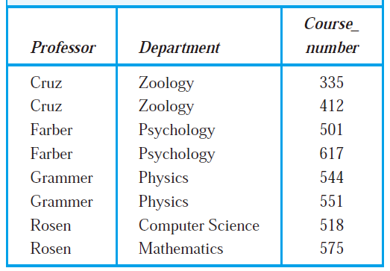
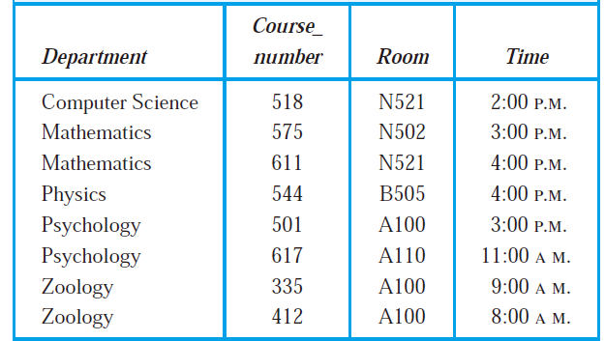
Operations on n-ary Relations
Join
produces a new relation from two relations by combining all m-tuples of the first relation with all n-tuples of the second relation, where the last p components of the m-tuples agree with the first p components of the n-tuples
J₂

Slide 26
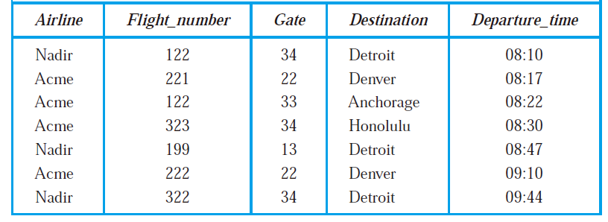
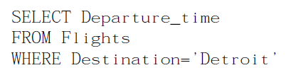
SQL
Structured Query Language

Slide 27
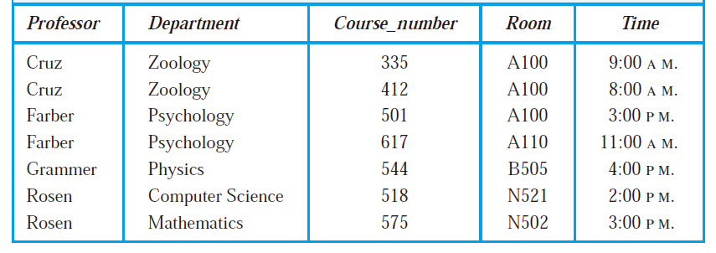
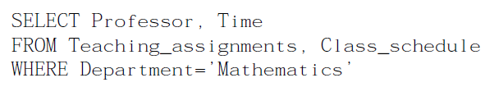
SQL
P_{1,5}
J₂

Slide 28
Homework
Chapter 9.1, Exercise 4, 6, 30, 56
Chapter 9.2, Exercise 20, 22, 24, 28

