Slide 1
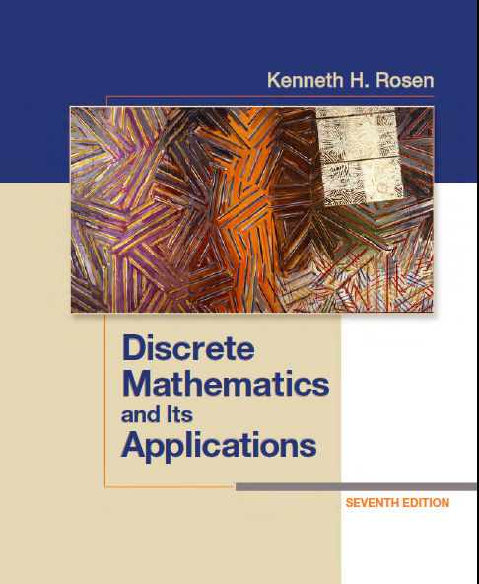
Discrete Math
Haiming Chen
Associate Professor, PhD
Department of Computer Science,
Ningbo University
http://www.chenhaiming.cn

Slide 2
Representing Relations
n-ary Relations
table
binary relations
matrices
directed graphs

Slide 3

Representing Relations Using Matrices
Suppose that R is a relation from A = {a₁, a₂, . . . , a_{m}} to B = {b₁, b₂, . . . , b_{n}}.
M_{R} = [m_{ij} ], i=1..m, j=1..n

Slide 4
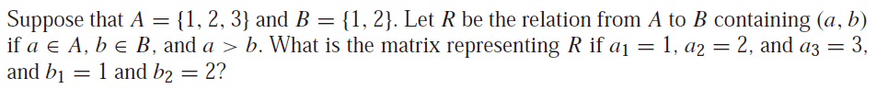
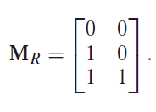
Representing Relations Using Matrices

Slide 5
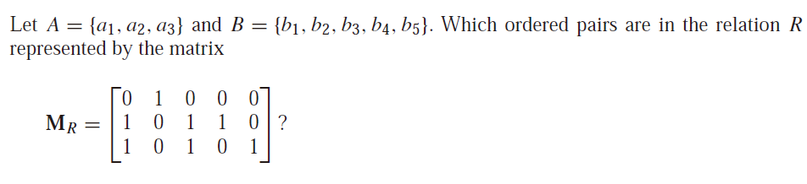
Representing Relations Using Matrices

Slide 6
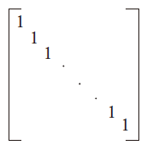
Representing Relations Using Matrices
a relation R on A is reflexive if (a, a) ∈ R whenever a ∈ A
R is reflexive if and only if m_{ii} = 1, for i = 1, 2, . . . , n
Note that the elements off the main diagonal can be either 0 or 1.

Slide 7
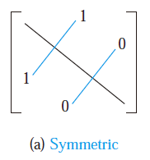
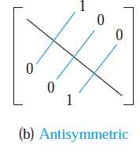
Representing Relations Using Matrices
a relation R is symmetric if (a, b) ∈ R implies that (b, a) ∈ R
R is symmetric if and only if m_{ji} = 1 whenever m_{ij} = 1，m_{ji} = 0 whenever m_{ij} = 0
R is symmetric if and only if m_{ij} = m_{ji}

Slide 8
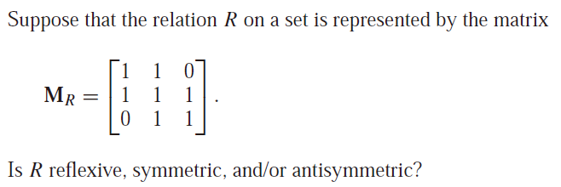
Representing Relations Using Matrices

Slide 9


Representing Relations Using Matrices
union and intersection of relations
Boolean operations of matrices

Slide 10
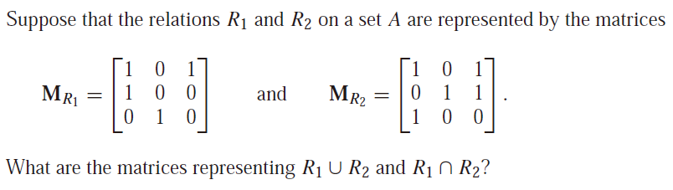
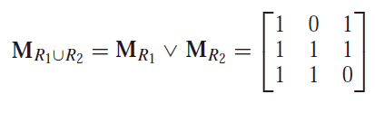
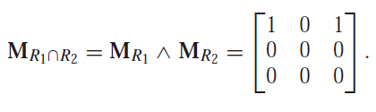
Representing Relations Using Matrices

Slide 11


Representing Relations Using Matrices
composite of relations

Slide 12
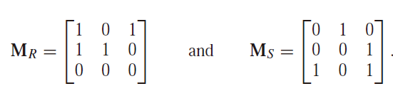
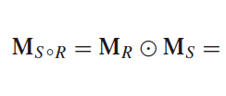
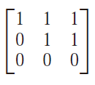
Representing Relations Using Matrices

Slide 13
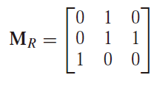
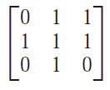

Representing Relations Using Matrices

Slide 14
Representing Relations
n-ary Relations
table
binary relations
matrices
directed graphs

Slide 15
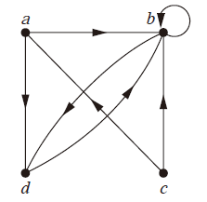
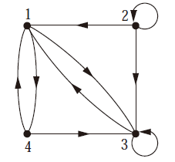
Representing Relations Using Digraphs
elements in set V → nodes
ordered pairs of elements of V → arcs
(a, b), (a, d), (b, b), (b, d), (c, a), (c, b), and (d, b)
R = {(1, 3), (1, 4), (2, 1), (2, 2), (2, 3), (3, 1), (3, 3), (4, 1), (4, 3)}.

Slide 16
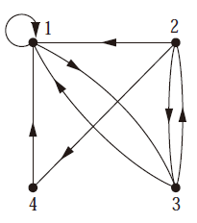
Representing Relations Using Digraphs

Slide 17
Representing Relations Using Digraphs
Reflexive ←→ loop at every node
Symmetric ←→ every edge between distinct vertices in its digraph there is an edge in the opposite direction
Antisymmetric ←→ there are never two edges in opposite directions between distinct vertices
Transitive ←→whenever there is an edge from a vertex x to a vertex y and an edge from a vertex y to a vertex z, there is an edge from x to z

Slide 18
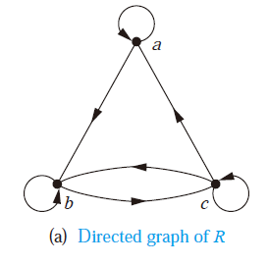
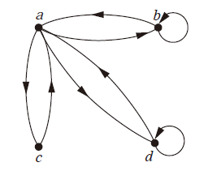
Representing Relations Using Digraphs

Slide 19
Homework
Chapter 9.3, Ex.2(a), 4(a), 14, 22, 26, 32(only for Ex.26)

