Slide 1
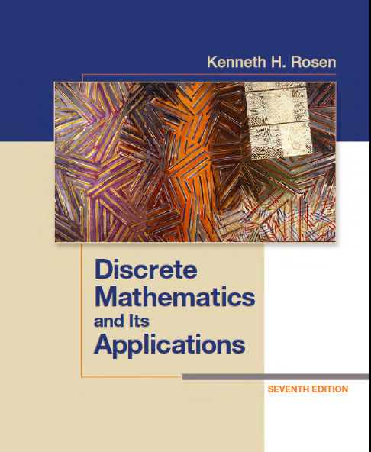
Discrete Math
Haiming Chen
Associate Professor, PhD
Department of Computer Science,
Ningbo University
http://www.chenhaiming.cn

Slide 2
Closure
let R be a relation on a set A.
R may or may not have some property P, such as reflexivity, symmetry, or transitivity
If there is a relation S with property P containing R such that S is a subset of every relation with property P containing R
S is the smallest transitive relation that contains R.
S is called the closure of R with respect to P

Slide 3
Reflexive Closure
R = {(1, 1), (1, 2), (2, 1), (3, 2)} on the set A = {1, 2, 3}
not reflexive
How can we produce a reflexive relation containing R that is as small as possible?
any reflexive relation that contains R must also contain (2, 2) and (3, 3)
S= {(1, 1), (1, 2), (2, 1), (3, 2)}∪{(2,2), (3,3)} is the reflexive closure of R
The reflexive closure of R equals R ∪ Δ, where Δ = {(a, a) | a ∈ A} is the diagonal relation on A.

Slide 4
Reflexive Closure

Slide 5
Symmetric Closure
The relation {(1, 1), (1, 2), (2, 2), (2, 3), (3, 1), (3, 2)} on {1, 2, 3} is not symmetric
How can we produce a symmetric relation that is as small as possible and contains R?
S={(1, 1), (1, 2), (2, 2), (2, 3), (3, 1), (3, 2)} ∪{(2,1), (1,3)}
S is called the symmetric closure of R
The symmetric closure of a relation can be constructed by taking the union of a relation with its inverse
R ∪ R⁻¹ is the symmetric closure of R, where R⁻¹ = {(b, a) | (a, b) ∈ R}.

Slide 6

Symmetric Closure

Slide 7
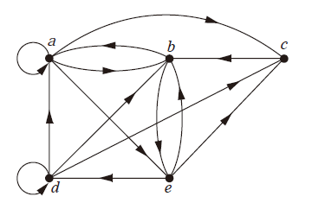
Transitive Closures
Path
d, c
a, b, e, d
b, a, c, b, a, a, b
Cycle
e, b, a, b, a, b, e
vertex
edge
Path length
A path in a directed graph can pass through a vertex more than once.
An edge in a directed graph can occur more than once in a path.

Slide 8
Transitive Closures
R = {(1, 3), (1, 4), (2, 1), (3, 2)} on the set {1, 2, 3, 4}
1
2
R²= {(1, 2), (2, 3), (2, 4), (3, 1)}
R³= {(1, 1), (2, 2), (3, 3), (3, 4)}
R⁴= {(1, 3), (1, 4), (2, 1), (3, 2)}
3
4
R⁵= {(1, 2), (2, 3), (2, 4), (3, 1)}
Path with length 2: {1, 3, 2}
Path with length 3: {1, 3, 2, 1}
Path with length 4: {1, 3, 2, 1, 4}
connectivity relation

Slide 9

Transitive Closures
connectivity relation
The relation R² contains (a, b) if there is a person c such that (a, c) ∈ R and (c, b) ∈ R,
that is, if there is a person c such that a has met c and c has met b.
R^{n} consists of those pairs (a, b) such that there are people x₁, x₂, . . . , x_{n−1} such that a has met x₁, x₁ has met x₂, . . . , and x_{n−1} has met b.
The relation R∗ contains (a, b) if there is a sequence of people, starting with a and ending with b, such that each person in the sequence has met the next person in the sequence.

Slide 10
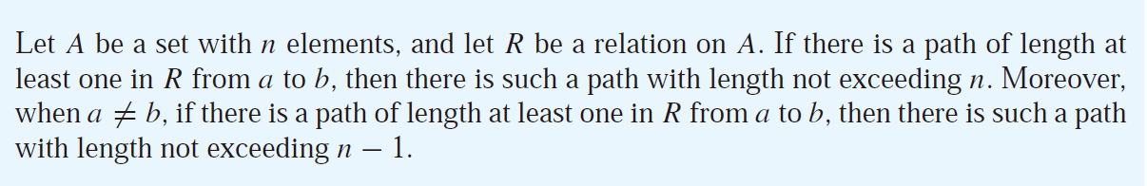
Transitive Closures
R = {(1, 3), (1, 4), (2, 1), (3, 2)} on the set {1, 2, 3, 4}
1
2
R²= {(1, 2), (2, 3), (2, 4), (3, 1)}
R³= {(1, 1), (2, 2), (3, 3), (3, 4)}
R⁴= {(1, 3), (1, 4), (2, 1), (3, 2)}
Is it transitive closures?
3
4
R⁵= {(1, 2), (2, 3), (2, 4), (3, 1)}

Slide 11
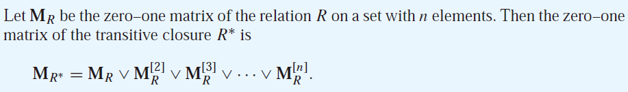
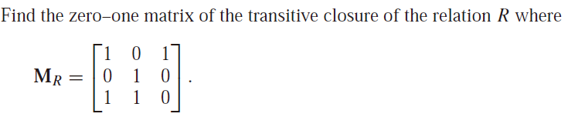
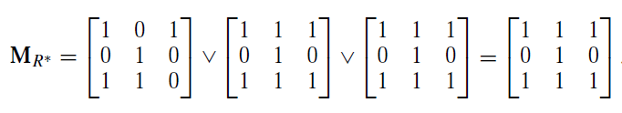
Transitive Closures
Notes:
复杂度分析：
((n+n-1)*n列*n行+n*n次加)*（n-1）=2n^3*(n-1)

Slide 12
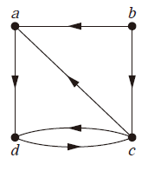
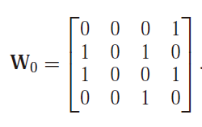
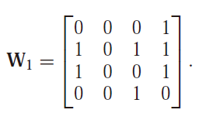
Transitive Closures
W₁ has 1 as its (i, j )th entry if there is a path from v_{i} to v_{j} that has only v₁ = a as an interior
vertex
If a, x₁, x₂, . . . , x_{m−1}, b is a path, its interior vertices are x₁, x₂, . . . , x_{m−1},

Slide 13
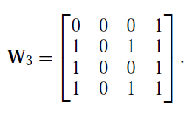
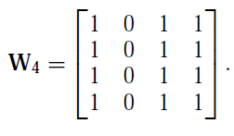
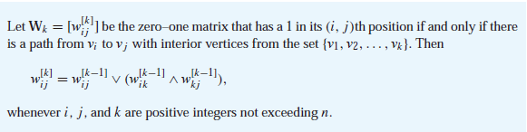
Transitive Closures
W3 has 1 as its (i, j )th entry if there is a path from v_{i} to v_{j} that has only v1 = a, v2 = b,
and/or v3 = c as its interior vertices, if any.
W4 has 1 as its (i, j )th entry if there is a path from v_{i} to v_{j} that has v₁ = a, v₂ = b,
v₃ = c, and/or v₄ = d as interior vertices, if any
Warshall’s Algorithm
W₄ is the matrix of the transitive closure，W_{n} = M_{R}∗
Notes:
复杂度分析：
2n^2*n

Slide 14
Homework
Chapter 9.4 Exercise 26(a)(c), 28(a)(c)

