Slide 1
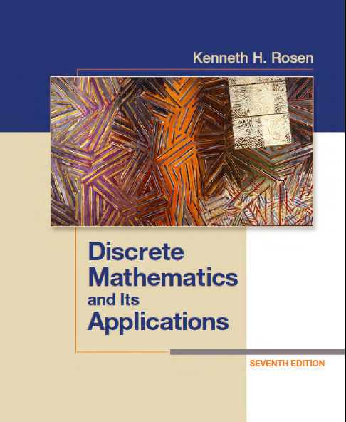
Discrete Math
Haiming Chen
Associate Professor, PhD
Department of Computer Science,
Ningbo University
http://www.chenhaiming.cn

Slide 2
Curriculum Progress
Part I：Logic （Thinking in Mathematics）
Propositional Logic, Predicates and Quantifiers
Definition, Theorem, Corollary and Proofs (Induction)
Part II：Combinatorial Counting
The Basic of Counting
The Pigeonhole Principle
Permutation and Combination
Binomial Coefficients and Combinations
Lists and Sequences (Recursive Definition /Recurrence Relations)
Part III: Discrete Structure
Sets
Functions
Relations
Trees
Graphs
Part IV: Algebra
Algebra (Groups) *
Boolean Algebra
Binary Relation and n-ary Relation
Representing Relations
Properties and Operations of Relations
Closure

Slide 3
Review
Find the smallest relation containing the relation {(1, 2), (1, 4), (3, 3), (4, 1)} that is reflexive, symmetric, and transitive.
Reflexive closure
Symmetricclosure
Transitive closure
{(1,1), (1, 2), (1, 4), (2,1),(2,2), (2,4), (3, 3), (4, 1), (4,2), (4,4)}

Slide 4
Equivalence Relations
A relation R on a set A is called an equivalence relation if it is reflexive, symmetric, and transitive.
if (a,b)∈R or a R b, a and b are equivalent, denoted as a ∽ b

Slide 5
Example 1
Let R be the relation on the set of integers such that aRb if and only if a = b or a = −b.
Equivalence relation or not?
Reflexive?
Symmetric?
Transitive?

Slide 6
Example 2
Let R be the relation on the set of real numbers such that aRb if and only if a − b is an integer.
Is R an equivalence relation?
Reflexive? a −a = 0 is an integer
Symmetric? a −b is an integer, so b−a is also an integer
Transitive? a −b and b−c are integers, so a −c = (a −b) + (b−c) is also an integer

Slide 7
Example 3
Congruence Modulo m
Let m be an integer with m > 1. R = {(a, b) | a ≡ b (mod m)}
on the set of integers
Reflexive? a ≡ a (mod m)
Symmetric? a − b = km, b − a = (−k)m, so b ≡ a (mod m)
Transitive? a − b = km and b − c = lm, a − c = (a − b) + (b − c) = km + lm = (k + l)m

Slide 8
Example 4
Suppose that R is the relation on the set of strings of English letters such that aRb if and only if l(a) = l(b), where l(x) is the length of the string x.
Is R an equivalence relation?

Slide 9
Example 5
Let n be a positive integer and S a set of strings. Suppose that R_{n} is the relation on S such that sR_{n}t if and only if s = t , or both s and t have at least n characters and the first n characters of s and t are the same.
Reflexive?
Symmetric?
Transitive?
In traditional C, only the first eight characters of a variable name are checked by the compiler

Slide 10
Example 6,7
the “divides” relation on the set of positive integers an equivalence relation.
Let R be the relation on the set of real numbers such that xRy if and only if x and y are real numbers that differ by less than 1, that is |x − y| < 1.
is not
R is not an equivalence relation.

Slide 11
Content
Equivalence Relations
Equivalence Classes
Partitions

Slide 12

Equivalence Classes
The set of all elements that are related to an element a of A is called the equivalence class of a.
The equivalence class of a with respect to R is denoted by [a]_{R}.
When only one relation is under consideration, we can write [a] for this equivalence class.
If b ∈ [a]_{R}, then b is called a representative of this equivalence class.

Slide 13
Example 1
Let R be the relation on the set of integers such that aRb if and only if a = b or a = −b.
[7] = {−7, 7},
[−5] = {−5, 5}
[0] = {0}.

Slide 14
Example 3
Let m be an integer with m > 1. R = {(a, b) | a ≡ b (mod m)}, m=4
[0] = {. . . ,−8,−4, 0, 4, 8, . . . }.
[1] = {. . . ,−7,−3, 1, 5, 9, . . . }.
[a]_{m} = {. . . , a − 2m, a − m, a, a + m, a + 2m, . . .}.

Slide 15
Example 5
Let n be a positive integer and S a set of strings. Suppose that R_{n} is the relation on S such that sR_{n}t if and only if s = t , or both s and t have at least n characters and the first n characters of s and t are the same.
n=3
[011]_{R3}= {011, 0110, 0111, 01100, 01101, 01110, 01111, . . .}.

Slide 16
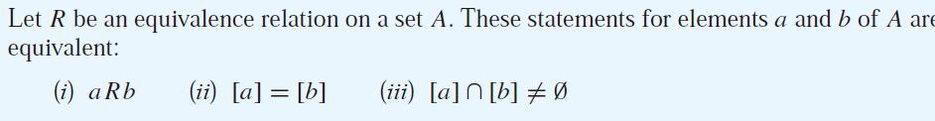

Content
Equivalence Relations
Equivalence Classes
Partitions
[a] ≠ [b] [a] ∩ [b] = O
The union of the equivalence classes of R is all of A
a partition of a set S is a collection of disjoint nonempty subsets of S that have S as their union.

Slide 17
Partitions
Let A be the set of students at our college who are majoring in exactly one subject, and let R be the relation on A consisting of pairs (x, y), where x and y are students with the same major.
[student₁]_{Rcs}={student₁, student₂, …student_{m}}
[student_{m+1}]_{Ree}={student_{m+1}, student_{m+2}, …student_{m+n}}
[student_{m+n+1}]_{Rce}={student_{m+n+1}, student_{m+n+2}, …student_{m+n+p}}
[student_{m+n+p+1}]_{Rat}={student_{m+n+p+1}, student_{m+n+p+2}, …student_{m+n+p+q}}

Slide 18
Partitions
A= [student₁]_{Rcs} ∪[student_{m+1}] _{Ree} ∪[student_{m+n+1}] _{Rce} ∪[student_{m+n+p+1}] _{Rat}
equivalence classes form a partition of A
an equivalence relation partitions a set
a partition of a set S is a collection of disjoint nonempty subsets of S that have S as their union.

Slide 19
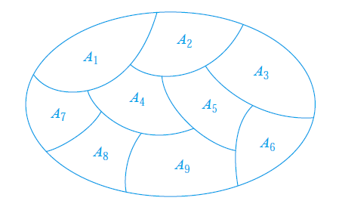
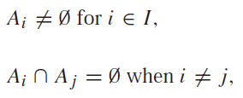
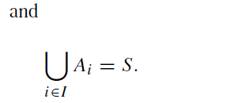
Partitions

Slide 20
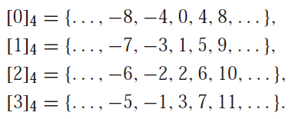
Example 3
What are the sets in the partition of the integers arising from congruence modulo 4?
Z= [0] _{m} ∪ [1] _{m} ∪ [2] _{m} ∪…… ∪ [m-1]_{m}

Slide 21
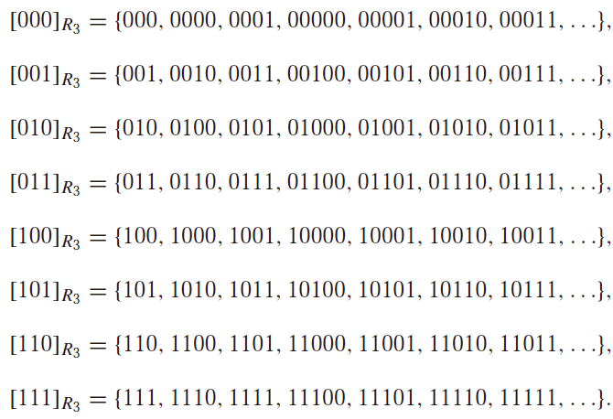
Example 5
What are the sets in the partition of the set of all bit strings arising from the relation R₃ on the set of all bit strings?

Slide 22
Partitions
Conversely, every partition of a set can be used to form an equivalence relation.

Slide 23
Example 8
a partition A₁ = {1, 2, 3}, A₂ = {4, 5}, and A₃ = {6} of S = {1, 2, 3, 4, 5, 6}
What’s the equivalence relation R?
(1, 1), (1, 2), (1, 3), (2, 1), (2, 2), (2, 3), (3, 1), (3, 2), (3, 3)
(4, 4), (4, 5), (5, 4), and (5, 5)
(6, 6)

Slide 24
Content
Equivalence Relations
Equivalence Classes
Partitions

Slide 25
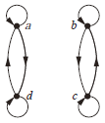
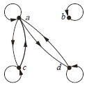
Key Knowledge Points
equivalence relation: a reflexive, symmetric, and transitive relation
equivalent: if R is an equivalence relation, a is equivalent to b (a ∽ b) if aRb
[a]_{R} (equivalence class of a with respect to R): the set of all elements of A that are equivalent to a
[a]_{m} (congruence class modulo m): the set of integers congruent to a modulo m
partition of a set S: a collection of pairwise disjoint nonempty subsets that have S as their union

Slide 26
Homework
Chapter 9.5,
Exercise 8, 16, 24(b), 48(b)(d), 56(c)

