Slide 1

Discrete Math
Haiming Chen
Associate Professor, PhD
Department of Computer Science,
Ningbo University
http://www.chenhaiming.cn

Slide 2
Curriculum Progress
Part I：Logic （Thinking in Mathematics）
Propositional Logic, Predicates and Quantifiers
Definition, Theorem, Corollary and Proofs (Induction)
Part II：Combinatorial Counting
The Basic of Counting
The Pigeonhole Principle
Permutation and Combination
Binomial Coefficients and Combinations
Lists and Sequences (Recursive Definition /Recurrence Relations)
Part III: Discrete Structure
Sets
Functions
Relations
Trees
Graphs
Part IV: Algebra
Algebra (Groups) *
Boolean Algebra

Slide 3
Partial Orderings（偏序）
A relation R on a set S is called a partial ordering or partial order if it is reflexive, antisymmetric, and transitive.
A set S together with a partial ordering R is called a partially ordered set, or poset (部分有序集), and is denoted by (S,R).

Slide 4
Example 1
“greater than or equal” relation (≥) on the set of integers
reflexive?
antisymmetric?
transitive?

Slide 5
Example 2
The divisibility relation | on the set of positive integers
reflexive?
antisymmetric?
transitive?

Slide 6
Example 3
the inclusion relation ⊆ on the power set of a set S
reflexive?
antisymmetric?
transitive?

Slide 7
Example 4
Let R be the relation on the set of people such that xRy if x and y are people and x is older than y.
antisymmetric?
transitive?
reflexive?

Slide 8
Partial Orderings
In different posets different symbols such as ≤, ⊆, and |, are used for a partial ordering.
a symbol that we can use when we discuss the ordering relation in an arbitrary poset
the symbol is used to denote the relation in any poset, not just the “less than or equals”relation

Slide 9
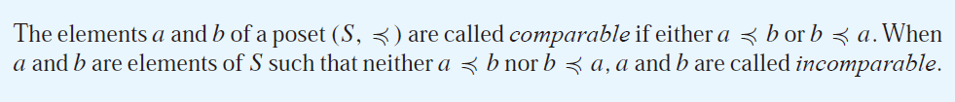


Partial Orderings
When every two elements in the set are comparable, the relation is called a total ordering.
A totally ordered set is also called a chain.

Slide 10

Well-ordered Set
The set of ordered pairs of positive integers, Z⁺× Z⁺, with (a₁, a₂) (b₁, b₂) if a₁ < b₁, or if a₁ = b₁ and a₂ ≤ b₂ (the lexicographic ordering), is a well-ordered set.
The set Z, with the usual ≤ ordering, is not well-ordered because the set of negative integers, which is a subset of Z, has no least element.

Slide 11

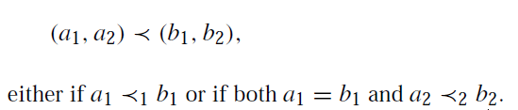
Lexicographic Order
two posets,
lexicographic ordering on A₁ × A₂

Slide 12
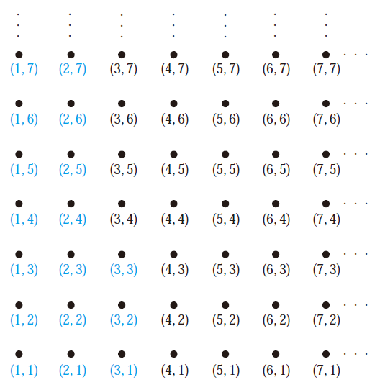
Example 5

Slide 13




Lexicographic Order
A lexicographic ordering can be defined on the Cartesian product of n posets

Slide 14




Lexicographic Order
The definition of lexicographic ordering is that the string a₁a₂ . . . a_{m} is less than b₁b₂ . . . b_{n} if and only if
t = min(m, n)

Slide 15
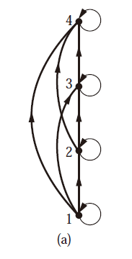
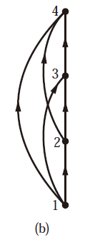
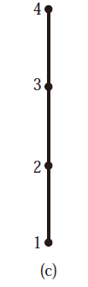
Hasse Diagrams
all edges are pointed “upward”
a partial ordering must be reflexive
a partial ordering must be transitive

Slide 16
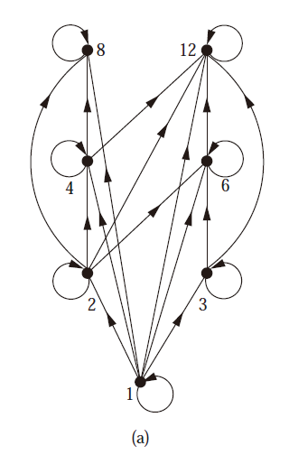
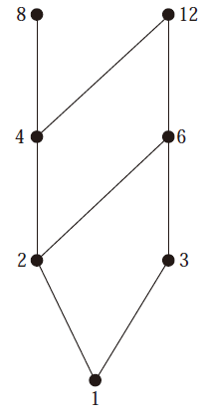
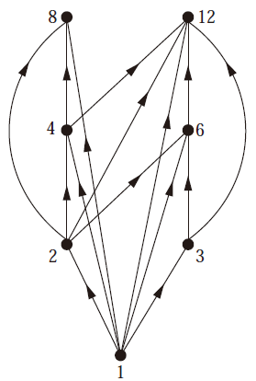
Example 6
Draw the Hasse diagram representing the partial ordering {(a, b) |a divides b} on {1, 2, 3, 4, 6, 8, 12}.

Slide 17
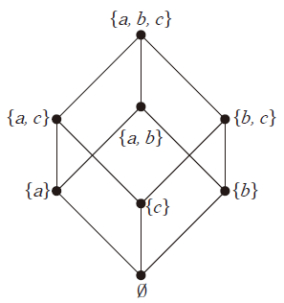
Example 2
Draw the Hasse diagram for the partial ordering {(A,B) | A ⊆ B} on the power set P(S) where S = {a, b, c}.
{a,b,c}
{a,c}
{b,c}
{a,b}
{a}
{c}
{b}
∅

Slide 18
Maximal and Minimal Elements
a is maximal in the poset (S, ) if there is no b ∈ S such that a ≺ b.
a is minimal if there is no element b ∈ S such that b ≺ a.
They are the “top” and “bottom” elements in the diagram.

Slide 19
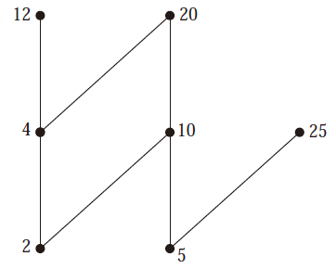
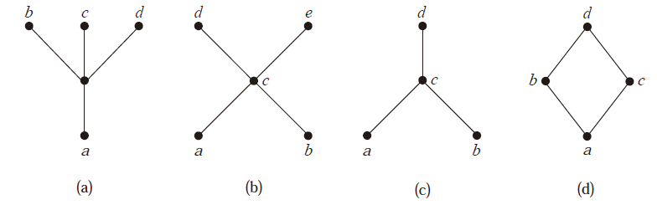
Maximal and Minimal Elements
Which elements of the poset ({2, 4, 5, 10, 12, 20, 25}, |) are maximal, and which are minimal?
greatest element
greatest element
least element
least element

Slide 20
Upper bound and lower bound
an element that is greater than or equal to all the elements in a subset A of a poset (S, ).
u is an element of S such that a u for all elements a ∈ A
l is an element of S such that l a for all elements a ∈ A

Slide 21
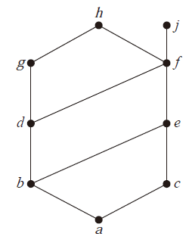
Example 7
Find the lower and upper bounds of the subsets {a, b, c}, {j, h}, and {a, c, d, f }
e, f, j, and h; a
; a, b, c, d, e, and f
f , h, and j; a
if a x whenever a ∈ A, and x z whenever z is an upper bound of A
least upper bound lub(A)
greatest lower bound glb(A)
if y a whenever a ∈ A, and z y whenever z is an lower bound of A

Slide 22
Example 8
Find the greatest lower bound and the least upper bound of the sets {3, 9, 12} and {1, 2, 4, 5, 10}, if they exist, in the poset (Z⁺, |).
glb({3, 9, 12} )=3, lub({3, 9, 12} )=36
glb({1, 2, 4, 5, 10})=1, lub ({1, 2, 4, 5, 10})=20

Slide 23
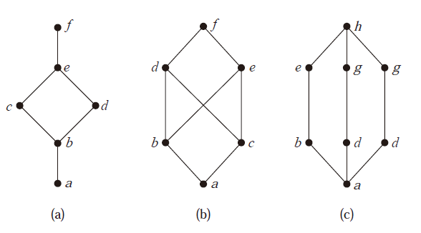
Lattices
A partially ordered set in which every pair of elements has both a least upper bound and a greatest lower bound

Slide 24
Example 8
Is the poset (Z⁺, |) a lattice?

Slide 25
Example 9
Determine whether the posets ({1, 2, 3, 4, 5}, |) and ({1, 2, 4, 8, 16}, |) are lattices.

Slide 26
Example 10
Determine whether (P (S),⊆) is a lattice where S is a set.

Slide 27
Homework
Chapter 9.6
Exercise 4, 8(c), 20, 22(b)(d), 32, 44(a)(d)

