Slide 1

Discrete Math
Haiming Chen
Associate Professor, PhD
Department of Computer Science,
Ningbo University
http://www.chenhaiming.cn

Slide 2
Curriculum Progress
Part I：Logic （Thinking in Mathematics）
Propositional Logic, Predicates and Quantifiers
Definition, Theorem, Corollary and Proofs (Induction)
Part II：Combinatorial Counting
The Basic of Counting
The Pigeonhole Principle
Permutation and Combination
Binomial Coefficients and Combinations
Lists and Sequences (Recursive Definition /Recurrence Relations)
Part III: Discrete Structure
Sets
Functions
Relations
Graphs
Trees
Part IV: Algebra
Algebra (Groups) *
Boolean Algebra

Slide 3
Graphs
A graph G = (V ,E) consists of V , a nonempty set of vertices (or nodes) and E, a set of edges. Each edge has either one or two vertices associated with it, called its endpoints. An edge is said to connect its endpoints.
infinite graph
finite graph

Slide 4
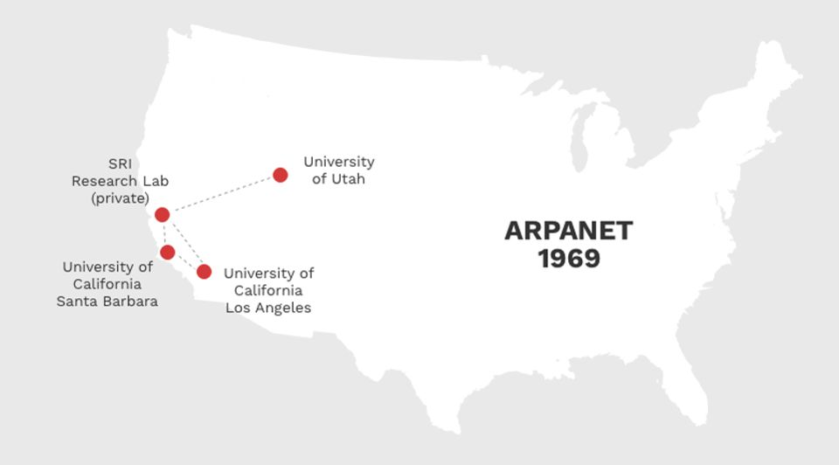
Examples

Slide 5
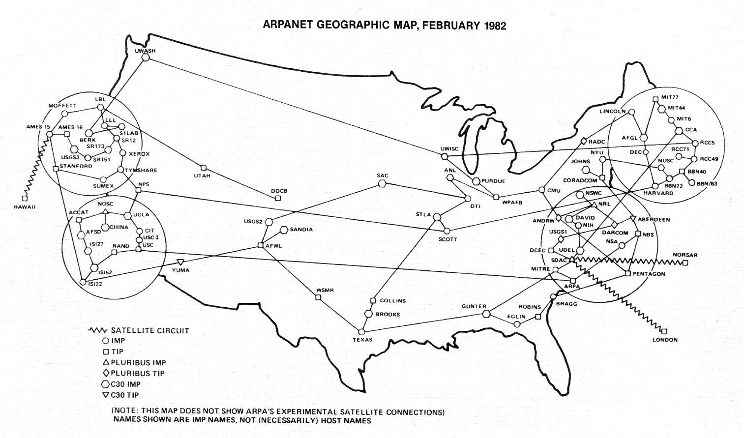
A graph in which each edge connects two different vertices and where no two edges connect the same pair of vertices is called a simple graph.

Slide 6
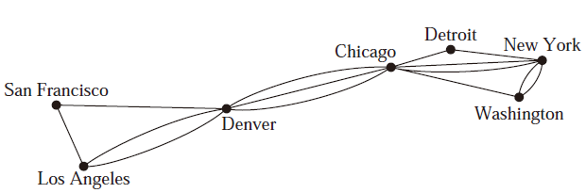
Multigraphs(多重图)
m different edges associated to the same unordered pair of vertices {u, v}
{u, v} is an edge of multiplicity m

Slide 7
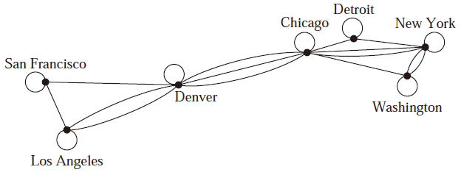
Pseudographs(伪图)
Graphs that may include loops, and possibly multiple edges connecting the same pair of vertices or a vertex to itself
undirected graphs

Slide 8
Digraph
A directed graph (or digraph) (V ,E) consists of a nonempty set of vertices V and a set of directed edges (or arcs) E. Each directed edge is associated with an ordered pair of vertices.
The directed edge associated with the ordered pair (u, v) is said to start at u and end at v.

Slide 9
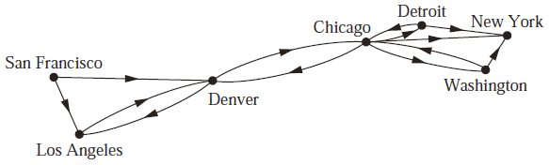
Simple Directed Graph
a directed graph has no loops and has no multiple directed edges

Slide 10
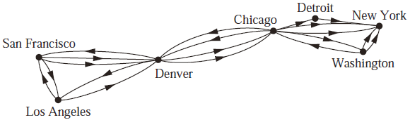
Directed Multigraphs
Directed graphs that have multiple directed edges from a vertex to a second (possibly the same) vertex
Directed Graphs
Mixed Graph: A graph with both directed and undirected edges.

Slide 11
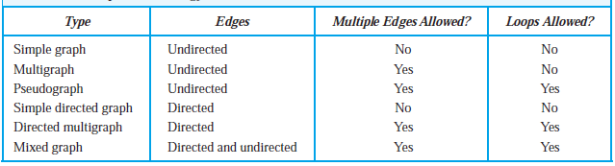
Graph Terminology

Slide 12
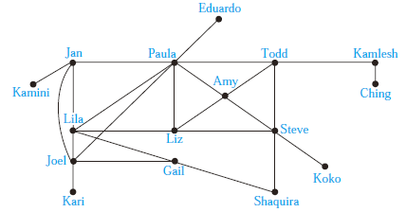
Graph Models-SOCIAL NETWORKS
Acquaintanceship and Friendship Graphs

Slide 13
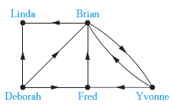
Graph Models-SOCIAL NETWORKS
Influence Graphs

Slide 14
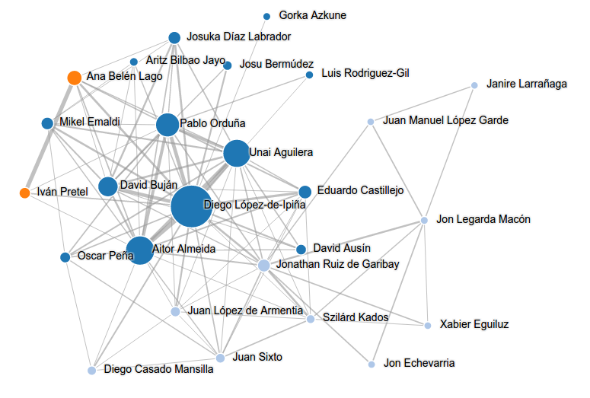
Graph Models-SOCIAL NETWORKS
academic collaboration graph

Slide 15
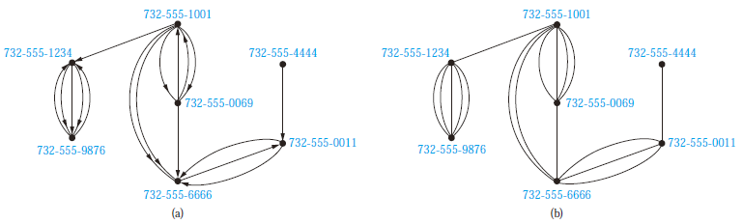
Graph Models-COMMUNICATIONNETWORKS
Call Graphs

Slide 16
Graph Models- INFORMATION NETWORKS
The Web Graph
Citation Graphs

Slide 17
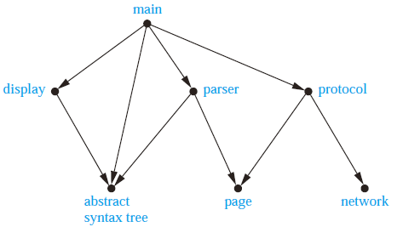
Graph Models- SOFTWARE DESIGN APPLICATIONS
Module Dependency Graphs

Slide 18
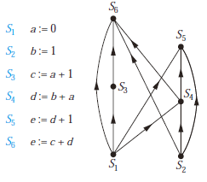
Graph Models- SOFTWARE DESIGN APPLICATIONS
Module Dependency Graphs

Slide 19
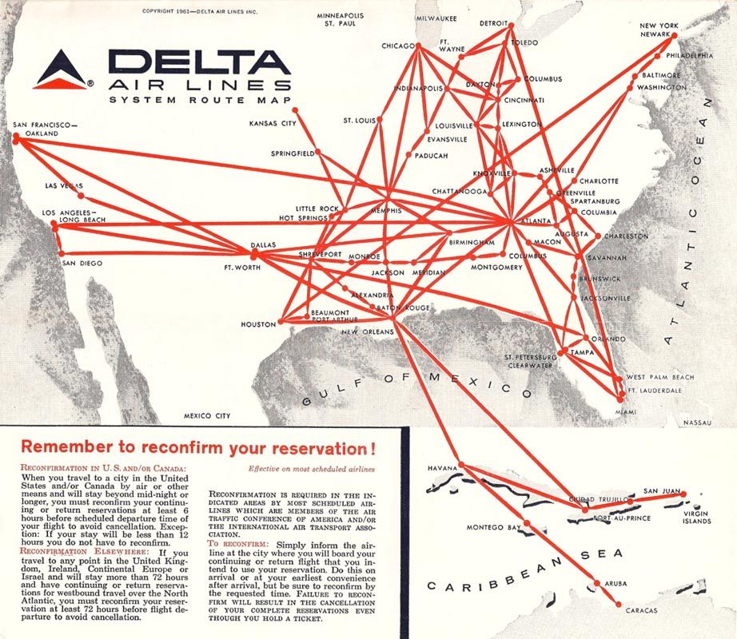
Graph Models- TRANSPORTATION NETWORKS
Airline Routes

Slide 20
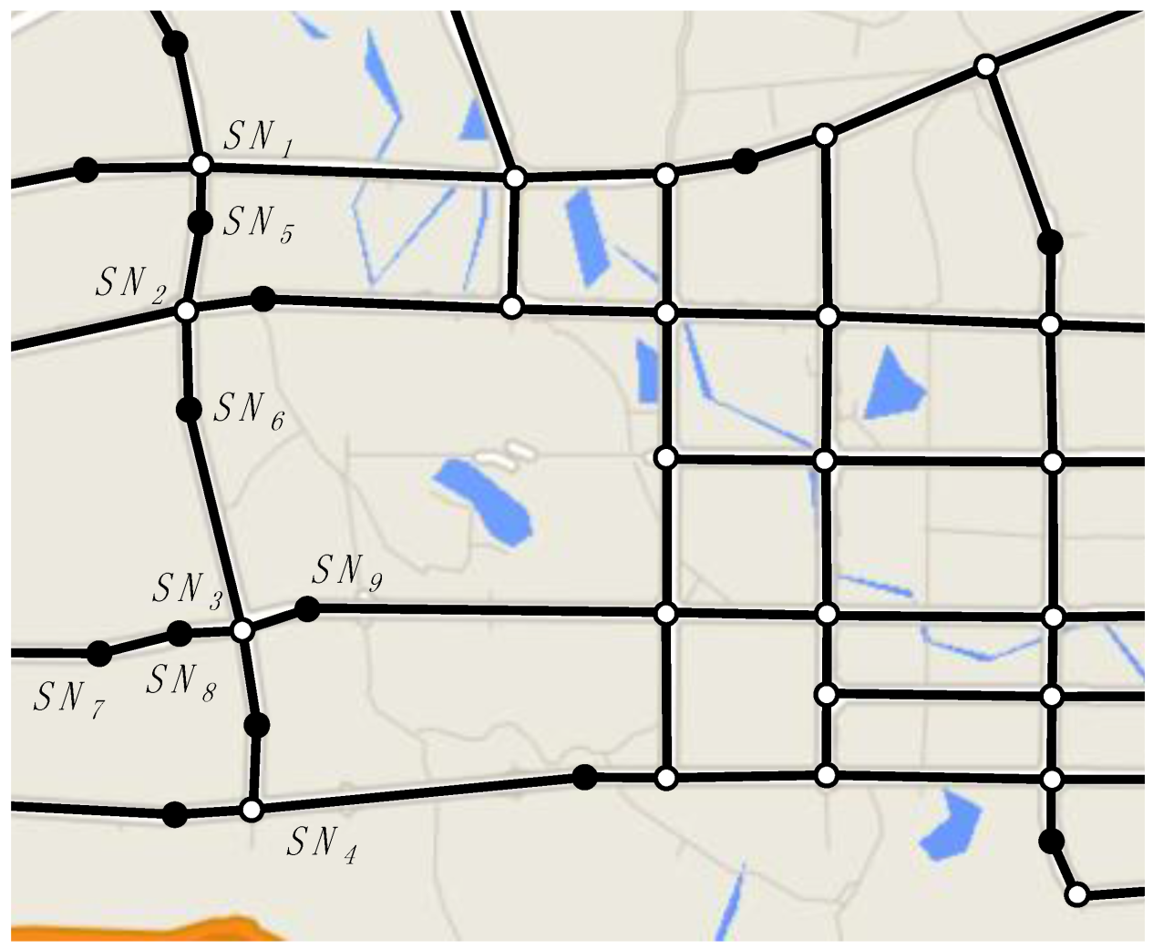
Graph Models- TRANSPORTATION NETWORKS
Road Networks

Slide 21
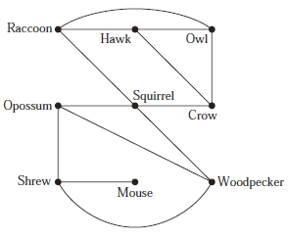
Graph Models- BIOLOGICAL NETWORKS
niche overlap graph

Slide 22
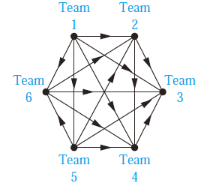
Graph Models-TOURNAMENTS
Round-Robin Tournaments

Slide 23
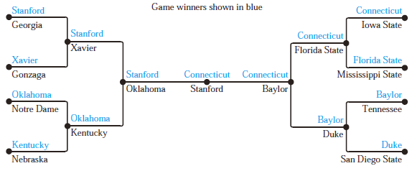
Graph Models-TOURNAMENTS
Single-Elimination Tournament

Slide 24
Homework
Chapter 10.1
Exercise 2, 16, 20, 28

