Slide 1
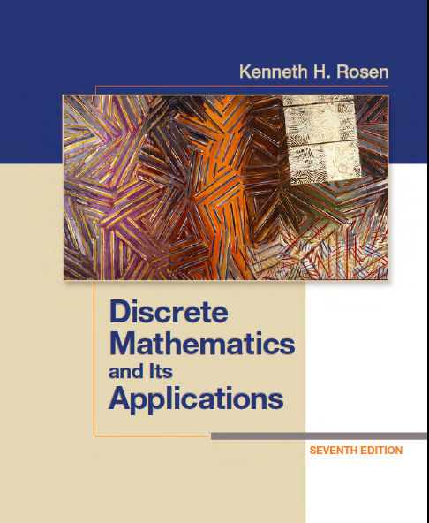
Discrete Math
Haiming Chen
Associate Professor, PhD
Department of Computer Science,
Ningbo University
http://www.chenhaiming.cn

Slide 2
Logic and Proofs
Propositional Logic
Predicates and Quantifiers
Inference/Reasoning (Logic Argument)
Proof (Mathematical Argument )
Notes:
Mathematical argument 数学论证 proof
Conjecture 推测

Slide 3
Predicates and Quantifiers
“Every computer connected to the university network is functioning properly.”
“There is a computer on the university network that is under attack by an intruder.”

Slide 4
Predicates
computer x is functioning properly
computer x is under attack by an intruder
x > 3
propositional function P(x)
Used for expressing preconditions and postconditions in verifying the correctness of computer programs

Slide 5
Quantifiers
all, some, many, none, and few
universal quantification
existential quantification

Slide 6
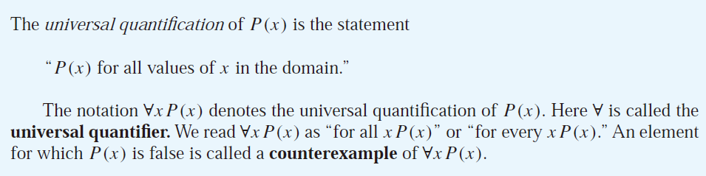
Universal Quantifier
domain

Slide 7
Examples
What is the truth value of ∀xP(x), where P(x) is the statement “x² < 10” and the domain consists of the positive integers not exceeding 4?
What is the truth value of ∀x(x² ≥ x) if the domain consists of all real numbers? What is the truth value of this statement if the domain consists of all integers?

Slide 8
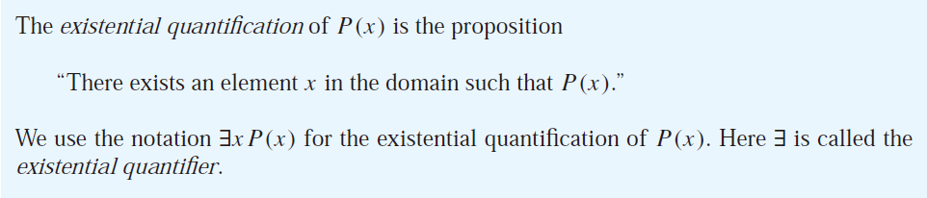
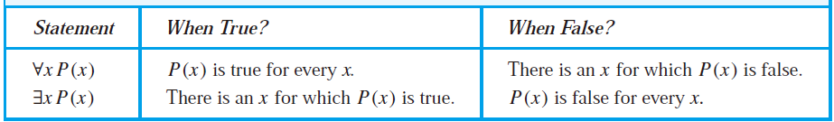
Existential Quantifier

Slide 9
Examples
What is the truth value of ∃xP(x), where P(x) is the statement “x² > 10” and the universe of discourse consists of the positive integers not exceeding 4?
What do the statements ∀x < 0 (x² > 0), ∀y ≠ 0 (y³ ≠ 0), and ∃z > 0 (z² = 2) mean, where the domain in each case consists of the real numbers?
∀x(x < 0 → x² > 0)
∀y(y ≠ 0 → y³ ≠ 0)
∃z(z > 0 ∧ z² = 2)

Slide 10
Uniqueness Quantifier
∃!x P(x) [or ∃₁xP(x)]
∃!x(x−1=0)
∃₁x(x-1=0)

Slide 11
Precedence of Quantifiers
∀xP(x) ∨ Q(x)
∀x(P(x) ∨ Q(x))
All the variables that occur in a propositional function must be bound or set equal to a particular value to turn it into a proposition.
bound
free

Slide 12
Logical Equivalences Involving Quantifiers
∀x(P(x) ∧ Q(x)) ≡ ∀xP(x) ∧ ∀xQ(x)
∀x(P(x) V Q(x)) ≡ ∀xP(x) V ∀xQ(x)
∃ x(P(x) V Q(x)) ≡ ∃ xP(x) V ∃ xQ(x)
∃ x(P(x) ∧ Q(x)) ≡ ∃ xP(x) ∧ ∃ xQ(x)

Slide 13
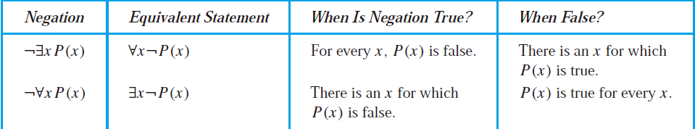
Negating Quantified Expressions
Show that ￢∀x(P(x) → Q(x)) and ∃x(P(x)∧￢Q(x)) are logically equivalent

Slide 14
Translating from English into Logical Expressions
Express the statement “Every student in this class has studied calculus” using predicates and quantifiers.
C(x), x has studied calculus
∀xC(x)
S(x), person x is in this class
∀x(S(x) → C(x))
Q(x, y), student x has studied subject y
∀x(S(x) → Q(x, calculus))

Slide 15
Translating from English into Logical Expressions
Use predicates and quantifiers to express the system specifications
Every mail message larger than one megabyte will be compressed
S(m, y) be “Mail message m is larger than y megabytes,” where the variable x has the domain of all mail messages and the variable y is a positive real number
C(m) denote “Mail message m will be compressed.”
If a user is active, at least one network link will be available
A(u) represent “User u is active,”
S(n, x) denote “Network link n is in state x,”

Slide 16
Nested Quantifiers
one quantifier is within the scope of another
∀x∃y(x + y = 0)
∀x∀y(x + y = y + x)
∀x∀y∀z(x + (y + z) = (x + y) + z)
∀x∀y((x > 0) ∧ (y < 0) → (xy < 0))

Slide 17
The Order of Quantifiers
∀x∀yP(x, y)
∃y∀xQ(x, y) x + y = 0
∀x∃yQ(x, y)
∀x∀y∃zQ(x, y, z) x + y = z
∃z∀x∀yQ(x, y, z)

Slide 18


Translating Mathematical Statements

Slide 19

Translating English Sentences
If a person is female and is a parent, then this person is someone’s mother
F(x) to represent “x is female,”
P(x) to represent “x is a parent
M(x, y) to represent “x is the mother of y.”

Slide 20


Translating English Sentences
Everyone has exactly one best friend
B(x, y) to be the statement “y is the best friend of x,”

Slide 21

Translating English Sentences
There is a woman who has taken a flight on every airline in the world
P(w, f ) be “w has taken f ”
Q(f, a) be “f is a flight on a.”
R(w, f, a) is “w has taken f on a.”

Slide 22
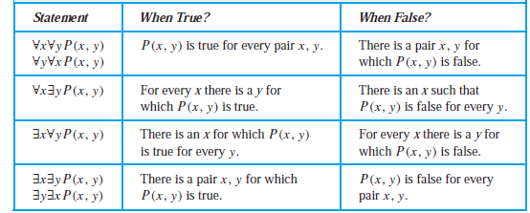
Negating Nested Quantifiers
∀x∃y(xy = 1)

Slide 23
Negating Nested Quantifiers
There does not exist a woman who has taken a flight on every airline in the world

Slide 24
Homework
Review the Chapter 1.4, 1.5
Chapter 1.4 Exercise 28, 40，;
Chapter 1.5 Exercise 8, 12, 18, 26, 30，38

