Slide 1
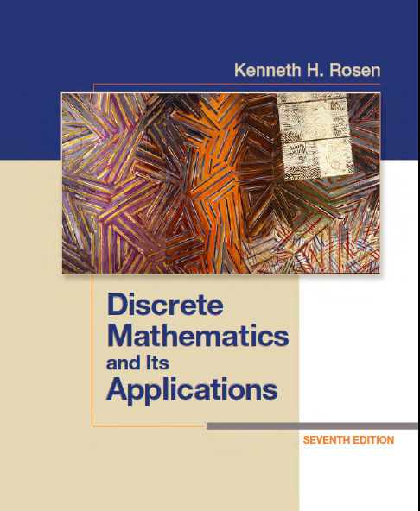
Discrete Math
Haiming Chen
Associate Professor, PhD
Department of Computer Science,
Ningbo University
http://www.chenhaiming.cn

Slide 2
Curriculum Progress
Part I：Logic （Thinking in Mathematics）
Propositional Logic, Predicates and Quantifiers
Definition, Theorem, Corollary and Proofs (Induction)
Part II：Combinatorial Counting
The Basic of Counting
The Pigeonhole Principle
Permutation and Combination
Binomial Coefficients and Combinations
Lists and Sequences (Recursive Definition /Recurrence Relations)
Part III: Discrete Structure
Sets
Functions
Relations
Graphs
Trees
Part IV: Algebra
Algebra (Groups) *
Boolean Algebra

Slide 3

Graph Terminology
Two vertices u and v in an undirected graph G are called adjacent (or neighbors) in G if u and v are endpoints of an edge e of G. Such an edge e is called incident with(关联) the vertices u and v and e is said to connect u and v.

Slide 4
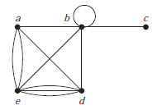
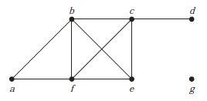
Graph Terminology
The degree of a vertex in an undirected graph is the number of edges incident with it, except that a loop at a vertex contributes twice to the degree of that vertex. The degree of the vertex v is denoted by deg(v).
A vertex is pendant if and only if it has degree one.
A vertex of degree zero is called isolated

Slide 5
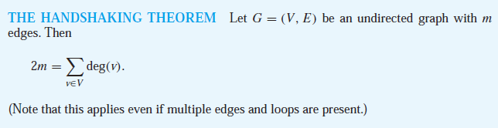
Handshaking Theorem

Slide 6
Graph Terminology
When (u, v) is an edge of the graph G with directed edges, u is said to be adjacent to v and v is said to be adjacent from u. The vertex u is called the initial vertex of (u, v), and v is called the terminal or end vertex of (u, v). The initial vertex and terminal vertex of a loop are the same.

Slide 7

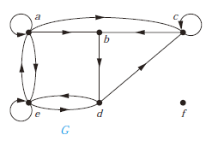
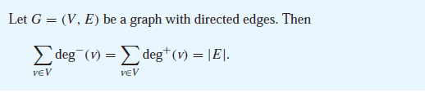
Graph Terminology

Slide 8
Some Special Simple Graphs
Complete Graphs
a simple graph that contains exactly one edge between each pair of distinct vertices
Cycles
consists of n vertices v₁, v₂, . . . , v_{n} and edges {v₁, v₂}, {v₂, v₃}, . . . , {v_{n−1}, v_{n}}, and {v_{n}, v₁}.
Wheels
add an additional vertex to a cycle Cn, for n ≥ 3, and connect this new vertex to each of the n vertices in Cn, by new edges.

Slide 9
Some Special Simple Graphs
n-dimensional hypercube (n-Cubes)
a graph that has vertices representing the 2^{n} bit strings of length n
Bipartite Graphs
vertex set can be divided into two disjoint subsets such that each edge connects a vertex in one of these subsets to a vertex in the other subset.
Planar Graphs
a graph can be drawn in the plane without edges crossing

Slide 10
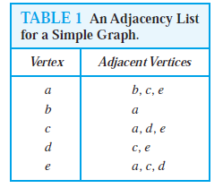
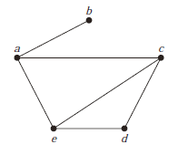
Representing Graphs
adjacency lists

Slide 11

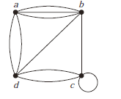
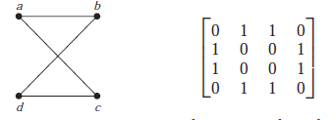

Representing Graphs
Directed?
Adjacency Matrices

Slide 12
Representing Graphs
How to choose?
sparse
dense

Slide 13

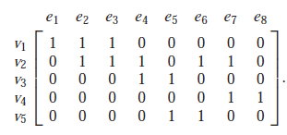
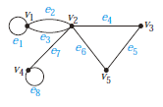
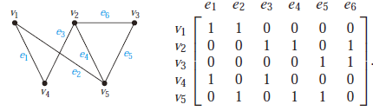
Representing Graphs
Incidence Matrices

Slide 14
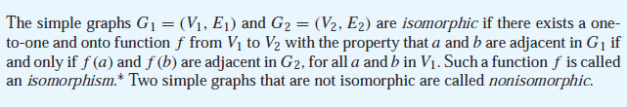
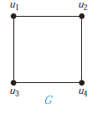
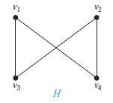
Isomorphism of Graphs

Slide 15
Determining whether Two Simple Graphs are Isomorphic
There are n! possible one-to-one correspondences between the vertex sets of two simple graphs with n vertices
The number of vertices, the number of edges, and the number of vertices of each degree are all invariants under isomorphism.

Slide 16
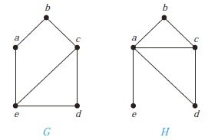
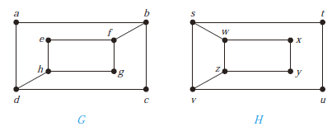
Example
use adjacency matrices

Slide 17
Determining whether Two Simple Graphs are Isomorphic
Algorithms
general purpose software for isomorphism testing, called NAUTY

Slide 18
Applications of Graph Isomorphisms
chemistry : molecular graphs
Bioinformatics
design of electronic circuits
computer vision

Slide 19
Homework
Chapter 10.2
2, 8, 18, 20(a)(d)(e)(f)
Chapter 10.3
4, 8, 12, 24, 36, 44, 57(a), 58(a)

