Slide 1
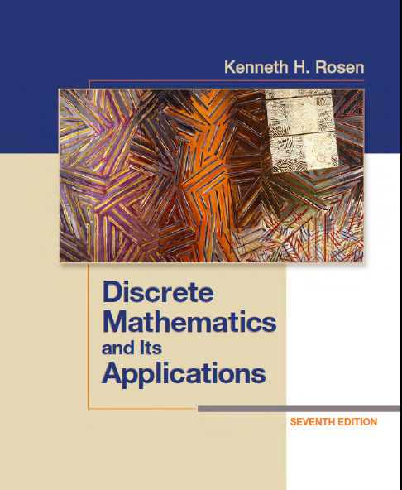
Discrete Math
Haiming Chen
Associate Professor, PhD
Department of Computer Science,
Ningbo University
http://www.chenhaiming.cn

Slide 2
Curriculum Progress
Part I：Logic （Thinking in Mathematics）
Propositional Logic, Predicates and Quantifiers
Definition, Theorem, Corollary and Proofs (Induction)
Part II：Combinatorial Counting
The Basic of Counting
The Pigeonhole Principle
Permutation and Combination
Binomial Coefficients and Combinations
Lists and Sequences (Recursive Definition /Recurrence Relations)
Part III: Discrete Structure
Sets
Functions
Relations
Graphs
Trees
Part IV: Algebra
Algebra (Groups) *
Boolean Algebra

Slide 3
Subgraph
A subgraph of a graph G = (V ,E) is a graph H = (W, F), where W ⊆ V and F ⊆ E. A subgraph H of G is a proper subgraph of G if H ≠ G.
LetG = (V ,E) be a simple graph. The subgraph induced by a subset W of the vertex set V is the graph (W, F), where the edge set F contains an edge in E if and only if both endpoints of this edge are in W.

Slide 4
Removing/Adding Edges of A Graph
G − e = (V ,E − {e}).
G + e = (V ,E ∪ {e}).

Slide 5
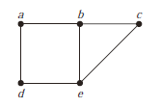
Edge Contraction
Remove an edge e with endpoints u and v and merges u and w into a new single vertex w
G = (V, E) (which is not a subgraph of G)
V = V − {u, v} ∪ {w}

Slide 6
Removing Vertices
G − v = (V − v, E)
E is the set of edges of G not incident to v.

Slide 7
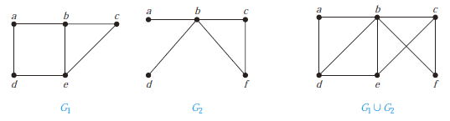
Union of the graphs
The union of two simple graphs G₁ = (V₁,E₁) and G₂ = (V₂,E₂) is the simple graph with vertex set V₁ ∪ V₂ and edge set E₁ ∪ E₂. The union of G₁ and G₂ is denoted by G₁ ∪ G₂.

Slide 8
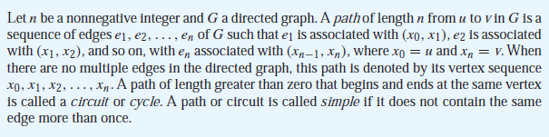
Connectivity
Paths
x₀, x₁, . . . , x_{n}.
walk
closed walk
denote a path e₁, e₂, . . . , e_{n}
trail
v₀, e₁, v₁, e₂, . . . , v_{n−1}, e_{n}, v_{n}

Slide 9
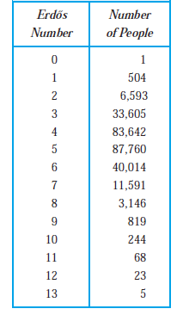
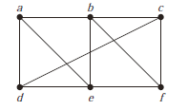
Paths
Paths in Acquaintanceship Graphs
Erdos (埃德斯) number

Slide 10
Connectedness in Undirected Graphs
An undirected graph is called connected if there is a path between every pair of distinct vertices of the graph.
An undirected graph that is not connected is called disconnected.
We say that we disconnect a graph when we remove vertices or edges, or both, to produce a disconnected subgraph.

Slide 11
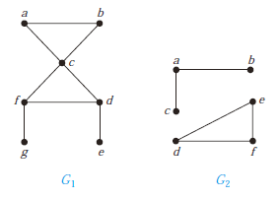
Connected or disconnected

Slide 12
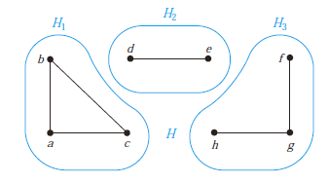
Connected component
a connected component （连通分支）of a graph G is a maximal connected subgraph of G
A graph G that is not connected has two or more connected components that are disjoint and have G as their union.

Slide 13
How Connected is a Graph?
cut vertex (or articulation point)
the removal from a graph of a vertex and all incident edges produces a subgraph with more connected components
cut edge or bridge
an edge whose removal produces a graph with more connected components than in the original graph

Slide 14
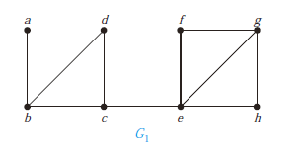
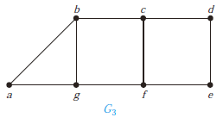
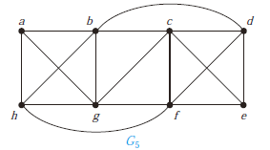
cut vertex & cut edge

Slide 15
How Connected is a Graph?
nonseparable graphs
connected graphs without cut vertices
K_{n}
Vertex Connectivity
Vertex cut: the minimum number of vertices that can be removed to disconnect a graph
κ(G)
Every connected graph, except a complete graph, has a vertex cut
0 ≤ κ(G) ≤ n − 1

Slide 16
How Connected is a Graph?
k-connected (or k-vertex-connected), if κ(G) ≥ k.
1-connected
it is connected and not a graph containing a single vertex
2-connected, or biconnected
it is nonseparable and has at least three vertices

Slide 17
How Connected is a Graph?

Slide 18
How Connected is a Graph?
edge connectivity
edge cut: the smallest set of edges that can be removed to disconnect it
λ(G)
0 ≤ λ(G) ≤ n − 1

Slide 19
How Connected is a Graph?

Slide 20

How Connected is a Graph?
upper bound for both the vertex connectivity of G and the edge connectivity of G

Slide 21
Applications
the reliability of networks

Slide 22
Connectedness in Directed Graphs
strongly connected if there is a path from a to b and from b to a whenever a and b are vertices in the graph.
weakly connected if there is a path between every two vertices in the underlying undirected graph.
strongly connected components

Slide 23
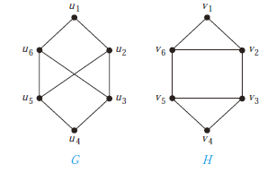
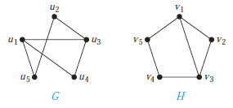
Paths and Isomorphism
isomorphic invariant
the existence of a simple circuit of length k, where k is a positive integer greater than 2

Slide 24

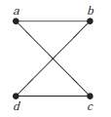
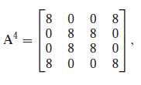

Counting Paths Between Vertices

Slide 25
Homework
Chapter 10.2
48, 50
Chapter 10.4
14(a), 22, 32, 34(only for 32), 50(b),(d)

